Slide 1
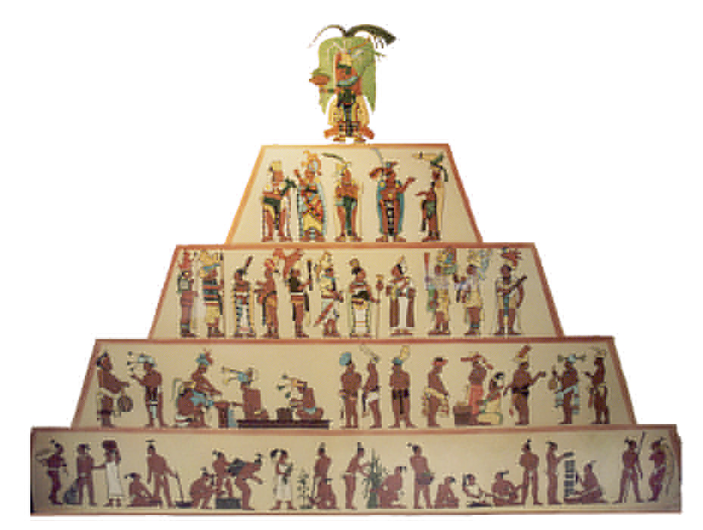
Resource Person Ms Mahwish Talib
Introduction to Sociology
Chapter 5a
Social Stratification
Prepared For BPA 2nd Semester

Slide 2
What is Social Stratification?
Definition: hierarchical arrangement of people within a society
Social stratification refers to how individuals and groups are layered or ranked in society according to how many valued resources they possess.
An ongoing sorting process
Legitimated by cultural beliefs
The hierarchical arrangement of large social groups based on their control over basic resources and their access to opportunities or life chances.
A system by which a society ranks categories of people in a hierarchy.

Slide 3
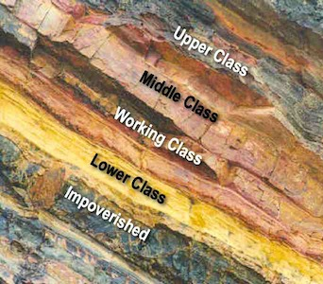
Strata
Definition: the levels people are placed within the hierarchy of
stratification based on various dimensions
Think: “Layers”

Slide 4
Three main assumptions underlie the concept of stratification
People are divided into ranked categories
There is an unequal distribution of desired resources
The criteria societies uses to rank others depends on:
The society’s history
Its geographic location
Level of development
The society’s political philosophy
The decisions of those in power

Slide 5
Basic Principles
Stratification is a trait of society
It carries over from generation to generation
It is universal, but variable
The explanation of why people should be unequal differs from society to society

Slide 6
Dimensions
Power: ability to control the behavior
of others (attached to the
social positions we hold)
Prestige: level of respect/admiration
in which one is regarded
by others (based on social
position & voluntarily given)

Slide 7
Income: amount of money received
within a given period of time
by an individual or group
Wealth: all economic resources
possessed by an individual
(everything you own)

Slide 8
Additional Dimensions
Education
Ethnicity
Race
Religion
Occupation
Family

Slide 9
Micro-level factors: Prestige and Influence
Cultural capital – knowledge and access to important information in society
Social capital – networks with others who have influence
Individual qualities also influence cultural and social capital

Slide 10
Macro-level factors influencing stratification
The economic system
The geographic location of nations
Resources
Strong educational system
Well-paying jobs
Productive land
Ample supply of water
Access to technology

Slide 11
Theoretical Explanations of Stratification
Symbolic Interaction
Individuals learn their social position through socialization
Cultural capital influences children’s school and home environments
Symbols also often represent social positions
Conspicuous consumption is displaying goods in a way that others will notice and that will presumably earn the owner respect

Slide 12
Theoretical Explanations of Stratification
Conflict Theory:
Inequality exists due to willingness of other to exploit people
Inequality impedes progress
Those whom have power keep others powerless to keep status quo
Positions in society exist only as those in power deem them important

Slide 13
Social Inequality
Definition: individuals in a society that do not have equal social status
Examples of Social Inequality:
Economic: inequality based on distribution
of wealth and income
Gender: obvious or hidden inequality of
power/reward based on gender
Racial: unequal treatment based on
physical characteristics

Slide 14
Theoretical Explanations of Stratification
Symbolic Internationalist Theory:
Social classes are based on hard work, talent, motivation
People accept those ideas as true to keep status quo
Functionalist Theory:
Assures most qualified fill most important jobs
Attach rewards (wealth, power, income, prestige) to those who attain position
Positions in society are ranked in order of importance
Inequality is inevitable and desirable

Slide 15
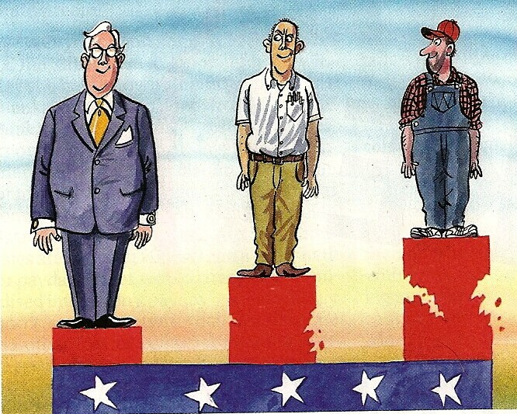
Class Consciousness
Definition: the awareness of belonging to ones social class, social, position or socioeconomic status within a given society

Slide 16
Meso- and Macro-level Theories of Stratification
Structural Functionalism
Stratification within societies is an inevitable—and probably necessary—part of the social world
The stratification system provides each individual a position in the social world
The stratification system motivates individuals to carry out their roles

Slide 17
Meso- and Macro-level Theories of Stratification
Structural Functionalism
Davis and Moore
Social stratification is beneficial for the operation of a society
Some positions are more highly valued because people feel they are very important to society.
Jobs that are more important require more training and sacrifice.
Societies must motivate talented individuals to occupy the most important positions
Differential rewards must be offered to attract the most qualified individuals into the most valued positions
As a result, stratification is inevitable
Therefore, stratification is necessary; it performs a useful function.

Slide 18
Critique of Structural Functionalist Theories
The question of which occupations are more important is far from clear.
The functional theory ignores the pool of talent that lies unused because of inequality.
The functional theory fails to examine how advantages and disadvantages are passed from generation to generation.

Slide 19
Meso- and Macro-level Theories of Stratification
Marxism
Marx saw four possible ways to distribute wealth:
According to each person’s needs
According to what each person wants
According to what each person earns
According to what each person can take

Slide 20
Meso- and Macro-level Theories of Stratification
Marxism
Marx thought there were two economically-based social classes
The bourgeoisie are the capitalist class; the haves
Control the means of production, or the necessary resources to create capital
Control the norms and values of society
Use their power to make the distribution of resources seem “fair” and justified
Use social control to maintain their control in society

Slide 21
Meso- and Macro-level Theories of Stratification
Marxism
Marx thought there were two economically-based social classes
The proletariats are the working class; the have-nots
The proletariats will remain exploited as long as they do not develop a class consciousness, or a shared awareness of their poor status in relation to the means of production
Intellectuals in society could help the proletariat develop a class consciousness and to mobilize to overthrow the bourgeoisie to create a classless society where all wealth is shared

Slide 22
Meso- and Macro-level Theories of Stratification
Recent conflict stratification theorists argue that there are 5 social classes:
Capitalists
Managers
Petty bourgeoisie
Workers
Underclass

Slide 23
Individual Life Chances and Lifestyles
Life chances refer to one’s opportunities, depending n their achieved and ascribed status in society
Important institutions that impact life chances are:
Education
Health, social conditions, and life expectancy
Family life and child rearing patterns
Lifestyles
Attitudes toward Achievement
Religious membership
Political behavior

