Slide 1
Introduction to Development Studies
DMDS 321 CH-3
Dr. Ghulam Murtaza
Disaster Management and Development Studies

Slide 2
1: The nature of development and Development studies
Development concepts and paradigms
Development in a global-historical context
The Third World, developing countries, the South, emerging markets and rising powers
Development and economic growth
Development and social welfare/human rights
Development as freedom
Measuring development: From GDP to the HDI and wider approaches
The concept of poverty

Slide 3
2: Theories and strategies of development
Enlightenment and the era of modernity
Dualistic and unilinear concepts of development
Neoliberalism
Dependency theories
World-systems theory: Core, semi-peripheral, and peripheral regions
Indigenous knowledge and development
Participatory development
Post-colonialism
Social capital and development

Slide 4
Reference Books/ Journals
Robert B. Potter, Tony Binns, Jennifer A. Elliott, David Smith (2008), “Geographies of development : an introduction to development studies”, Pearson Education Limited, England
Vandana Desai and Robert B. Potter, (2014) “The Companion to Development Studies”, Third edition, Routledge, 711 Third Avenue, New York
Seth D. Kaplan (2013) “Betrayed: Politics, Power, and Prosperity”, PALGRAVE MACMILLAN, 175 Fifth Avenue, New York.
Development in Practice, Journal
Development and Change

Slide 5
The Concepts and Measures of Development

Slide 6
Definitions of Development
For almost every writer a different definition of development exists
Thus definitions of, and approaches to, development have varied from place to place, from time to time, from country to country, region to region
Brookfield’s (1975) simple and straightforward definition of development as Positive change

Slide 7
Meaning of Development-Todaro
Development is not purely an economic phenomenon but rather a multi-dimensional process involving reorganization and reorientation of entire economic and social system
Development is process of improving the quality of all human lives with three equally important aspects. These are:

Slide 8
Todaro’s Three Objectives of Development
Raising peoples’ living levels, i.e. incomes and consumption, levels of food, medical services, education through relevant growth processes
Increasing peoples’ freedom to choose by enlarging the range of their choice variables, e.g. varieties of goods and services
Creating conditions conducive to the growth of peoples’ self-esteem through the establishment of social, political and economic systems and institutions which promote human dignity and respect.

Slide 9
Alternative Interpretations of Development (Mabogunje)
Development as Economic Growth- Emphasizes on commodity output (GNP) rather than people.
Note in this interpretation the persistence of a dual economy where the export sector (Industry) contains small number of workers but draws technology as opposed to traditional sector (Agriculture) where most people work and is dominated by inefficient technology

Slide 10
(2nd) Alternative Interpretations of Development
Development as Modernization- emphasizes process of social change which is required to produce economic advancement; examines changes in social, psychological and political processes;
How to develop wealth oriented behavior and values in individuals; profit seeking rather than subsistence and self sufficiency.
Shift from commodity to human approach with investment in education and skill training.
Thus Modernization emphasizes on two aspects;
More production of wealth/ commodities
Improving human skills through education and training

Slide 11
(3rd) Alternative Interpretations of Development
Development as Distributive Justice- view development as improving basic needs (Food, Clothing, Shelter, (roti, kapda, makan)
Interest/focuses in social/distributive justice which has raised three issues:
1.Nature of goods and services provided by governments
2. Matter of access of these public goods to different social classes
3. How burden of development can be shared among these classes
Target groups include small farmers, landless people, urban poor and unemployed

Slide 12
Measurement Indicators of Development
Indicators of Development
Growth
Development
Other Measures
Human Development Index

Slide 13
Definition of Economic Development: 1950s
In economic terms, development is the capacity of a nation to generate and sustain an annual increase in its GNP of 5% or more.
Traditional economic measures:
GDP (Gross Domestic Product): is the market value of all final goods and services produced within a country in a given period of time
GNP (Gross National Product): is the market value of all final goods and services produced by permanent residents of a country in a given period of time
GNP= GDP+ net factor income from abroad
GDP per Capita?? GDP/ Total Population, not a representative indicator

Slide 14
Measurement Indicators of Development
Indicators of Development
Growth
Development
Other Measures
Human Development Index

Slide 15
Development
Development incorporates the concept of Human Welfare
It is normative concept- open to interpretation and subjectively
What should it include?

Slide 16
Development (aspects)
Poverty: It is relative term
Level of poverty:
Absolute Poverty
Relative Poverty
Inequality: or disparities in Income
Progress: what items constitute progress?
Definition of progress is highly subjective
What has progress brought to native tribes across the world

Slide 17
Development (aspects)
Freedom: political, religious, gender
Self esteem
Sustainable development
Proportion of activity in different sectors of economy
Primary (Agriculture)
Secondary (Industry)
Tertiary (Services)

Slide 18
Measurement Indicators of Development
Indicators of Development
Growth
Development
Other Measures
Human Development Index

Slide 19
Human Development Index (HDI)
Human Development Index (HDI) is a socio-economic measure of Development
It focuses on Three dimensions of human welfare:
Longevity: Life Expectancy (from 37 - 80 years)
Knowledge: Access to education and literacy rate
Standard of living: GDP per capita in Purchasing Power Parity (PPP) terms

Slide 20
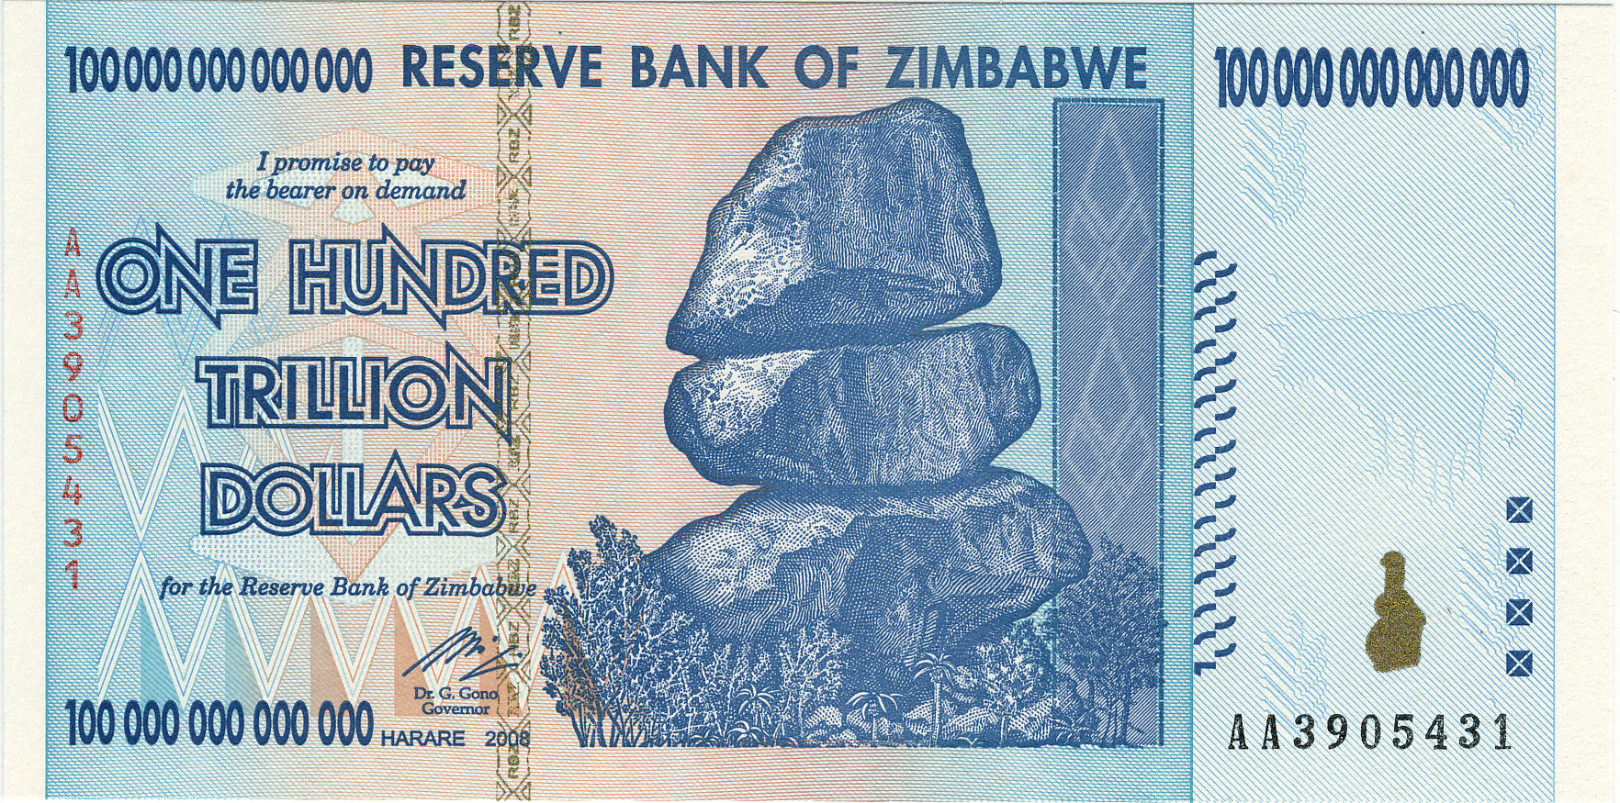
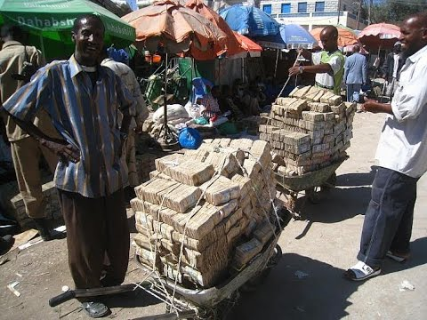
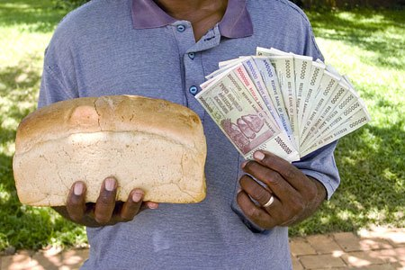

Slide 21
Other Measures…
Number of Doctors per 1000 people (Highest Cuba7.5, Pakistan 0.98, Lowest Malawi 0.016)
Number of Tv sets per Household
Number of cars per HH
Level of stress
Crime rate
Health care data

Slide 22
Measurement Indicators of Development
Human Development Index (HDI), Gender Development Index (GDI), Human Poverty Index (HPI)
Economic Indicators
Gross Domestic Product (GDP)
Types of Work (Economic Sectors)
Social Indicators
Education and Literacy
Health and Welfare
Demographic Indicators
Life Expectancy (from 37 - 80 years)
Infant Mortality
Natural Increase

Slide 23
End of Presentation

