Slide 2
Biotechnology

Slide 3
In 1995, a major milestone, the sequence of entire chromosome of bacterium Haemophilus influenzea was sequenced.
Thereafter, by 2007, researchers had completely sequenced hundreds of prokayotic genomes and dozens of eukaryotic genomes including Human genome of 3 billion nucleotides
These achievements can be attributed to advances in DNA technology-methods of working with and manipulating DNA, that had their roots in 1970s.
A key accomplishment was the invention of techniques for making recombinant DNA, DNA molecules formed when sigments of DNA fom two different sources – often different species are combined in vito (in test tubes).

Slide 4
DNA cloning
The method by which a gene of interest is copied in bacterial cell
To clone a piece of DNA e.g. a human gene, researchers first isolate a plasmid from a bacterial cell
Then insert piece of DNA (foreign DNA) in plasmid
The resulting plasmid is a “recombinant plasmid”
The palsmid is then returned back into bacterial cell and the resulting bacterial cell is now a “recombinant bacterium”
The division and redivision of recombinant bacteria yield multiple copies of foreign DNA called “gene cloning”
Applications of DNA cloning
Production of protein from gene of interest :foreign gene”
To make many copies of foreign gene to get it inserted in an organism of interest ☺

Slide 5
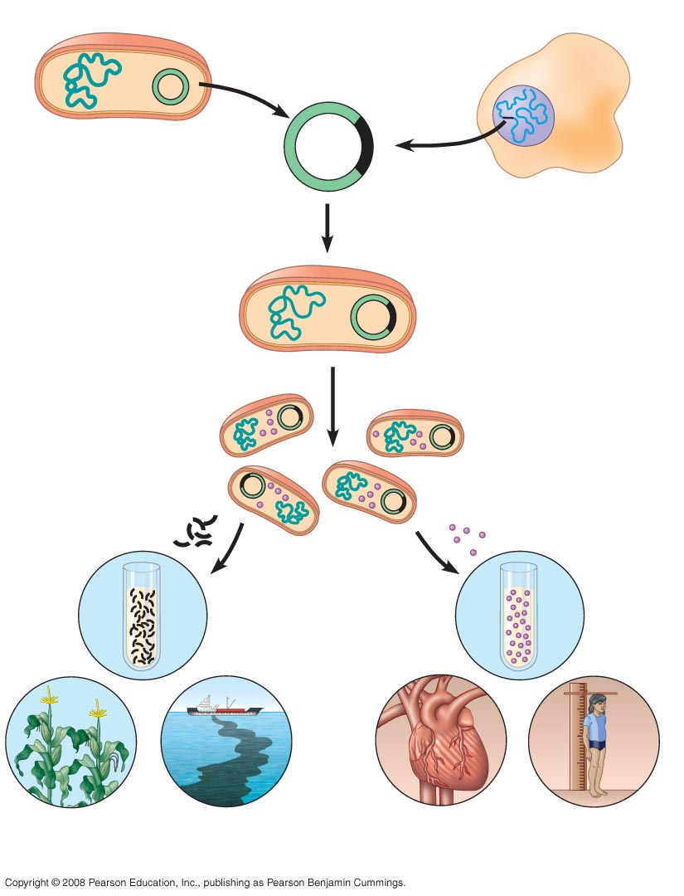
Fig. 20-2
Bacterium
Cell containing gene of interest
1
Gene inserted into plasmid
Bacterial chromosome
Plasmid
Gene of interest
Recombinant DNA (plasmid)
DNA of chromosome
2
Plasmid put into bacterial cell
Recombinant bacterium
3
Host cell grown in culture to form a clone of cells containing the “cloned” gene of interest
Gene of Interest
Protein expressed by gene of interest
Copies of gene
Protein harvested
4
Basic research and various applications
Basic research on gene
Basic research on protein
Gene for pest resistance inserted into plants
Gene used to alter bacteria for cleaning up toxic waste
Protein dissolves blood clots in heart attack therapy
Human growth hor- mone treats stunted growth
Notes:
Figure 20.2 A preview of gene cloning and some uses of cloned genes

Slide 6
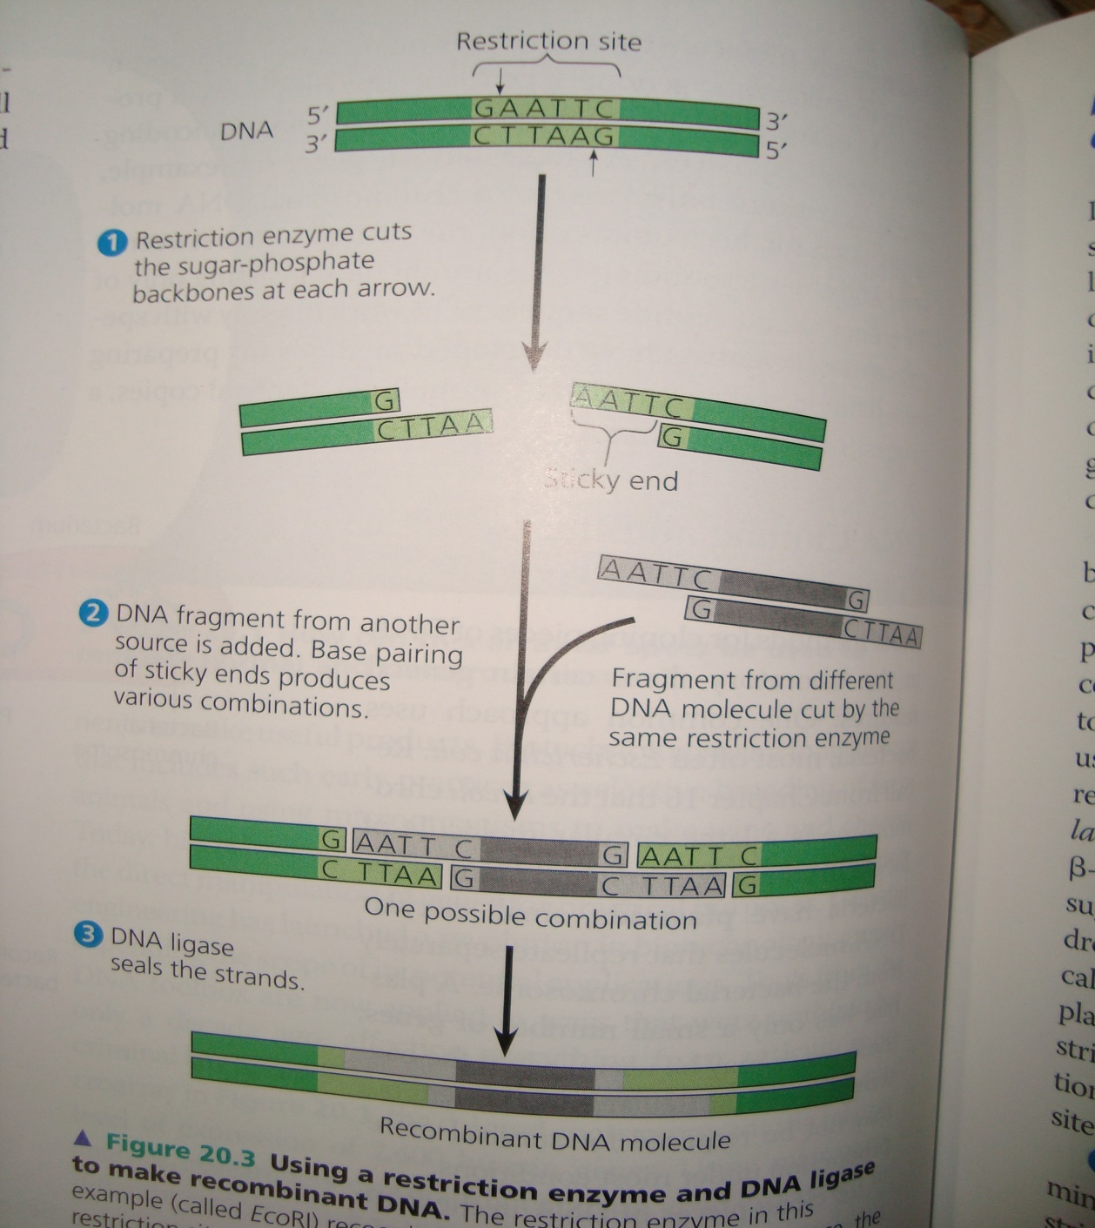
DNA cloning stage 1: Using restriction enzymes to make recombinant DNA
Gene cloning and genetic engineering rely on the use of enzymes that cut DNA molecule at a limited number of specific locations
Those enzymes are called “restriction endonucleases” or “restriction enzymes”
These enzymes cut DNA molecule at specific sites on DNA
These enzymes cut the DNA molecule into “sticky” or “blunt” ends
The most useful restriction enzymes cleave the DNA molecule in staggered manner (making sticky ends). These short extentions can form hydrogen-bonded base pairs with complementary sticky ends on another DNA molecules cut with the same enzyme

Slide 7
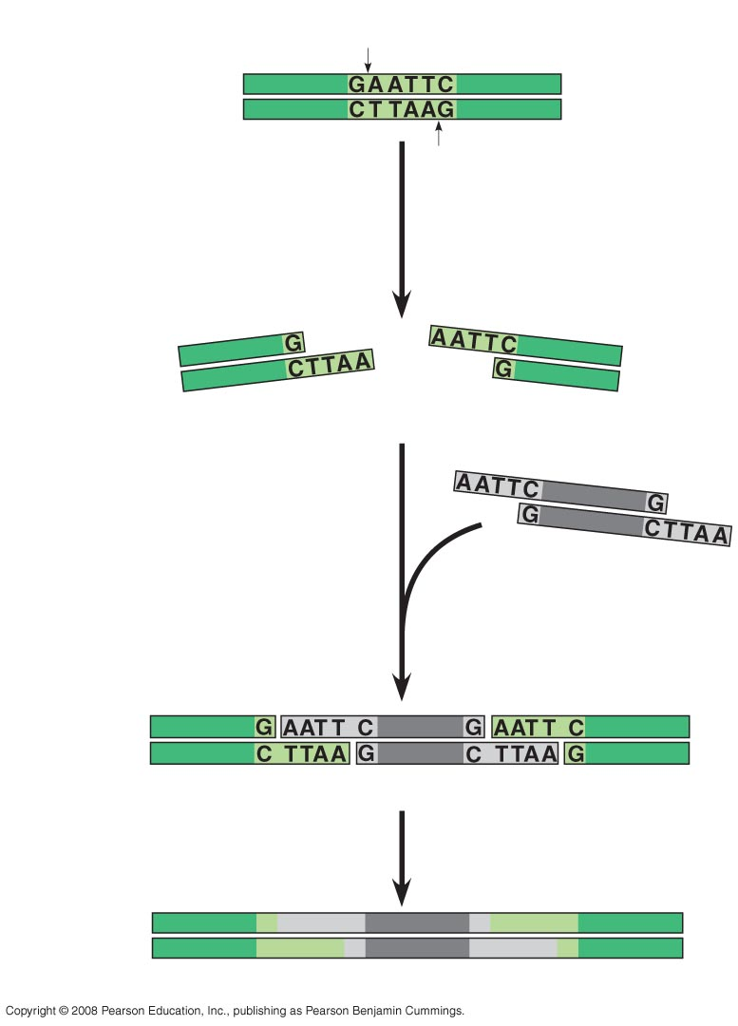
Fig. 20-3-3
Restriction site
DNA
5′
3′
3′
5′
1
Restriction enzyme cuts sugar-phosphate backbones.
Sticky end
2
DNA fragment added from another molecule cut by same enzyme. Base pairing occurs.
One possible combination
3
DNA ligase seals strands.
Recombinant DNA molecule
Notes:
Figure 20.3 Using a restriction enzyme and DNA ligase to make recombinant DNA

Slide 8
Restriction enzymes are bacterial-based

Slide 9
DNA cloning stage 2: Cloning a eukaryotic gene in a bacterial plasmid
Now we learned about restriction enzymes.
We can take a closer look that how genes are cloned in plasmids
The original plasmid is called a cloning vactor, defined as a DNA molecule that can carry a foreign DNA into a host cell and replicate there
Bacterial plasmids are widely used as cloning vectors for several reasons:
They can be easily isolated from bacteria
Easily manipulated to form recombinant plasmids
Easy introduced back into bacterial cell

Slide 10
DNA cloning stage 3: Producing clones of cells carrying recombinant plasmids
Lets say we are interested to study the β-globin gene in hummingbird
We begin by isolating the hummingbird genomic DNA
We also isolated a plasmid from E. coli cell
The plasmid is engineered to have 1) amp gene an ampicillin resistant gene 2) β-galactosidase coding gene the lac-Z gene, which produce blue product upon hydrolysis of X-gal 3) it has only one restriction site within lac-Z gene

Slide 11
Both the plasmid and the hummingbird DNA are cut with the same restriction enzyme
The DNA fragments are mixed together, so the sticky ends of DNA fragments bind together
We add ligase enzyme to further bind the to DAN fragments together
The DNA mixture is then added to bacteria that have a mutation in lacZ gene, making them unable to hydrolyze X-gal to make blue color
Bacteria are subjected to solid nutrient medium containing ampicillin. The bacteria that have plasmids, will survive, the others will die
The plasmids that contain recombinant DNA will form whit colonies the other bacteria will form blue colonies. Why?

Slide 12
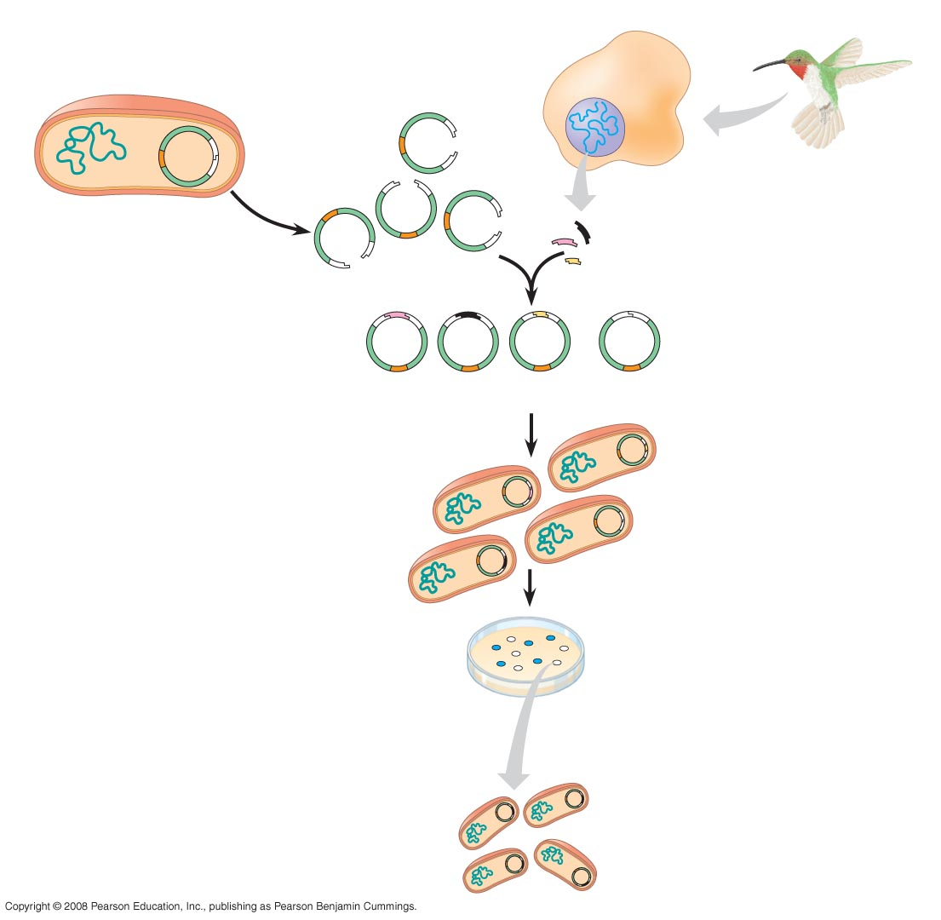
Fig. 20-4-4
TECHNIQUE
Hummingbird cell
Bacterial cell
lacZ gene
Restriction site
Sticky ends
Gene of interest
amp^{R} gene
Bacterial plasmid
Hummingbird DNA fragments
Nonrecombinant plasmid
Recombinant plasmids
Bacteria carrying plasmids
RESULTS
Colony carrying non- recombinant plasmid with intact lacZ gene
Colony carrying recombinant plasmid with disrupted lacZ gene
One of many bacterial
clones
Notes:
Figure 20.4 Cloning genes in bacterial plasmids

