Slide 1
Basic Principles of Disaster Planning and Management
By: JAMAL-UD-DIN
Department of Disaster, Management & Development Studies, University of Balochistan Quetta.

Slide 2
Course Learning Outcomes:
National Disaster Management Acts
National Disaster Management Policies
Administrative Structures

Slide 3
Course content:
Pakistan’s exposure to natural hazards and disasters could be ranked between moderate to severe. Natural hazards including avalanches, cyclones and storms, droughts, earthquakes, epidemics, floods, glacial lake outbursts, landslides, pest attacks, river erosion and tsunami pose risks to Pakistani society .
A variety of human-induced hazards also threaten the society, economy and environment.

Slide 4
Course content:
The Earthquake of October 08, 2005 highlighted Pakistan's vulnerability to disaster risks.
With the current transition in economy, the importance of disaster risks for the society may increase.

Slide 5
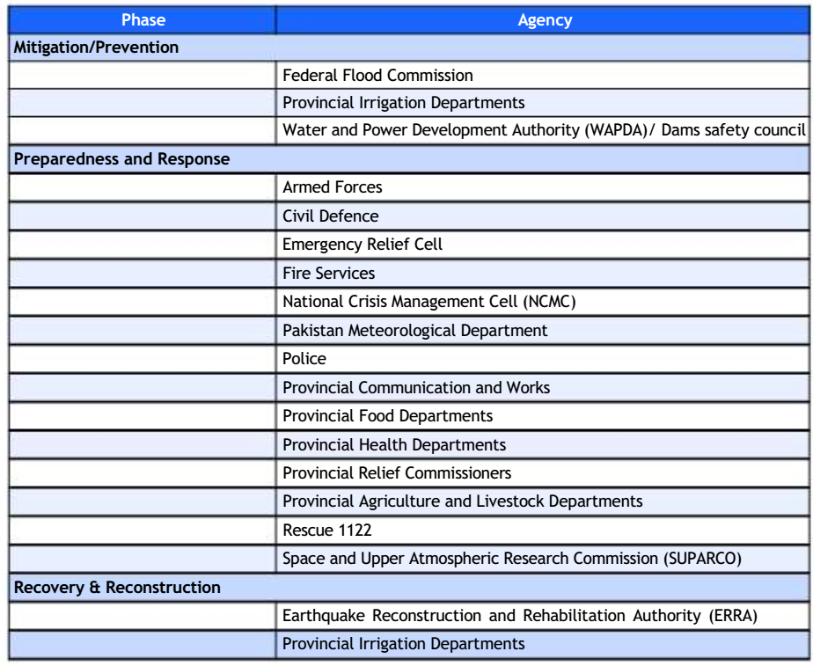
Course content:
Organizations Working on Disaster Risk Management

Slide 6
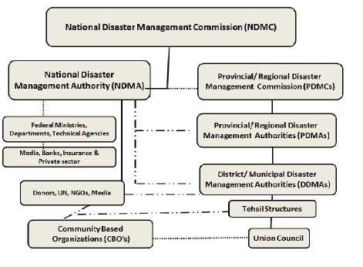
Course content:
Organizational Structure for Disaster Management in Pakistan

