Slide 1
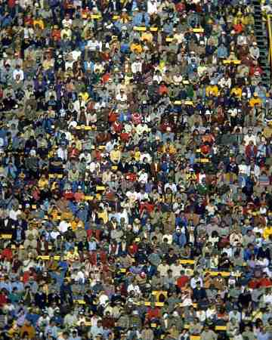
Resource Person Ms Mahwish Talib
Introduction to Sociology
Chapter 3b
Social Interaction
Prepared For BPA 2nd Semester

Slide 2
What is the Most Common Type of Social Interaction?
When you play a role – you are interacting with others
Some interactions stabilize the social structure
Some interactions promote change.
There are five (5) types of interaction that takes place in society

Slide 3
1.) Exchange
Interacting in an effort to receive a reward or return for actions.
Most common form of interaction
Example: Working, dating, family life, friendship, politics.
Reciprocity: you do something – other person owes you. Basis for Exchange.
Example: a “Thank You” from your parents when you wash the dishes.
Exchange Theory: Belief that people are motivated by self interest. Cost/Benefit analysis.

Slide 4
2.) Competition
When two or more people oppose each other to achieve a goal only one can have.
Example: College applications, Football Games, Contests
Positive: Rules of accepted proper conduct are followed.
Negative: Can lead to stress, lack of cooperation, inequality and conflict

Slide 5
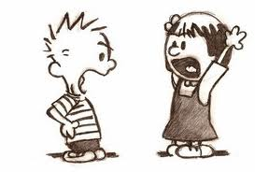
3.) Conflict
Competition is about achieving a goal – but with Conflict, the emphasis is on defeating the opponent.
Deliberate attempt to control a person by force, oppose or harm someone.
Four major sources of Conflict: wars, disagreements, legal disputes, ideology
Sometimes competition becomes conflict
Example: Business undercuts another business on price to force them into bankruptcy.
Can be negative, but also Positive: reinforces loyalty by focusing on outside threat, draws attention away from internal problems, can lead to social change

Slide 6
4.) Cooperation
Two or more people work together to achieve a goal that benefits more than one person.
Example: Employees of a company work together to increase sales.
Gets things done. No group can achieve its goals without cooperation.

Slide 7
5.) Accommodation
State of balance between cooperation and conflict
Give a little, take a little.
Example: compromise, truce, mediation, arbitration

Slide 8
Question
Which types of interactions stabilize social structure and which can disrupt it?

Slide 9
Which types of interactions stabilize social structure and which can disrupt it?
Accommodation, Exchange, and Cooperation—stabilize social structure
Competition and Conflict—can disrupt social structure

Slide 10
ASSIGNMENT
Prepare a chart of all the roles that you play as a member of your society, beginning from your family. Relate the kind of status that you occupy as per that role and what are the duties or privileges that you enjoy as a result of your status.
Write an essay of about two pages on “My Role and Status in My Society”.

