Slide 1
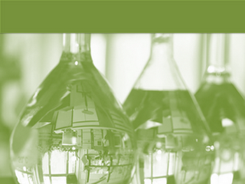
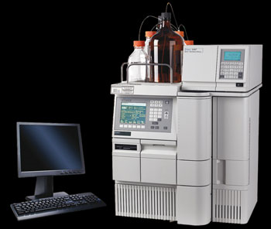
HPLC
High performance liquid chromatography

Slide 2
Introduction
HPLC stands for “High-performance liquid chromatography”(sometimes referred to as High-pressure liquid chromatography).
High performance liquid chromatography is a powerful tool in analysis, it yields high performance and high speed compared to traditional columns chromatography because of the pumped mobile phase.
HPLC is a chromatographic technique that can separate a mixture of compounds
It is used in biochemistry and analytical chemistry to identify, quantify and purify the individual components of a mixture.

Slide 3
When a mixture of components are introduced into the column various chemical and physical interactions take place between the sample molecules and the particles of the column packing .
They travel according to their relative affinities towards the stationary phase. The component which has more affinity towards the adsorbent, travels slower.
The component which has less affinity towards the stationary phase travels faster.
Since no two components have the same affinity towards the stationary phase, the components get separated

Slide 4
COMPOSITION OF A LIQUID CHROMATOGRAPH SYSTEM
Solvent
Solvent Delivery System (Pump)
Injector
Column
Detectors
Waste Collector
Recorder (Data Collection)

Slide 5
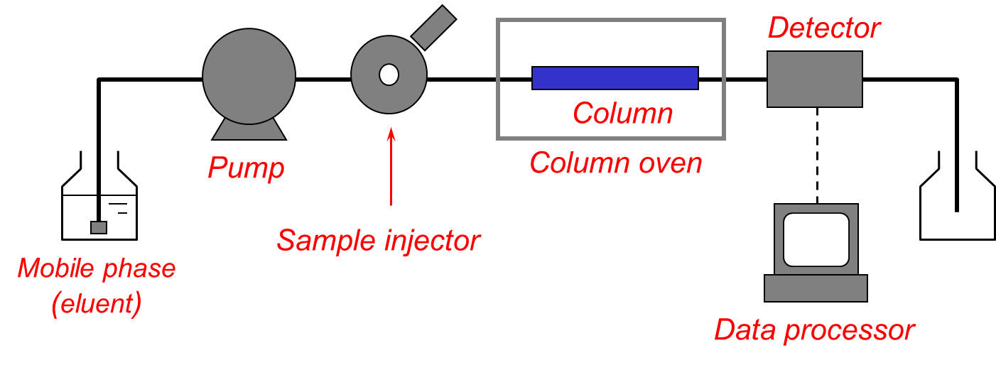
HPLC Flow Line Diagram

Slide 6
Solvent system
Mobile phase reservoirs: Several reservoirs – Use to carry mobile phase
Degassing: Remove dissolved gas - interfering detection
Protect band spreading
Sparing: fine bubble of gas (He)
Vacuum pumping.
Dust removal: Dust interference with detection, column clogging, damage pumping system
Millipore filter under vacuum
Isocratic elution: constant composition
Gradient elution: different solvent systems during elution, continuous change or step wise, solvent proportion valve

Slide 7
Pumping system
Requirements for HPLC pump.
High pressure
• pulse free, prevents remixing of solutes
• control flow rate from 0.1 to 10 mL/min

Slide 8
Pumps
•The role of the pump is to force a liquid (called the mobile phase) through the liquid chromatograph at a specific flow rate, expressed in milliliters per min (mL /min).
•Normal flow rates in HPLC are in the 1-10 mL/min range.
•Typical pumps can reach pressures in the range of 6000-9000 psi (400-to 600-bar).
•During the chromatographic experiment, a pump can deliver a constant mobile phase composition (isocratic) or an increasing mobile phase composition (gradient).

Slide 9
Pump Cont. ….
Isocratic pump - Delivers constant mobile phase composition;
•solvent must be pre-mixed
•lowest cost pump
Gradient pump - Delivers variable mobile phase composition;
•can be used to mix and deliver an isocratic mobile phase or a
gradient mobile phase
–Binary gradient pump –delivers two solvents
–Quaternary gradient pump –four solvents

Slide 10
Injector
•The injector serves to introduce the liquid sample into the flow stream of the mobile phase.
•Typical sample volumes are 5-20 microliters (μL).
•The injector must also be able to withstand the high pressures of
the liquid system.
•An auto sampler is the automatic version for when the user has many samples to analyze or when manual injection is not practical .

Slide 11
Manual Injector 1.User manually loads sample into the injector using a syringe and then turns the handle to inject sample into the flowing mobile phase… which transports the sample into the beginning (head) of the column, which is at high pressure
Auto sampler
1.User loads vials filled with sample solution into the auto sampler tray (100 samples) and the auto sampler automatically
a. measures the appropriate sample volume,
b. injects the sample,
c. then flushes the injector to be ready for the next sample, etc., until all sample vials are processed for unattended automatic operation.

Slide 12
Sample injection system
Sample Injection system:
Limit of precision of HPLC
Sample size: 0.5 ~ 500 μL
No interference with the pressure
Sample loop, 1 ~ 100 μL,
Auto sampler: inject continuously
Volume uptake: 1 μL – 1 mL
Controlled temperature environment

Slide 13
Column
• Considered the “heart of the chromatograph” the column’s stationary phase separates the sample components of interest using various physical and chemical parameters.
• The small particles inside the column are what cause the high back pressure at normal flow rates.
• The pump must push hard to move the mobile phase through the column and this resistance causes a high pressure within the chromatograph.

Slide 14
HPLC Columns
Within the Column is where separation occurs.
Materials of construction for the tubing
Stainless steel (the most popular; gives high pressure capabilities)
Glass (mostly for biomolecules)
PEEK polymer (biocompatible and chemically inert to most solvents
Packing material:
The packing material is prepared from SILICA particle, ALUMINA particle and ion exchange RESIN.
Porous plug of stainless steel or Teflon are used in the end of the columns to retain the packing material.
According to the mode of HPLC , they are available in different size , diameters, pore size or they can have special materials attached ( such as antigen or antibody ).

Slide 15
HPLC Column
Made of Stainless steel tubing for high pressure.
Analytical column: straight, L(5 ~ 25 cm), d (3 ~ 5 mm), dp(3~5 μm). N (40 k ~ 70 k plates/m)
Micro column: L (3 ~ 7.5 cm), d (1 ~ 5 mm), dp: (3 ~ 5 μm) , N: ~100k plates/m, high speed and minimum solvent consumption
Guard column: protects analytical column, similar packing, remove particulate matter and contamination.
Temperature control: 0.1 °C - 150 °C.
Column packing: silica, alumina, a polystyrene-divinylbenzene, synthetic or an ion-exchange resin
Pellicular particle: original, spherical, nonporous beads, proteins and large biomolecules separation (dp: 5 μm)
Porous particle: commonly used, dp: 3 ~ 10 μm. Narrow size distribution, porous micro particle coated with thin organic films.

Slide 16
Detector
• The detector can see (detect) the individual molecules that come out (elute) from the column.
•A detector serves to measure the amount of those molecules so that the chemist can quantitatively analyze the sample components.
•The detector provides an output to a recorder or computer that results in the liquid chromatogram (i.e., the graph of the detector response).

Slide 17
Detectors
Ideal Detector Properties:
High Sensitivity
specificity
Large linear response range
Low dead volume
Non-Destructive
Insensitive to temperature & mobile phase
Continuous operation
Reliable and easy to use
No single detector fits all these criteria

Slide 18
Computer
Frequently called the data system,
The computer not only controls all the modules of the HPLC instrument but it takes the signal from the detector and uses it to:
1. determine the time of elution (retention time) of the sample components (qualitative analysis) and
2. the amount of sample ( quantitative analysis) .

Slide 19
Types of HPLC
Normal Phase: Separation of polar analytes by partitioning onto a polar, bonded stationary phase using non polar mobile phase.
Reversed Phase: Separation of non-polar analytes by partitioning onto a non-polar, bonded stationary phase using polar mobile phase.
Adsorption: In Between Normal and Reversed. Separation of moderately polar analytes using adsorption onto a pure stationary phase (e.g. alumina or silica)
Ion Exchange Chromatography: Separation of organic and inorganic ions by their partitioning onto ionic stationary phases bonded to a solid support.
Size Exclusion Chromatography: Also called as Gel filtration chromatography. Separation of molecules based on their size.
Notes:
NPLC- Separation based on polarity
Stationary phase : Polar Mobile phase: Non polar
Mainly used for : Highly Polar analyte separation
RPLC: Separation based on polarity
Stationary phase : Non Polar Mobile phase: polar
Mainly used for : Highly Non Polar analyte separation
IEC:

Slide 20
OPERATION
Switch on instrument
Check system set up
Prime the pump
Prepare the column

Slide 21
Set-up software(for system flushing)
Software set up(for sample run)
Sample injection
Chromatograph data acquisition

Slide 22
Applications
HPLC is one of the most widely applied analytical separation techniques.
Pharmaceutical
Tablet dissolution of pharmaceutical dosages.
Shelf life determinations of pharmaceutical products.
Identification of counterfeit drug products.
Pharmaceutical quality control.

Slide 23
Environmental
Phenols in Drinking Water.
Identification of diphenhydramine in sediment samples.
Biomonitering of PAH pollution in high-altitude mountain lakes through the analysis of fish bile.
Estrogens in coastal waters - The sewage source.
Toxicity of tetracyclines and tetracycline degradation products to
environmentally relevant bacteria.
Assessment of TNT toxicity in sediment..

Slide 24
Forensics
A mobile HPLC apparatus at dance parties - on-site identification and quantification of the drug Ecstasy.
Identification of anabolic steroids in serum, urine, sweat and hair.
Forensic analysis of textile dyes.
Determination of cocaine and metabolites in meconium.
Simultaneous quantification of psychotherapeutic drugs in human plasma.

Slide 25
Clinical
Quantification of DEET in Human Urine.
Analysis of antibiotics.
Increased urinary excretion of AQP in patients with liver cirrhosis.
Detection of endogenous neuropeptides in brain extracellular fluids

Slide 26
Food and Flavor
Ensuring soft drink consistency and quality.
Analysis of vicinal ketones in beer.
Sugar analysis in fruit juices.
Polycyclic aromatic hydrocarbons in vegetables and fruits.
Trace analysis of military high explosives in agricultural crops.
Stability of aspartame in the presence of glucose and vanillin

Slide 27
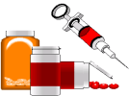
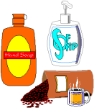
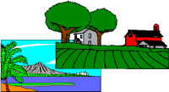
HPLC Applications
Bioscience
Chemical
proteins
peptides
nucleotides
polystyrenes
dyes
phthalates
tetracyclines
corticosteroids
antidepressants
barbiturates
Pharmaceuticals
Consumer Products
lipids
antioxidants
sugars
Environmental
polyaromatic hydrocarbons
Inorganic ions
herbicides
Clinical
amino acids
vitamins
homocysteine

Slide 28
ADVANTAGES OF HPLC
Separations fast and efficient (high resolution power)
Continuous monitoring of the column effluent
It can be applied to the separation and analysis of very complex mixtures
Accurate quantitative measurements.
Repetitive and reproducible analysis using the same column.
Adsorption, partition, ion exchange and exclusion column separations are excellently made.
7. HPLC is more versatile than GLC in some respects, because it has the advantage of not being restricted to volatile and thermally stable solute and the choice of mobile and stationary phases is much wider in HPLC

Slide 29
ADVANTAGES OF HPLC
8. Both aqueous and non aqueous samples can be analyzed with little or no sample pre treatment
9. A variety of solvents and column packing are available, providing a high degree of selectivity for specific analyses.
10. It provides a means for determination of multiple components in a single analysis.

