Slide 1
Interview

Slide 2
Interview
The term interview has been derived from the French word entre voir that means to see each other.
By definition it means a meeting for obtaining information by questioning a person or persons.
A formal meeting at which somebody is asked questions to see if they are suitable for a particular job or course of study of a college/university.
Basically ,an interview is a conversation between two people (the interviewer and the interviewee) where questions are asked by the interviewer to obtain information from the interviewee.
An interview is a conversation that has a purpose.
Notes:
In other words, it is an interaction between interviewer and interviewee where the interviewer asks the interviewee a series of questions in order to obtain information about specific predetermined subjects.
The progress of the interview requires much capability on the part of the interviewer since the objective is to successfully obtain the necessary information completely and objectively in an environment of great respect, discretion, and friendliness.

Slide 3
Interviewer
The interviewer is the person tasked to complete the interview; that is, to present the questionnaires – pose the questions, listen to and record the answers of the interviewees – in accordance with the procedures and regulations. The work of the interviewers is critical because, to a large degree, the work of collecting reliable, complete, and high quality information depends on them.
Interviewee
The interviewee (respondent) is the person selected to answer the questionnaire with whom the interviewer interacts.
Notes:
The progress of the interview requires much capability on the part of the interviewer since the objective is to successfully obtain the necessary information completely and objectively in an environment of great respect, discretion, and friendliness.

Slide 4
The Purpose of the Interview
A. The Employer’s Purposes:
Employers need to know three things about you:
Can you do the work? Do you possess the skills and qualifications as reflected in your experience and education.
2. Will you do the work? They need to know, based upon your interests and goals at this stage of your career, if you are motivated.
3. Will you fit in? They want to determine if you are a good fit with co-workers and if your values are in line with the company’s culture and mission. All other factors being equal, many hiring managers base their decisions on likeability and fit.

Slide 5
B. The Candidate’s Purpose:
As a candidate, you need to:
Describe your skills and abilities to show that you can do the work.
2. Describe your interests and goals at this stage of your career to demonstrate that you are motivated and will do the work.
3. Learn as much as possible about the position and employer to determine if the job and the company’s culture are a good fit with your skills, values, interests, and goals.

Slide 6
Types of interview
Classification according to structure
Patterned or structured interview:
Such interview is fully planned. It’s based on the assumption that to be more effective every pertinent (relevant, important) detail should be worked out in advance.
Therefore, a list of questions to be asked is prepared and the questions are asked in a particular cycle. The time to be allowed to each candidate and the information to be sought a pre-defined. Such interview is also known as directed or guided interview.
It allows for a systematic coverage of the required information.

Slide 7
Unstructured interview:
This interview is also called non directive approach. Under unstructured interview, questions for interview are not prepared in an advance.
Only general guideline for interview are known but interviewer remain free for ask the questions.
After starting interview, interviewers ask question as the environment of interview gets changed. This creates the situation of asking different questions to different candidates.
Questions of such interview are created through the response of questions.

Slide 8
Semi structure interview:
This is also known as mixed interview as it considers content of both structure and unstructured interview.
Semi-structure interview contains only few pre-determined questions for basic information.
Remaining questions may be asked on the basis of environment of interview. Normally, job specific questions are left flexible. This interview is normally lengthy as interviewee has to respond both structured and unstructured questions.
This is the most popularly used interview as it provides information to compare candidates as well as job specific information.

Slide 9
Classification according to purpose
Stress Interview:
This interview aims at testing the candidate’s job behavior and level of with standing during the period of stress and strain (damage, injure).
Interviewer tests the candidate by putting him under stress and strain by interrupting the applicant from answering,
criticizing his opinions,
asking questions pertaining to unrelated areas,
keeping silent for unduly long period after he has finished speaking etc.
Notes:
Stress during the middle portion of the interview gives effective results. Stress interview must be handled with at most care and skill. This type of interview is often invalid.
As the interviewee’s need for a job, his previous experience in such type of interviews may inhibit his actual behavior under such situations.

Slide 10
Exit Interview :
This type of an interview is conducted by an organization with those employees who have put in their resignation papers.
It may be conducted on the last day of employment of the employee.
Exit interview helps to find out why the candidate is resigning from the job.

Slide 11
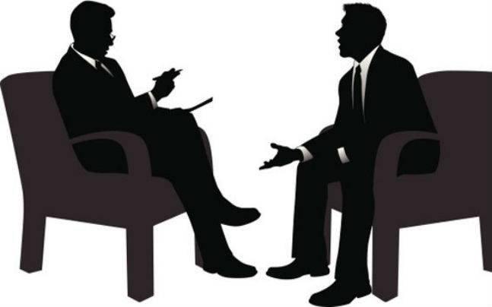
Classification according to administering interview
One on one/ Individual Interview:
In this interview, only one interviewee
is taken at a time by an interviewer.
This means only one candidate is interviewed by a interviewer at a time one after another. Interviewees need to face interview with different interviewer one after another.
For example, candidate has to face first interview with human resource manager, then with marketing manager and then with production manager, then finally with senior manager.
This interview takes more time but different expert ask specific question from their area so candidates can be judged in each area of job. This method is common in selecting managerial level employees.
Notes:
manage, direct, control, operate, regulate, conduct, handle, run, orchestrate, organize, supervise, superintend, oversee, preside over, boss, be the boss of, govern, rule, lead, head, guide, steer, pilot;

Slide 12
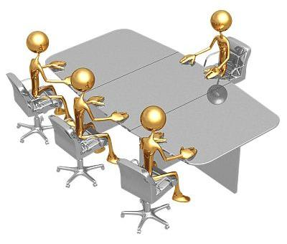
Panel/ Board interview:
In this method, a group of expert interviewer is prepared from different area of specialization. Such group of expert is called panel.
Panel is to be led by one member as chairperson. Each candidate needs to face the group of expert panel individually.
Each member of panel ask question from their respective area of specialization and evaluate candidate's response individually.

Slide 13
Meal interviews:
Many organizations offer to take the candidate to lunch or dinner for the interview.
This can allow for a more casual (informal, relaxed) meeting where, as the interviewer, you might be able to gather more information about the person, such as their manners and treatment of wait staff (waiters and waitresses collectively).
This type of interview might be considered an unstructured interview, since it would tend to be more of a conversation as opposed to a session consisting of specific questions and answers.

Slide 14
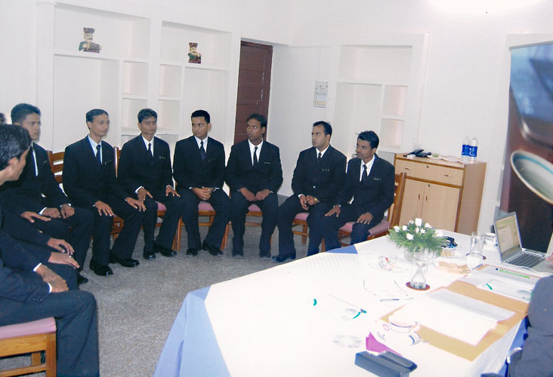
Group Discussion Interview:
There are two methods of conducting group discussion interview, namely group interview method and discussion interview method.
Group interview
All candidates are brought into one room i.e. interview room and are interviewed one by one under group interview.
Notes:
This type of interview helps the interviewer in appraising, certain skills of the candidates like initiative, inter-personal skills, presentation, collaboration etc.

Slide 15
Discussion interview method.
Under the discussion interview method, one topic is given for discussion to the candidates who assemble in one room and they are asked to discuss the topic in detail. In this method, interviewers do not concern about what the answers given but they care about how they give the answer.
Leadership capacity, problem identification skills, convincing power, self confidence and energy level, habit of listening and accepting the others logic, capacity to manage stress, etc. are judged by the interviewers

Slide 16
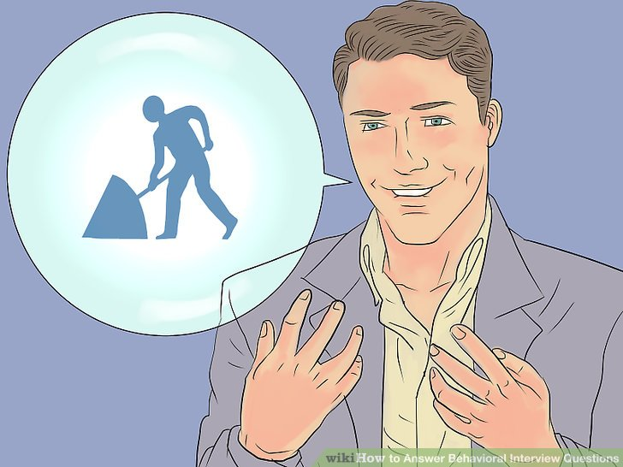
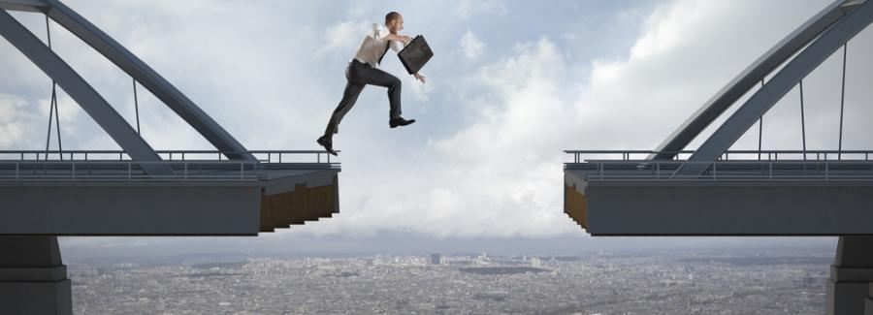
Situational interview
Classification according to interview’s content
Interviewing technique that places an applicant in a problematic situation and the candidate is asked to assess a situation and to provide solutions on how he or she would handle it.
The purpose of situational interview is to evaluate the applicant's ability to think logically or creatively.
Notes:
Situational interviews are similar to behavioral interviews except while behavioral focus on a past experience situational interviews focus on a hypothetical situation. For example in a behavioral interview the interviewer might start a question with “Tell me about a time you had to deal with…” In a situational interview the interviewer asks “How would you handle…”
The key to preparation and success in situational interviews is simply to review your past work experiences and review the steps you took to resolve problems and make corrections. You should also have short stories of some of these past experiences so you can also incorporate them into your answers to show that you have experience handling similar situations.

Slide 17
Here’s one question an interviewer might ask an applicant for a customer-service manager position: “How would you handle an angry customer who was promised delivery of the product on a certain date but because of manufacturing delays the company was not able to deliver on a timely basis? The customer is demanding some kind of compensation for the unexpected delay.”
Or for a management position a job-seeker might be asked: “How do you handle a disgruntled (displeased, angry) employee in your department who has made a habit of arriving late to work and causing minor disruptions during the day as well as a declining morale among the rest of the staff?”

Slide 18
Behavioral Interview:
A behavioral interview is a popular interview technique employers use to assess job candidates based on their past behavior.
Typically this means interviewers don’t ask hypothetical questions like, “How would you react if you were under a lot of pressure at work?
” Instead,
they would ask behavioral questions such as, “Describe a time you were under a lot of pressure at work. How did you react?
It helps the employers by giving the employers an inside knowledge about the candidate, whether he posses the core competencies required for the job or not.
Notes:
Situation refers to a condition which we face in our day to day life. The term situational interview in the HR context is a technique in which a probable employee are asked to explain how they behaved in the past in a particular circumstance/ different scenarios whether it be workplace or any other field of life.
In a situational interview a person is given some hypothetical situation & asked how he would respond under that situation. It looks to the future and expects you to come up with an answer. It is important from the employers point of view due to the fact that it gives them an indication of how the person will behave when under that condition. A person can prepare for the hypothetical/ situational interview by taking a guess at the questions which could be asked based on the prospective candidates knowledge about the job & the role for which he is applying. A person can prepare for the same by thoroughly going through the company’s website and by drawing experience from his past.
Preparing for this type of interview requires the candidate to introspect about themselves and learn how those experiences will help them in gaining an edge over other people. The most widely known approach used for the same is the STAR approach ( S-Smart, T- Task, A-Action, R-Result).
The candidate is asked questions like describe a time when you faced a decision where you had to make a choice between family and friends?.

Slide 19
Here are few more examples of behavioral interview questions:
Give me an example of a difficult problem you solved. How did you solve this problem?
Tell me about a mistake that you’ve made. How did you handle it?
Can you tell me about a challenging situation you overcame at work?
Tell me about a time you learned a new skill. How did you approach it and how did you apply your new learning's?
Notes:
Use the STAR method to structure answers to behavioral questions
You can use the STAR method to prepare for behavioral interviews — a technique that helps you structure your response to behavioral interview questions. Using this method, you create a deliberate story arc that your interviewer can easily follow. Here’s how it works:
Situation: What is the context of your story? In setting the situation, you are telling your listener when or where this event took place. For example, “We were working on a six-month contract for a high-value client, when our agency merged with another, larger firm…”
Task: What was your role in this situation? For example, “It was my role to lead the transition for my group while also communicating with our client to keep the project on track.”
Action: What did you do? For example, “I set up weekly check-ins with the client to update them on the progress of the merger. This cemented an important level of trust between us. I also had regular one-on-ones with each person on the team, both to assess how they were handling the change and to make sure we would meet our deadlines.”
Result: What did your actions lead to? For example, “We ended up completing the project on time, meeting all of their specifications. It was incredibly rewarding to navigate a lot of change and succeed under pressure.”
With these kinds of questions, interviewers are usually trying to learn three things: First, they want to know how you behaved in a real-world situation. Second, they want to understand the measurable value you added to that situation. Finally, they are trying to learn how you define something like “pressure at work” — a concept different people might interpret differently.

Slide 20
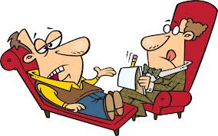
Psychological interviews:
Psychological interviews are interviews conducted by a psychologist, In which questions are intended to assess personal traits such as trustworthiness, loyalty or dependability etc.
Notes:
A behavioral interview deals with a person’s past.

Slide 21
Employment Interviews: The Interviewer’s Responsibilities
Developing Job Specifications
actual requirements of a job (e.g., experience, education, skills).
Advertising the Position
Reviewing Résumés
Helps to screen out 90% of all job candidates.

Slide 22
Creating a Comfortable Atmosphere
Select a welcoming/comfortable location.
Introduce yourself, smile, sustain eye contact, shake hands, and actively listen.
Sequencing Questions
Plan questions in a sequence that accomplishes a specific goal.
Closing the Interview
Ask for questions, summarize main issues.
Notes:
Select best person from applicant pool.
Sell candidates on their value to the organization.

Slide 23
Employment Interviews: The Interviewee’s Responsibilities
Developing a Personal Biography
Education, job experience, activities, hobbies, interests, special skills.
Researching the Company
Placement offices, no of offices, company’s website/PR department, present/past employees, history, main campus etc.
Notes:
Prepare a flawless résumé.
he life story of a person written by someone else

Slide 24
Preparing a Résumé and Cover Letter
Be honest.
Be concise.
Limit: 1-2 pages.
Use headings.
Proofread.
Tailor for each job.
Dress appropriately.

Slide 25
Handle discriminatory questions with politeness.
Be Prepared
Rehearse answers to probable questions.
Prepare Questions.
What do you want to know about the job/company?
Practice Self-Confidence
Concentrate on your positive qualities.
What assets can you bring to the company?
Notes:
Judge the success of the interview process.
Follow up after the interview.
Be prepared to answer 4 general questions:
Why are you here?
What can you do for us?
What kind of person are you?
How much will you cost us?

