Slide 1
Essential elements of community Types of community

Slide 2
Essential elements of community
1.Group of people:
A group of people is the most fundamental or essential characteristic or element of community. This group may be small or large but community always refers to a group of people. Because without a group of people we can’t think of a community. Therefore a group of people is the first basic of community.
2.Definite locality: A community always occupies a definite geographical area. Locality is the physical which includes territory, buildings, roads and etc.
3.Community Sentiment:
Community sentiment means a feeling of belonging together. It is "we feeling" among the members. The members of a community speak the same language, conform to the same mores, posses the same sentiment, and have the same attitudes.
4.Particular name: Every community has some particular name. For example, Quetta, Karachi

Slide 3
Essential elements of community
5.Permanence : Community is always a permanent group. It refers to a permanent living of individuals within a definite territory. It is not temporary like that of a crowd or association.
6.Size of Community: A community is classified on the basis of it’s size. It may be big or small. Village is an example of a small community whereas a nation or even the world is an example of a big community. Both the type of community are essential for human life.

Slide 4
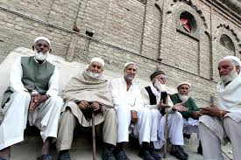
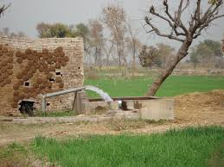
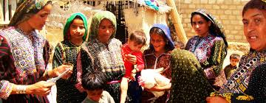
Types of community
Communities have been classified into rural, and urban.
Rural community: The community , which has less than 5000 individuals.
They have no modern facilities i.e. college, industry, hotels, hospitals etc
Characteristics of Rural Community
Primary relationship
Agriculture is the main profession
The population is homogeneous

Slide 5
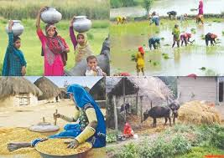
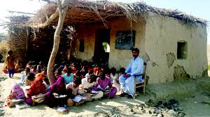
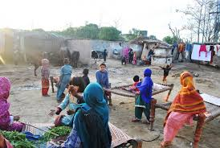
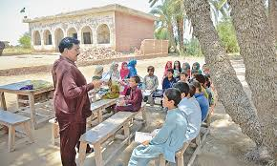
Rural community

Slide 6
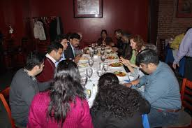
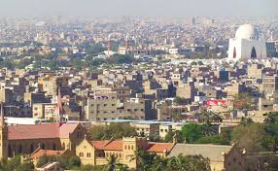
Urban community
The community, which has more than 5000 individuals.
They have modern facilities i.e. college, industry, hotels, hospitals etc
Characteristics of Urban community
Not Primary relationship
Diversity in professions
The population is heterogeneous

Slide 7
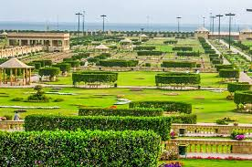
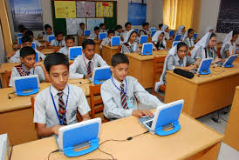
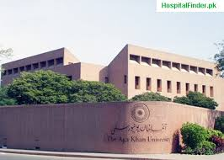
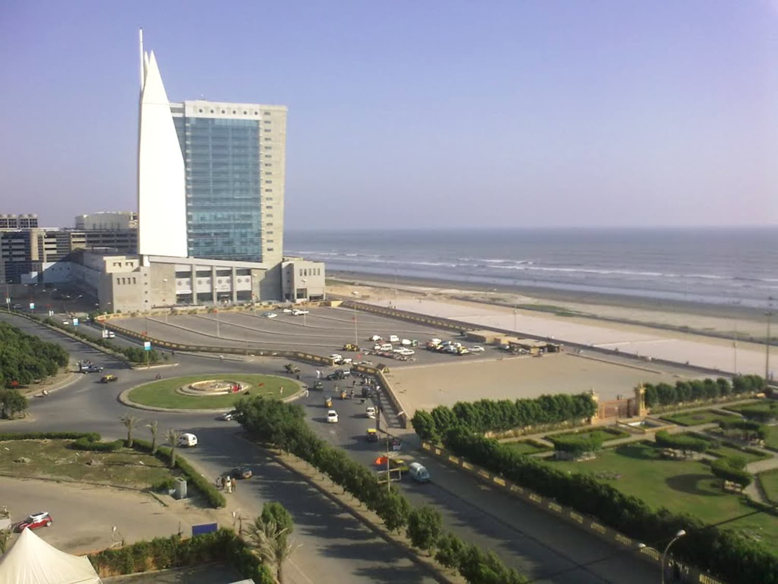
Urban Community

Slide 8
“Without community service, we would not have a strong quality of life. It's important to the person who serves as well as the recipient. It's the way in which we ourselves grow and develop”.

