Slide 1
Introduction to psychology
By: Mr.M Sulaman

Slide 2
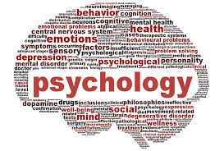
Psychology

Slide 3
Contents
Definition of psychology.
What is psychology and what dose psychologists do?
Mind
Behavior
Goals of psychology.

Slide 4
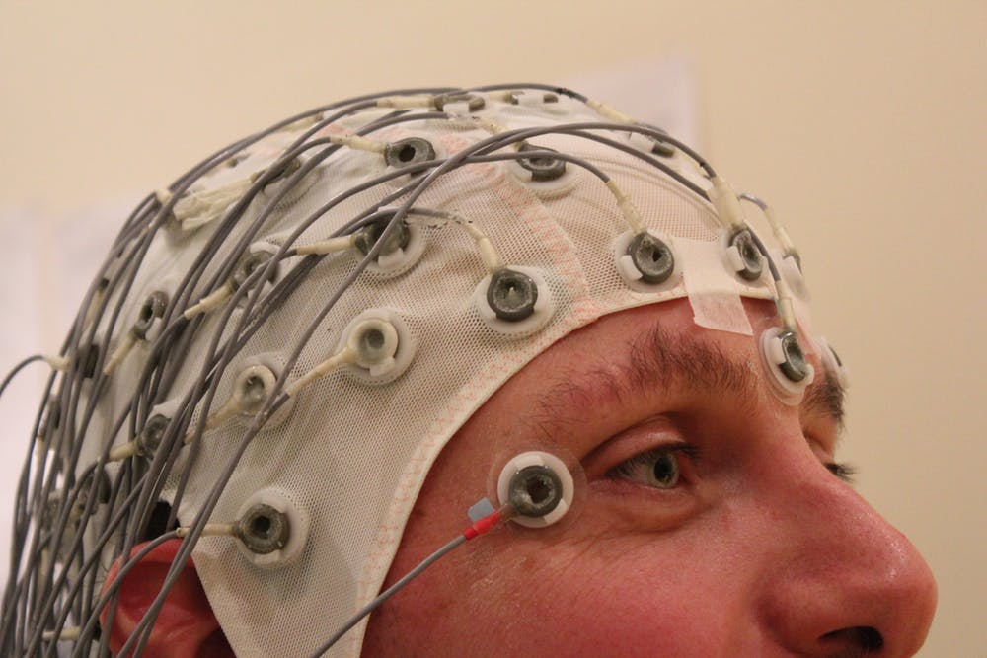
Psychology:

Slide 5
Definition of Psychology
Definition 1:
Psychology is the scientific study of mind and behavior
Definition 2:
The British Psychological Society has defined psychology as
Psychology is the scientific study of people, the mind and behavior. It is both a thriving academic discipline and a vital professional practice.
Definition 3:
American Psychological Association defined psychology as
The scientific study of the behavior of individuals and their mental processes.

Slide 6
Definition:
The definition of psychology contains three important elements
First psychology is a scientific discipline that obtains knowledge through systematic and objective methods of observation and experimentation
Second psychology is the study of behavior, here behavior means any action or reaction that can be measured or observed
Third psychology is the study of mind which means both conscious and unconscious mental processes.

Slide 7
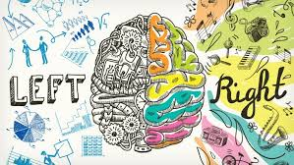

Slide 8
What is psychology
Psychology is both an applied and academic field that studies the human mind and behavior.
Research in psychology seeks to understand and explain thought, emotion, and behavior.
Applications of psychology include mental health treatment, performance enhancement, self-help and many other areas affecting health and daily life.
The field and study of psychology was truly born when Wilhelm Wundt established the first psychology lab in Leipzig, Germany.
Wilhelm Wundt is also known as the father of modern psychology through his research he established a school of thought known as structuralism

Slide 9
CONT…
Today, psychologists prefer to use more objective scientific methods to understand ,explain, and predict human behavior.
Psychological studies are highly structured, beginning with a hypothesis that is then empirically tested.
Psychology has two major areas of focus: academic psychology and applied psychology.
Academic psychology focuses on the study of different sub-topics within psychology including personality psychology, social psychology, and developmental psychology.
Academic psychologists conduct basic research that seeks to expand our theoretical knowledge,

Slide 10
Cont.…
Applied psychologists conduct applied research that seeks to solve everyday problems.
Applied psychology focuses on the use of different psychological principles to solve real world problems

Slide 11
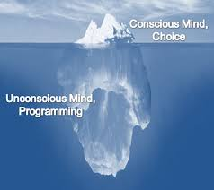
Psychology:

Slide 12
MIND
In Psychology Mind can be defined as:
The totality of conscious and unconscious mental processes and activities.
Mind has Two parts
The conscious mind:
The conscious mind involves all of the things that you are currently aware of and thinking about.
The unconscious mind:
The unconscious mind consists of the processes in the mind, which occur automatically this include thought processes, memories, interests, and motivations

Slide 13
Behavior
Definition of Behavior:
In psychology, behavior consists of an organism's external reactions to its environment.
Or
In simple words behavior can be defined as the reaction or response to any stimulus is called behavior
Examples:
Organism start salivation when it see food
We become sad when we lose something we like

Slide 14
The Goals of Psychology
Psychologist basically focuses on fore major goals while they scientifically study about humans and animals the four goals are as follows.
Describe behavior
Explain behavior
Predict behavior
Influence behavior.

Slide 15
Cont…
Description :
The first goal for any scientist or psychologist is to describe or gather information about the behavior being studied and to present what is known.
Explanation :
Psychologists are not content simply to state the facts. Rather, they also seek to explain why people (or animals) behave as they do. Psychologists propose these explanations as hypotheses.

Slide 16
Prediction :
The third goal of psychologists is to predict, as a result of accumulated knowledge, what organisms will do and, in the case of humans, what they will think or feel in various situations. By studying descriptive and theoretical accounts of past behaviors, psychologists can predict future behaviors.

Slide 17
Influence:
Finally, some psychologists seek to influence behavior in helpful ways. These psychologists are conducting studies with a long-term goal of finding out more about human or animal behavior. They are doing basic science, or research. Other psychologists are more interested in discovering ways to use what we already know about people to benefit others. They view psychology as an applied science and are using psychological principles to solve more immediate problems.

