Slide 1
Sociolinguistics (ELing620) Language and Society
Week 2

Slide 2
Our speech provides clues to others about who we are, where we come from, and perhaps what kind of social experiences we have had.
Written transcripts provide no auditory clues to readers. This ‘clue bearing’ role is very important whilst studying a conversation ( see Peter Trudgill, pg.1 &2)

Slide 3
Languages provide a variety of ways of saying the same thing – addressing and greeting others, describing things, paying compliments
As examples 1 and 2 illustrate, our final choices provide clues to social factors, such as the relationship between the people in the particular situation, and how the speaker feels about the person addressed.
The choice of one linguistic form rather than another is a useful clue to nonlinguistic information.
Linguistic variation can provide social information.
Definition: The term linguistic variation (or simply variation) refers to regional, social, or contextual differences in the ways that a particular language is used.

Slide 4
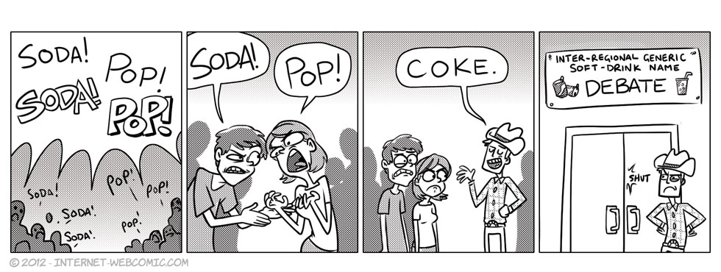

Slide 5
Linguistic Variation: How we say things
https://www.youtube.com/watch?v=MJr9SSJKkII
Kindly watch the video above. In this scene taken from the movie ‘My Fair Lady’ which is an adaptation of George Bernard Shaw’s “Pygmalion”. Professor Higgins takes it upon himself to modify Eliza’s pronunciation which has thick Cockney accent.

Slide 6
Dialect and Accent
Accent is a distinctive way of pronouncing a language, especially one associated with a particular country, area, or social class.
The most obvious linguistic variation involves pronunciation. Sam ‘drops his aitches’ while Jim doesn’t.
Just as vocabulary choices convey social information, so using different pronunciation conveys social information too.
Despite their common regional origins they have different social backgrounds, and that is indicated by their speech.

Slide 7
Dialect
https://www.youtube.com/watch?v=hS2fdP1bNV0
The above video illustrates how pronunciations singularly and dialects collectively varies based on someone’s demographic location.
The term ‘dialect’ has generally been used to refer to a subordinate variety of a language.
Check out the example of Hemnesberget, a village in northern Norway and how they shift between two local dialects Ranamål and Bokmål.

Slide 8
So how do the two differ?
An accent is simply how one pronounces words—a style of pronunciation.
A dialect includes not just pronunciations, but also one's general vocabulary and grammar.
Why call both a variety?
Because of similarities between dialect and accent, sociolinguists use the term variety (or sometimes code) to refer to any set of linguistic forms which patterns according to social factors.
Variety is a sociolinguistic term referring to language in context. A variety is a set of linguistic forms used under specific social circumstances, i.e., with a distinctive social distribution. Variety is therefore a broad term which includes different accents, different linguistic styles, different dialects and even different languages which contrast with each other for social reasons.
It has proved a very useful sociolinguistic term because it is linguistically neutral and covers all the different realisations of the abstract concept ‘language’ in different social contexts.

Slide 9
Reading assignment
Read the complete chapter 1 from Ronald Wardaugh’s book “An Introduction to Sociolinguistics”

