Slide 1
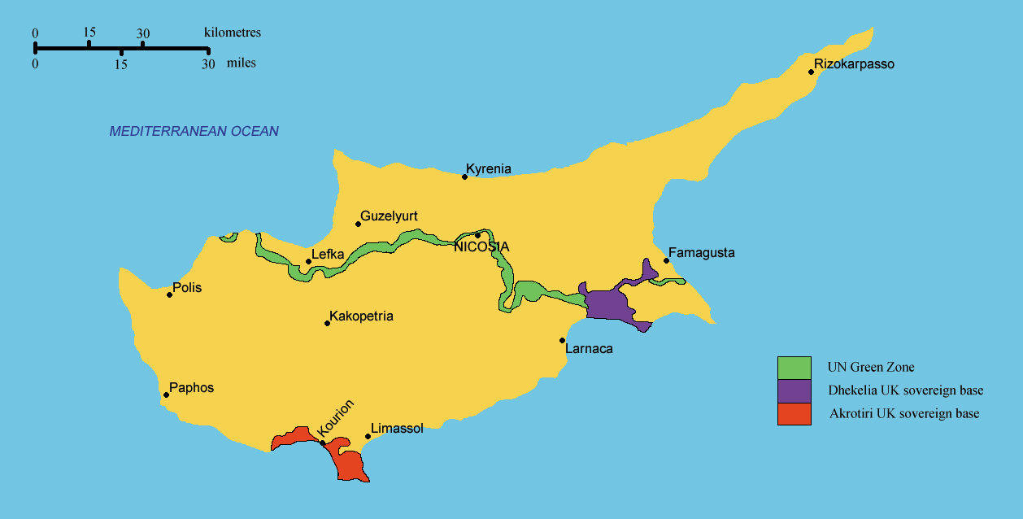
The Cyprus Problem
The Cyrpus Problem

Slide 2
Cyrpus- An Island in the Eastern Mediterranean
- At the Crossroads of Asia, Africa and Europe
Island is 150 miles long from east to west and 100 miles north to south
The coastline is central to the tourist industry
Nicosia is the capital and largest city
Differs in culture and religion between North and South

Slide 3
History
Strategic importance- Ruled by different Empires
Part of Ottoman Empire until 157118th century
British Rule from 1878 -1960
Independence in 1960 – Archbishop Makarious as President

Slide 4
The Conflict
Greeks wanted ‘Enosis’/ Turks wanted ‘Taksim’
Greeks and Turks argue about Constitution
1963 Fighting broke out – People Killed on both sides
1964 – The British intervened, UN peacekeeping force sent
However, UN could do little / Green Line Drawn

Slide 5
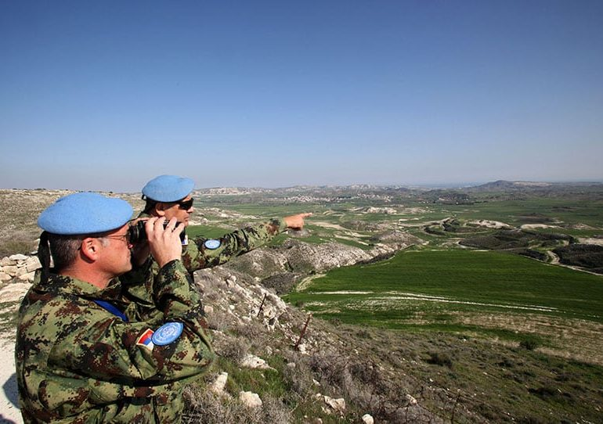

Slide 6
The Conflict broadens
Makarious suggests amendments to constitution/ Turks reject it
1974- Greece coup d’eteta, ousted Makarious
Turkey feared ‘Enosis’ as imminent
1974- Turkish forces captured 40 % of Northern Cyprus

Slide 9
Turkish settlers descended/ 160,000 Greeks displaced
1983 – An independent Turkish State
Problem – land, ethnicity, nationalism, territorial and population exchange and religion
Greece helped Republic of Cyrpus/ Turrkey helps Northern Cyrpus

Slide 10
Republic of Cyrpus – member of UN/ E.U in 2004
Greek side, thriving economy- 2.4 m tourists each year
Northern Cyrpus- Defacto independence
Enemity between Greece and Turkey

Slide 11
Solutions
2003- Turkey relaxes travel restriction, 200,000 people crossed the Green line
Kofi Annan Plan- 2004- power sharing plan – right of return, gradual reduction of troops
Greeks rejected the deal, Turkish cyrpiots accepted deal inreferndum

Slide 13
One of Most intractable conflicts
A Bicommunal Federation
Turkey accept UN Resultions/ undivided sovereignty of Island
Frustrated generations of negotiators/ solution as elusive
People want a solution/ Compromise

