Slide 1
The Puritan Movement (1620 – 1660)
Thaterra Achakzai

Slide 3
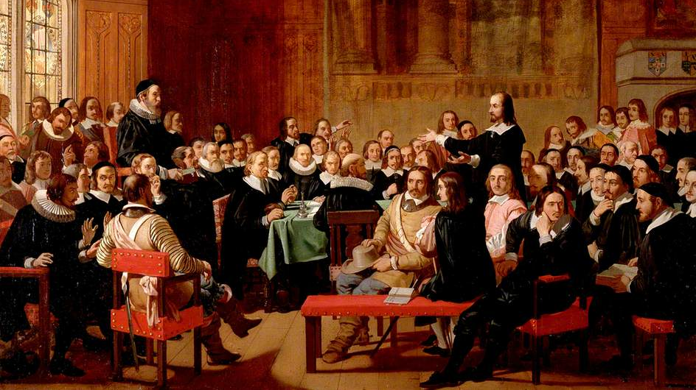
Conti…
17th century may be divided into two periods—The Puritan Age or the Age of Milton (1600-1660), which is further divided into the Jacobean and Caroline periods after the names of the ruler James I and Charles I, who ruled from1603 to 1625 and 1625 to 1649 respectively; and the Restoration Period or the Age of Dryden (1660-1700).
Puritan age is marked by the decline of Renaissance age the age of revival of knowledge. Puritan age is further divided into two classes; The Jacobean period in which James I was the ruler and Caroline period in which Charles I was the ruler .

Slide 4
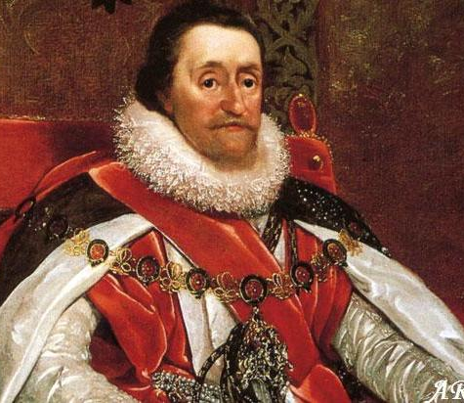
James I and Charles I

Slide 5
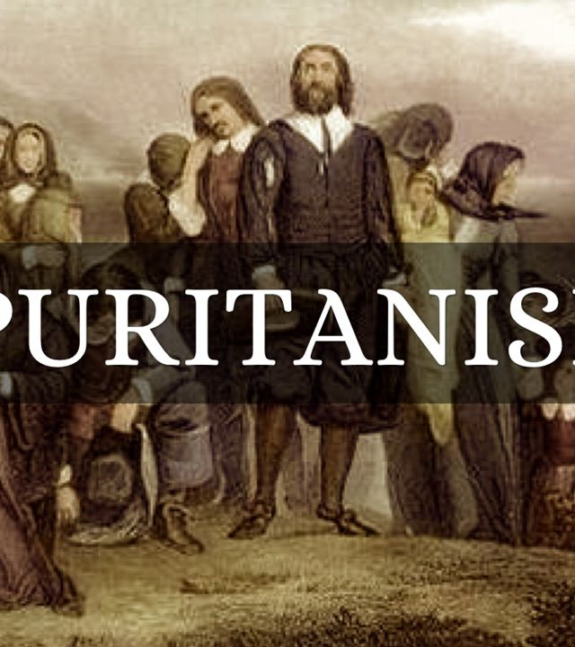
WHAT IS PURITANISM
A member of a group of English Protestants who in the 16th and 17thcenturies advocated strict religious discipline along with simplification of the ceremonies and creeds of the Church of England
Puritan is the One who lives in accordance with Protestant precepts, especially one who regards pleasure or luxury as sinful
Puritanism was the doctrine or School of English Protestants of the 16th & 7thcenturies whose aim was the purification of the religious practice.

Slide 6
Salient Features Of Puritan Age
The writers of Puritan ages followed the paths of the great Renaissance writers
The spirit of science popularizes by great men like Newton, Bacon and Descartes
In literature the spirit infuses itself in the form of criticism, which was truly the creation of Puritan age.
People classified, analyzed, and systematized many things which were having no importance before that.
English language was started being used as the medium for instruction and for storing the data and for conveying facts.

Slide 7
Conti…
Art of Biography popularized which was unknown in previous ages.
Readers had become criticizers and asked for the facts and figures, so that they may judge and can take sides in the controversial matters.
Puritanism is considered as the second greatest renaissance
Rebirth of the moral nature of man which followed intellectual awakening of Europe in 15th and 16th century
Puritan movement stood for the liberty of people of Europe
It aimed at making people free and honest.

Slide 8
Characteristics Of Puritan Age
In Literature also the Puritan Age was one of confusion, due to the breaking up of old ideals.
In the absence of any fixed standard of literary criticism there was nothing to prevent the exaggeration of the ―Metaphysical’ poets.
Poetry took new and startling forms in Donne and Herbert, and prose became somber (serious)

Slide 9
Development of Poetry
During the age of Milton, the Metaphysical Poetry which had been started by Donne in the later part of the age of Shakespeare, began to blossom.
It was in full swing during this age and the writers who carried forward the tradition of John Donne were Crashaw, George Herbert, Vaughan, and Marvell.
They were the Metaphysical poets who produced a kind of poetry in which conceit and learning were blended.
They are usually lyrical in nature. Their work shows surprising blend of passion and thought.
These poems are full of learned imagery and striking conceits.

Slide 10
Conti…
At their best metaphysical poems revealed great psychological insight and subtlety of thought development.
There were also secular poets who are called the Cavalier poets.
Whereas the metaphysical poets took delight in mysticism and religious thought
the Cavalier poets dealt with the subject of love.
The Cavalier poets – Herrick, Carew, Love lace and Suckling.

Slide 11
The End

