Slide 1
Theories of Development

Slide 2
HISTORICAL MAP Of THE MAIN THEORIES OF DEVELOPMENT
THEORIES OF DEVELOPMENT.docx

Slide 3
Classical Theories: Adam Smith and the Division of Labour
Adam Smith in 1776 published “Wealth of Nations”
merchants, and large trading companies (e.g. East India Company) had great power in relation to national governments
he claimed that divisions of labour would help improve productivity and therefore economic growth and wealth creation.
Divisions of labour describes the breaking up of the production process (for example making cloth) into a number of stages; rather than one person completing all stages, different people concentrate on one aspect of the process. They become greatly skilled at this and so more items can be produced in the same time.
Smith believed that individuals would act in self-interest; thus if a product was too expensive then nobody would buy it and the seller would either reduce the prices or change to selling something else. Similarly, if wages were too low, then workers would move to other jobs.
Smith identified only three functions for the state to perform: defense of national sovereignty, protection of citizens‘ rights against violation by one another, and provision of public or collective goods.
Public or collective goods are those that society needs but that the market will not normally provide, e.g. roads, electricity etc.

Slide 4
David Ricardo: The Theory of ‘Comparative Advantage’
Another highly influential classical economist was David Ricardo who lived in the late eighteenth to early nineteenth centuries.
He was a great advocate of free trade and developed the theory of ‘comparative advantage’.
According to this theory, countries should concentrate on producing and then selling the goods that they had an advantage in producing because of their assets, such as land, mineral resource, labour, technical or scientific expertise.
This meant a global division of labour (GDL). Ricardo argued that it made more sense for countries to specialize in this way, rather than trying to produce everything, because through specializing, production would be more efficient, there would be greater capacity for growth and scarce resources could be used more effectively. (illustration on next slide)

Slide 5
Example: The Theory of ‘Comparative Advantage’

Slide 6
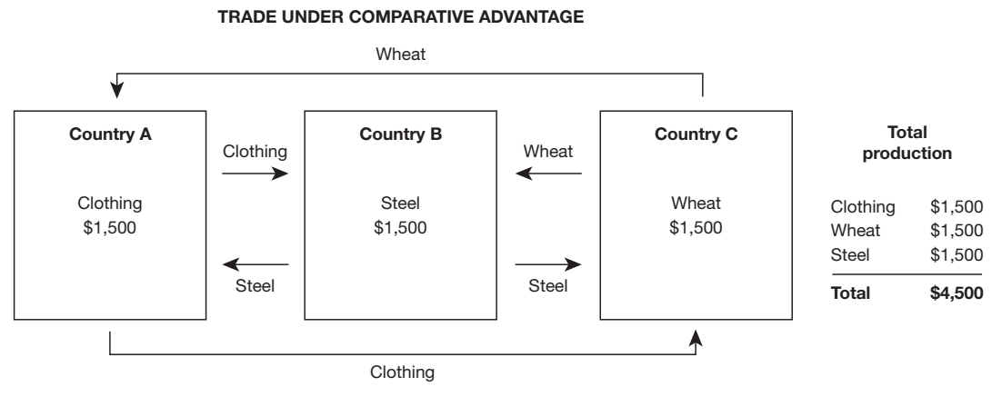
Example: The Theory of ‘Comparative Advantage’

Slide 7
Karl Marx Theory of Economic Development
Karl Marx, the father of socialism, is considered a great thinker of history.
He predicted the decline of capitalism and the advent of socialism
His famous book ‘Das Kapital’ is known as the Bible of socialism (1867).
He presented the process of growth and collapse of the capital economy.
Emphasizes Mode of Production - elements and activities necessary to produce and reproduce material.
Capitalist (market economy) mode depends on wage labor whose labor power produces a surplus which is accumulated and appropriated/seized by the employer
Result is often class conflict in capitalist societies.

Slide 8
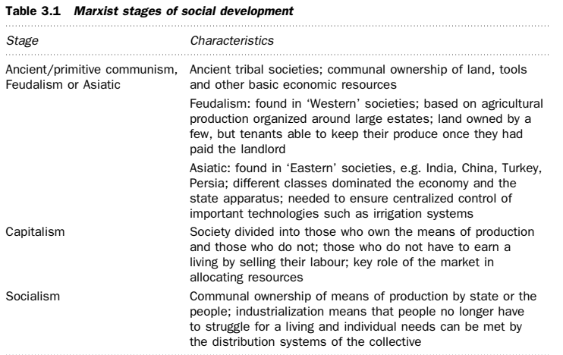

Slide 9
Colonialism/Imperialism (From pdf + White board)
Bernstein defines colonialism as ‘the political control of peoples and territories by foreign states, whether accompanied by significant permanent settlement . . . or not; dominating the economy and cultural practices.
Indigenous (Local) population exploited.
Traditional way of life and self sufficient mode of production have been destroyed
Forced to pay taxes and recruited labor practices
Social differentiation increased- disintegrating force
Fatal effects on secondary (manufacturing) and tertiary (service) sectors- import of cheap goods forced indigenous artisans out of work
Discouraged modern industrialization

Slide 10
Colonialism/Imperialism (cont’d)
Thus what occurred in these situations was dependent development
Colonial powers extracted wealth for home country-Netherlands, France, Great Britain
International division of labor (IDL) and western dominated trading structure was created to take advantage of colonial authority
IDL=allocation of tasks among laborers such that each one engages in tasks that he performs most efficiently and this promotes worker specialization and productivity

Slide 11
End of Presentation

