Slide 1
NON-ESSENTIAL PARTS OF A BUSINESS LETTER
Some letters may ask for certain additional parts which are not the requirements of all letters. One or more of these parts may be mentioned, as and when required. These parts are: 1. Reference Line 2. Attention Line 3. Subject Line 4. Identification Line 5. Enclosure Line 6. Carbon Copies
7. Postscript

Slide 2
Reference Line
Some companies, especially big ones, have a system of tracking letters by chronological (in order) numbers, employee initials, department codes/numbers or whatever else they choose. This is what they put in the reference line.
Sometimes you can include the reference line in your letter to refer to the information specifically requested by the recipient, such as invoice number.
The reference is typed on one or two lines, immediately below the date. This means it is typed to the right OR at the center in the indented business and modified block letter layouts.
You can also refer in the reference line to the letter you are replying to, if you wish.
Our reference: Project #234 Your reference: Invoice #3444

Slide 3
Examples of references:
Re: 180/VG Re: Job # 389-03 Re: Your letter dated 11/15/2006 (this can also be used as a subject line)
Ref No. SBP/2008/90
Different organizations have different ways to mention the reference number but, whatever form it may take, the purpose remains the same i.e. to enable the reader to link the letter with the previous/subsequent correspondence.
Although it is regarded as a Non-Essential part, nowadays almost all organizations mention Reference Line to make things convenient for the senders and the receivers.
Notes:
When Replying, Refer to:"
This reference notation is commonly used in job postings or requests for proposals bearing an identification code. For instance, "When replying, refer to code JOB1A." Respondents would then reference the notation in their reply letter.
"In re:"
"In re" is found in a respondent's letter before the salutation. It may read as, "Application for JOB1A on hiremenow.com." This reference notation version is similar to "RE:," but usually is only used in response to a letter.
This reference number of the business letter (file number of the business letter) is useful to refer to the previous letters which are related to the current letter. The recipient will refer those old letters for relevant matters.
Although this is not necessary, adding the reference number is advisable in many cases. Adequate space might have been provided for this reference number in the letterhead. Depending upon the layout of the business letter that you are adopting, you should add the reference number in the appropriate space provided for it. So, all these things make it simple to simply type the reference number.
A letter may be given a reference number. This number is used for filing purposes and future references.
This number is usually taken from the initials of the name of the organization. It is placed at the left margin below the date. e.g.

Slide 4
Attention Line:
Sometimes a letter is sent to a firm with the expressed desire to invite the attention of a particular individual, In that case, his name is mentioned separately and distinctly.
Attention : Head of Marketing
This indicates that you do not know the name of the head of the marketing team and that the letter should be directed to the head of marketing.
Attention Line is usually typed in center of the page, leaving double space after the Inside Address. It is mentioned only when the Inside Address is impersonal.
If Inside Address already contains a name, no Attention Line is required.

Slide 5
Attention : Peter – Marketing Department This indicates that you know the name of the addressee, but not his/her designation. In that case, you should use the attention option. That means that the letter should be routed to the person Peter who is in the marketing Department. This option is used to draw the attention of the addressee to the core issue.
Attention: Human Resources Manager or Attn: Public Relations Manager or For the attention of Senior Administrative Officer
Attention line can also include the name of the person, in this case you usually don’t type the person’s name in the inside address. Below is an example of such simple attention line:
Attention: Jane Forrester
Notes:
Dixie thinks that you can have different reasons for including an attention line in your letter. One of them could be wanting the organization to respond even if the person you write to is unavailable. In this instance, Dixie suggests you put the name of the organization or department on the first line of the inside address, and the attention line immediately afterwards:

Slide 6
Subject Line:
Purpose of Subject Line is to invite the attention of the reader to the central idea of the message. It is usually typed at the left-hand margin in capital or bold letters, leaving double space after the Salutation.
Some organizations, however, prefer using the Subject Line after the Inside Address of the letter.
Subject Line is mentioned only in long letters. In a short letter, it is not a requirement.
A subject line of text indicates the content matter to follow in the body of the business letter.
It is written as a phrase -- for example, "Subject: Monday's editorial meeting" -- rather than as a sentence.
Thus, it does not require punctuation at the end.

Slide 7
This is not a compulsory issue. But now a day, business letters are written with this.
Normally this is typed and underlined.
You can type this either at the left-hand side or at the center.
This is to indicate what is there in the letter. Just the most concise form of the letter should be mentioned here.
The subject of the letter becomes must when the letter is lengthy one.

Slide 8
Identification Line / Initials:
Identification Line comprises the initials of names of the persons who are involved in drafting and typing Of the message. The purpose of Identification is to Show who dictated a letter and who typed it.
Initials of the person who drafts the message in capital letters whereas initials of the person who types the message made in small letters. The two initials are separated by using the colon mark.
For example, if Diana Meer Smith typed the letter then she would put dms as the Identification Initials.
DDB: dms DDB/dms
This is usually not necessary nowadays as most people (even big CEOs type their own letters) don’t have a secretary to type their letters.
Notes:
Dictionary.com defines initials as: The first letter of each word of a person's full name considered as a unit While a signature is defined as: a person's name, or a mark representing it, as signed personally or by deputy, as in subscribing a letter or other document. To me, the signature definition is much more personal. Anyone can write down to letters of anyone's name, and they would, by definition, be initials. You cannot reproduce someone else's signature.

Slide 9
The abbreviation 'p.p.' is used in the signature of the business letter. It stands for 'per pro' and means 'by one acting as an agent.
When you see them it just means that the letter was not typed by the person who signed it, but rather by his/her assistant whose name follows 'p.p.' like this:
Sincerely,
Howard Lindham
Howard Lindham, Director
p.p. M. Raynor

Slide 10
There is another way of putting it: the person, who typed the letter for the boss first includes three of the boss’s initials in uppercase characters and then two of his or hers in all lowercase characters, avoiding ‘p.p.’ which is becoming so rare many humans don’t even know what it is.
The signature block in this case would look like this (note that Howard Lindham’s middle name is Kenneth, and his assistant's name is Mary Raynor):
Yours sincerely,
Howard Lindham
Howard Lindham, Director
HKL/mr

Slide 11
Enclosure: To enclosing additional information with the letter such as a curriculum vitae, Skip two single lines after your typed name and type “Enclosure” or “Enclosures.”
The notations Enclosure(s), Encl., Attachment(s) and Att. indicate that the envelope contains one or more documents in addition to the letter or attached to the letter.
The number of such documents, if there are more than one, should appear after the notation.
Notes:
Enclosures- If you have enclosed any documents along with the letter, such as a resume, you indicate this simply by typing Enclosures ('Enc. ).
- As an option, you may list the name of each document you are including in the envelope. For instance, if you have included many documents and need to ensure that the recipient is aware of each document, it may be a good idea to list the names.

Slide 12
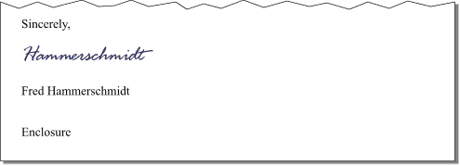
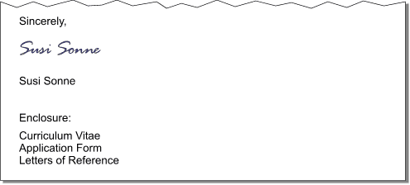
Enclosure notations can look like this:
Enclosure Enclosures: 3 Enclosures (3)
2 Enclosures
you could include the actual description of the enclosure/enclosures:
Enclosure: Purchase Order No. 3506
When you have several enclosures you can include them in the letter like this:
Enc: Certificate of Origin Order Form No. DS 5318

Slide 13
Copy circulated: When any copy of the letter is sending to be distributed to other person, office or department is called ‘Copy Circulated’, Carbon copy’ or ‘Distribution list’, ‘Copy forwarded to’ or ‘Copy’ title is used.
A lot of humans, nowadays prefer to state that 'CC' means ‘courtesy copy/copies’ though.
Some companies started using 'PC' instead of 'CC', where 'PC' stands for photocopy.
Notes:
Use cc, meaning carbon copy, even though you may use photocopy or other reproductions.This notation goes at the very end of your letter and flush left when used in a correct business letter format.
If you do not want your reader to know that you are sending a copy to another person, omit cc and instead, type bcc, blind carbon copy, only on your copy of the letter.

Slide 14
The 'CC' notation usually includes names of people to whom you distribute copies, sometimes you could include their addresses as well. 'CC' is typed at the end of the letter after enclosure notations or identification initials.
CC: Jarrod Curtis cc: Jarrod Curtis
If you don’t want the addressee to know that a copy is being forwarded to a third party, use 'BCC' that can be shortened to 'BC' for blind (carbon or courtesy) copy.
Below are the ways to present this feature.
cc: Sarah Smith
cc: Dr. Howard Stewart 12337 Rocky Lane Houston, Texas 77070
Copy to: Sarah Smith
Copies to: Sarah Smith Howard Jones
Notes:
This notation appears on the office copy and the third-party copy only, not on the original.

Slide 15
Postscript (P.S.)
is an afterthought, thought of occurring after the letter has been written and signed. The term comes from the Latin post scriptum, an expression meaning "written after.
It is the final optional part of a letter. If a thing has been forgotten from the body of the letter, it may be brought below everything in the letter.
But as far as possible the use of postscript should be avoided.
It does not leave a good impression on the reader. It shows carelessness of the writer. But if you are forced to include it, it must be handwritten. Exp.
P.S. Send your cheque to our old address.

Slide 16
Basically, a post script is a letter-writing technique that says, “Oh, I forgot to tell you something,” or “By the way, here’s one more thing you should know.”
If you think about it, the P.S. it antiquated. It comes from a time when letters were written by hand. If you thought of something you wanted to add after you wrote the letter, you had only two choices:
rewrite the letter or
add it to the end of the letter.
Today, there is no logical need for the P.S. If you forget something, you just edit the letter on your computer before you print it.

Slide 17
However, like so many things in advertising, the P.S. is not about logic but about persuasive power.
It is a convention (rule, principle) adopted by copywriters (a person who writes the text of advertisements or publicity material) to highlight an important point.
It is not an afterthought, but a purposeful piece of copy.
Many copywriters think of the P.S. as a “headline” at the end of the letter. Others have called it a “hotspot,” since people often glance at the end of a letter to see the offer and the signature before they read the entire text.

Slide 18
Here are my thoughts on using a post script in your sales letters:
Always use a P.S. at the end of the main sales letter.
Remind your reader of the deal or special offer.
Add urgency with a time limit or reminder about limited supplies.
Add multiple post scripts (P.S., P.P.S., P.P.P.S., etc.) for an unusual twist and to call more attention to the postscript area.
Instead of P.S., try “NOTE,” “By the way,” or “One last thing …” after the signature.
Keep the P.S. to 2 or 3 lines maximum. It’s an afterthought, not an after novel.
Notes:
after novel.:"short story of something new”

Slide 19
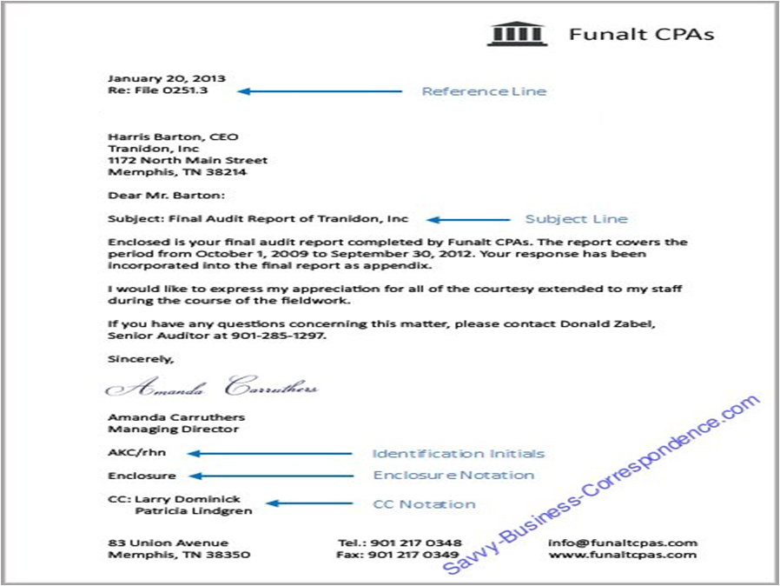

Slide 20
