Slide 1
Letter

Slide 2
LETTER:
A letter is a written or typed message from one person to another or from one organization to another.
Types Of Letters
There are two basic types of letters.
1. Formal Letters
2. Informal Letters.
Formal Letters
A formal letter is a letter written to a business, a college, or any professional that are not considered friends or family. These are also called official letters.
Informal Letters:
An informal letter is a letter written to a friend or family. These are also known as personal letters.

Slide 3
Difference between Hard letter and Soft letter writing
Hard letters are in the form of printed or written on pages.
• Hard letters do not need any electronic mean to read them.
Soft letters are in the form of soft copies.
• These can either be saved in cd’s, hard disks or flash drives.
• Soft copy letters need electronic means to read them.

Slide 4
What is style?
The words in a business letter and the way in which they are arranged express the writer’s personally and give the letter it’s best appearance is called its style.
Block style
Simplified style
Semi block style
Hanging indented style
Modified Block style

Slide 6
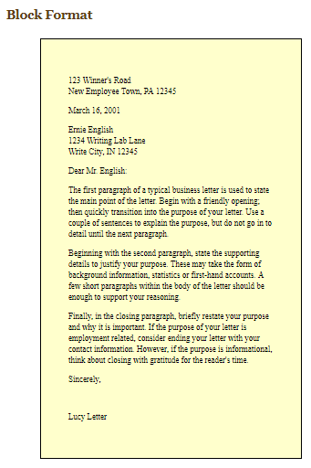
Block Style:
A full block style business letter is when all the components of the letter are aligned at the left margin.
Sides, top and bottom margins should be 1 to 1 1/4 inches. Font size should be 12 in times new roman.

Slide 7
Simplified Style.
Simplified Style.
This is another modification of the fully-blocked style.
This style is used when you write a letter and you do not know the name and title of the person to whom you are writing the letter.
The subject is mentioned in capital fonts and that subject need not be underlined. Today around all the business houses, this style is widely used when the writer of the letters does not want to give importance to formality. Since the formality is not adopted here, this style goes to the heart of the addressee. This style give more importance only to the core matter of the letter.

Slide 8
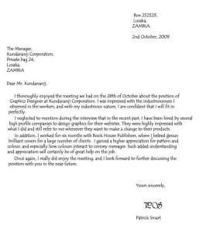
Indented or Semi-Block Business Letter
Semi Block Style:
All text is aligned to the left margin, except the address, date, complimentary close and signature.
Paragraphs are separated by double or triple spacing.

Slide 9
Hanging Indented form
Hanging Indented form letter:
When writing a letter using indented form, indent each paragraph.
First include your name, address, phone number, and the date
You then include the name and address of the person to whom you are sending the letter.
At the end of the letter, place your signature on the right side or at center of the page.
The first line of the paragraph begins at the left-hand margin. And the other lines of the same paragraph are indented three to four spaces. This is the reversal of semi-indented style.
Notes:
However, for normal business communications, this style is very rarely used.

Slide 10
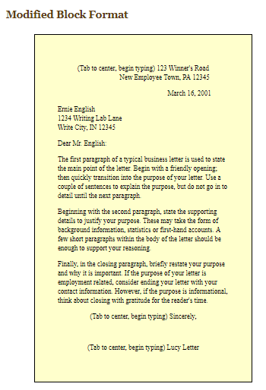
Modified Block style:
In this style we usually put all text aligned to the left margin, except for the author's address, date, and complimentary closing.
All paragraphs we write in a modified block style are not indented. The author's address, date, and closing begin at the center.

Slide 11
ESSENTIAL PARTS OF A LETTER:
1. Letterhead
2. The date of the letter
3. The Inside Address
4. The Greeting / Salutation
5. The Body
6. The Complimentary Close
7. Signature and Writer’s identification

Slide 12
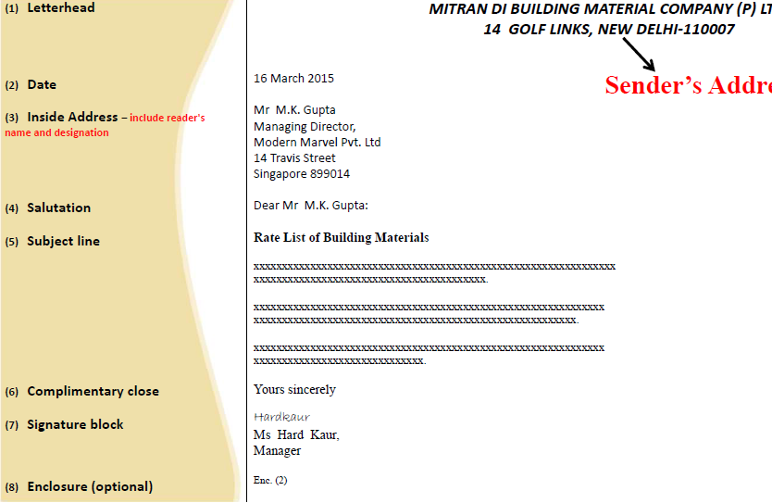

Slide 13
The Heading—consists of the name of the firm or the individual and the address. These are the essentials for a printed letterhead.
The Date Line—consists of the month, the day of the month, and the year.

Slide 14
The Inside Address
– Consists of the name and address of the person or the firm to whom the letter is written.
Salutation
Begin with Dear:
–Use Mr. or Ms. before the receiver’s Name.
–Use Dear followed by an appropriate title, such as Customer Service Department or Sales Manager.
–Use Dear Sir or Madam or Ladies and gentlemen. Include BOTH genders for a general audience.
Notes:
Unless the person is a close associate, never use just the first name; use 'Dear Mr. Jones', 'Dear Sir/Madam' (if name/s unknown), or title of person if known, 'Dear Prof. Jones'. Always use a formal greeting for a business letter.

Slide 15
DON'T address women as Miss or Mrs.
Mistake #1: Dear Miss DeVille: Should be: Dear Ms. DeVille:
DON'T use a generic greeting (find a name).
Mistake #2: To Whom It May Concern: Should be: Dear Mr. or Ms. Lastname:
DON'T use first names unless the employer sets the precedent.
Mistake #3. Dear Steve, Should be: Dear Mr. Lastname:

Slide 16
Get a name! If you really, can’t find the hiring party’s name, use their job title. It’s (marginally) better to say Dear Marketing Manager than Dear Sir or Madam.
Mistake #4. Dear Sir or Madam: Should be: Dear Marketing Manager:
DON'T misspell anyone's name!
Mistake #5. Dear Mr. Radcliff: Should be: Wait a minute... this looks fine, right?
DO use this format: Dear Mr./Ms./Dr. Lastname:
Notes:
You probably think the greeting of your cover letter (the "Dear..." line) is pretty simple. After all, it has only four little parts: the Dear, the Title (Mr., Ms., Dr., etc.), the Last Name, and the Colon [:]. How can you screw that up? Ah, we have our ways. In fact, there are at least five common mistakes people make in their cover letter greetings, any of which might affect their chances of getting an interview. Are you guilty of any of these? Mistake #1: Dear Miss DeVille: Should be: Dear Ms. DeVille: WHY? "Miss" and "Mrs." are archaic in business settings, because marital status is irrelevant. "Ms." is the business-appropriate way to address a woman – unless of course she’s earned a title such as Dr., Rev., Sgt., or Prof. Be sure to use Ms. (pronounced "miz") when speaking, too.
Mistake #2: To Whom It May Concern: Should be: Dear Mr. or Ms. Lastname: WHY? "To Whom It May Concern" just sounds lazy and form-letterish. Check the company web site or make a phone call to find out who "Whom" is. Be the one who takes the extra step. It demonstrates your attention to detail.
Mistake #3. Dear Sir or Madam: Should be: Dear Mr. or Ms. Lastname:
WHY? Let’s see… "Dear Sir or Madam" is dated, stuffy, awkward, and has the same problem as "Whom." (And don’t EVEN get me started if you try just Dear Sir.) Get a name! If you really, truly can’t find the hiring party’s name, use their job title. It’s (marginally) better to say Dear Marketing Manager than Dear Sir or Madam.
Mistake #4. Dear Steve, Should be: Dear Mr. Lastname:
WHY? First names are too informal, unless you and "Steve" have already been corresponding and he has clearly set the standard of using first names only. A cover letter is a formal piece of business correspondence, so keep it formal until you've established a relationship. Many workplaces today are informal, and it's typical to move quickly to a first-name basis, but let "Steve" be the one to decide when.
Mistake #5. Dear Mr. Radcliff: Should be: Wait a minute... this looks fine, right? WRONG! It would be fine, except the guy’s name is Radcliffe with an “e.” Some folks might not notice a typo like manger instead of manager (though most will), and hardly anybody will get miffed about a comma instead of a colon. But everybody knows when their name is misspelled. Proofread, proofread, proofread — especially the recipient's name.
Summary In your cover letter greeting... • DO use this format: Dear Mr./Ms./Dr. Lastname: • DON'T address women as Miss or Mrs. • DON'T use a generic or gender-specific greeting (find a name). • DON'T use first names unless the employer sets the precedent. • DON'T misspell anyone's name!

Slide 17
The Subject Line—enables the reader to know at a glance what the letter is about. It may be placed in various positions (sometimes above the inside address).
Body- The body is where you explain why you’re writing. It’s the main part of the business letter.
- Use a new paragraph when you wish to introduce a new idea or element into your letter. Depending on the letter style you choose, paragraphs may be indented. Regardless of format, skip a line between paragraphs

Slide 18
Complimentary Close - This short phrase ends your letter but continues to communicate your tone. It is either at the left margin or right edge, depending on the Business Letter Style that you use.
Choose a letter closing that suits your relationship with the reader, always communicate with courtesy and respect. Follow your closing phrase with a comma.
Like: "Dear Sir or Madam" must end "Yours faithfully”.
Sincerely, Regards, Yours truly, and Yours sincerely - These are the simplest and most useful letter closings to use in a formal business setting.
These are appropriate in almost all instances and are excellent ways to close a cover letter or an inquiry.

Slide 19
Best regards, Cordially, and Yours respectfully - These letter closings fill the need for something slightly more personal. They are appropriate once you have some knowledge of the person to whom you are writing. You may have corresponded via email a few times, had a face-to-face or phone interview, or met at a networking event.
Warm regards, Best wishes, and With appreciation - These letter closings are also appropriate once you have some knowledge or connection to the person to whom you are writing. Because they can relate back to the content of the letter, only use these if they make sense with the content of your letter.

Slide 20
More Letter Closing Examples
When you're ending your letter, be sure to choose a letter closing that is appropriate to the topic of your letter and to your personal situation and relationship with the person you are writing to. Here are more examples to choose from.
Best,
Cordially yours,
Fond regards,
In appreciation,
In sympathy,
Kind regards,
Kind thanks,
Kind wishes,
Many thanks,
Regards,
Yours faithfully,
Yours sincerely,
Yours truly,
Respectfully, Respectfully yours,
Sincerely, Sincerely yours,
Thanks,
Thank you,
Thank you for your assistance in this matter,
Thank you for your consideration,
Thank you for your
Yours cordially,
recommendation,
Thank you for your time,
Warm regards,
Warm wishes,
Warmly,
With appreciation,
With deepest sympathy,
With gratitude,
With sincere thanks,
With sympathy,
Your help is greatly appreciated,
Notes:
The complimentary close you choose depends on how formal the correspondence is and how well you know the person you’re writing to.
“Sincerely,” “Yours truly” and “Cordially” work well for most forms of correspondence.
However, if you know the reader well and the tone of the message calls for a more personal ending (for example, an email to congratulate a colleague on a promotion), you could use “Best wishes,” “Regards,” or “Warmest regards.”

Slide 21
Complimentary Closing depends upon the formality of the salutation that you used in the letter.

Slide 22
Although these types of expressions of complimentary closings are required, business world is not following these strictly these days. The normal complimentary closings are :
The closings should be typed at the left-hand side just below the body of the letter. In few cases, it is used at the center of the letter just below the body of the letter.

Slide 23
Signature and Writer’s identification - The signature is the last part of the letter. You should sign your first and last names. The signature line may include a second line for a title, if appropriate. Use blue or black ink.
Notes:
Job seekers frequently send a cover letter along with their curriculum vitae or applications for employment as a way of introducing themselves to potential employers and explaining their suitability for the desired positions.^{[2]}Employers may look for individualized and thoughtfully written cover letters as one method of screening out applicants who are not sufficiently interested in their positions or who lack necessary basic skills.^{[1]} Cover letters are typically categorized according to two purposes:
applying for a specific, advertised opening (“letter of application”)
expressing interest in an organization when the job seeker is uncertain whether there are current openings (“letter of inquiry”) ^{[3]}
Your Signature
Beneath your letter closing, include your signature. If this is a physical letter, first sign your name in pen, and then include your typed signature below. If this is an email letter, simply include your typed signature below your sendoff.
It is also important to include your contact information in your letter. If this is a physical letter, your contact information will be at the top of the letter. However, if this is an email, include that information beneath your typed signature. This will allow the recipient to respond to you easily.

