Slide 1
Paulo Coelho
Thaterra Achakzai

Slide 2
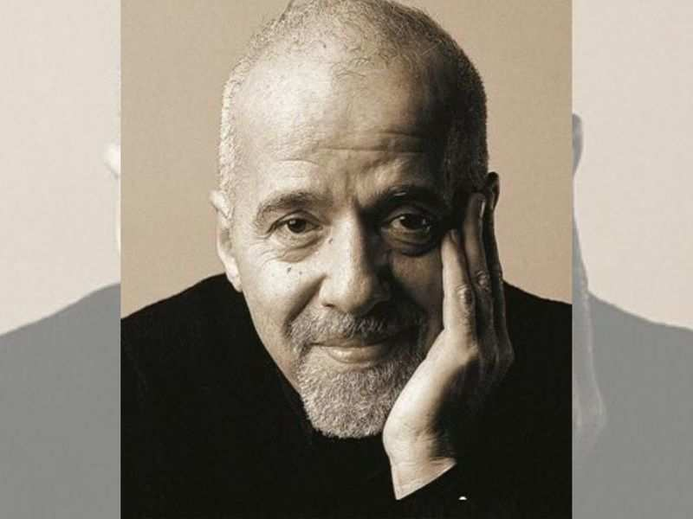
INTRODUCTION
Paulo Coelho was born in Rio de Janeiro in 1947
He was a son of an engineer and his mother was a housewife
He attended a Jesuit school, and from a young age Coelho dreamed of becoming a writer
Coelho enrolled in law school as a young man but dropped out to travel, through Latin America, North Africa, and Europe.
He became involved with a theater group as an actor and director and worked as a journalist

Slide 3
Conti…
He found a magazine which was called 2001
He also wrote lyrics for rock songs and collaborated on a political comic strip
Because of his progressive activities, Coelho was kidnapped and tortured by a Brazilian paramilitary group in 1974.
His life's major turning point occurred when Coelho met a stranger in an Amsterdam café who told him to make the traditional Roman Catholic pilgrimage to Santiago de Compostela in Northern Spain.

Slide 4
Conti….
Coelho did so in 1986. As a result, he experienced an epiphany that readers of The Alchemist will recognize: He decided to follow his dream.
Coelho set out to become a writer.
Inspired by his journey to Santiago de Compostela, Coelho wrote The Pilgrimage: Diary of Magus, about extraordinary events that happen to ordinary people.
Published in 1987, the book's commercial and cultural impact was at first negligible.
The following year The Alchemist was published. The novel sold only nine hundred copies initially and was not reprinted.
Coelho's next book, Brida, was well-received, however, and as a result, both The Pilgrimage and The Alchemist became best-sellers.

Slide 5
Conti…
Indeed, The Alchemist became the best-selling Brazilian book ever and then an international best-seller — one of the best-selling books in history, ultimately.
Coelho has written and published more than twenty-five books in all, including collections of essays and newspaper columns, though most are novels.
Some of his best-known books are By the River Piedra I Sat Down and Wept, The Fifth Mountain, Veronika Decides to Die, The Devil and Miss Prym, Warrior of the Light: A Manual, The Zahir, and Eleven Minutes.
The author, now internationally recognized, lives with his wife in Europe and in Rio de Janeiro.

Slide 6
VERONIKA DECIDES TO DIE
a 1998 novel by Brazilian novelist Paulo Coelho
story of a 24-year-old woman’s attempted suicide and stay at a mental hospital.
Much of the novel is based on the author’s own experiences in mental institutions
Coelho was himself institutionalized by his parents three times by age sixteen

