Slide 1
ONLINE TEACHING / E-LEARNING COLLEGES, HIGHER & TECHNICAL EDUCATION DEPARTMENT BALOCHISTAN
BS Implementation & Coordinator Committee

Slide 2
MOST IMPORTANT COMPUTER SKILLS
Operating Systems (Windows etc.)
MS Office (Word etc.)
Presentation Software (Power Point / software)
Spreadsheets for data etc. (Excel etc.)
Communication & Collaboration tools (Skype, Zoom, MS team etc.)
Social Media (facebook, Whatsapp etc.)

Slide 3
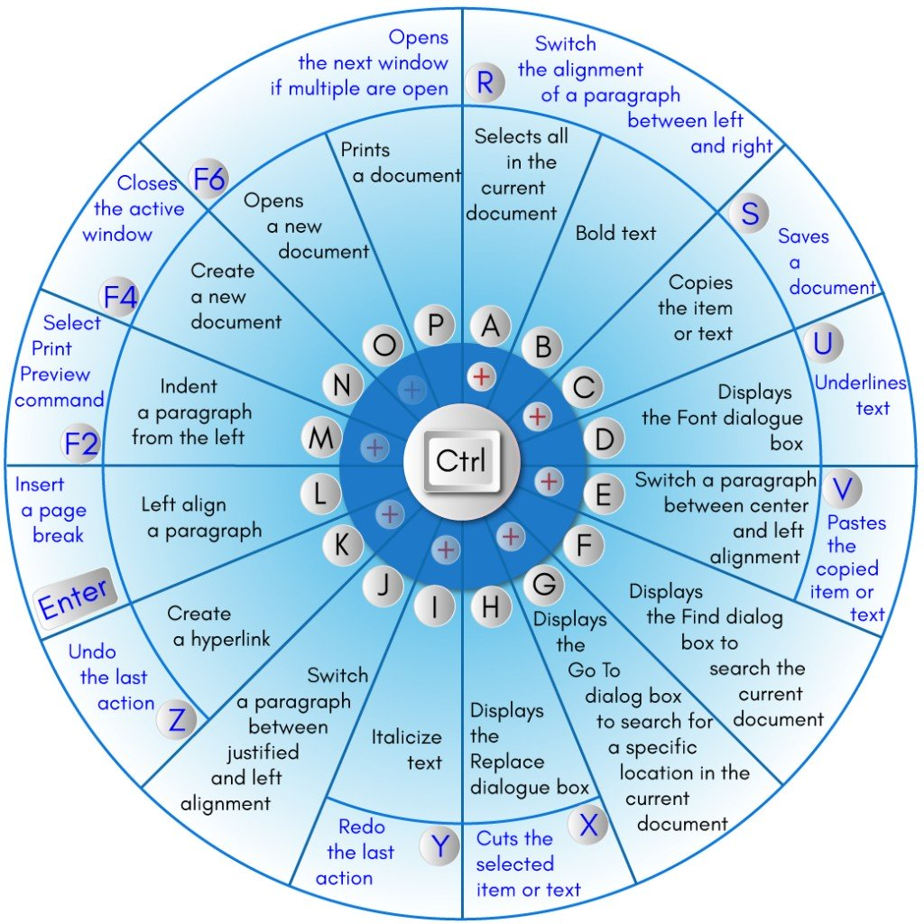
BASIC COMPUTER SKILLS (Keyboard Short Cuts… Managing Windows (minimize, maximize, restore)

Slide 4
FACULTY TRAINING SESSION ON LEARNING MANAGEMENT SYSTEM (LMS)
REGISTRATION: Through Committee or online link to register themselves for LMS, along with course / courses information that are to be taken online through LMS.
IN THIS TRAINING SESSION, LMS along with its importance will be introduced and try to demonstrate developing a new course on our LMS, with Hybrid Approach While Demonstrating Interactive as well as Indirect teaching approach, on LMS.
OUTCOMES OF THIS TRAINING:
By end of this training session, we expect that our participants will become familiar with LMS and the different software tools that are supportive in dissemination of online education. Furthermore, participants having basic IT knowledge will become at majority self independent in development of their course material, and will be able to operate LMS different features and inbuilt tools with a level of ease and confidence.

Slide 5
Moodle: Learning Management System
UoB has deployed Moodle LMS by following HEC guidelines.
In simplest way we can describe LMS as:
Online Platform In-between Teacher and Student
Can be used for Synchronous (Interactive) as well as for asynchronous (indirect) teaching modes.
Offers variety of interesting features and tools, to support constructive learning environment

Slide 6
LMS General Demonstration As Guest
Accessing Sample Course “Learning Management System”
Contents include all relevant documented tutorials, as well as video based self-explanatory demonstration of using LMS.
http://website.uob.edu.pk/moodle/login/index.php

Slide 7
Synchronous (Interactive) Mode
Various Video Conferencing Tools:
UoB Moodle LMS has integrated ZOOM video conferencing software / solution.
Zoom can be downloaded from https://zoom.us
The basic free version supports 40mins continuous video conferencing session allowing maximum 100 participants.
Every faculty member needs to create zoom account with same email address (either Gmail, Yahoo, Outlook, UoB etc) that is associated also with faculty LMS account.
Zoom sessions can be easily Recorded on your laptop / computer and later can be uploaded on internet based cloud free storage e.g. Google Drive, OneDrive, Drop Box etc and then linked on your LMS course.

Slide 8
Screen Recording Software
CamStudio: It is an open-source screen-casting program for Microsoft Windows released as free software.
Ezvid: is home of the best video reviews, wiki, and the world's easiest to use freeware screen recorder and video editor.
FFsplit: It is a lightweight utility that lets you capture videos from multiple sources and composite them into a live video feed.
PicPick: All-in-one Graphic Design, Best Screen Capture Software, Image Editor, Color Picker, Pixel Ruler and More.
Other Commercial Video Recording / Capturing Software
Movavi screen recorder (Download Link)
Camtasia

Slide 9
Content Development of a New Course on LMS
Course Detail (Introduction, Credit Hours, Total Marks, Marking Criteria if any, Learning Outcomes, Topics Chapter wise, Reference Books etc)
Basic Ingredients:
Topic / Chapter wise Course Development Strategy
-> Lecture Slides / Handouts
-> Interactive Video Conference with recording
-> Pre-Recorded Lectures
-> Third Party Lecture Videos Links
-> Reading Material with Links
-> Inclusion of adaptive Lessons, Quiz, Assignments etc

Slide 10
Lets Start Developing a Sample Course
SWITCH TO LMS……..FOR PRACTICAL DEMONSTRATION (P:123456789)
Target:
To create / Place Course Detail, that should include all relevant information about our course.
To upload Power point Lecture slides, starting from Topic1/Chapter1
To Place / embed a third party lecture video about the topic
Create an Adaptive Lesson (Inclusion of Stepwise Learning…)
Add an Assignment
Schedule / Add Interactive Zoom Session for class.

Slide 11
Important LINKS / WEB-SITES
https://pern-my.sharepoint.com/:v:/g/personal/dit_um_uob_edu_pk/ERCMCuBd7JVMsj5HS71felcBRAa5h8vUv9-1XBdcAi-VfA?e=lBZJc1
(Recorded Demonstration of LMS Video / Training Link of Dated: 20 May, 2020)
https://www.youtube.com/watch?v=69U3cpUvNaA&feature=youtu.be
(Recorded Demonstration of LMS Video / Training Link of Dated: 11 May, 2020)
dit@um.uob.edu.pk (mailing address of director information technology, UoB)
http://colleges.uob.edu.pk/colleges/register.php (Registration of students)
http://colleges.uob.edu.pk/colleges/faculty.php (Registration of teacher)

