Slide 1
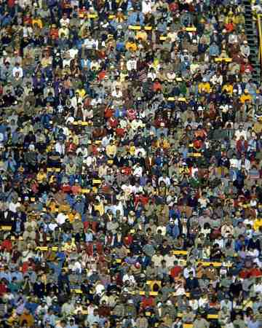
Resource Person Ms Mahwish Talib
Introduction to Sociology
Chapter 3
Social Structure and Social Interaction
Prepared For BPA 2nd Semester

Slide 2
Social Structure
The word structure meant originally, the construction of a building. Gradually, structure began to imply inter-relations between the parts of any whole.
Generally speaking, anything whether an object or an idea has a structure. It is only through the enduring aspects of a structure that we comprehend its existence.
Similarly, we can say that each society in the world has a structure, which can be called its social structure. We can understand a society through the permanent and enduring aspects of its structure.

Slide 3
Social Structure and Social Organization
Raymond Firth, regards both social organization and social structure as distinct concepts.
According to him, social organization is concerned with the choices and decisions involved in actual social relations; while the concept of social structure deals with the more fundamental social relations, which give a society its basic form, and which provide limits to the range of action organizationally possible within it.

Slide 4
Social Structure
Structure helps us know what is expected of us
Ensures stability from one generation to the next – even though the actual society changes
Social Structure: network of interrelated statuses and roles

Slide 5
Section 1: Building Blocks of Social Structure
Question
What are the two major components of social structure?

Slide 6
Defines where you fit in society
Ascribed Status: assigned according to things outside your control. (age, gender, etc.)
Achieved Status: role you achieve through your own efforts. ( occupation, college graduate, basketball player, wife, mother, etc.)
Master Status: One rank that determines your social identity. Can change throughout life. (Fulltime Mom, Police Officer, Grandparent, etc.)

Slide 7
Roles
Statuses are social categories – but roles bring statuses to life
You occupy a status – you play a role

Slide 8
Types of Roles
Reciprocal Roles: define interaction with others. Can’t be fulfilled alone. Example: you can’t perform the role of husband without a wife.
Examples of reciprocal roles:
Teacher – Student, Doctor-Patient, Athlete – Coach
Employee – Boss , Friend – Friend.

Slide 9
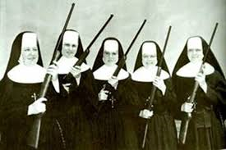
Role Expectations
Socially determined behaviors expected are Role Expectations
Example: Doctors treat their patients with skill
Parents provide for their children, Police uphold the law.
Role Performance: actual role behavior that doesn’t always match what society expects.
Example: Doctor neglects patient, Parent fails to provide for child.
Problems: even when performing expected role does not meet expectations – this is because we play many roles
Sometimes roles contradict each other.

Slide 10
Role Conflict & Role Strain
Role Conflict: conflict between statuses. Example: working fulltime and having young children at home.
Role Strain: difficulty meeting the role of a single status. Example: Boss trying to motivate employees while having to lower their salaries.

Slide 11
Building Blocks of Social Structure
Status
Examples of Roles
Examples of Conflict / Strain
Put out fires, save lives, wear a uniform
Voluntarily puts self in danger, but has loved ones who need him or her
Firefighter
Provide food and shelter, nurture family, discipline children
Fatigue and long shifts make household tasks and interactions difficult
Mother
CEO of a company
Run meetings, recruit new members, plan activities
Has trouble getting members to attend and follow through on promises

Slide 12
How do these two components of social structure affect human interaction?
People’s particular roles and statuses affect how they relate to one another.
Statuses are ways of defining where individuals fit in society and how they relate to others
Most roles have reciprocal roles that define the patterns of interaction between related statuses, such as husband and wife or teacher and student

Slide 13
Wrap Up
Social Structure: network of interrelated statuses and roles\
Status: Defines where you fit in society
Ascribed Status: assigned
Achieved Status: role you achieve through your own efforts
Master Status: One rank that determines your social identity.
Role: you play - bring statuses to life
Reciprocal Roles: define interaction with others
Role Expectations: Socially determined expected behaviors
Role Conflict: conflict between statuses.
Role Strain: difficulty meeting the role of a single status.

