Slide 1
Trends affecting Organizations
Lecture 03

Slide 2
Learning Organizations- A learning organization is the business term given to a company that facilitates the learning of its members and continuously transforms itself.

Slide 3
Major Factors Affecting Organizations
Technological Advancement
Demographics and Diversity
Organization
Globalization
Legislation
Other factors

Slide 4
“By 1976 Kodak accounted for 90% of film and 85% of camera sales in America. Until the 1990s it was regularly rated one of the world’s five most valuable brands”. In fact, In 1996, Kodak was ranked the world’s fourth most-valuable brand behind Disney, Coca-Cola and McDonald’s….
In 1998, Kodak had 170,000 employees and sold 85% of all photo paper worldwide.
Within just a few years, their business model disappeared and they got bankrupt.

Slide 5
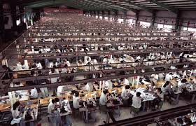
Foxconn Technology Group, is a multinational electronics contract manufacturing company headquartered in New Taipei, Taiwan. Foxconn is the world's largest contract electronics manufacturer, and the third-largest information technology company by revenue.
Foxconn is predominantly a contract manufacturer and its clients include major American, Japanese, and Canadian electronics and information technology companies. Notable products that the company manufactures include Dell, Samsung, Intel, iPad, iPhone.

Slide 6
Foxconn replaces '60,000 factory workers with robots
25 May 2016 From BBC Technology
One factory has "reduced employee strength from 110,000 to 50,000 thanks to the introduction of robots", a government official told the South China Morning Post.
"We are applying robotics engineering and other innovative manufacturing technologies to replace repetitive tasks previously done by employees, and through training, also enable our employees to focus on process control and quality control.
"It's cheaper to buy a $35,000 robotic arm than it is to hire an employee who is inefficient, making $15 an hour.

Slide 7
Impact of Technologies on Organizations
Notes:
Telecommuting, remote work, telework, or teleworking is a work arrangement in which employees do not commute to a central place of work. A person who telecommutes is known as a "telecommuter," "teleworker," and sometimes as a "home-sourced," or "work-at-home" employee.

Slide 8
Negative Aspects of Older Workers
Perceived resistance to change by older workers.
Increased health-care costs for senior workers
Blocking advancement opportunities for younger workers
Higher wage and salary costs for senior workers
Positive Aspects of Older Workers
As productive or more productive than younger workers
Have more organizational loyalty than younger workers
Possess broader industry knowledge and professional networks

Slide 10
Protean Career
The career of the 21st century is protean, a career that is driven by the person, not the organization, and that will be reinvented by the person from time to time, as the person and the environment change.
The protean career is a process which the person, not the organization, is managing. It consists of all of the person's varied experiences in education, training, work in several organizations, changes in occupational field, etc.
Notes:
The Protean Career is a concept that requires everyone to 1) monitor and assess the job market; 2) anticipate future developments, trends, and industry shifts, 3) gain the necessary skills, qualifications, relationships, and assets to meet the shifts, and 4) adapt quickly to thrive in an ever-changing workplace.

Slide 11
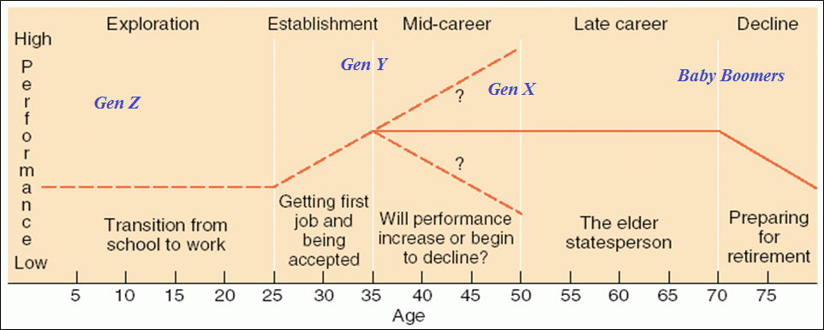
Implications

Slide 12
New Employee/Workplace Dynamics
Less Employee Loyalty, More Loyal to Self
Staying with employers for shorter periods; demanding more meaningful work and involvement in organizational decisions
Increased Personal and Family Dynamic Effects
Nuclear families, dual-career couples, and commuter couples
Increased Nontraditional Work Relationships
Part-time, consulting, and temporary employment flexibility

Slide 13
Dual-Career Couples - An issue related to increased feminization of the workforce is the number of dual-career families. The number of couples having two wage earners has increased rapidly, having passed the two-thirds point more than a decade ago. In order to accommodate such families, many employers offer support services such as “sick child” care programs and day care.
Commuter couples are a subset of dual-career couples who live apart in separate residences while both partners pursue careers.
Notes:
The added worker effect refers to an increase in the labor supply of married women when their husbands become unemployed.

Slide 14
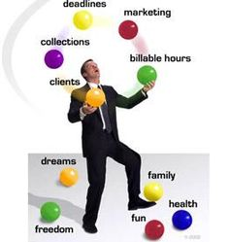
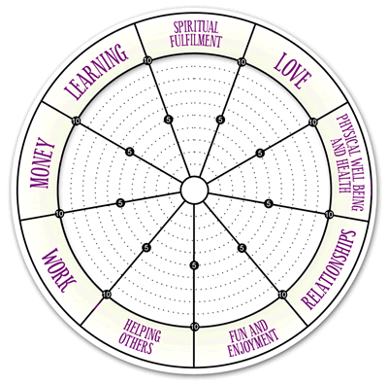
Wheel of Life
Work-Life Balance

Slide 15
Managing Workplace Diversity
Understanding and Appreciating Diversity
Is critical to effectively marketing to ethnic and minority groups
Is promoted by having a diverse workforce at all organization levels
Helps ensure that hiring and promotion decisions are unbiased by person differences

Slide 16
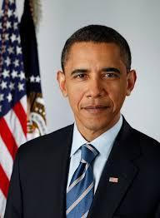
Notes:
sundar pichai
satya nadella
Sadiq Khan

Slide 17
Globalization
Globalization is a process of interaction and integration among the people, companies, and governments of different nations, a process driven by international trade and investment and aided by information technology.
Challenges for Management
Managing diversity of workforce
Managing pressures for more labor rights in third world countries.
Downsizing the workforce
Coping with flexible working hour
Great emphasis on training
Notes:
Third world is a phrase commonly used to describe a developing nation, but actually started as term used to describe a country's allegiance. A Third World country is a country whose views are not aligned with NATO and capitalism or the Soviet Union and communism. The use of the term Third World started during the Cold War and was used to identify which of three categories the countries of the world aligned with. The First World meant that you aligned withe NATO and capitalism, and the Second World meant you supported Communism and the Soviet Union.

