Slide 1
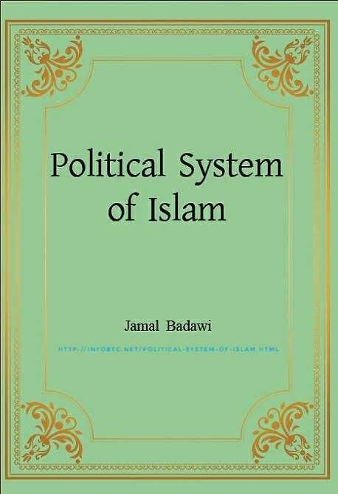
POLITICAL SYSTEM IN ISLAM

Slide 2
Political aspects of Islam
Political aspects of Islam are derived from the Qur'an, the Sunnah (the sayings and living habits of Muhammad(PBUH),Muslim history Muslim history, and elements of Political movements outside Islam.
Traditional political concepts in Islam include leadership by elected or selected successors to the Prophet known as Caliphs,; the importance of following Islamic law or Sharia; the duty of rulers to seek Shura or consultation from their subjects; and the importance of rebuking unjust rulers.

Slide 3
Pre-modern Islam
Origins of Islam as a political movement are to be found in the life and times of Islam's prophet Muhammad(PBUH) and his successors. In 622 CE, in acknowledgment of his claims to prophet hood, Muhammad (PBUH) was invited to rule the city of Medina. At the time the local Arab tribes of Aus and Khazraj dominated the city, and were in constant conflict. Medinans saw in Muhammad(PBUH) an impartial outsider who could resolve the conflict. Muhammad (PBUH) and his followers thus moved to Medina, where Muhammad(PBUH ) drafted the Medina Charter.

Slide 4
This document made Muhammad( PBUH)the ruler, and recognized him as the Prophet of Allah. The laws Muhammad (PBUH) established during his rule, based on the revelations of the Quran and doing of Muhammad( PBUH), are considered by Muslims to be Sharia or Islamic law, which Islamic movements seek to establish in the present day. Muhammad(PBUH) gained a widespread following and an army, and his rule expanded first to the city of Mecca and then spread through the Arabian peninsula through a combination of diplomacy and military conquest.

Slide 5
Islamic State of Medina
The Constitution of Medina was drafted by the Islamic prophet Muhammad(PBUH). It constituted a formal agreement between Muhammad (PBUH) and all of the significant tribes and families of Yathrib (later known as Medina, including Muslims, Jews, Christians and Pagans. This constitution formed the basis of the first Islamic state. The document was drawn up with the open concern of bringing to an end the bitter intertribal fighting between the clans of the Aws (Aus) and Khazraj within Medina. To this effect it instituted a number of rights and responsibilities for the Muslim, Jewish, Christian and Pagan communities of Medina bringing them within the fold of one community—the Ummah.

Slide 6
The precise dating of the Constitution of Medina remains debated. It effectively established the first Islamic state. The Constitution established: the security of the community, religious freedoms, the role of Medina as a haram or sacred place (barring all violence and weapons), the security of women, stable tribal relations within Medina, a tax system for supporting the community in time of conflict, parameters for exogenous political alliances, a system for granting protection of individuals, a judicial system for resolving disputes, and also regulated the paying of blood money.

Slide 8
ISLAMIC CONSTITUTIONAL VALUES
I. SHURA
Shura is simply seeking the experts’ judgment and then acting upon it.
This implies that ruling authorities should take all decisions and actions, based on the opinions of the people of learning, knowledge and experience, distinguishing actions that emphasize national interest and actions that go against it.
They therefore must implement the actions in favor of national interest and abstain from others that run against it (Al-ʿAwa, 2006).

Slide 9
Shura council
prescribes the establishment of a group inviting to all that is good, enjoining what is right and forbidding what is wrong. In addition, Shura is not to be used when there are explicit rules, nor should lead to advice against such rules. An important tool for practicing Shura is the Shura council which should represent the whole nation and be chosen out of free will by the people. They are considered as agents of the people. Therefore, the principal (the people) should be entitled to fire them at will. This can be done by presenting a case against members whose membership becomes in doubt to a special court. Similarly, injustice is prohibited and those committing injustice are to be punished.

Slide 10
II. JUSTICE
Muslims must observe justice among themselves and between Muslims and non-Muslims. It is important to emphasize that justice is particularly stressed as a value in the political sphere. Generally, when acceptable actions lead to injustice, they become impermissible. The obligation to be just is not limited to rulers but covers all citizens in all aspects of life.

Slide 11
III. LIBERTY
In the political area, liberty means absence of dictatorship and the rights of the ruled to take part in the management of their public affairs in a way that is consistent with national interest. Liberty also includes freedom of opinion, of belief, of education, of ownership and personal freedom. Personal freedom includes freedom of movement, right to security and right to shelter.

Slide 12
Since freedom of opinion is the most directly related to the political system, Islam stresses the right to choose among positions or actions. Liberty is therefore considered as a God-given of human nature (Al-‘Awa, 2006). Profits stories in the Qur’an highlights their open arguments with their people regarding the existence of God and his obedience. In addition, several Qur’anic verses and Prophet narrations that emphasize freedom of opinion, to the extent that some writhers opine that thinking is a religious obligation in Islam.

Slide 13
The Islamic principle, “There is no compulsion in religion,” is a proof of the freedom of speech in Islam. Another proof is that Muslims are obliged to exile themselves to protect their faith, when their rulers conquer them with cruelty. Political freedom is a branch of human liberty. Voicing one’s opinion is an obligation rather than a privilege

Slide 14
IV. EQUALITY
In principle, people must have equal rights, liberties, duties and public responsibilities, without discrimination, based on gender, ethnic origin, language or faith. Such equality is of legal and not actual type, meaning that people in the same circumstances must be judged by the same rules. That is why this principle is called equality under the law.

Slide 15
Equality has been instituted by Qur’an and the Prophet’s traditions. In particular, the Prophet (PBUH)said: “Your God is one; your father is one; the red are not preferred to the black, nor the Arabs to non-Arabs, except in piety.” The tie between human equality and Tawheed (the absolute unity of God) must be noted as important. Equality has not exceptions. Piety would be a standard only on the day of judgement and not in this life.

Slide 16
V. RULERS’ ACCOUNTABILITY
The people have the right to make their rulers accountable, based on their obligation to command what is good and to forbid what is bad, as well as their right to Shura. In addition, this is supported by several Qur’anic verses and Prophetic(PBUH) narrations; it is also supported by the Prophet’s narrations that decree obedience of rulers as long as they obey God and abstention from their obedience when they disobey God.

Slide 17
Both the first and second Caliph demanded that he would be corrected by the people should he err. Such is not just idiom but a solid obligation that should be applied in heart, by tongue and then by action. Scholars of several schools of thought agree to charge and remove the ruler who violates the rules of Shari'ah.

Slide 18
MAQASSED AL SHARI'AH & POLITICS
Maqassed al Shari'ah, or the objectives of Shari'ah are summary headlines that sum up the Islamic values in all aspects of life. Because of their central importance in Fiqh, we will attempt to draw the relevant political values from each.
I. PROTECTION OF FAITH
As mentioned above, Tawheed is the central creed and the supreme source of all values. Protection of faith implies that all state powers must not act in contrary with Tawheed or the values drawn therefrom. The following values can therefore be highlighted:

Slide 19
1. Rulers are public servants of the people, they should not raise themselves to a higher rank, or seek being adored by the public.
2. Rulers must avoid treatments through any means that would award them with a great image.
3. Rulers must practice Islamic teachings individually and socially, in order to set an example of obedience and piety to God.

Slide 20
II. PROTECTION OF LIFE
1. Protection of human life as well as human rights must reign supreme.
2. Rulers are directly responsible for protecting human life.
3. Capital punishment must be safeguarded with the strictest safeguards and meaningful reviews.

Slide 21
III. PROTECTION OF offspring
1. Human rights start with humans before their conception. This includes rights to life,
2. The State must take full responsibility for providing health and education.
3. When citizens establish Awqaf to provide education and health services, it must be done under socially accepted standards, approved by society.
4. The government must observe in exploiting natural resources, taxation and finance the interests of future generations.

Slide 22
IV. PROTECTION OF INTELLECT
1. Leading members of the three branches of government must possess the highest level of intellectual excellence that would enable them to better serve their society.
2. Efforts must be exerted to eliminate illiteracy in all forms, and to encourage citizens to develop their intellectual faculties.

Slide 23
V. PROTECTION OF PROPERTY
1. Private property must be protected.
2. The rights to own homes, productive assets and develop one’s human capital must be fulfilled.
3. Markets must be organized as competitive outlets where well-informed citizens can freely exchange.
4. Production and exchange of lawful commodities must be facilitated by a suitable infrastructure and a legal system that protects people’s right to the fruit of their own efforts.
5. Economic and financial transactions must be carried out without Reba (trading present for future money at a premium), Ghabn (cheating) and Gharar (risk trading).

