Slide 2
Marriage
Introduction
Marriage is one of the oldest socially recognized institution and essential for the procreation of children and satisfaction of sexual urges.
In different societies there are different methods of marriage. Some societies allow a male to marry only a single female whereas in other societies a husband is allowed to have more than one wife.
Similarly some societies allow a women to have one husband whereas other societies do not mind a women having more than one husbands.
In some cases parents arrange the marriage whereas in others the boys and the girls arrange for their marriage of their own.
Similarly in some cases the bonds of marriage are very powerful and strong while in other cases these are rather frequently broken and divorce is becoming a problem there.

Slide 6
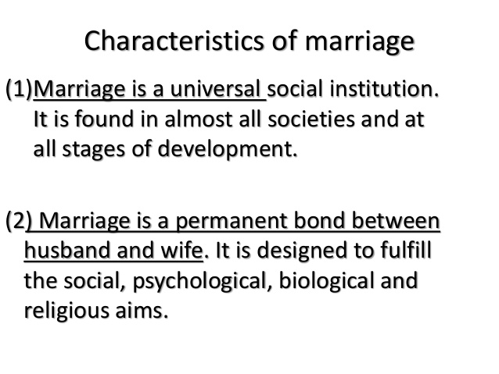

Slide 7
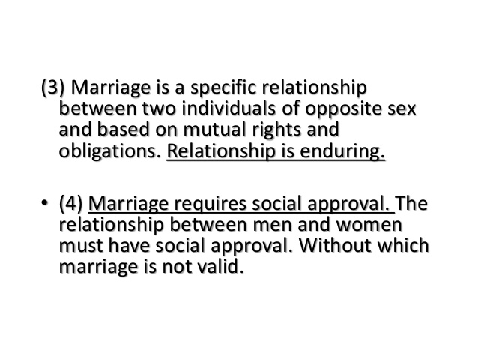

Slide 8
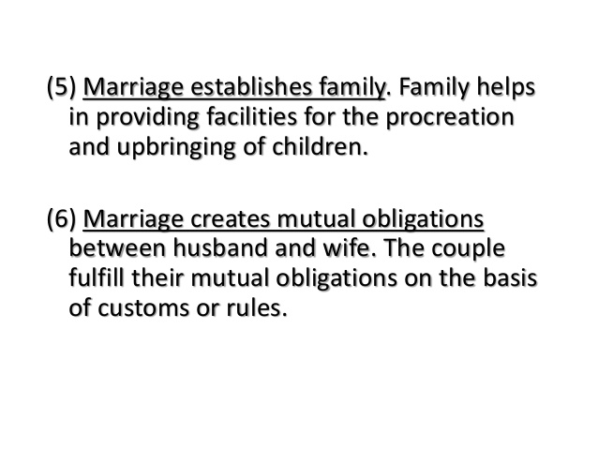

Slide 10
Functions of marriage
Regulation of Sex life
Marriage leads towards the establishment of family
Reproduction of Children
Economic Cooperation
Social Solidarity

