Slide 1
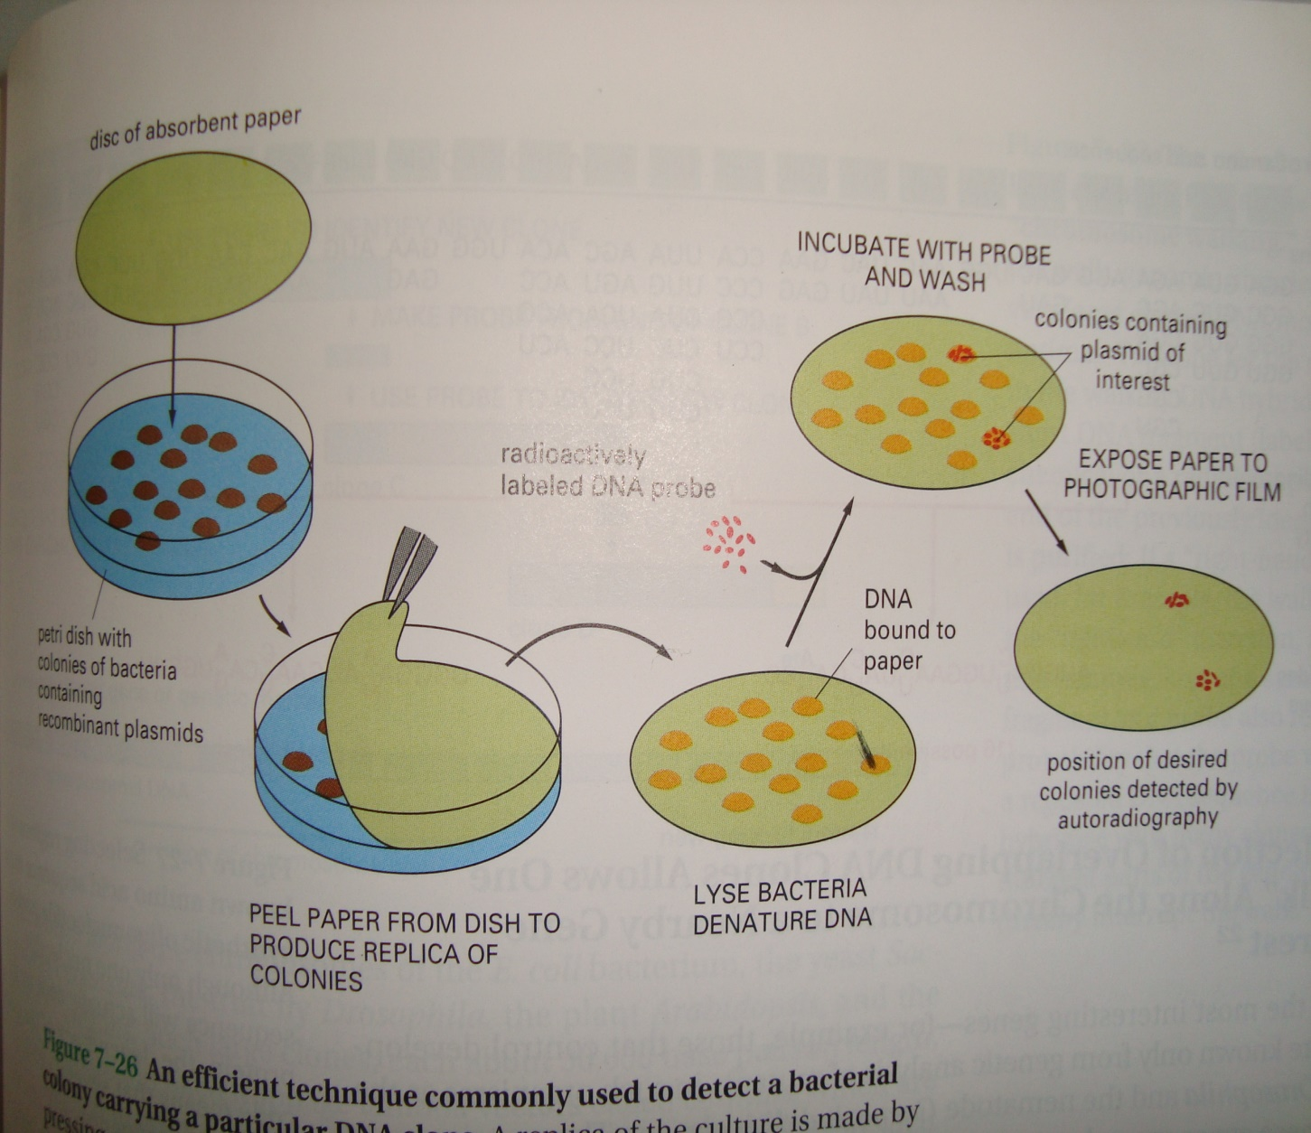
Replica plating and DNA hybradization: an efficient technique commonly used to detect a bacterial colony carrying a particular DNA clone
A replica of the culture is made by pressing a piece of absorbent paper (nylon or nitrocellulose paper) against the surface. This replica is then hybradized to a highly radioactive DNA probe. Those bacterial colonies that have bound the probe are identified by autoradiography

Slide 2
Bacterial cell lysis and DNA denaturation for probe hybridization
The bacterial cell lysis and DNA denaturation can be carried out with 0.5 M NaOH solution. Place the replica nitrocellulose filter paper containing bacterial colonies on the surface of 0.5 N NaOH solution for 7 minutes in a special apparatus.
Replace the NaOH solution with 1.0 M Tris-HCL (pH 7.4) for 1 minute.
Repeat the process one more time and replace this buffer with 1.5 M NaCl, 0.5 M Tris-HCl (pH 7.4) for 1 minute
A 2 mg/ml solution of proteinase K in 1 X SSC (0.15 M NaCl, 0.015 M sodium citrate) is added to just cover the filter.
After 15 min, it is removed by vacuum filtration, and 95% ethanol is similarly passed through the filter. After five washes effected by passing chloroform through the filter, the filter is removed from the apparatus, dipped into 0.3 M NaCl to remove loose cellular debris, and baked at 800 in vacuo for 2 hr.
DNA hybridization
The dry filter is moistened with a 5 X SSC, 50% formamide solution containing the labeled RNA, using 10-15 1A/cm2 of filter. The filter is covered with mineral oil, incubated for 16 hr at 370 to allow hybridization, and then washed for 10 min in a beaker containing chloroform that is gently agitated on a shaking platform. Two more identical chloroform washes are followed by 10 min washes in 6 X SSC, 2 X SSC, and 2 X SSC containing 20 ,ug/ml of pancreatic ribonuclease. If the RNA is 32P-labeled, the filter is blotted to remove excess liquid, covered with Saran Wrap, and placed under Kodak RPS/54 x-ray film for autoradiography.

Slide 3
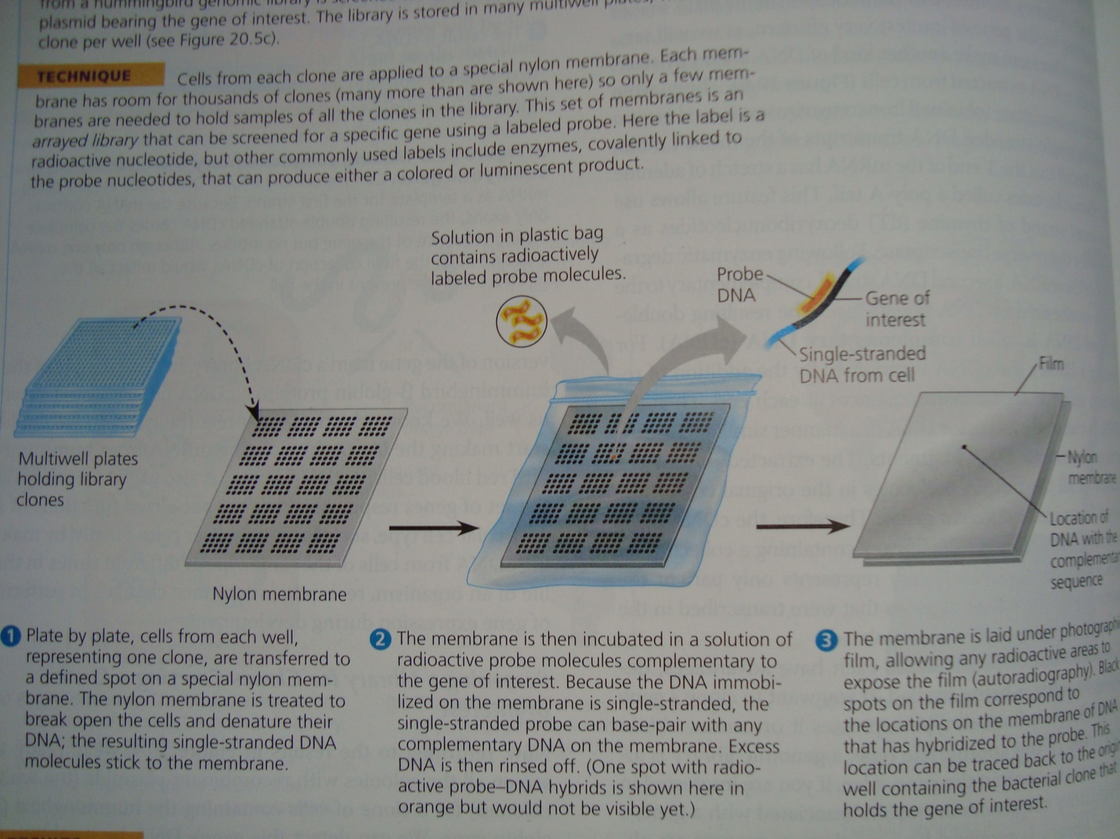

Slide 4
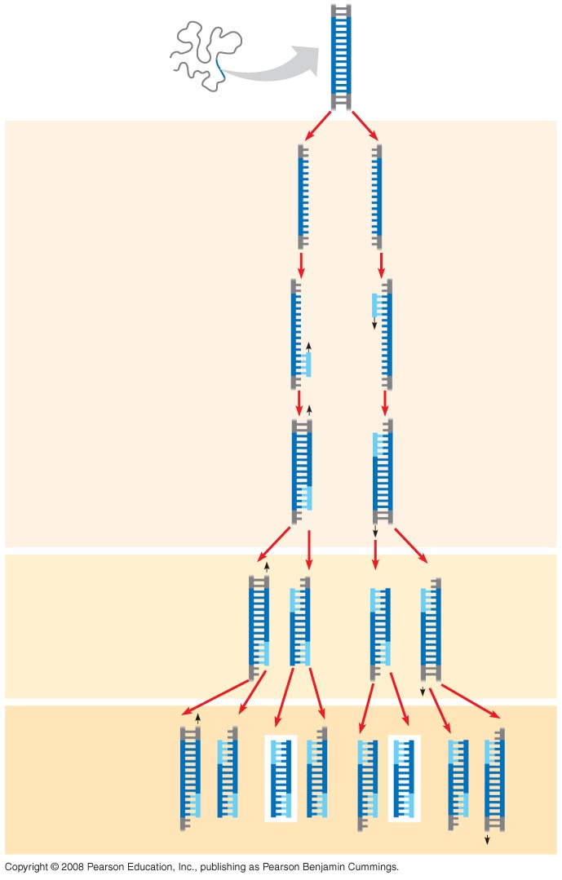
Polymerase chain reaction: a technique for in vitro DNA amplification
TECHNIQUE
5′
3′
Target
sequence
Genomic DNA
3′
5′
DNA isolation
Test tube contain all nucleotides, polymerase enzyme and primer
Denaturation of DNA molecule at ~90oC depending on G-C or A-T quantity
Annealing of primer to DNA at cooling down of test tube
Extension of new stand
Polymerase used in this reaction is a special polymerase obtained fom an archaial bacteria, called a Taq polymerase and is heat resistant
1
Denaturation
5′
3′
3′
5′
2
Annealing
Cycle 1
yields
2
molecules
Primers
3
Extension
New
nucleo-
tides
Cycle 2
yields
4
molecules
Cycle 3
yields 8
molecules;
2 molecules
(in white
boxes)
match target
sequence

Slide 5
Gel electrophoresis is used to separate proteins and nucleic acids of various sizes
This technique uses a gel made of polysaccharide from sea weeds, known as agarose gel
The gel act as a molecular sieve to separate nucleic acids or proteins on the bases of size and electrical charge
Because nucleic acid molecules carry negative charges on their phosphate groups, they all travel toward the positive pole in an electric field
As they move the thicket of polymer fibers impedes longer molecules more than it does shorter ones, separating them by length

Slide 6
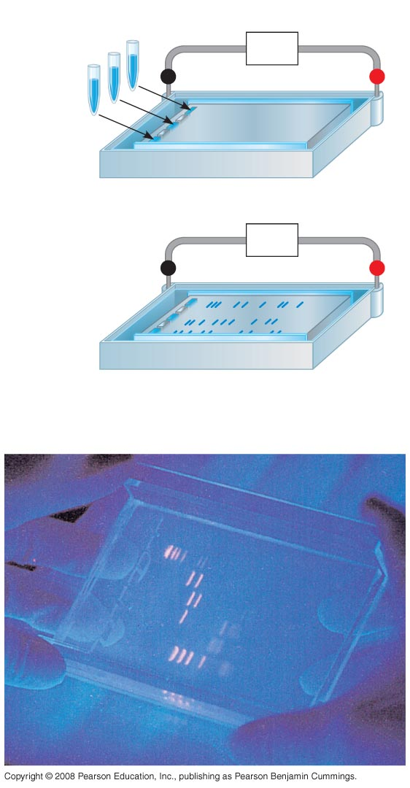
Fig. 20-9
TECHNIQUE
Mixture of
DNA mol-
ecules of
different
sizes
Power
source
–
Cathode
Anode
+
1
Gel
Power
source
–
+
Longer
molecules
2
Shorter
molecules
RESULTS
Notes:
Figure 20.9 Gel electrophoresis

Slide 7
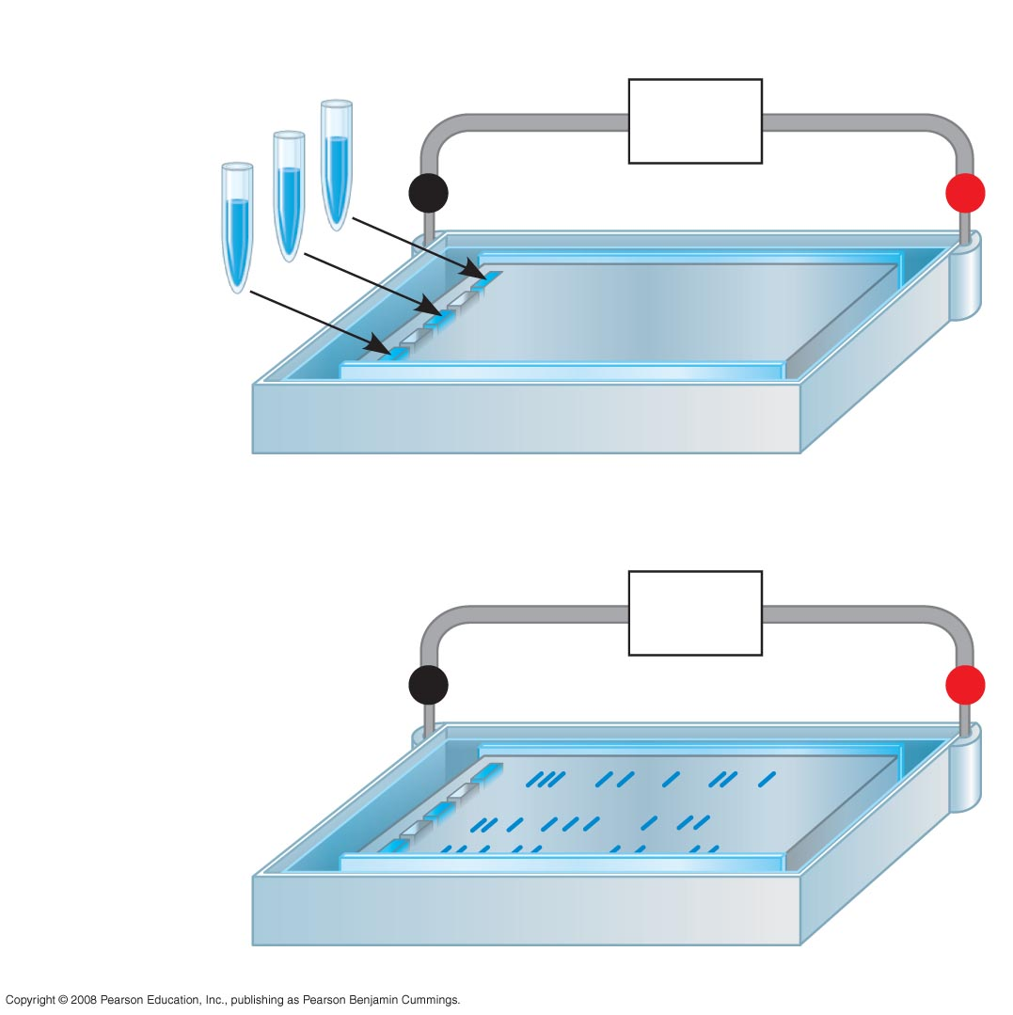
Fig. 20-9a
TECHNIQUE
Mixture of
DNA mol-
ecules of
different
sizes
Power
source
–
Cathode
Anode
+
Gel
1
Power
source
–
+
Longer
molecules
2
Shorter
molecules
Notes:
Figure 20.9 Gel electrophoresis

Slide 8
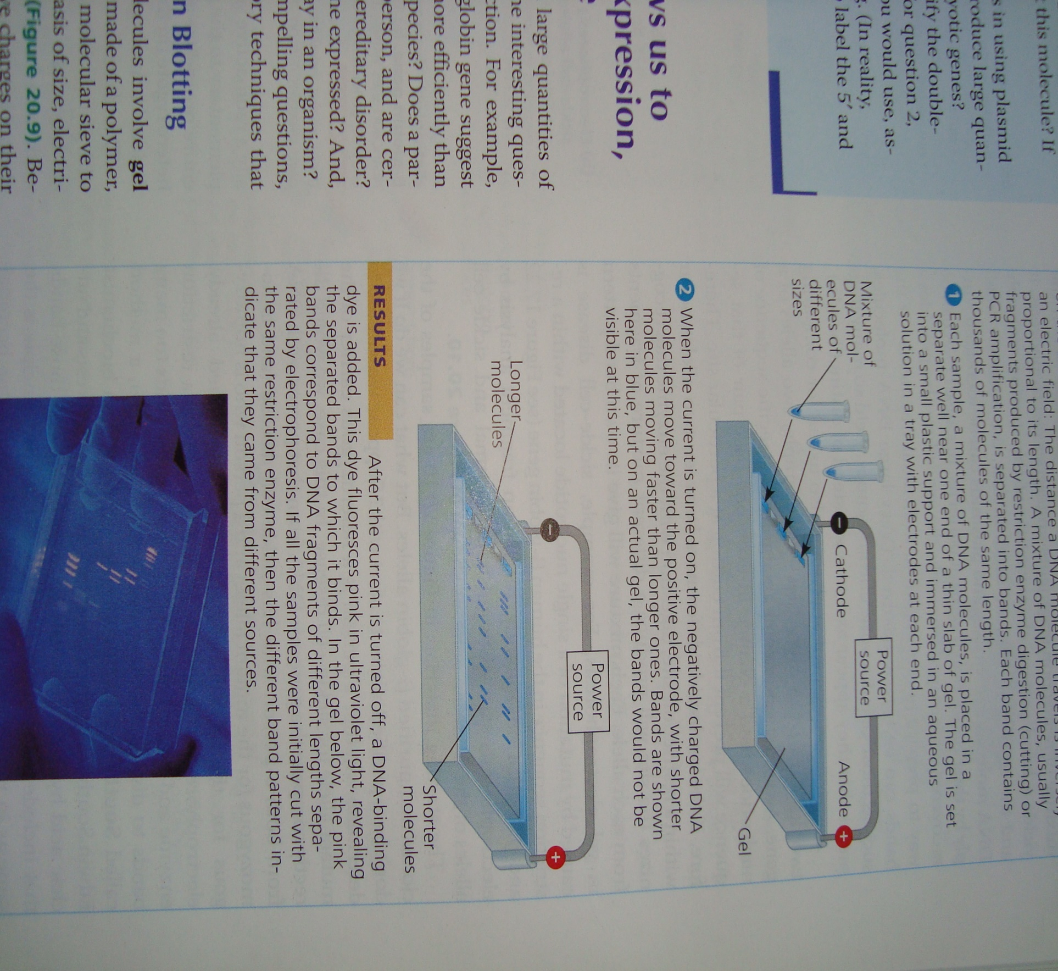

Slide 9
Southern blotting and northern blotting: To detect specific nucleotide sequences within a DNA sample or to identify gene of interest
This technique is the same as probing a DNA segment of interest in a genomic or cDNA library
Replica of RNA or DNA is transferred (blotted) to nitrocellulose paper (nylon paper)
The nylon paper is thereafter transferred to the plastic bag containing DNA probe of the gene of interest
The RNA or DNA complementary to the sequences of probe are hybradized and can be detected with autoradiography
For DNA segment to be detected, it needs to be denatured first prior to hybridization

Slide 10
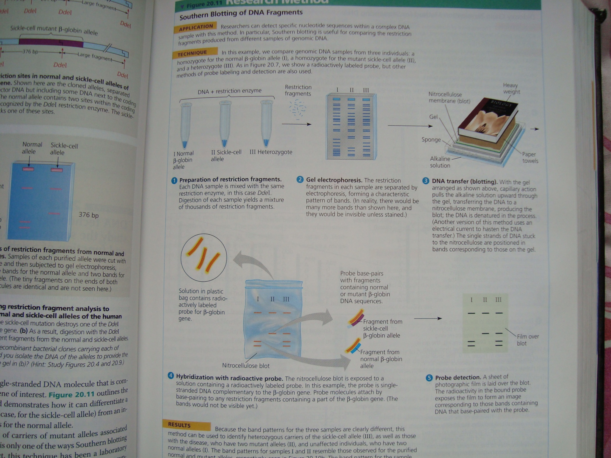

Slide 11
Quiz
Q1. The restriction site for an enzyme called Pvul is the following sequence:
5/-CGATCG-3/
3/-GCTAGC-5/
Staggered cuts are made between the T and C on each strand. What type of bonds are being cleaved?
Q2. One stand of a DNA molecule has the following sequence: 5/-CCTTGACGATCGTACCG-3/
Draw the other strand. Will Pvul cut this molecule? If so draw the products

