Slide 1
Biotechnology

Slide 2
In 1995, a major milestone, the sequence of entire chromosome of bacterium Haemophilus influenzea was sequenced.
Thereafter, by 2007, researchers had completely sequenced hundreds of prokayotic genomes and dozens of eukaryotic genomes including Human genome of 3 billion nucleotides
These achievments can be attributed to advances in DNA technology-methods of working with and manipulating DNA, that had their roots in 1970s.
A key accomplishment was the invention of techniques for making recombinant DNA, DNA molecules formed when sigments of DNA fom two different sources – often different species are combined in vito (in test tubes).

Slide 3
DNA cloning
The method by which a gene of interest is copied in bacterial cell
To clone a piece of DNA e.g. a human gene, researchers first isolate a plasmid from a bacterial cell
Then insert piece of DNA (foreign DNA) in plasmid
The resulting plasmid is a “recombinant plasmid”
The palsmid is then returned back into bacterial cell and the resulting bacterial cell is now a “recombinant bacterium”
The division and redivision of recombinant bacteria yield multiple copies of foreign DNA called “gene cloning”
Applications of DNA cloning
Production of protein from gene of interest :foreign gene”
To make many copies of foreign gene to get it inserted in an organism of interest ☺

Slide 4
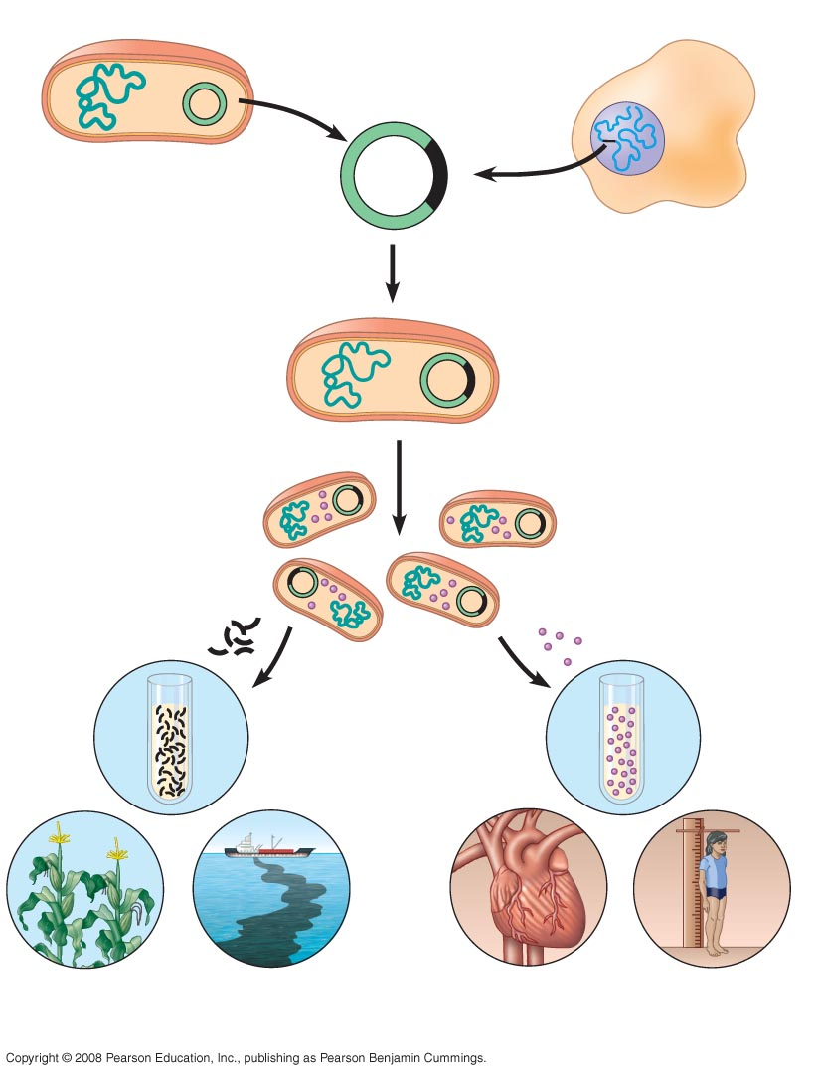
Fig. 20-2
Bacterium
Cell containing gene
of interest
1
Gene inserted into
plasmid
Bacterial
chromosome
Plasmid
Gene of
interest
Recombinant
DNA (plasmid)
DNA of
chromosome
2
Plasmid put into
bacterial cell
Recombinant
bacterium
3
Host cell grown in culture
to form a clone of cells
containing the “cloned”
gene of interest
Gene of
Interest
Protein expressed
by gene of interest
Copies of gene
Protein harvested
4
Basic research and
various applications
Basic
research
on gene
Basic
research
on protein
Gene for pest
resistance inserted
into plants
Gene used to alter
bacteria for cleaning
up toxic waste
Protein dissolves
blood clots in heart
attack therapy
Human growth hor-
mone treats stunted
growth
Notes:
Figure 20.2 A preview of gene cloning and some uses of cloned genes

Slide 5
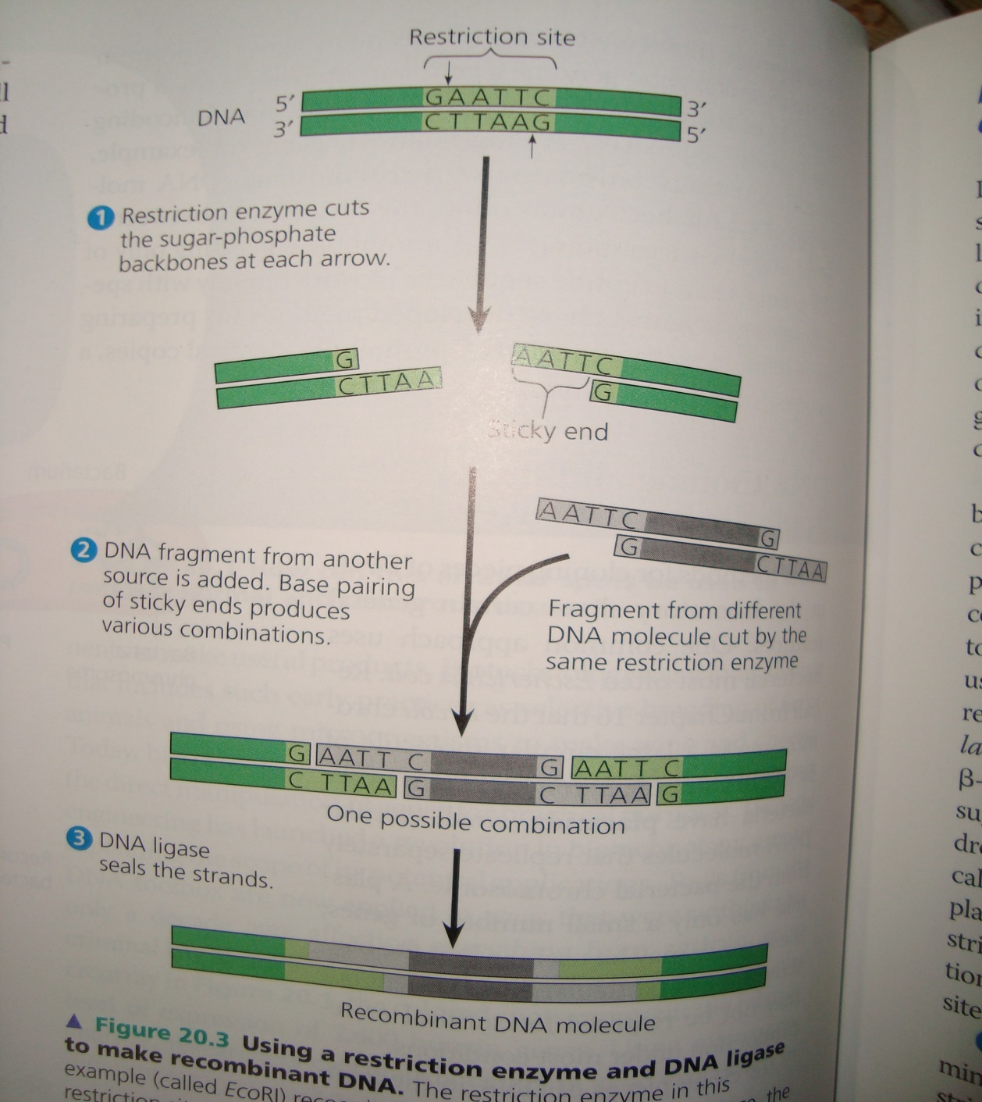
DNA cloning stage 1: Using restriction enzymes to make recombinant DNA
Gene cloning and genetic engineering rely on the use of enzymes that cut DNA molecule at a limited number of specific locations
Those enzymes are called “restriction endonucleases” or “restriction enzymes”
These enzymes cut DNA molecule at specific sites on DNA
These enzymes cut the DNA molecule into “sticky” or “blunt” ends
The most useful restriction enzymes cleave the DNA molecule in staggered manner (making sticky ends). These short extentions can form hydrogen-bonded base pairs with complementary sticky ends on another DNA molecules cut with the same enzyme

Slide 6
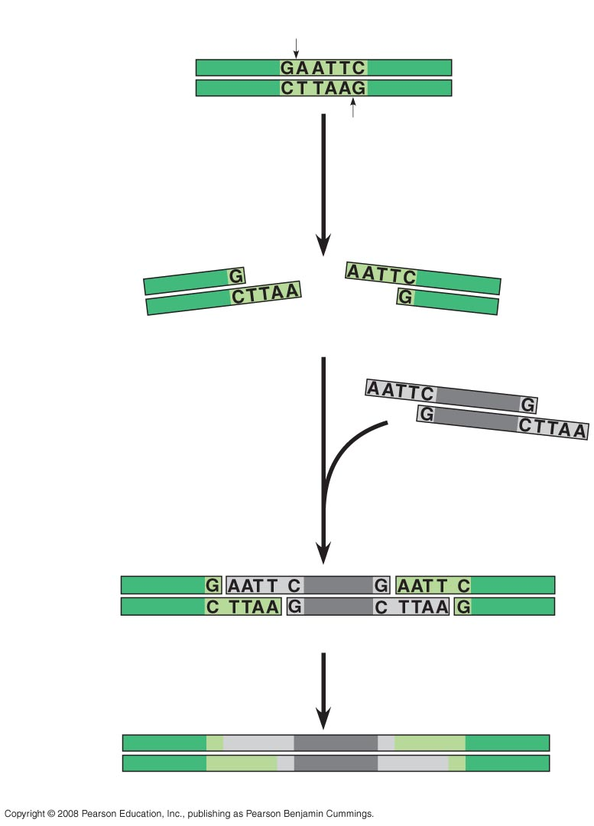
Fig. 20-3-3
Restriction site
DNA
5′
3′
3′
5′
1
Restriction enzyme
cuts sugar-phosphate
backbones.
Sticky end
2
DNA fragment added
from another molecule
cut by same enzyme.
Base pairing occurs.
One possible combination
3
DNA ligase
seals strands.
Recombinant DNA molecule
Notes:
Figure 20.3 Using a restriction enzyme and DNA ligase to make recombinant DNA

Slide 7
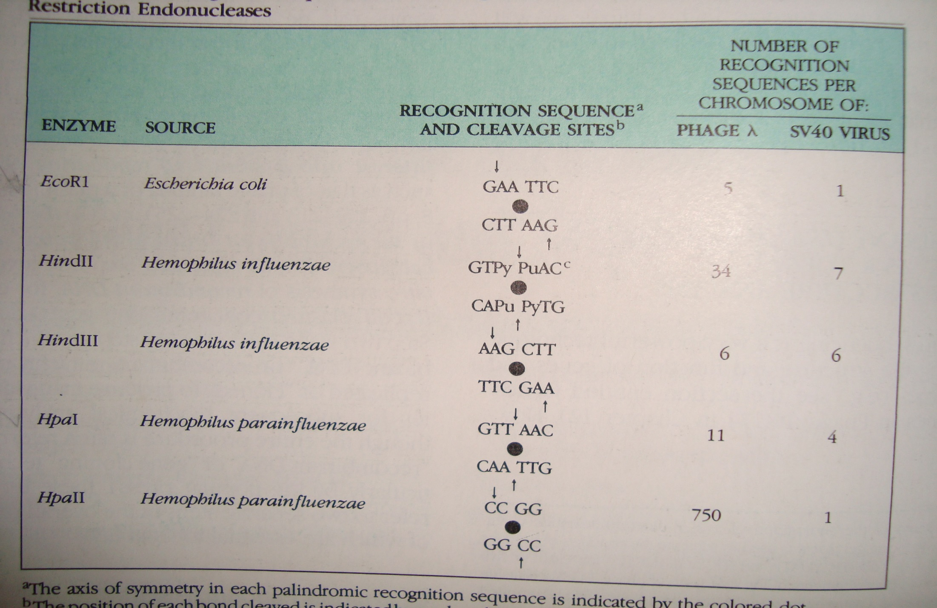
Restriction enzymes are bacterial-based

Slide 8
DNA cloning stage 2: Cloning a eukaryotic gene in a bacterial plasmid
Now we learned about restriction enzymes.
We can take a closer look that how genes are cloned in plasmids
The original plasmid is called a cloning vactor, defined as a DNA molecule that can carry a foreign DNA into a host cell and replicate there
Bacterial plasmids are widely used as cloning vectors for several reasons:
They can be easily isolated from bacteria
Easily manipulated to form recombinant plasmids
Easy introduced back into bacterial cell

Slide 9
DNA cloning stage 3: Producing clones of cells carrying recombinant plasmids
Lets say we are interested to study the β-globin gene in hummingbird
We begin by isolating the hummingbird genomic DNA
We also isolated a plasmid from E. coli cell
The plasmid is engineered to have 1) amp gene an ampicillin resistant gene 2) β-galactosidase coding gene the lac-Z gene, which produce blue product upon hydrolysis of X-gal 3) it has only one restriction site within lac-Z gene

Slide 10
Both the plasmid and the hummingbird DNA are cut with the same restriction enzyme
The DNA fragments are mixed together, so the sticky ends of DNA fragments bind together
We add ligase enzyme to further bind the to DAN fragments together
The DNA mixture is then added to bacteria that have a mutation in lacZ gene, making them unable to hydrolyze X-gal to make blue color
Bacteria are subjected to solid nutrient medium containing ampicillin. The bacteria that have plasmids, will survive, the others will die
The plasmids that contain recombinant DNA will form whit colonies the other bacteria will form blue colonies. Why?

Slide 11
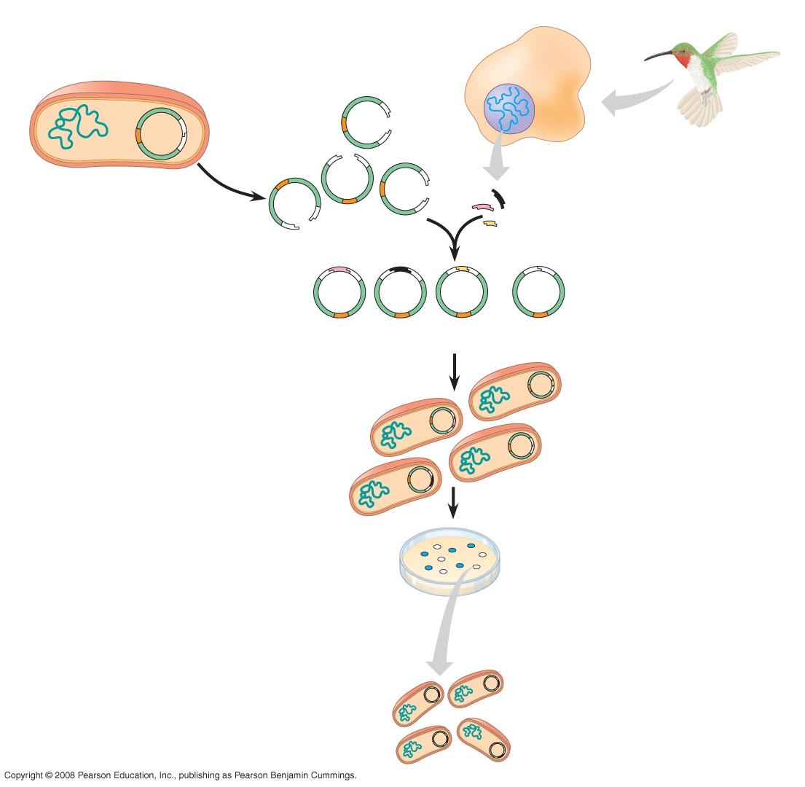
Fig. 20-4-4
TECHNIQUE
Hummingbird
cell
Bacterial cell
lacZ gene
Restriction
site
Sticky
ends
Gene of interest
amp^{R} gene
Bacterial
plasmid
Hummingbird
DNA fragments
Nonrecombinant
plasmid
Recombinant plasmids
Bacteria carrying
plasmids
RESULTS
Colony carrying non-
recombinant plasmid
with intact lacZ gene
Colony carrying recombinant
plasmid with disrupted lacZ gene
One of many
bacterial
clones
Notes:
Figure 20.4 Cloning genes in bacterial plasmids

Slide 12
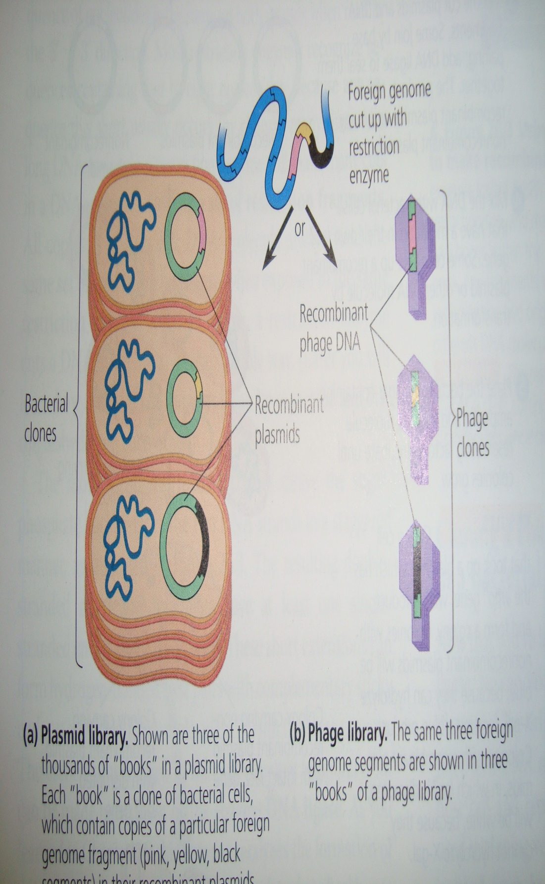
Storing cloned genes in DNA libraries
The cloning procedure described in the last slide is called as “shotgun approach” as whole genome was used to make its multiple copies
Each white colony of bacteria carry recombinant plasmids, which have a same foreign DNA segment
The complete set of plasmid-carrying copies of a particular segment from the initial genome from hummingbird, is referred to as “genomic library”
They can be stored for long period of time at low temperatures (e.g. -10 ºC to -20ºC)
Certain bacteriophages can also be used as cloning vectors
Bacterial plasmids do not carry a foreign DNA larger than 12 kb (kilo bases) while phage virus can carry 25 kb long foreign DNA fragment

Slide 13
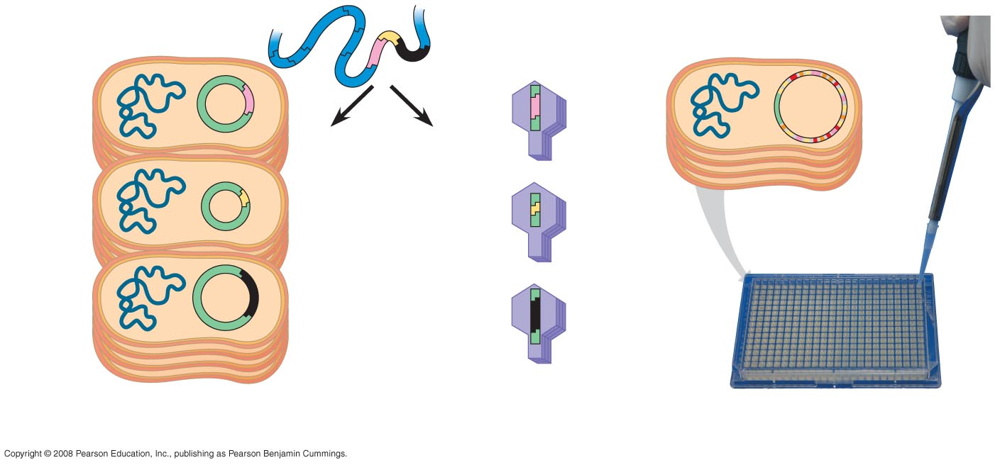
Fig. 20-5
Foreign genome
cut up with
restriction
enzyme
Large insert
with many genes
Large plasmid
or
BAC
clone
Recombinant
phage DNA
Bacterial
clones
Recombinant
plasmids
Phage
clones
(a) Plasmid library
(b) Phage library
(c) A library of bacterial artificial
chromosome (BAC) clones
Notes:
Figure 20.5 Genomic libraries

Slide 14
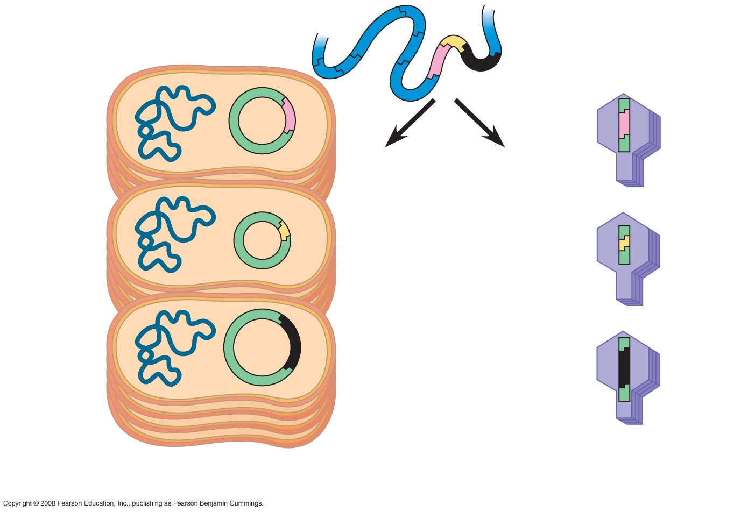
Fig. 20-5a
Foreign genome
cut up with
restriction
enzyme
or
Recombinant
phage DNA
Bacterial
clones
Recombinant
plasmids
Phage
clones
(a) Plasmid library
(b) Phage library
Notes:
Figure 20.5a, b Genomic libraries

Slide 15
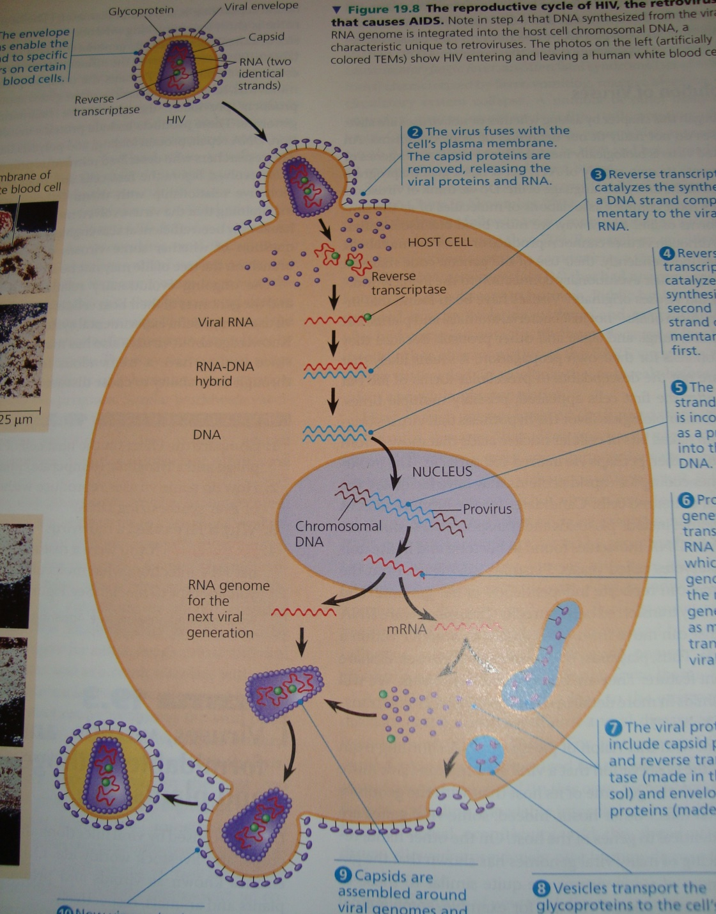
cDNA library
Researchers can make another kind of DNA library my starting with mRNA extracted fom cells
The enzyme “reverse transcriptase” obtained from retroviruses in used in vitro to make single-stranded DNA transcripts of the mRNA molecules

Slide 16
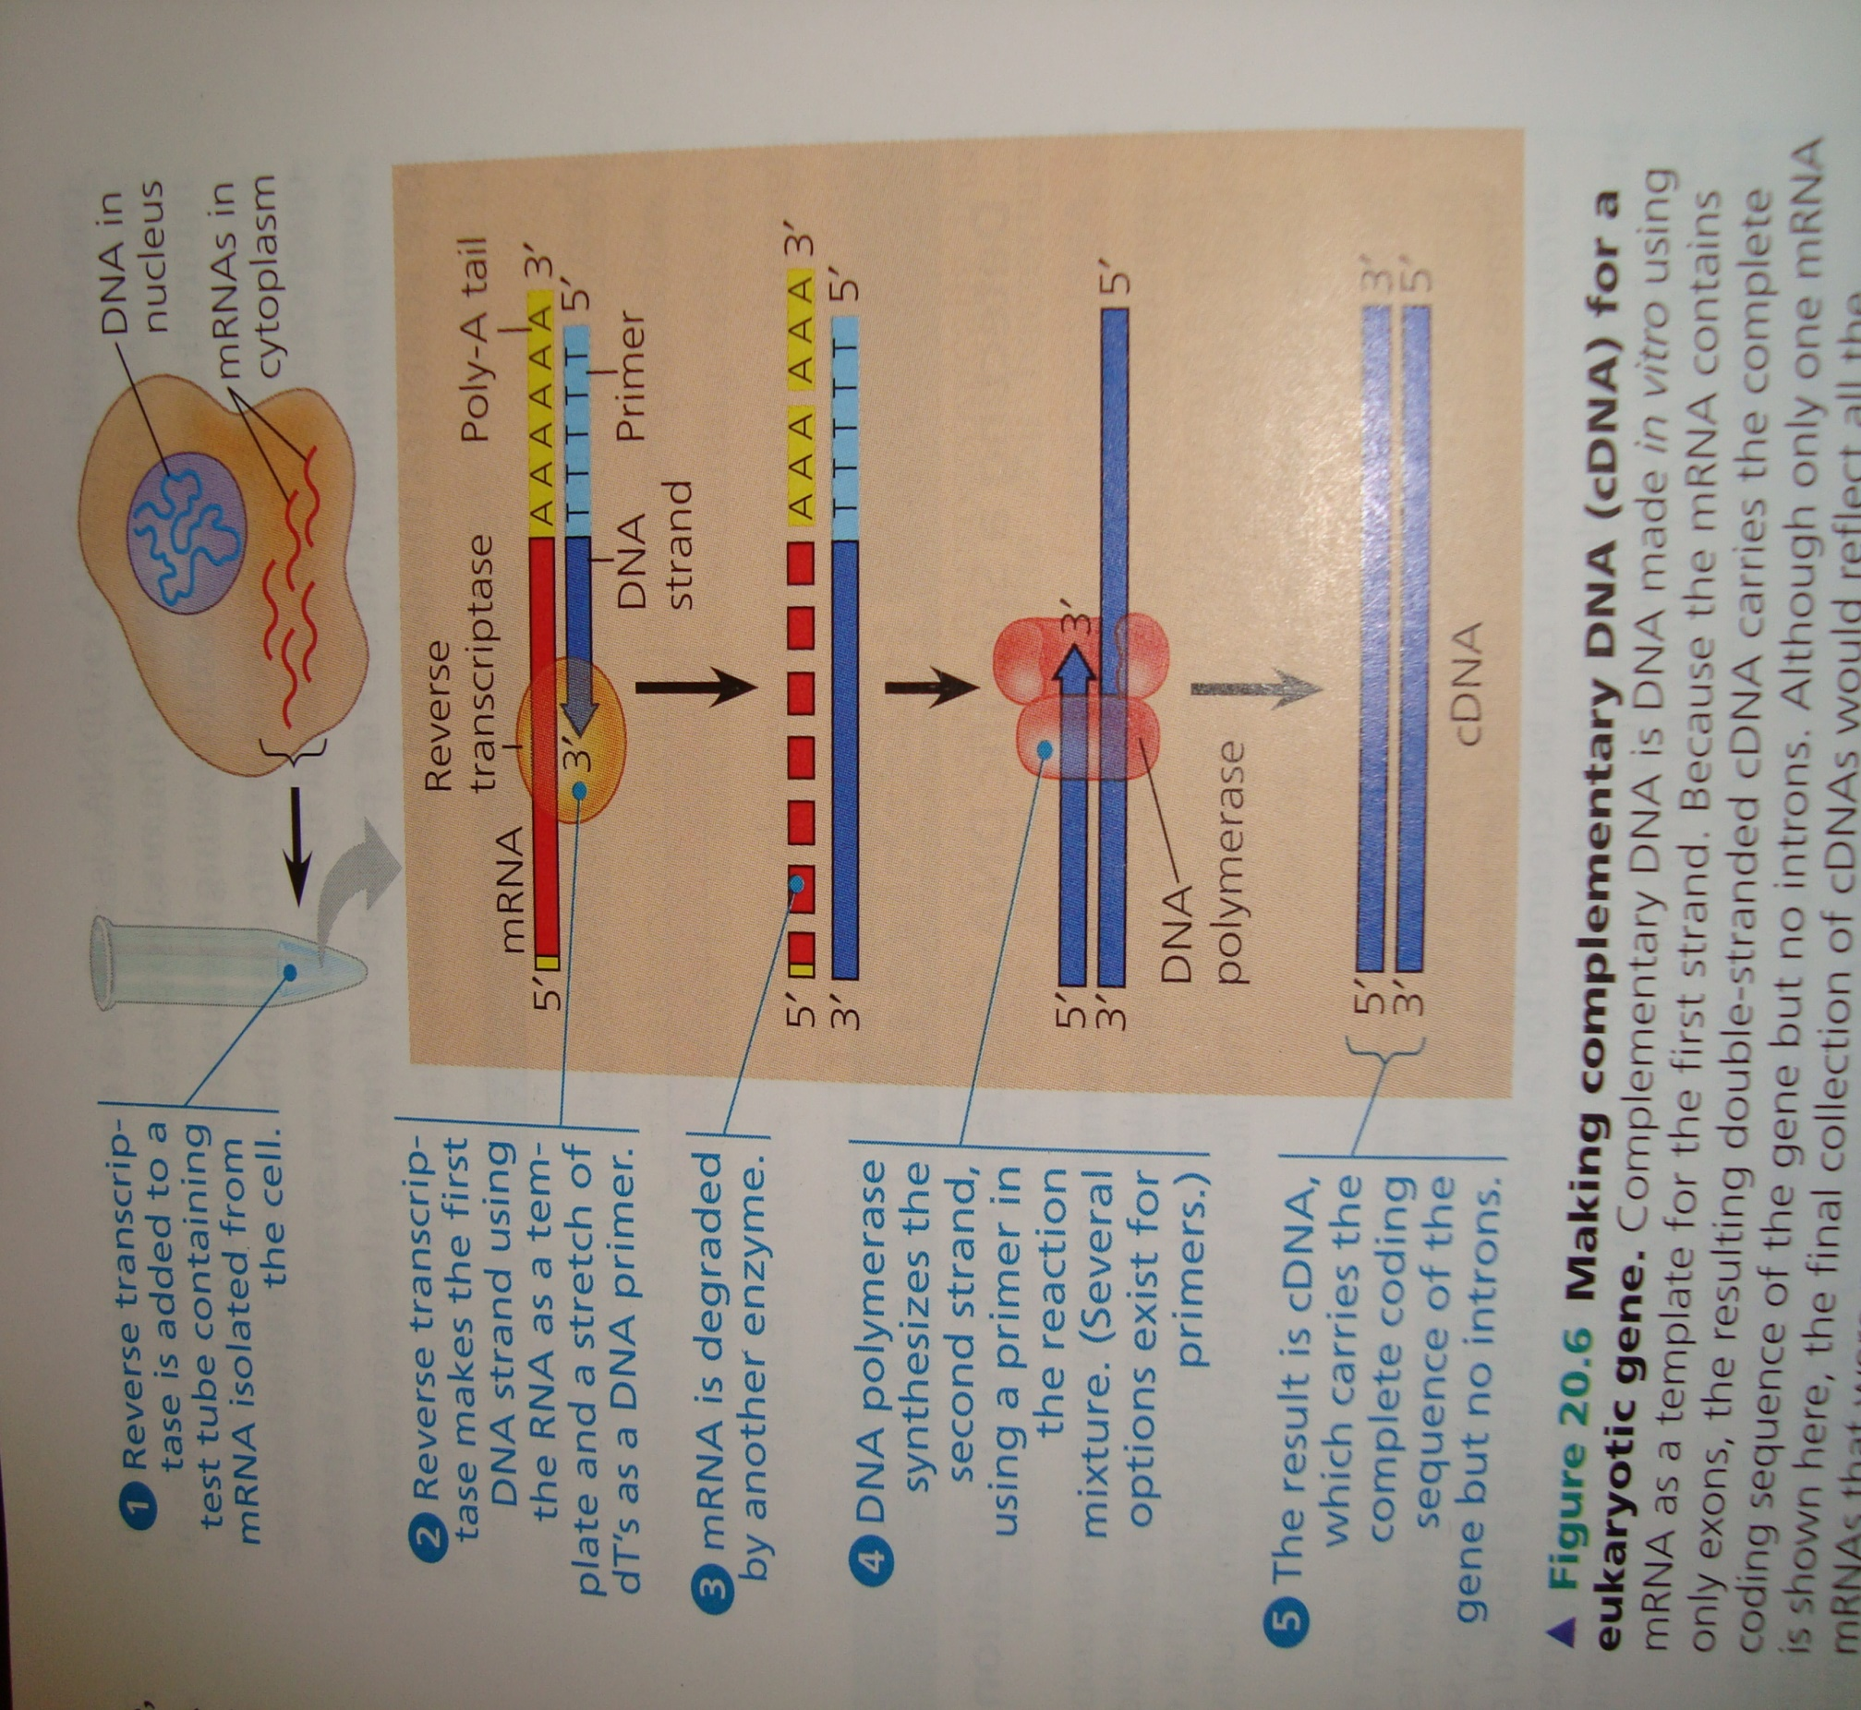
cDNA library
Recall that the 3/ end of mRNA has a stretch of adenine (A) ribonucleotides called poly A-tail.
This feature allows use of a short strand of thymine (dT) deoxyribonucleotides as a primer for reverse transcriptase.
Following enzymatic degradation of the mRNA, a second DNA strand, complementary to the first, is synthesized by DNA polymerase.
For creating a library, the cDNA is modified by the addition of restriction enzyme recognition sequences at each end
Then the cDNA is inserted into vector DNA in a manner similar to insertion of genomic DNA fragments

Slide 17
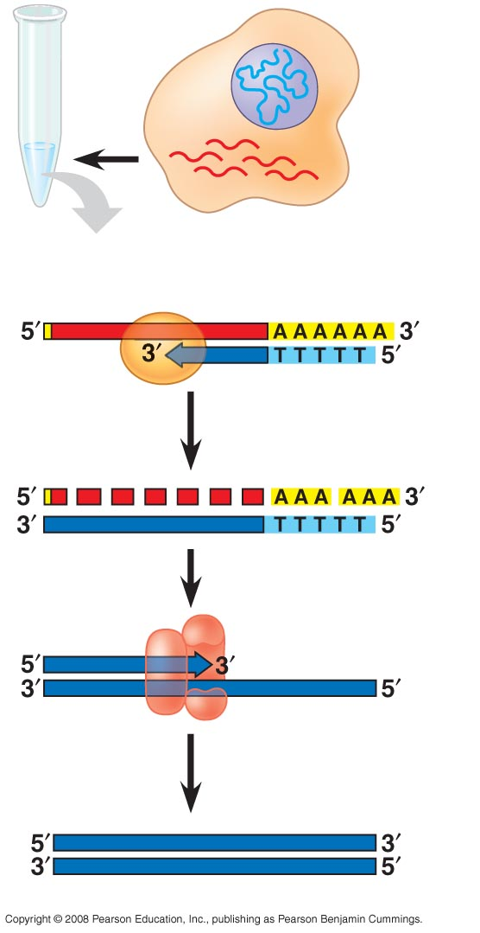
Fig. 20-6-5
DNA in
nucleus
mRNAs in
cytoplasm
Reverse
transcriptase
Poly-A tail
mRNA
DNA
strand
Primer
Degraded
mRNA
DNA
polymerase
cDNA
Notes:
Figure 20.6 Making complementary DNA (cDNA) for a eukaryotic gene

Slide 18
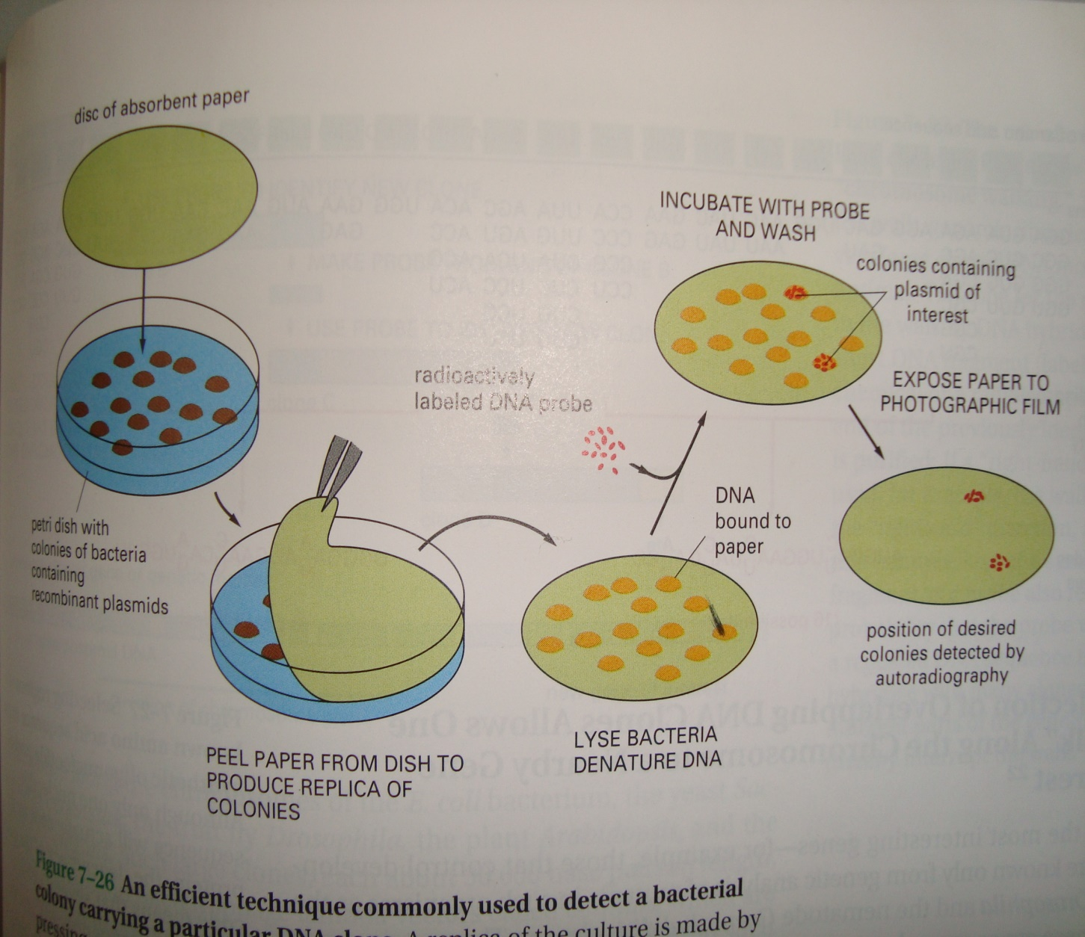
Replica plating and DNA hybradization: an efficient technique commonly used to detect a bacterial colony carrying a particular DNA clone
A replica of the culture is made by pressing a piece of absorbent paper (nylon or nitrocellulose paper) against the surface. This replica is then hybradized to a highly radioactive DNA probe. Those bacterial colonies that have bound the probe are identified by autoradiography

Slide 19
Bacterial cell lysis and DNA denaturation for probe hybridization
The bacterial cell lysis and DNA denaturation can be carried out with 0.5 M NaOH solution. Place the replica nitrocellulose filter paper containing bacterial colonies on the surface of 0.5 N NaOH solution for 7 minutes in a special apparatus.
Replace the NaOH solution with 1.0 M Tris-HCL (pH 7.4) for 1 minute.
Repeat the process one more time and replace this buffer with 1.5 M NaCl, 0.5 M Tris-HCl (pH 7.4) for 1 minute
A 2 mg/ml solution of proteinase K in 1 X SSC (0.15 M NaCl, 0.015 M sodium citrate) is added to just cover the filter.
After 15 min, it is removed by vacuum filtration, and 95% ethanol is similarly passed through the filter. After five washes effected by passing chloroform through the filter, the filter is removed from the apparatus, dipped into 0.3 M NaCl to remove loose cellular debris, and baked at 800 in vacuo for 2 hr.
DNA hybridization
The dry filter is moistened with a 5 X SSC, 50% formamide solution containing the labeled RNA, using 10-15 1A/cm2 of filter. The filter is covered with mineral oil, incubated for 16 hr at 370 to allow hybridization, and then washed for 10 min in a beaker containing chloroform that is gently agitated on a shaking platform. Two more identical chloroform washes are followed by 10 min washes in 6 X SSC, 2 X SSC, and 2 X SSC containing 20 ,ug/ml of pancreatic ribonuclease. If the RNA is 32P-labeled, the filter is blotted to remove excess liquid, covered with Saran Wrap, and placed under Kodak RPS/54 x-ray film for autoradiography.

Slide 20
Advance technique of probing the DNA segment of interest using multiwell plates

Slide 21
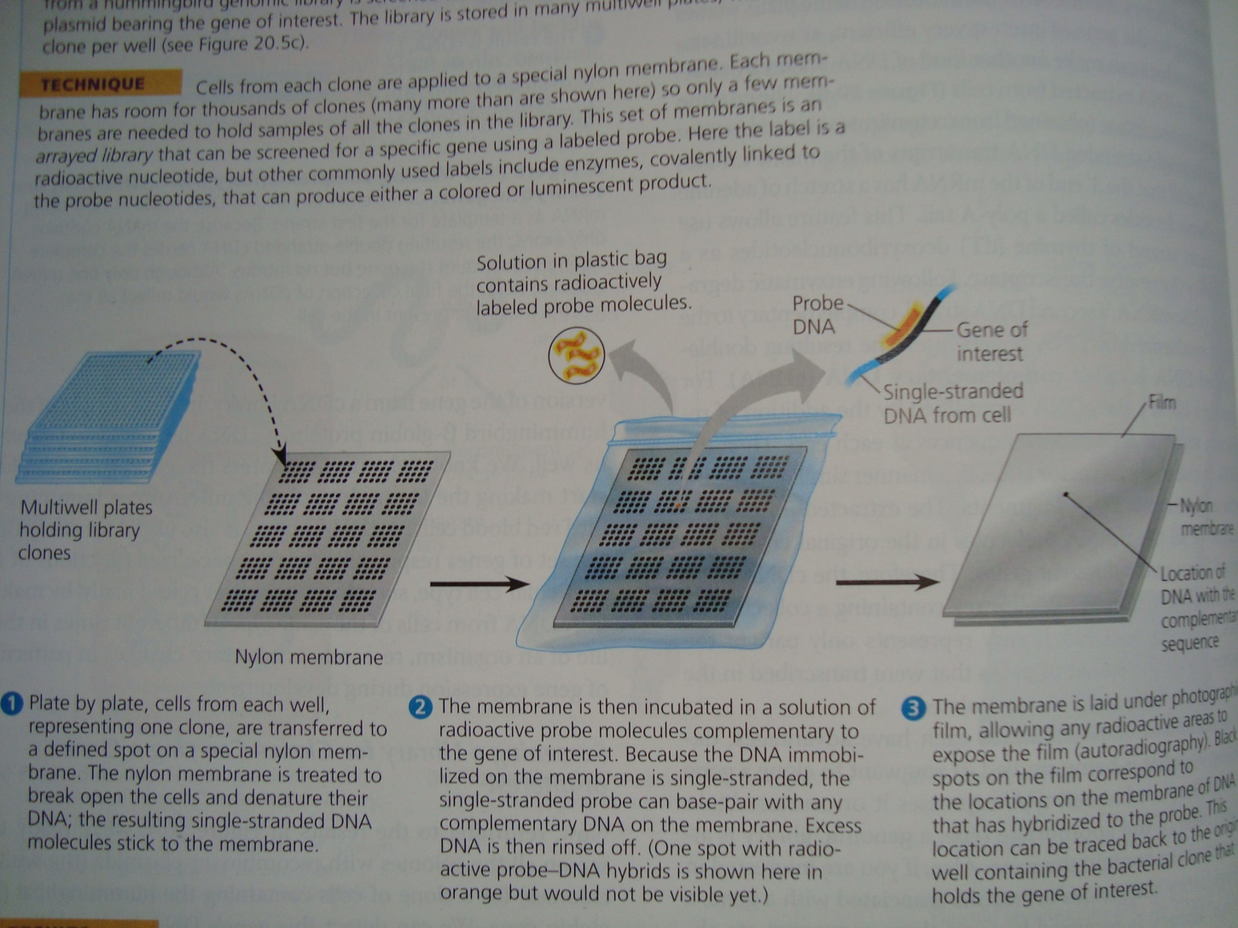

Slide 22
Questions
Define restriction enzymes
Define vector
Define genomic library
Define phage genomic library
Define plasmid genomic library
What is reverse transcriptase?
What is its application in biotechnology?
What is cDNA library?
What advantage a phage genome have over a plasmid for cloning a foreign DNA segment?

Slide 23
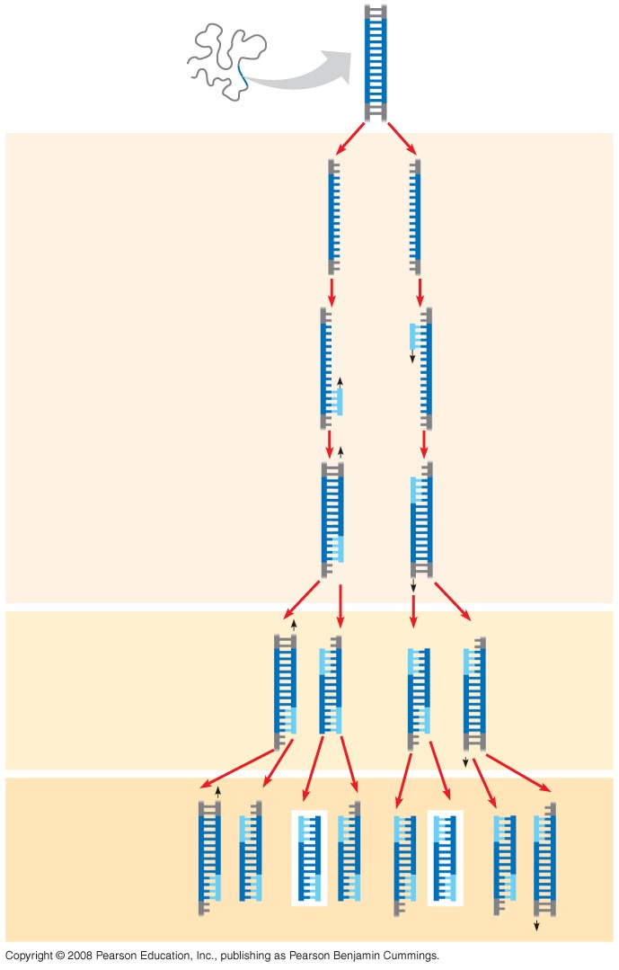
Polymerase chain reaction: a technique for in vitro DNA amplification
TECHNIQUE
5′
3′
Target
sequence
Genomic DNA
3′
5′
DNA isolation
Test tube contain all nucleotides, polymerase enzyme and primer
Denaturation of DNA molecule at ~90oC depending on G-C or A-T quantity
Annealing of primer to DNA at cooling down of test tube
Extension of new stand
Polymerase used in this reaction is a special polymerase obtained fom an archaial bacteria, called a Taq polymerase and is heat resistant
1
Denaturation
5′
3′
3′
5′
2
Annealing
Cycle 1
yields
2
molecules
Primers
3
Extension
New
nucleo-
tides
Cycle 2
yields
4
molecules
Cycle 3
yields 8
molecules;
2 molecules
(in white
boxes)
match target
sequence

Slide 24
Gel electrophoresis is used to separate proteins and nucleic acids of various sizes
This technique uses a gel made of polysaccharide from sea weeds, known as agarose gel
The gel act as a molecular sieve to separate nucleic acids or proteins on the bases of size and electrical charge
Because nucleic acid molecules carry negative charges on their phosphate groups, they all travel toward the positive pole in an electric field
As they move the thicket of polymer fibers impedes longer molecules more than it does shorter ones, separating them by length

Slide 25
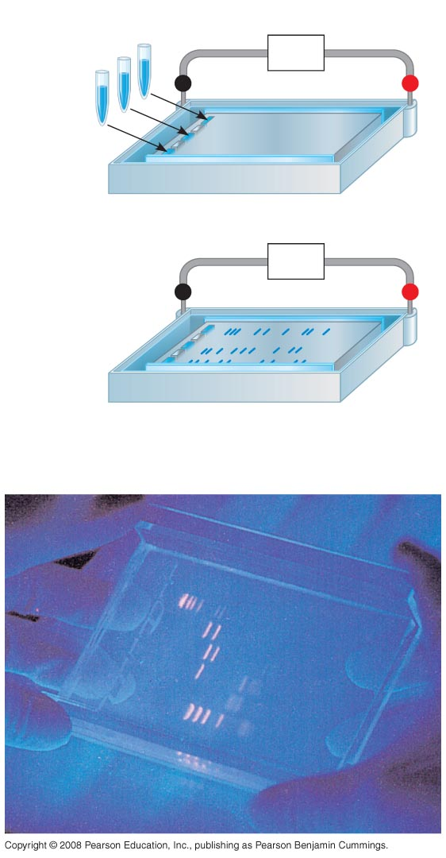
Fig. 20-9
TECHNIQUE
Mixture of
DNA mol-
ecules of
different
sizes
Power
source
–
Cathode
Anode
+
1
Gel
Power
source
–
+
Longer
molecules
2
Shorter
molecules
RESULTS
Notes:
Figure 20.9 Gel electrophoresis

Slide 26
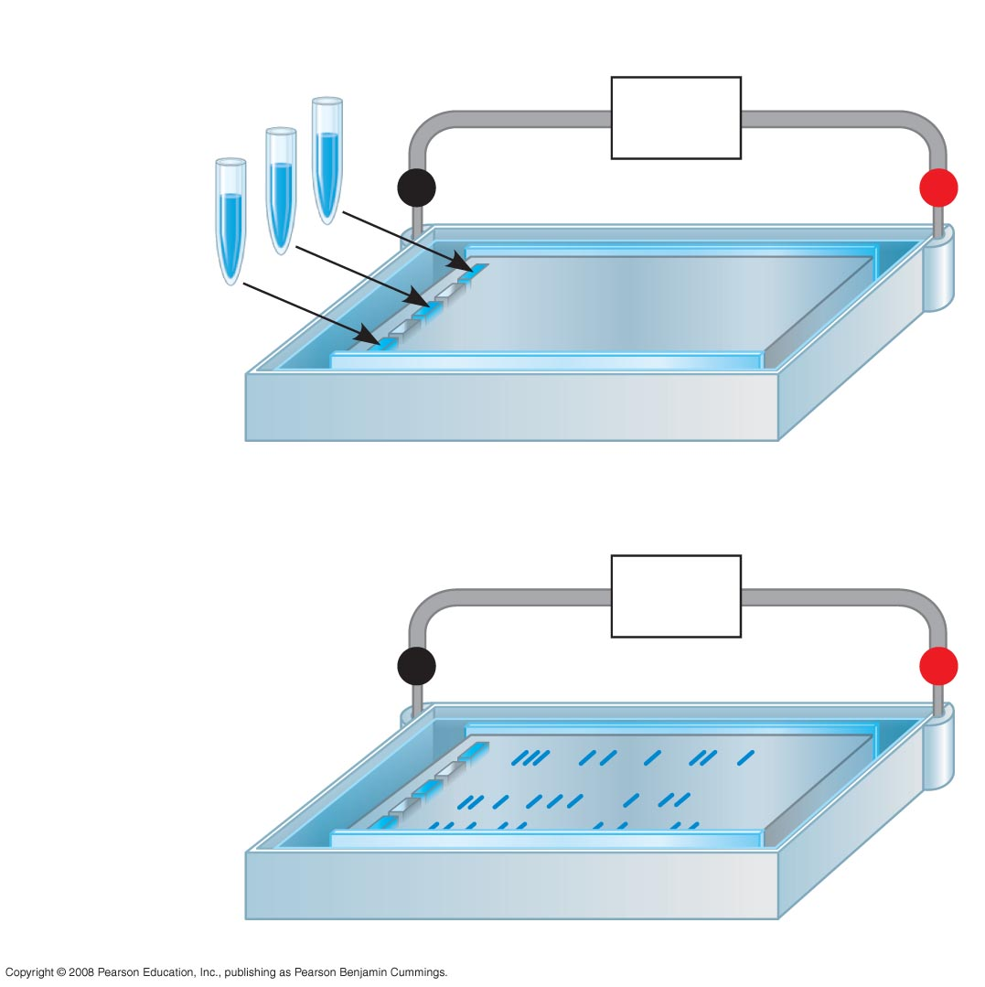
Fig. 20-9a
TECHNIQUE
Mixture of
DNA mol-
ecules of
different
sizes
Power
source
–
Cathode
Anode
+
Gel
1
Power
source
–
+
Longer
molecules
2
Shorter
molecules
Notes:
Figure 20.9 Gel electrophoresis

Slide 27
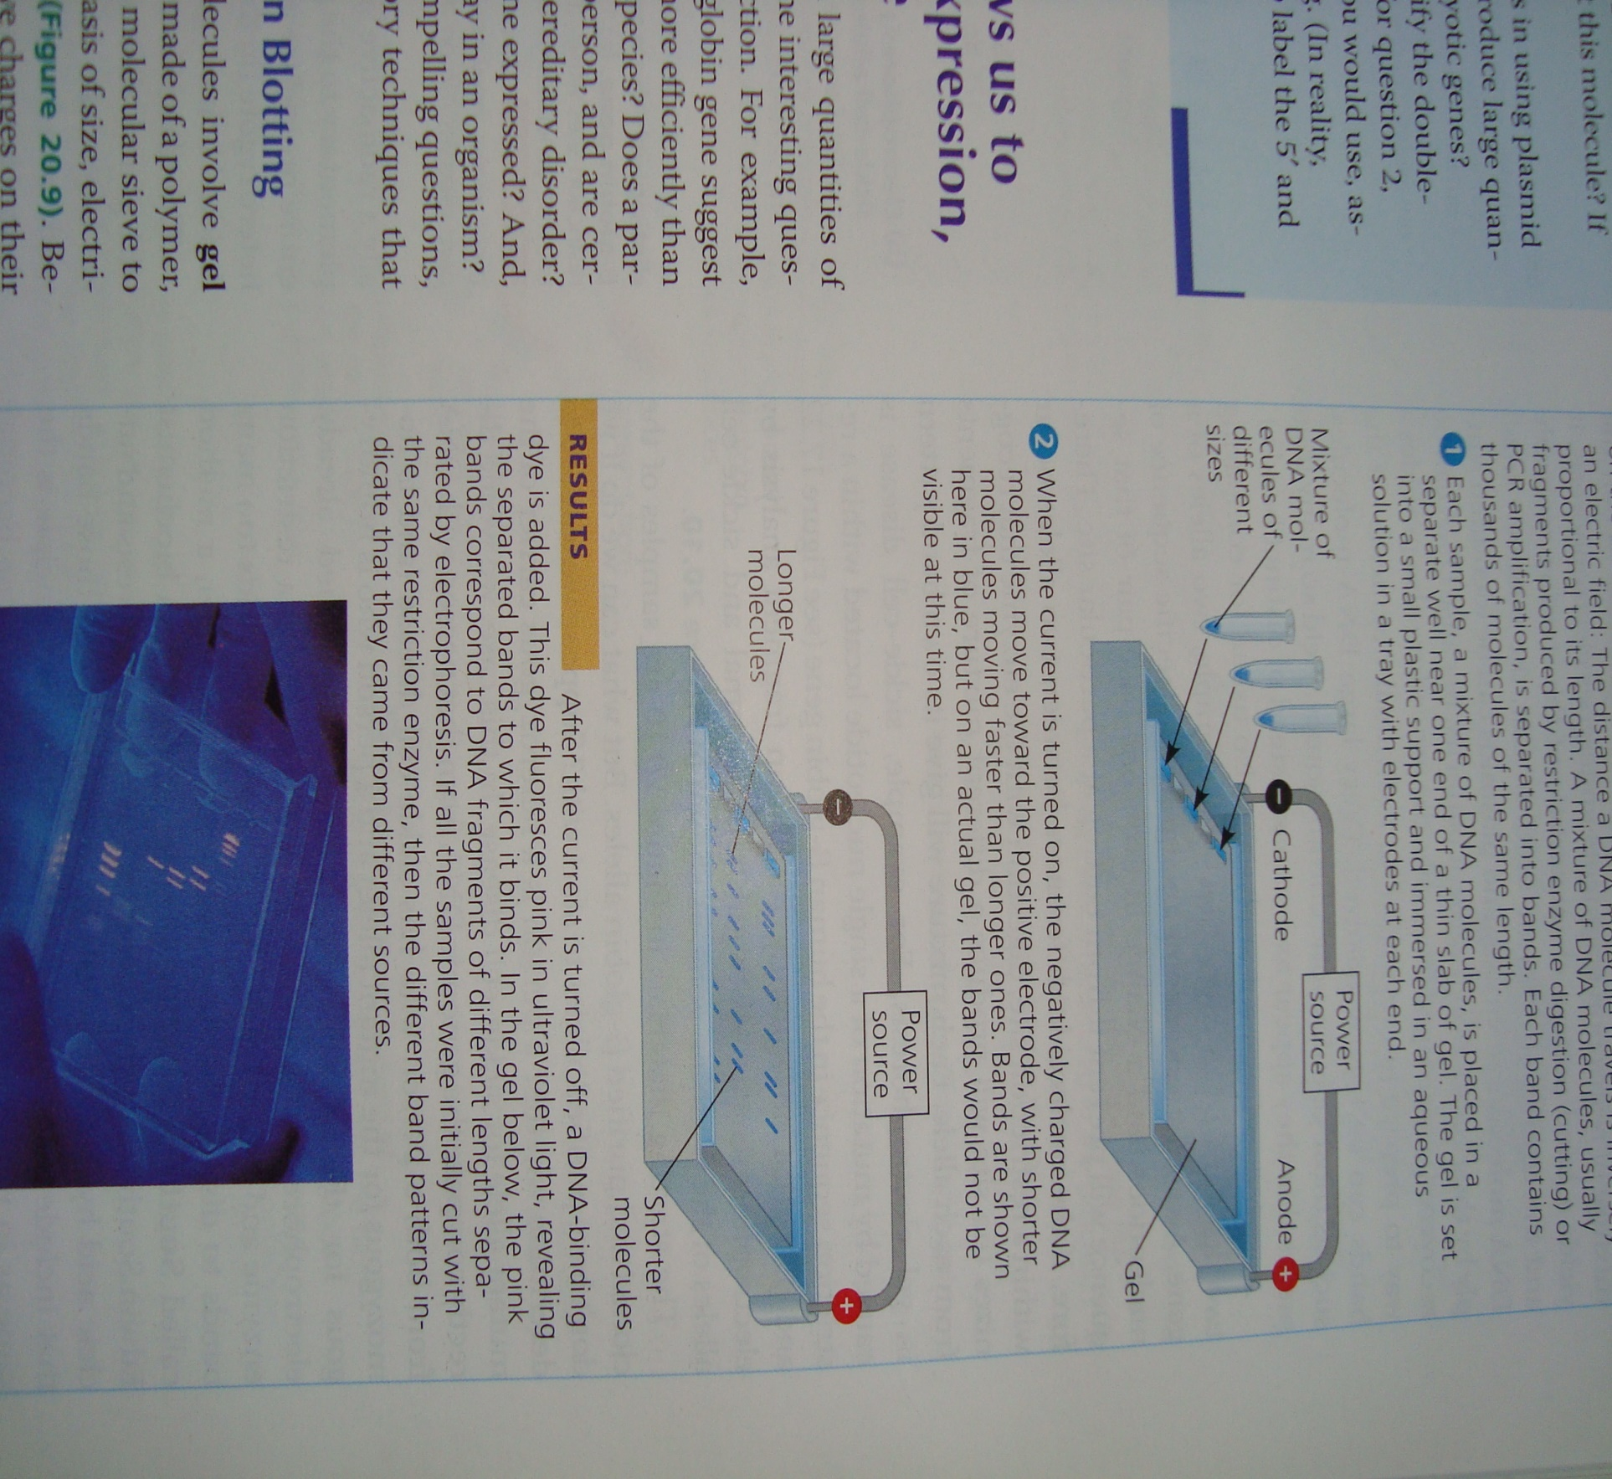

Slide 28
Southern blotting and northern blotting: To detect specific nucleotide sequences within a DNA sample or to identify gene of interest
This technique is the same as probing a DNA segment of interest in a genomic or cDNA library
Replica of RNA or DNA is transferred (blotted) to nitrocellulose paper (nylon paper)
The nylon paper is thereafter transferred to the plastic bag containing DNA probe of the gene of interest
The RNA or DNA complementary to the sequences of probe are hybradized and can be detected with autoradiography
For DNA segment to be detected, it needs to be denatured first prior to hybridization

Slide 29
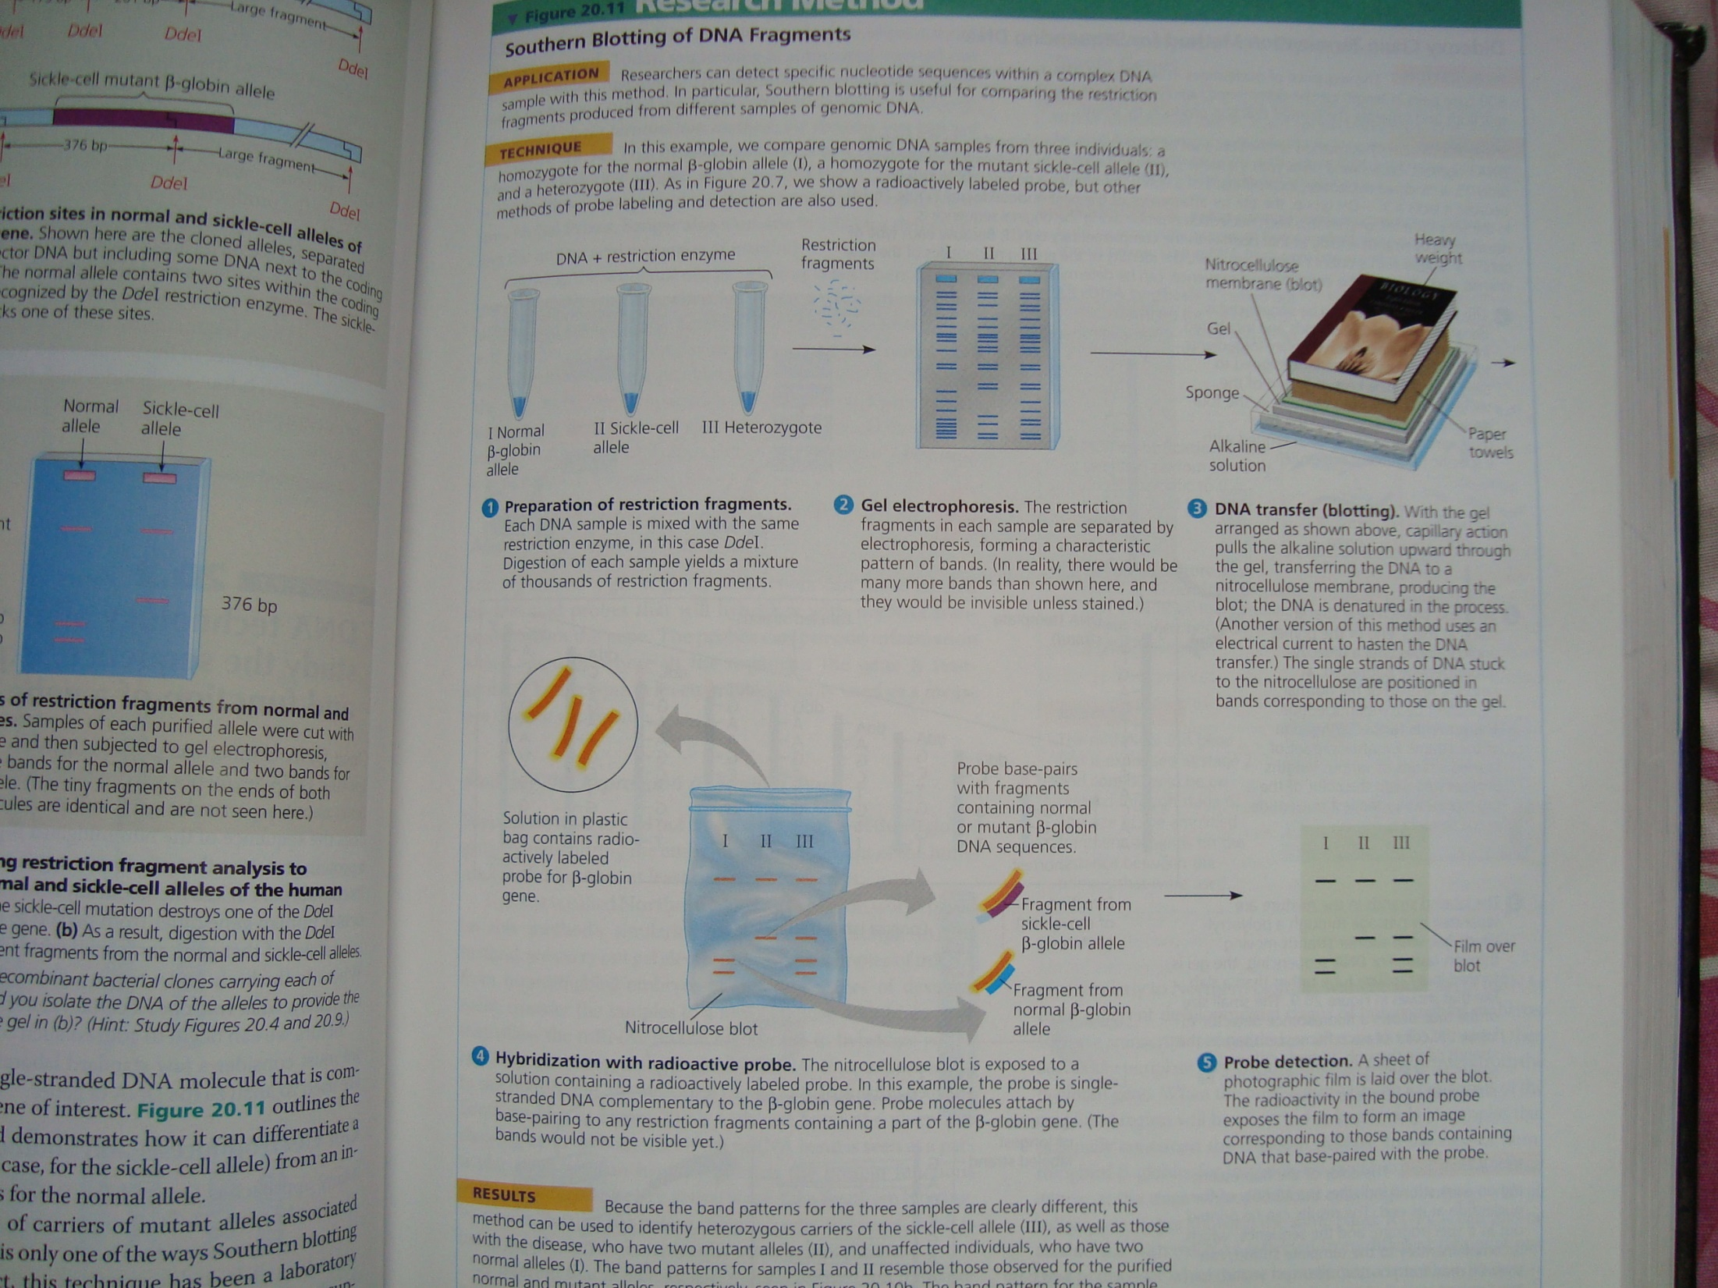

Slide 30
Quiz
Q1. The restriction site for an enzyme called Pvul is the following sequence:
5/-CGATCG-3/
3/-GCTAGC-5/
Staggered cuts are made between the T and C on each strand. What type of bonds are being cleaved?
Q2. One stand of a DNA molecule has the following sequence: 5/-CCTTGACGATCGTACCG-3/
Draw the other strand. Will Pvul cut this molecule? If so draw the products

Slide 31
DNA sequencing: Sanger method
The technique is polymerase chain reaction and gel-electrophoresis based
DNA from a given tissue (e.g. leaf of maize) is separated in four test tubes
the test tubes besides DNA, contain
dATP, dTTP, dGTP and dCTP
Primer
Special flourescent nucleotide of one kind in a given test tube i.e. ddATP or ddTTP or ddGTP or ddCTP, which lacks the 3/OH site that is an attachment site for coming nucleotide
Polymerase enzyme

Slide 32
DNA sequencing: Sanger method
Test tubes are heated to ~90ºC to denature DNA
Test tubes are cool down to ~ 50ºC to anneal primer to DNA
polymerase enzyme will start synthesizing the complementary DNA strand until the given dideoxynucleotide comes to the growing DNA chain
The test tubes after certain period of time (to be sure that DNA replication is done) is subjected to gel-electrophoresis to separate strands
The DNA of a given test tube is poured in a given well of gel labeled according to the kind of ddnucleiotide present

Slide 33
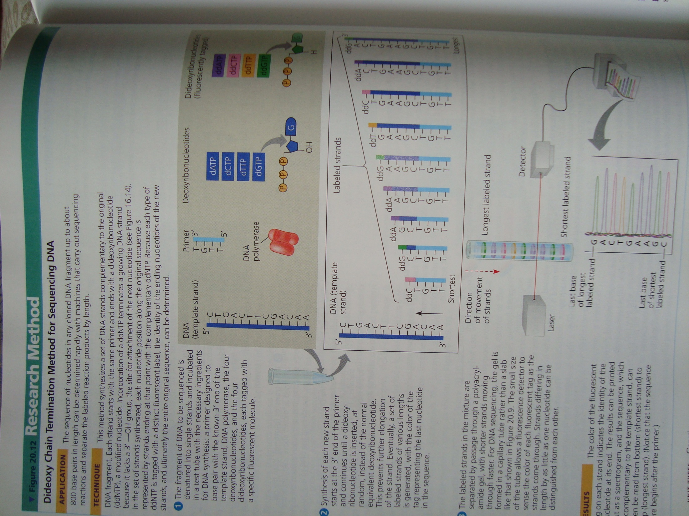

Slide 34
Quiz
What is dideoxiribonucleotide used in Sanger method of DNA sequencing?
Define Taq polymerase and tell about its source and characteristic, which make it unique than other polymerases

Slide 35
Reverse Transcriptase Polymerase Chain Reaction
RT-PCR uses the enzyme “reverse transcriptase” in combination with PCR and gel electrophoresis.
This technique can be used to COMPARE gene expression between samples – for instance, in different embryonic stages, in different tissues, or in the same type of cell under different conditions

Slide 36
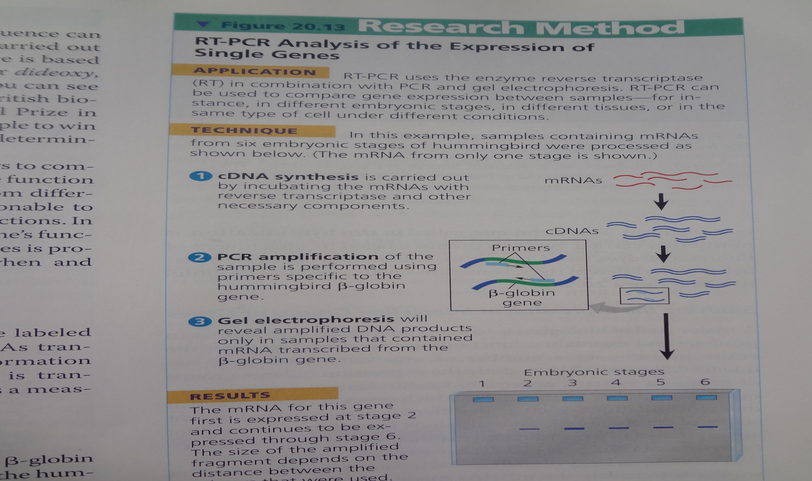

Slide 37
DNA Microarray assay of gene expression level
Applications:
With this method the researchers can test thousands of genes simultaneously to determine which ones are expressed in a particular tissue, under different environmental conditions, in various disease states or at different developmental conditions

Slide 38
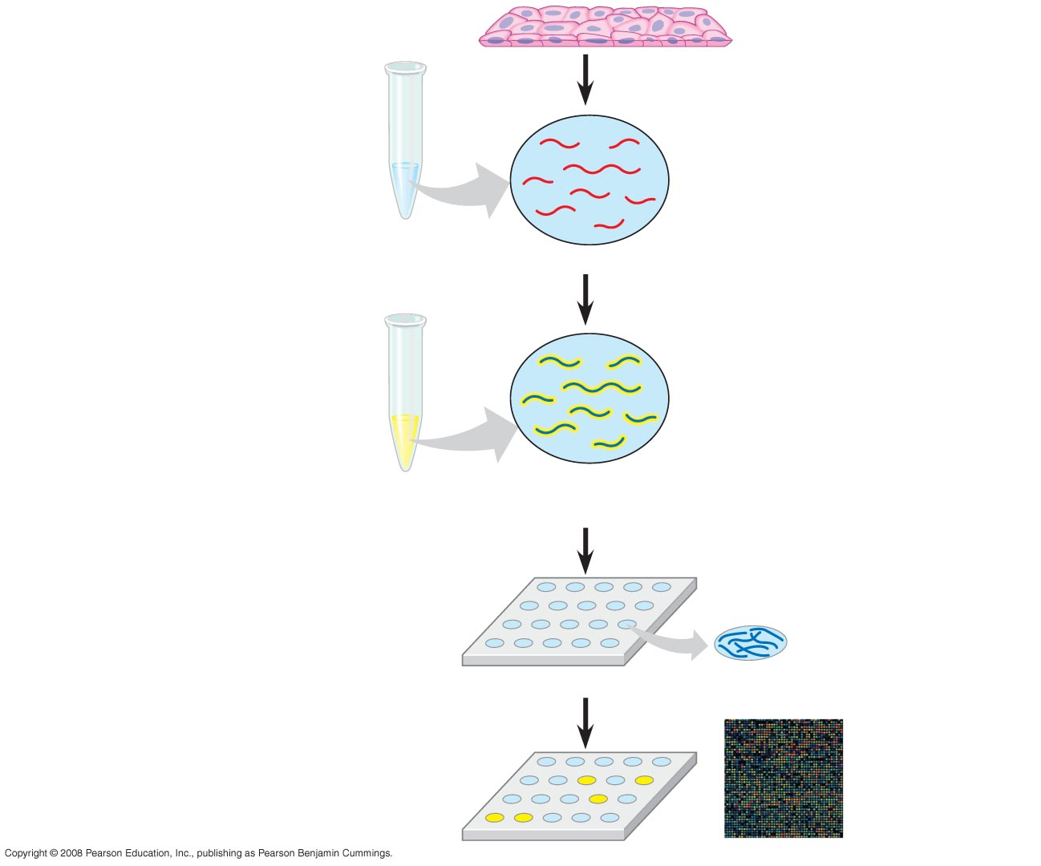
Fig. 20-15
TECHNIQUE
1
Isolate mRNA.
Tissue sample
2
Make cDNA by reverse
transcription, using
fluorescently labeled
nucleotides.
mRNA molecules
Labeled cDNA molecules
(single strands)
3
Apply the cDNA mixture to a
microarray, a different gene in
each spot. The cDNA hybridizes
with any complementary DNA on
the microarray.
DNA fragments
representing
specific genes
DNA microarray
4
Rinse off excess cDNA; scan
microarray for fluorescence.
Each fluorescent spot represents a
gene expressed in the tissue sample.
DNA microarray
with 2,400
human genes
Notes:
Figure 20.15 DNA microarray assay of gene expression levels

Slide 39
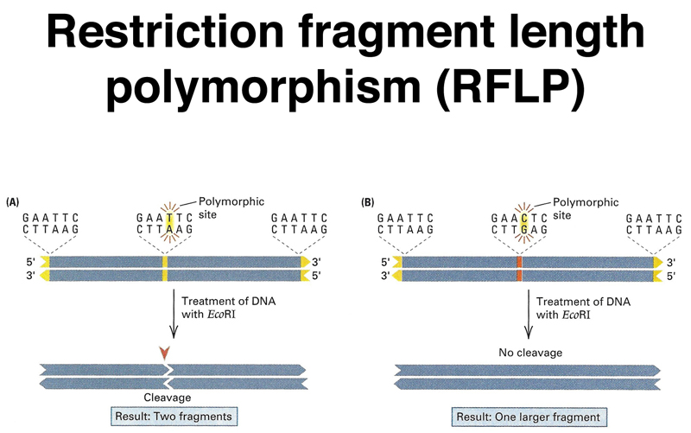
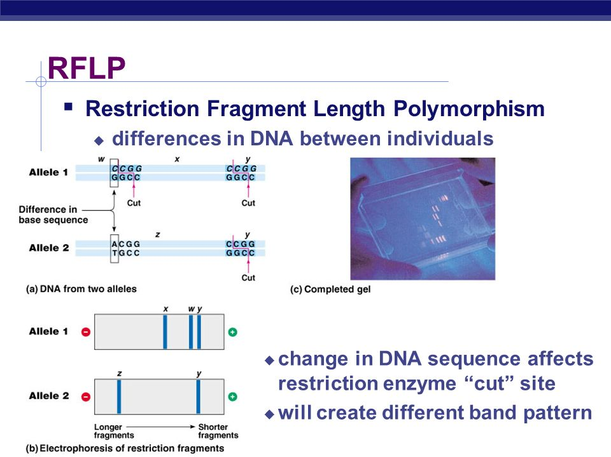
Restriction Fragment Length Polymorphism (RFLP)s
Mutation in the sequence specific for a restriction enzyme will cause elimination of cutting of DNA molecule at that site when subjected to restriction enzyme digestion, resulting in a variable length of DNA fragments when obtained from two individuals.

Slide 40
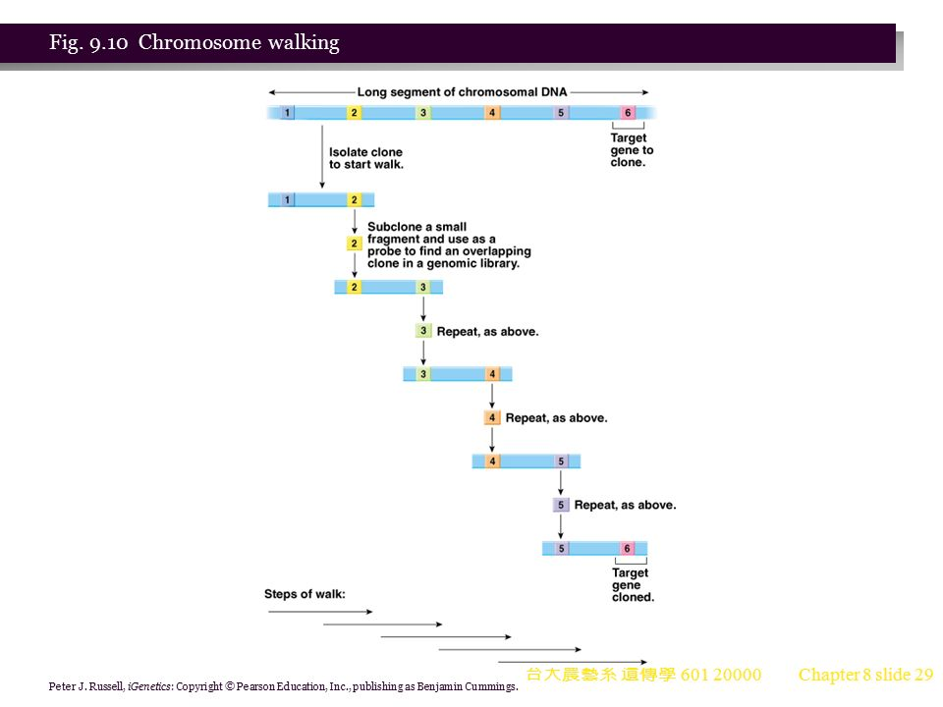
Chromosome walking
Selection of overlapping DNA clones help to “walk” along chromosome to a nearby gene of interest

Slide 41
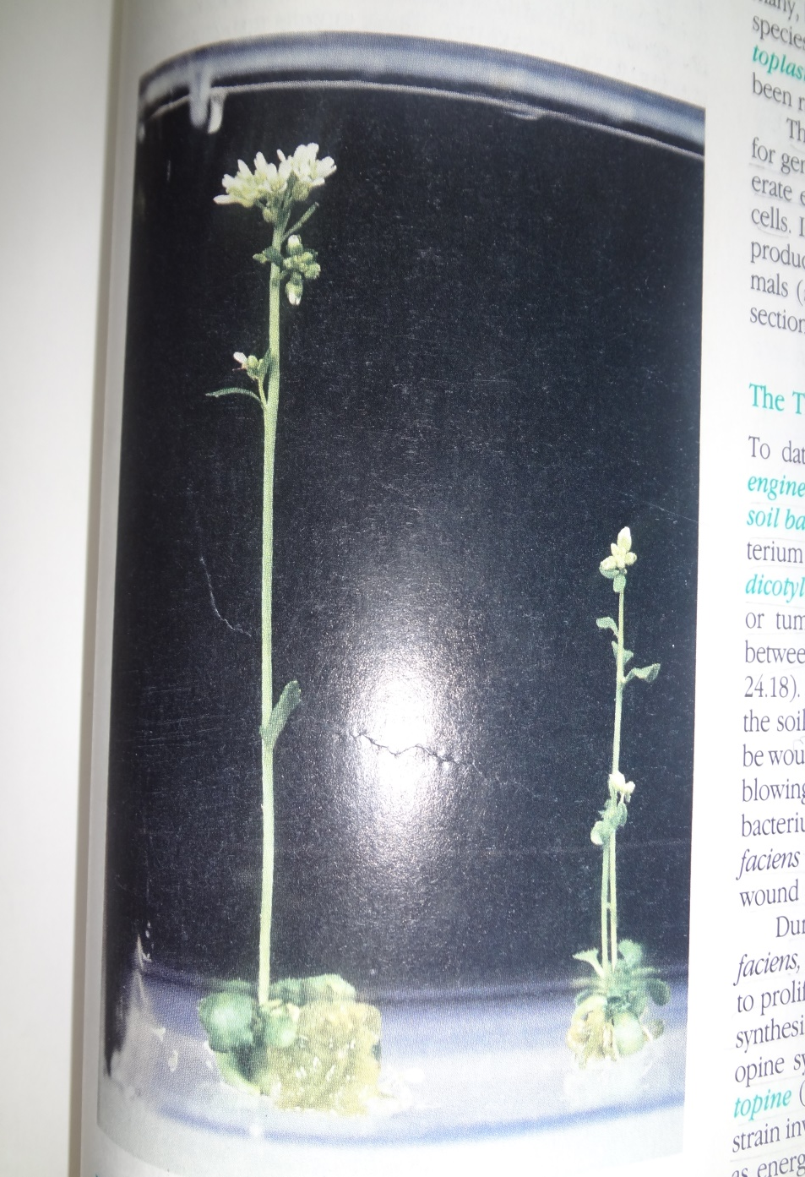
Genetic Modification in Plants
Regeneration of plants from protoplasts and callus tissue
Plant cell have the ability to give rise to any differentiated cell type of the mature plant, this ability is known as totipotency
When excised tissues from mature plants are placed in the appropriate sterile tissue culture conditions (notably in the presence of plant hormon 2,4-dichlorophenoxyacetic acid, 2,4-D), cells in these tissue explants will often dedifferentiate and grow into unorganized cell masses called calli or calluses
If these undifferentiated callus cell-clumps are subsequently (within no longer than a year) transferred to growth medium favoring differentiation (medium lacking 2, 4-D, but containing growth hormones such as kinetin), plantlets will regenerate.
This totipotency of plants is a major advantage for genetic engineering as it allows to regenerate entire plants from “modified somatic cells”.

Slide 42
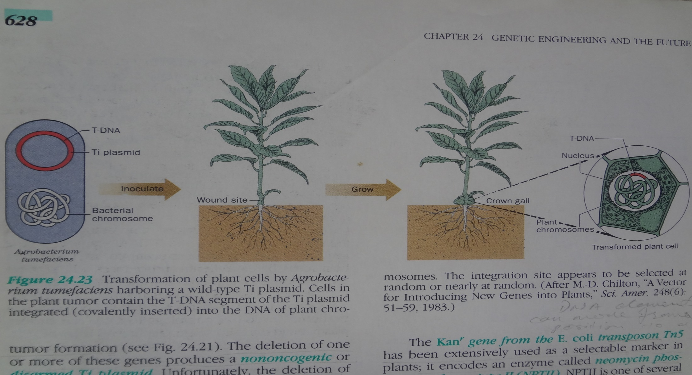
The Ti plasmid of Agrobacterium tumefaciens
A tumefaciens cause a crown gall disease in dicotyledonous plants
Plasmid of this bacterium is known as Ti plasmid, “T” stands for “tumor” and “i” for “inducing”
The T-DNA excise from Ti plasmid and get transformed into plant cell and gets incorporated into any where in any of plant chromosome
T-DNA portion then cause tumor formation in infected plant cell and synthesis of arginine derivative “opine”, which is a nutritive source for A. tumefaciens

Slide 43
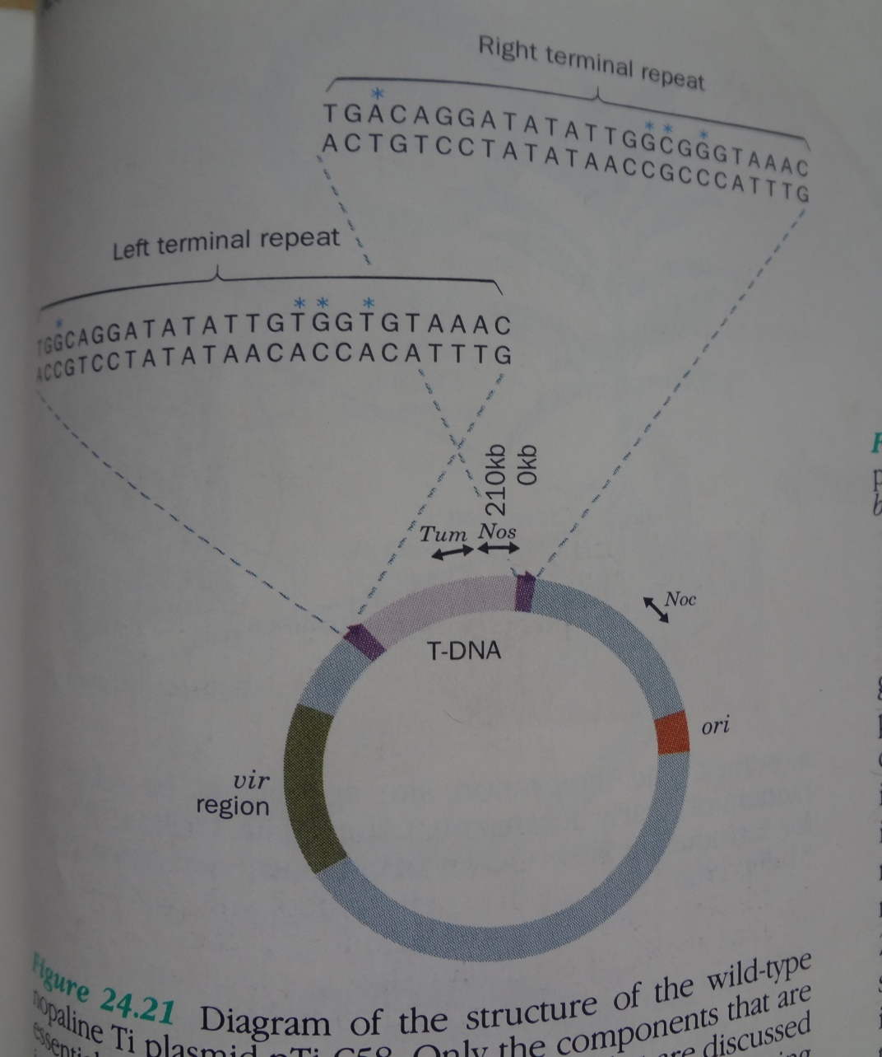
Genetic engineering of plants by using Ti Plasmid
The crown gall disease is controlled by bacterial tumor inducing (Ti) plasmid
The Ti plasmid is used as a tool to insert “gene of interest” into a plant cell
The T-DNA portion if contains the foreign gene, gets incorporated into plant chromosome, making plant chromosome as “transgenic”
The Ti plasmid used for genetic engineering of plants is genetically engineered for not having tumor causing gene(s) (tumor causing genes are deleted)

Slide 44
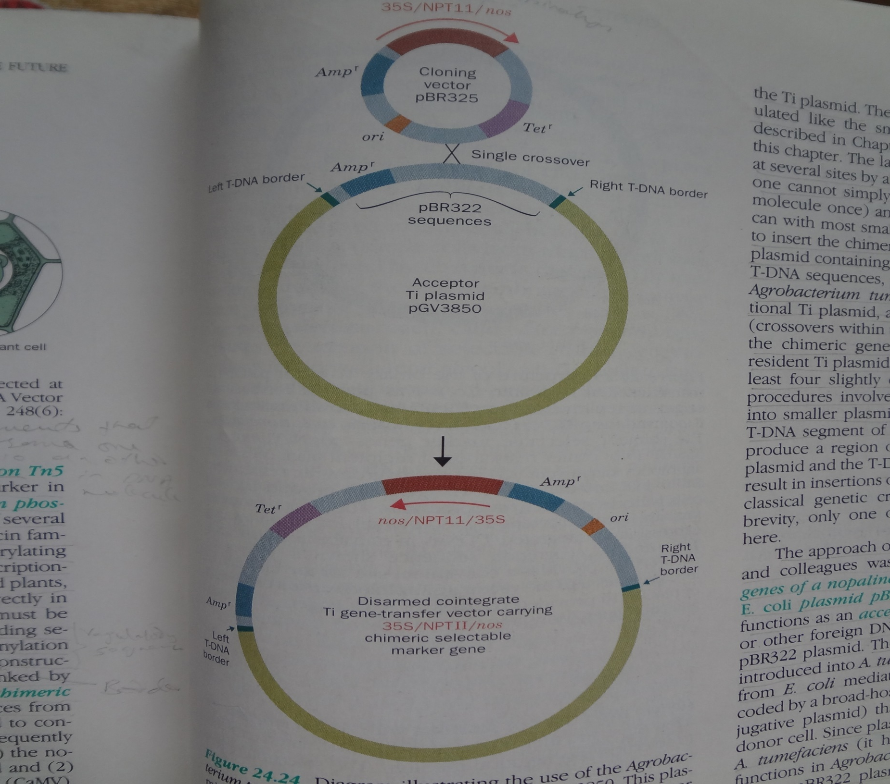
The gene of interest is first inserted into a E. coli bacterial plasmid, which has ampicillin resistant gene, then this E. coli plasmid is inserted into Ti plasmid

Slide 45
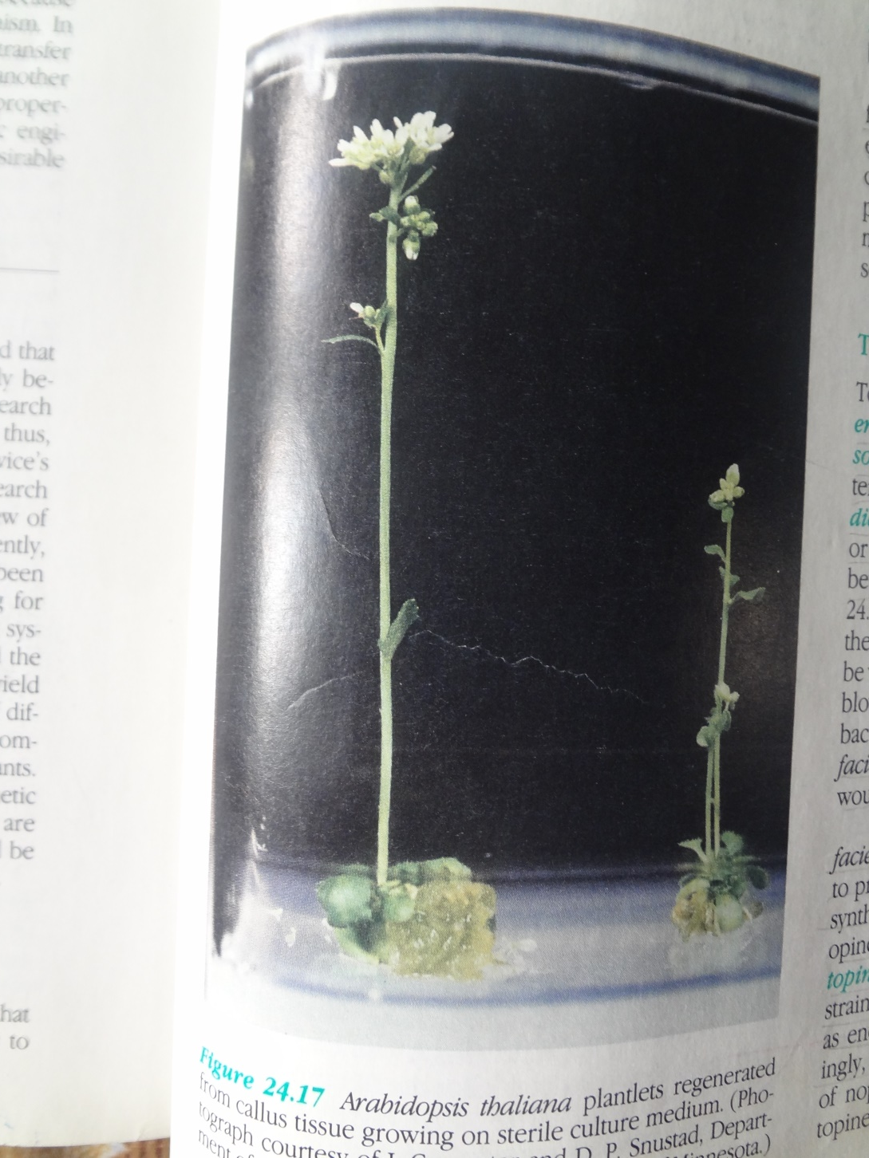
Transfer of Ti plasmid carrying gene of interest into plant cell: Transformation of Ti plasmid by co-cultivation of tissue explants with agrobacterium having Ti plasmid, which carry foreign gene of interest

Slide 46
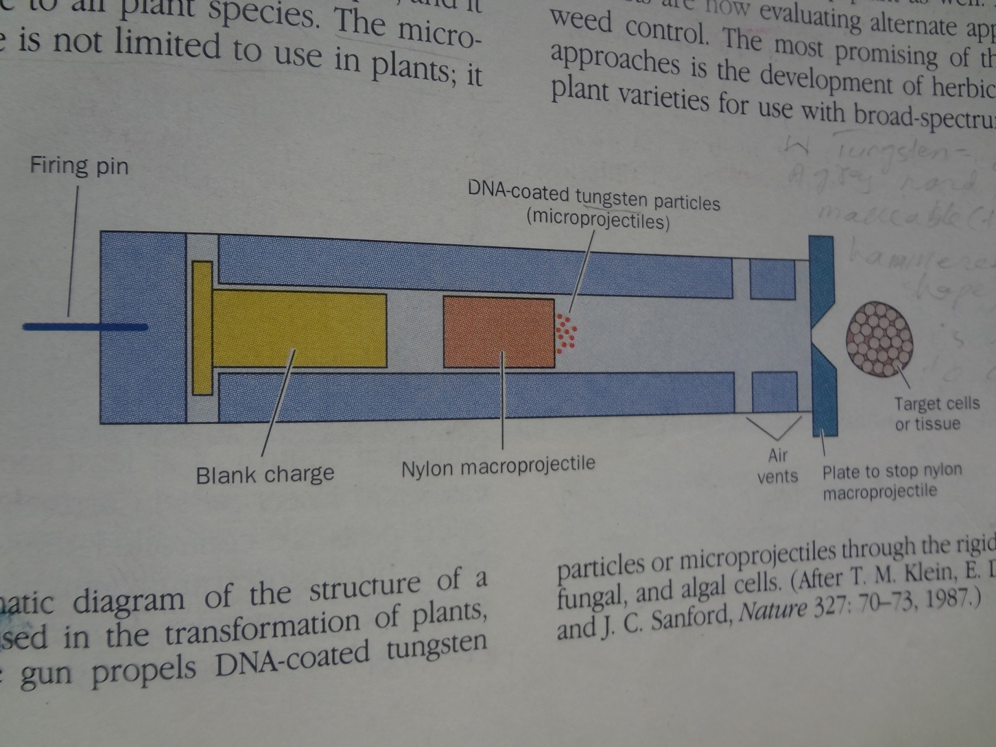
Transfer of Ti plasmid carrying gene of interest into monocotyledonous plant cell: Direct gene transfer (addition of selectable marker genes + polyethylene glycol (which seems to stimulate membrane fusion), electroporation (short pulse of high-intensity electrical current) to make the cell membrane permeable for DNA absorption), and microprojectile guns

Slide 47
