Slide 1
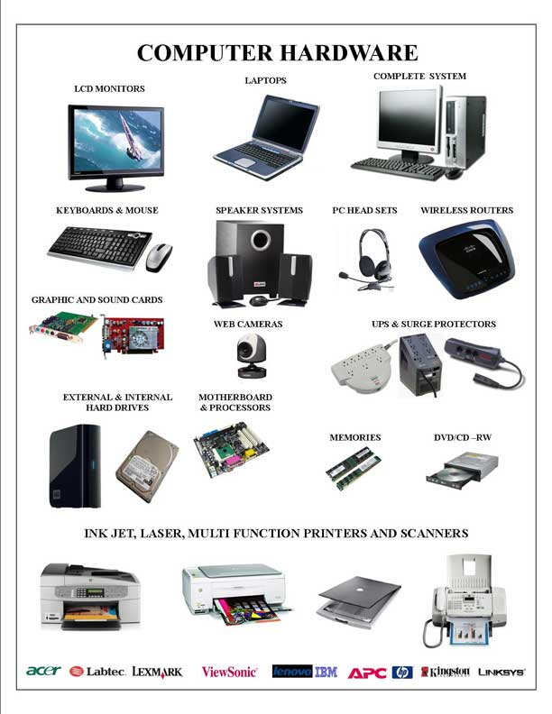
What is Computer Hardware
Computer hardware is the collection of physical elements that constitutes a computer system. Computer hardware refers to the physical parts or components of a computer such as the monitor, mouse, keyboard, computer data storage, hard drive disk (HDD), system unit (graphic cards, sound cards, memory, motherboard and chips), etc. all of which are physical objects that can be touched

Slide 2
Components of Computer Hardware
Input Devices
Output Devices
Storage Devices
CPU
Communication / Network Devices
Computer Motherboard
Power Supply

Slide 3
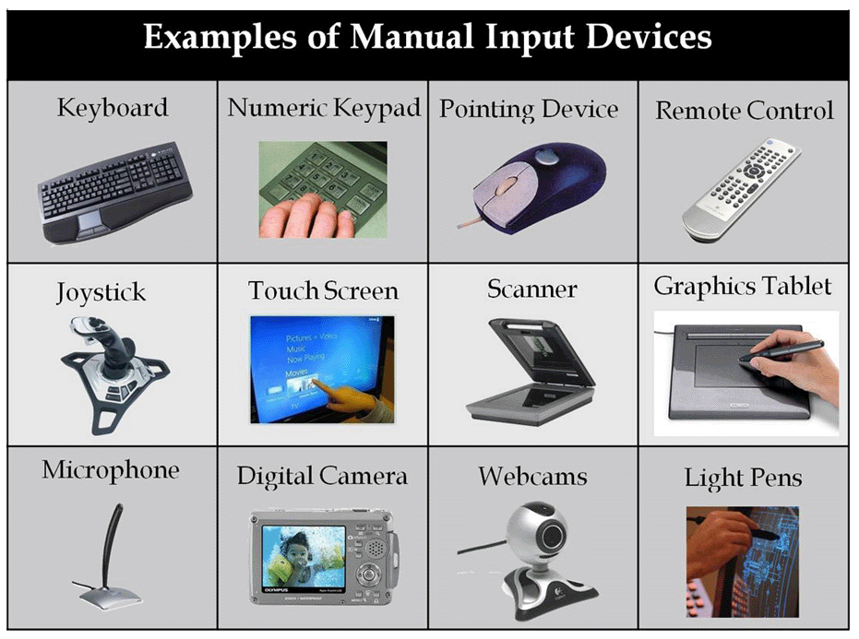
Input Devices
An input device is any hardware device that sends data to a computer, allowing users to interact with and control it. The picture shows the a Logitech trackball mouse; an example of an input device. Below is a listing of different computer input devices that can be used on a computer.

Slide 4
Types of Input Devices
Audio conversion device
Barcode reader
Biometrics (e.g. fingerprint scanner)
Business Card Reader
Digital camera and Digital Camcorder
Electroencephalography (EEG)
Finger (with touchscreen or Windows Touch)
Gamepad, Joystick, Paddle, Steering wheel, and Microsoft Kinect
Graphics tablet
Keyboard
Light gun and light pen scanner
Magnetic ink (like the ink found on checks)
Magnetic-stripe reader
Medical imaging devices (e.g., X-Ray, CAT Scan, and Ultrasound images)
Microphone (using voice speech recognition or biometric verification)
MIDI keyboard
MICR
Mouse, touchpad, or other pointing device
Optical Mark Reader (OMR)
Paddle
Pen or Stylus
Punch card reader
Remote
Scanner
Sonar imaging devices
Touch screen
Video capture device
VR helmet and gloves
Webcam
Yoke

Slide 5
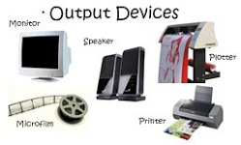
Output Devices
An output device is any peripheral that receives or displays output from a computer. The picture shows an inkjet printer, an output device that can make a hard copy of anything being displayed on a monitor. Below is a listing of all the different computer output devices used with a computer.

Slide 6
Types of Output Devices
3D Printer
Braille reader (For Blinds)
Flat panel (LED, LCD)
GPS
Headphones
Computer Output Microfilm (COM)
Monitor
Plotter
Printer
Projector
Sound card
Speakers
Speech-generating device (SGD)
TV
Video card

Slide 7
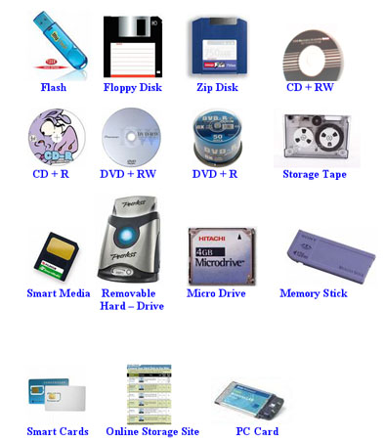
Storage Devices
Alternatively referred to as storage, storage media, or storage medium, a storage device is any hardware capable of holding information. There are two types of storage devices used in computers; a primary storage device, such as RAM, and a secondary storage device, like a hard drive. Secondary storage can be a removable, internal, or external storage.
Without a storage device, your computer would not be able to save any settings or information and would be considered a dumb terminal

Slide 8
Types of Computer Storage Devices
Floppy diskette
CD-ROM disc
CD-R and CD-RW disc
Cloud storage
DVD-R, DVD+R, DVD-RW, and DVD+RW disc
Jump or USB flash drive
Hard drive
Memory card
Memory stick
Network media
Tape cassette
Zip diskette

Slide 9
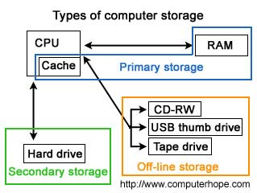
Primary storage device
Alternatively referred to as internal memory, main memory, and primary memory, primary storage is a storage location that holds memory for short periods of times while the computer running. For example, computer RAM and cache are both examples of a primary storage device. This storage is the fastest memory in your computer and is used to store data while it's being used. For example, when you open a program data is moved from the secondary storage into the primary storage.

Slide 10
Secondary Storage Devices
Alternatively referred to as external memory and auxiliary storage, secondary storage is a storage medium that holds information until it is deleted or overwritten regardless if the computer has power. For example, a floppy disk drive and hard drive are both good examples of secondary storage devices. As can be seen by the picture below there are three different storage on a computer, although primary storage is accessed much faster than secondary storage because of the price and size limitations secondary storage is used with today's computers to store all your programs and your personal data.

Slide 11
Off-line Storage Devices
Term used to describe any storage that is removable and cannot be accessed by the computer once removed. A good example of off-line storage is a floppy disk. Off-line storage allows a user to store information that will not be affected by computer viruses or hardware failure.
Although off-line storage could be considered secondary storage, we've separated these into their own category because this media can be easily removed from the computer and stored elsewhere.

Slide 12
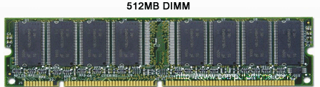
What is Memory
Computer memory is any physical device capable of storing information temporarily or permanently. For example, Random Access Memory (RAM), is a type of volatile memory that is stores information on an integrated circuit, and that is used by the operating system, software, hardware, or the user. Below is an example picture of a 512MB DIMM computer memory module.

Slide 13
Volatile vs. non-volatile memory
Memory can be either volatile and non-volatile memory. Volatile memory is a temporary memory that loses its contents when the computer or hardware device loses power. Computer RAM is a good example of a volatile memory and is why if your computer freezes or reboots when working on a program you lose anything that hasn't been saved. Non-volatile memory, sometimes abbreviated as NVRAM, is memory that keeps its contents even if the power is lost. EPROM is a good example of a non-volatile memory.

Slide 14
Memory is not disk storage
It is very common for new computer users to be confused by what parts in the computer are memory. Although both the hard drive and RAM are considered memory, it is more appropriate to refer to RAM as "memory" or "primary memory" and a hard drive as "storage" or "secondary storage" and not memory.
When a program such as your Internet browser is open, it is loaded from your hard drive and placed into RAM, which allows that program to communicate with the processor at higher speeds. Anything you save to your computer such as a picture or video is sent to your hard drive for storage.
When someone asks how much memory is in your computer, it is likely between 1GB and 8GB of Random Access Memory (RAM) and several hundred Gigs of hard disk drive memory (storage). In other words, You will almost always have more hard drive space than RAM.

Slide 15
What is RAM
Alternatively referred to as main memory, primary memory, or system memory, Random Access Memory (RAM) is a computer storage location that allows information to be stored and accessed quickly from random locations within DRAM on a memory module. Because information is accessed randomly instead of sequentially like a CD or hard drive the computer can access the data much faster than it would if it was only reading the hard drive. However, unlike ROM and the hard drive RAM is a volatile memory and requires power in order to keep the data accessible, if power is lost all data contained in memory lost.
As the computer loads parts of the operating system and drivers are loaded into memory, which allows the CPU to process the instructions much faster and your computer to load faster. After the operating system has loaded, each program you open such as the browser you're using to view this page is loaded into memory while it is running. If too many programs are open the computer will swap the data in the memory between the RAM and the hard disk drive.
Over the evolution of computers there has been different variations of RAM used in computer. Some of the more common examples are DIMM, RIMM, SIMM, SO-DIMM, and SOO-RIMM. Below is an example image of a 512MB DIMM computer memory module and what the typical desktop computer memory card will look like. This memory module would be installed into memory slots on the motherboard.

Slide 16
SD, DDR, DDR2 & DDR3 RAM Comparison
SD, DDR, DDR2 and DDR3 are all different types of RAM (Random Access Memory). RAM is a kind of computer memory that temporarily stores information, improving your systems performance. Or in other words RAM simply holds data for the processor. The processor also has its own memory known as the L2 cache, the cache lies between the processor and the RAM. The processor sends and retrieves data from this cache, when this cache overflows data is sent to the RAM.
There are mainly four types of RAM; SD, DDR, DDR2 and DDR3. They differ in the way they operate and mainly in their operation speeds. All RAM's used in computers today have a synchronous interface meaning they wait for a clock signal before it can respond to clock signals.

Slide 17
SD RAM
SDRAM stands for synchronous dynamic random access memory. SDRAM is Single Data Rate meaning that SDRAM can accept one command and transfer one word of data per clock cycle. As mentioned above SDRAM's have synchronous interface therefore they depend on the computer clock signals to perform operations. Typical speeds of SDRAM are 100 and 133 MHz.

Slide 18
DDR SDRAM
DDR SDRAM stands for double data rate synchronous dynamic random access memory. DDR RAM transfers data twice per clock cycle, hence the name double data rate. DDR clock speeds range between 200 MHz (DDR-200) and 400 MHz (DDR-400). DDR-200 transfers 1600 MB/s, while DDR-400 transfers 3200 MB/s.

Slide 19
DDR2 SDRAM
DDR2 SDRAM stands for double data rate 2 synchronous dynamic random access memory.DDR2 is twice as fast as DDR which means twice as much data is carried to the module for each clock cycle. Also due to the design improvements DDR2 consumes less power as compared to the DDR memory. DDR2 speeds range between 400 MHz (DDR2-400) and 800 MHz (DDR2-800). DDR2-400 transfers 3200 MB/s. DDR2-800 transfers 6400 MB/s.

Slide 20
DDR3 SDRAM
So by now after reading the previous slide it is quite obvious what DDR3 SDRAM stands for, double data rate 3 synchronous dynamic random access memory. In theory DDR3 is supposed to act twice as fast as DDR2 memories. Thus DDR3 speeds range between 800 MHz (DDR3-800) and 1600 MHz (DDR3-1600). DDR3-800 transfers 6400 MB/s; DDR3-1600 transfers 12800 MB/s.

Slide 21
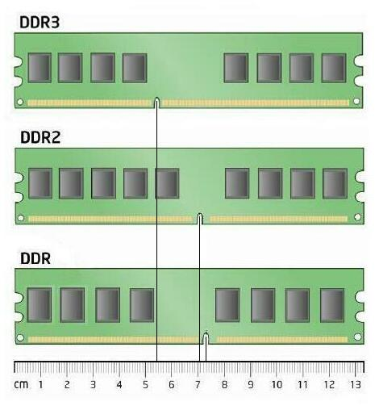
RAM Diagram

Slide 22
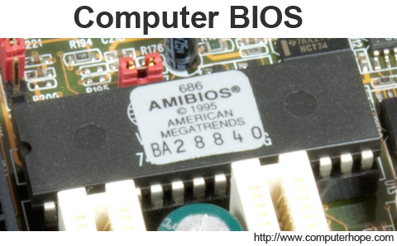
What is ROM?
Short for Read-Only Memory, ROM is a type of "built-in" memory that is used with computers and other electronic devices. As the name indicates, data stored in ROM may only be read; it is either modified with extreme difficulty or not at all. ROM is mostly used for firmware updates. A simple example of ROM is the cartridge used with video game consoles; which allows one system to run multiple games. Another example of ROM is EEPROM, which is a programmable ROM used for the computer BIOS, as shown in the picture.
Unlike Random Access Memory (RAM), ROM is non-volatile which means it keeps its contents regardless of whether or not it has power.

Slide 23
BIOS
Short for Basic Input/output System, the BIOS, ROM BIOS, or System BIOS is a chip located on all motherboards that contain instructions and setup for how your system should boot and how it operates. In the picture below, is an example of what a BIOS chip may look like on your computer motherboard. In this example, this is a picture of an early AMIBIOS, a type of BIOS manufactured by the AMI. Another good example of a BIOS manufacturer is Phoenix.

Slide 24
The four main functions of a PC BIOS
POST - Test the computer hardware and make sure no errors exist before loading the operating system. Additional information on the POST can be found on our POST and Beep Codes page.
Bootstrap Loader - Locate the operating system. If a capable operating system is located, the BIOS will pass control to it.
BIOS drivers - Low level drivers that give the computer basic operational control over your computer's hardware.
BIOS or CMOS Setup - Configuration program that allows you to configure hardware settings including system settings such as computer passwords, time, and date.

Slide 25
CPU
Alternatively referred to as the brain of the computer, processor, central processor, or microprocessor, the CPU (pronounced as C-P-U) was first developed at Intel with the help of Ted Hoff in the early 1970's and is short for Central Processing Unit. The computer CPU is responsible for handling all instructions it receives from hardware and software running on the computer.
The processor is placed and secured into a compatible CPU socket found on the motherboard, and because of the heat it produces it is covered with a heat sink to help keep it cool and running smoothly.
the CPU chip is usually in the shape of a square or rectangle and has one notched corner to help place the chip into the computer properly. On the bottom of the chip are hundreds of connector pins that plug into each of the corresponding holes on the socket. Today, most CPU's resemble the picture shown above; however, Intel and AMD have also experimented with slot processors that were much larger and slid into a slot on the motherboard. Also, over the years there have been dozens of different types of sockets on motherboards, each socket only supports so many different processors, and each has its own pin layout.

Slide 26
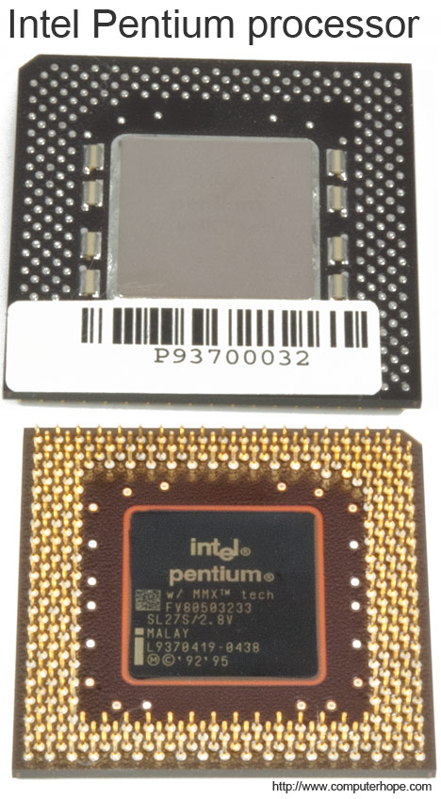
CPU (cont)
In the CPU, the primary components are the ALU (Arithmetic Logic Unit) that performs mathematical, logical, and decision operations and the CU (Control Unit) that directs all of the processors operations. Over the history of computer processors, the speed (clock speed) and capabilities of the processor have dramatically improved. For example, the first microprocessor was the Intel 4004 that was released November 15, 1971 and had 2,300 transistors and performed 60,000 operations per second. The Intel Pentium Processor shown on this page has 3,300,000 transistors and performs around 188,000,000 instructions per second.

Slide 27
Types of CPUs
There are two main types of CPUs found in computers today: 32-bit and 64-bit. In addition to this, CPUs can be broken down into types based on the manufacturer and version as well.
Below is a list of the more common types of CPUs for home or business computers, in chronological order of release by manufacturer.
AMD Processors
K6-2 K6-III Athlon Duron Athlon XP | Sempron Athlon 64 Mobile Athlon 64 Athlon XP-M Athlon 64 FX | Turion 64 Athlon 64 X2 Turion 64 X2 Phenom FX Phenom X4 | Phenom X3 Athlon 6-series Athlon 4-series Athlon X2 Phenom II | Athlon II E2 series A4 series A6 series A8 series A10 series

Slide 28
Intel processors
Pentium Pentium w/ MMX Pentium Pro Pentium II | Celeron Pentium III Pentium M Celeron M | Pentium 4 Mobile Pentium 4-M Pentium D | Pentium Extreme Edition Core Duo Core 2 Duo | Core i3 Core i5 Core i7
The AMD Opteron series and Intel Xeon series are two common types of CPUs for servers and some workstation computers.
Some mobile devices, like smartphones and tablets, use ARM CPUs. These CPUs are smaller in size, require less power and generate less heat.

Slide 29
What is 32bit in Processors?
Computers, operating systems, or software programs capable of transferring data 32-bits at a time. With computer processors, (e.g. 80386, 80486, and Pentium) they were 32-bit processors, which means the processor were capable of working with 32 bit binary numbers (decimal number up to 4,294,967,295). Anything larger and the computer would need to break up the number into smaller pieces.
A good example of the first 32-bit operating system is OS/2 and Windows NT, often versions of Windows that are 32-bit are referred to as WOW32. Today, 32-bit computers and operating systems are being replaced by 64-bit computers and operating systems such as 64-bit versions of Windows 7.

Slide 30
What is 64bit in Processors?
Replacement for the older x86 or 32-bit platform, 64-bit is a computer or software program that is capable of transferring 64-bits at a time. With respect to hardware, 64-bit is referencing the width of the registers on a computer's microprocessor or the computer bus; sometimes called WOW64 and x64.
Examples of 64-bit processors
Below is a list of examples of 64-bit computer processors.
AMD Opteron, Athlon 64, Turion 64, Sempron, Phenom, FX, and Fusion.
All Intel Xeon processors since the Nocona released in June 2004.
Intel Celeron and Pentium 4 processors since Prescott.
Intel Pentium Dual-Core, Core i3, Core i5, and Core i7 processors.

Slide 31
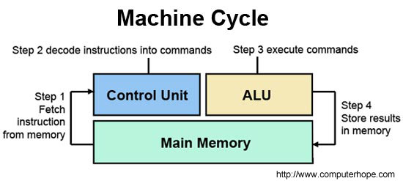
ALU in Processor
Short for Arithmetic Logic Unit, ALU is one of the many components within a computer processor. The ALU performs mathematical, logical, and decision operations in a computer and is the final processing performed by the processor. After the information has been processed by the ALU, it is sent to the computer memory.
In some computer processors, the ALU is divided into an AU and LU. The AU performs the arithmetic operations and the LU performs the logical operations.

Slide 32
Control unit in Processors
A control unit is circuitry that directs operations within the computer's processor by directing the input and output of a computer system. The processor then controls how the rest of the computer operates (giving directions to the other parts and systems). A control unit works by gathering input through a series of commands it receives from instructions in a running programs and then outputs those commands into control signals that the computer and other hardware attached to the computer carry out.
The control unit is basically circuitry inside the CPU, controlling the operations inside the CPU and "directing traffic" in a sense. The functions a control unit performs can depend on the type of CPU, since the varying degrees of architecture between all the different CPUs determine the functions of the control unit.

