Slide 1
An Introduction to HRM & SHRM
Tuesday, March 27, 2018
Chapter 1
References:
Human Resource Management, Wayne Dean Mondy
Strategic Human Resource Management, Jeffrey A. Mello
Strategic Human Resource Management, Charles R. Greer
Resource Person: Furqan-ul-haq Siddiqui

Slide 2
What is Management?
A set of activities (Planning, organizing, leading, and controlling) directed at an organization’s resources (human, financial, physical, and information) with the aim of achieving organizational goals in an efficient and effective manner.
Notes:
5

Slide 3
The Management
HUMAN
RESOURCES
Planning
PHYSICAL RESOURCES
Controlling
ORGANIZATIONAL
GOALS
Organizing
INFORMATION RESOURCES
Leading
FINANCIAL RESOURCES

Slide 4
Management in Organizations
Planning
and decision
Organizing
making
Inputs from the environment
•
Human resources
Goals attained
•
Financial resources
•
Efficiently
•
Physical resources
•
Effectively
•
Information resources
Controlling
Leading

Slide 5
Organizational Performance
Efficiency: A measure of how well resources are used to achieve a goal
“Doing Things Right”
Effectiveness: A measure of the appropriateness of the goals chosen (are these the right goals?), and the degree to which they are achieved
“Doing the Right Things Right”
Notes:
Managers are key components to organizational performance. It is a managers responsibility to choose the correct output goals and then try to minimize the input of resources to attain the same output goal.
Efficiency and Effectiveness are key terms to understand when talking about organizational performance.
Efficiency – doing things right! (produce 1000 z widgets (when the customer wanted x) at a low cost)
Effectiveness –doing the right things right. (produce X widgets at a low cost)
Refer to figure 1-1 pg. 6
Organizations are more effective when managers choose the correct goals and then achieve them.

Slide 6
HRM
Human
Resource
Management

Slide 7
Human Resource Management
Managerial function that tries to match an organization’s needs to the skills and abilities of its employees.
“Assets make things possible, people make things happen”.

Slide 8
Human Resource Management
Human Resource Management (HRM) is the approach of Management of an organization's most valued assets - the people working there who individually and collectively contribute to the achievement of the objectives of the business. In simple sense, HRM means employing people, developing their resources, utilizing, maintaining and compensating their services in tune with the job and organizational requirements to achieve its goals effectively & efficiently.

Slide 9
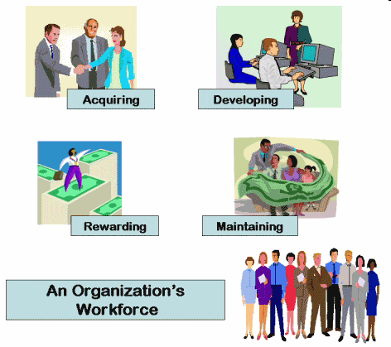
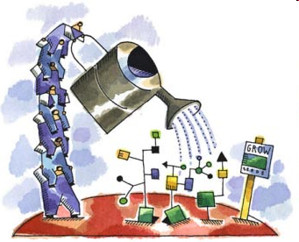

Slide 10
Functions of HRM
1.Staffing
5.Employee
& Labor
Relations
2.Human
Resource
Development
Functions
of HRM
3.Compensation
& Benefits
4.Safety &
Health

Slide 11
1. Staffing
Process through which an organization ensures that it always has the proper number of employees with the appropriate skills in the right jobs at the right time to achieve the organization’s objectives.
It includes
HR Planning
Job Analysis
Recruitment
Selection
Notes:
Human resources planning is a process that identifies current and future human resources needs for an organization to achieve its goals.

Slide 12
2. Human Resource Development
It consist not only of T&D but also individual career planning, developing activities and performance appraisal.
HRD is composed of
Training
Development
Career planning
Career Development
Performance Appraisal

Slide 13
3. Compensation & Benefits
Consist of all direct, indirect, financial & non financial rewards given to employees in return of their services.
Pay - Money that a person receives for performing a job
Benefits – Additional Financial rewards in addition to base pay including paid vocations, sick leave, insurance etc.
Non financial Rewards
The Job
The Environment

Slide 14
4. Safety & Health
Safety involves protecting employees from injuries caused by work related accidents. Health refers to employee’s freedom from physical or emotional illness.
5. Employee & Labor Relation
Deals with employee employer relationship & dealing with labor unions

Slide 16
Strategy…!
A strategy is an integrated plan of action designed to achieve a particular goal.
The word strategy has military connotations, because it is derives from the Greek word for army ("leader or commander of an army, general“).

Slide 17
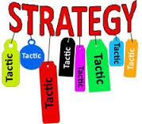
Tactic is concerned with the conduct of an engagement while strategy is concerned with how different engagements are linked.
A method of employing forces in combat
Tactical planning takes a company's strategic plan and sets forth specific short-term actions and plans, usually by company department or function. The tactical planning horizon is shorter than the strategic plan horizon.

Slide 18
Strategic Management
Strategic or Institutional management is comprehensive and ongoing management process aimed at the conduct of drafting, implementing and evaluating cross-functional decisions that will enable an organization to achieve its objectives
Art and science of formulating, implementing, and evaluating cross-functional decisions that enable an organization to achieve its objectives.
Notes:
Science (from the Latin scientia, meaning "knowledge") refers to any systematic knowledge-base or prescriptive practice that is capable of resulting in a prediction or predictable type of outcome. In this sense, science may refer to a highly skilled technique or practice.[1]

Slide 19
Strategic-Management Process
Strategy Formulation
Strategy Implementation
Strategy Evaluation

Slide 20
Strategic Human Resource Management
Strategic human resource management (SHRM) is a concept that integrates traditional human resource management activities within a firm's overall strategic planning and implementation.
By a strategic approach to HRM, we are referring to a managerial process requiring human resource (HR) policies and practices to be linked with the strategic objectives of the organization.
.

Slide 21
Strategic Human Resource Management
Involves the development of a consistent, aligned collection of practices, programs, and policies to facilitate the achievement of the organization’s strategic objectives.
Requires abandoning the mindset and practices of “personnel management” and focusing on strategic issues than operational issues.
Integration of all HR programs within a larger framework, facilitating the organization’s mission and its objectives.

Slide 22
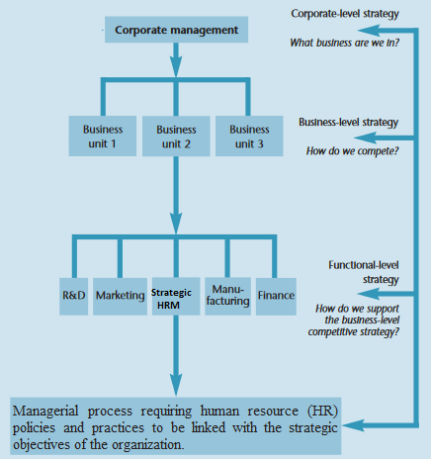

Slide 23
Strategic Human Resource Management
Once the business strategy has been determined, an HR strategy is implemented to support the chosen competitive strategy.
one-way downward from business- to functional level strategy.
This relatively young field represents an intersection of the strategic management and human resource management (HRM) literatures
In this sense, a HR strategy is concerned with the challenge of matching the philosophy, policies, programs, practices and processes – the ‘five Ps’

Slide 25
The major objectives of SHRM are as follows:
To ensure the availability of a skilled committed and highly motivated workforce in the organization to achieve sustained competitive advantage
To provide direction to the organization so that both the business needs of the organization and the individual and collective needs of its workforce are met
This is achieved by developing and implementing HR practices that are strategically aligned.

Slide 26
SHRM is practiced in only those organizations that have a clearly articulated corporate or business strategy.
Organizations who do not have a corporate plan cannot have SHRM.
In such organization HR personnel carry out the traditional administrative and service roles-not concerned with strategic business issues.

Slide 28
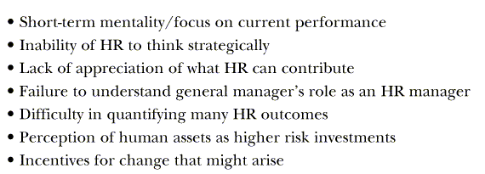
Barriers to Strategic HR

Slide 29
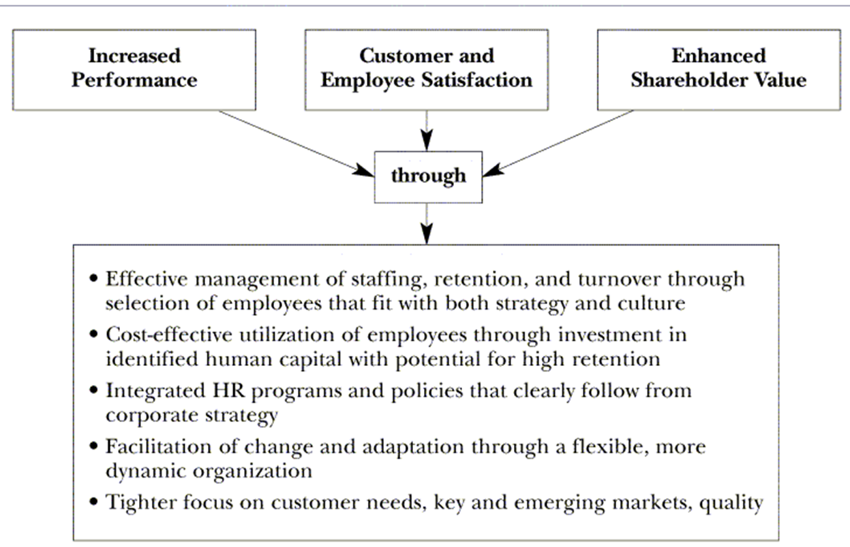
Outcomes of Strategic HR

Slide 33
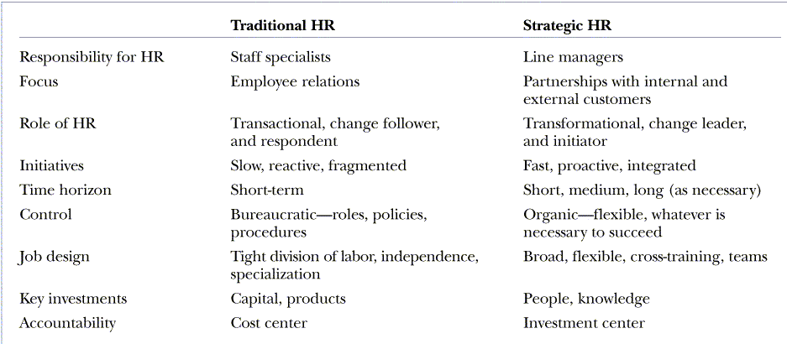
Traditional HR versus Strategic HR
Notes:
Line managers have the formal power to direct and control immediate subordinates.
Staff specialist: Job duties are narrower than line managers and include the right to advise, recommend, and counsel in the staff specialists' area of expertise. It is a communication relationship with management. It has an influence that derives indirectly from line authority at a higher level and takes a human resource manager as an instance.
Organic growth often refers to the growth in a company's sales that did not occur because of an acquisition of another company.

Slide 34
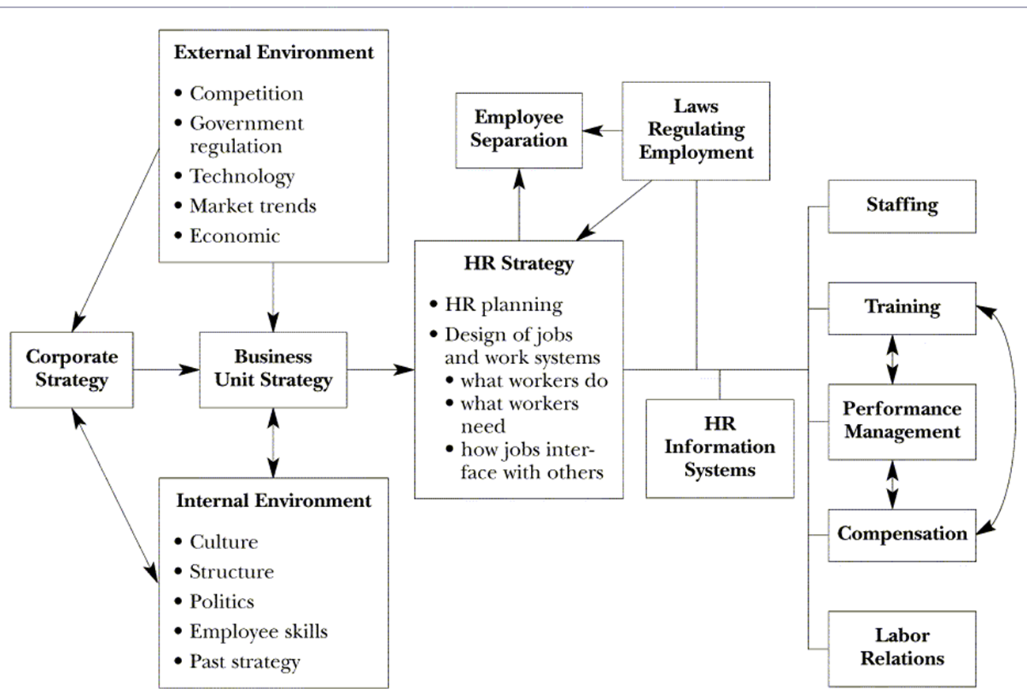
Model of SHRM

