Slide 1

Section 4.1
Follow up Exercises

Slide 2
Question No.1
Determine f(0), f(-2) and f(a+b)
f(x)= 5x-10
Solution:
f(0)= 5(0)-10
= 0-10
= -10
f(-2)=5(-2)-10
= -10-10
=-20
f(a+b)=5(a+b)-10
=5a+5b-10

Slide 3
Question No.12
12. f(u)= -2u³+5u
determine f(0), f(-2) and f(a+b)
Solution:
f(0)= -2(0)³+5(0)
=0
f(-2)=-2(-2)³+5(-2)
= -2(-8)+(-10)
= 16-10
= 6
f(a+b)= -2(a+b)³+5(a+b)
= (a+b)(-2(a+b)² +5)
= (a+b)(-2a²-2b²-4ab+5)
= -2a³-2ab²-4a²b+5a-2a²b-2b³-4ab²+5b
= -2a³-6ab²-6a²b-2b³+5a+5b

Slide 4
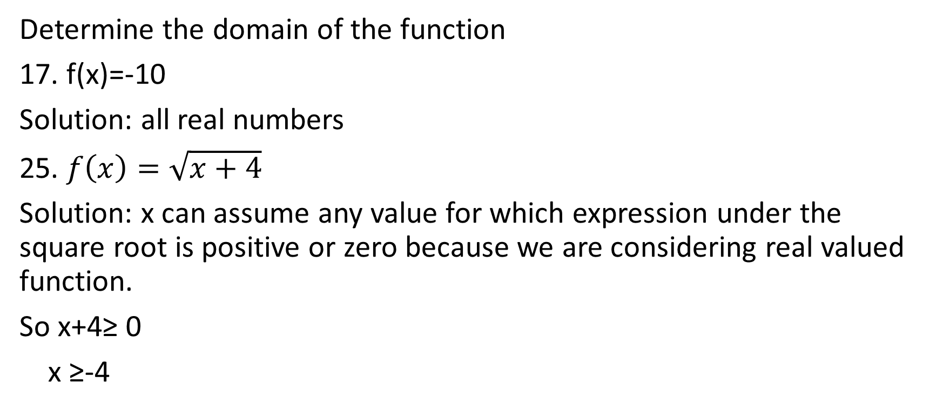
Question No. 17 and 25
Determine the domain of the function
17. f(x)=-10
Solution: all real numbers
25. $f\left(x\right)=\sqrt{x+4}$
Solution: x can assume any value for which expression under the square root is positive or zero because we are considering real valued function.
So x+4≥ 0
x ≥-4

