Slide 1
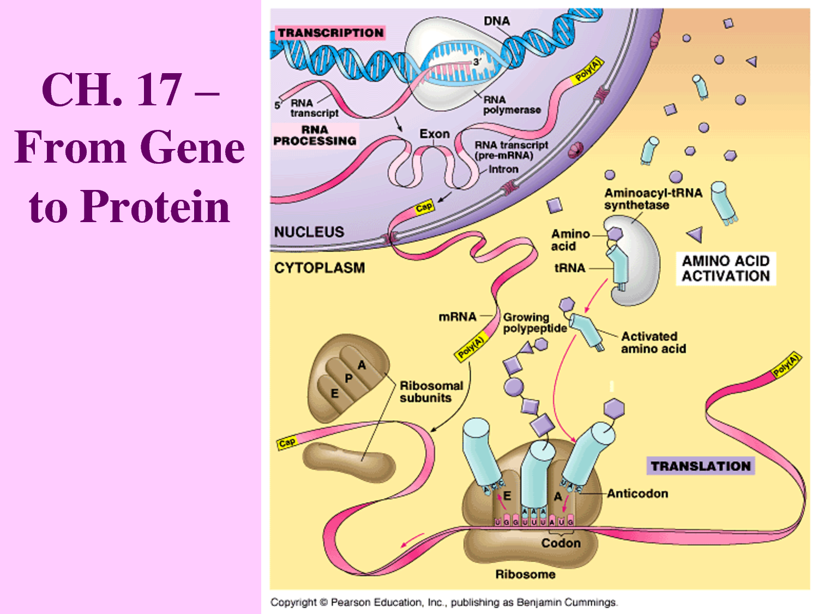
From Chromosome to Protein

Slide 2
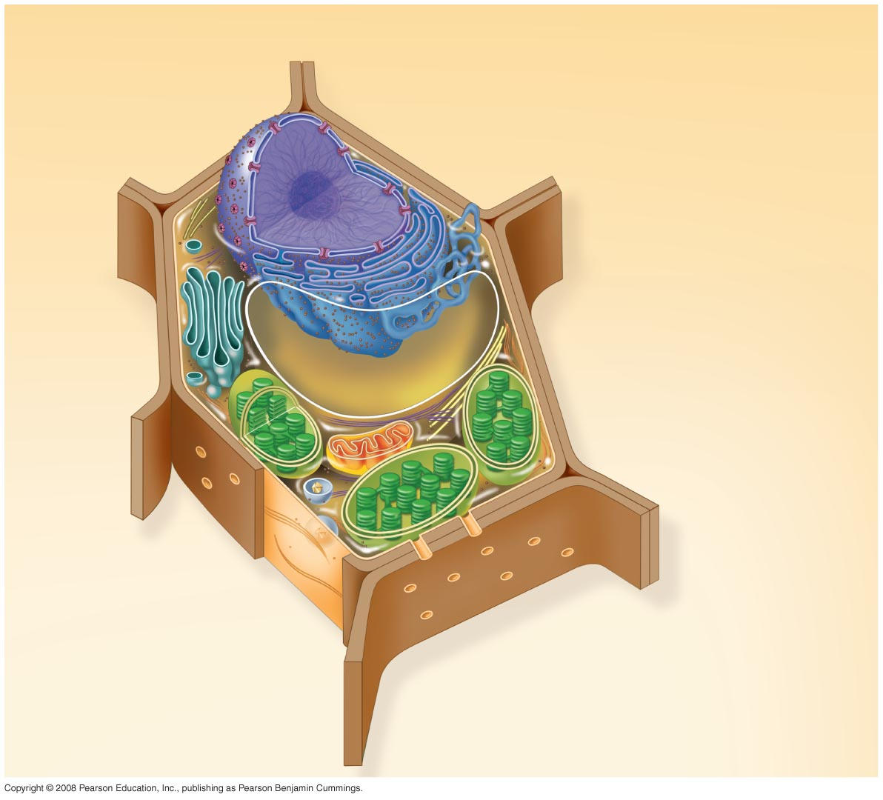
Fig. 6-9b
Nuclear envelope
Rough endoplasmic reticulum
NUCLEUS
Nucleolus
Chromatin
Smooth endoplasmic reticulum
Ribosomes
Golgi
apparatus
Central vacuole
Microfilaments
Intermediate filaments
CYTO-
SKELETON
Microtubules
Mitochondrion
Peroxisome
Plasma membrane
Chloroplast
Cell wall
Plasmodesmata
Wall of adjacent cell
Notes:
Figure 6.9 Animal and plant cells—plant cell

Slide 3
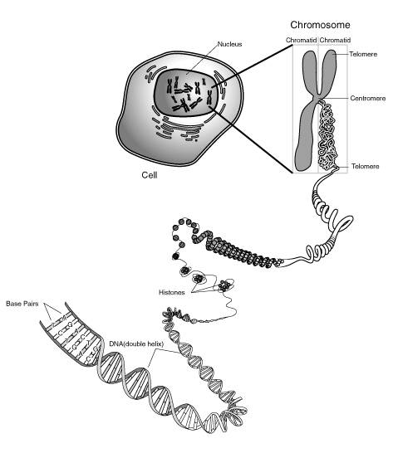
DNA the genetic material
DNA = deoxy ribonucleic acid
In eukaryotes it exists in nucleus
DNA a giant molecule
The largest human genome DNA is 85 mm long
Bacterial and eukaryotic DNA is bound with proteins through coiling and supercoiling

Slide 4
Packaging the DNA molecules into chromosoms in eukaryotes

Slide 5
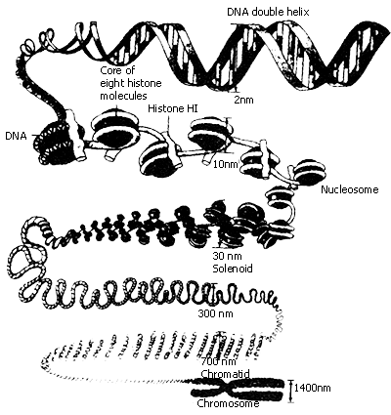
First level packaging
Under electron microscopy, chromatin (chromosome) consists of ellipsoidal beads joined by threads
These beads are 100 ºA in diameter and 60 ºA in length
These beads are known as nucleosomes
Nucleosomes consist of 146-nucleotide-pair length of DNA and two molecules of each of histones H2a, H2b, H3, H4.
Second level packaging
Make the DNA-protein complex of 300 ºA diameter core
Histone H1 is involved in this condensation
The supercoiled structure is known as chromatin

Slide 6
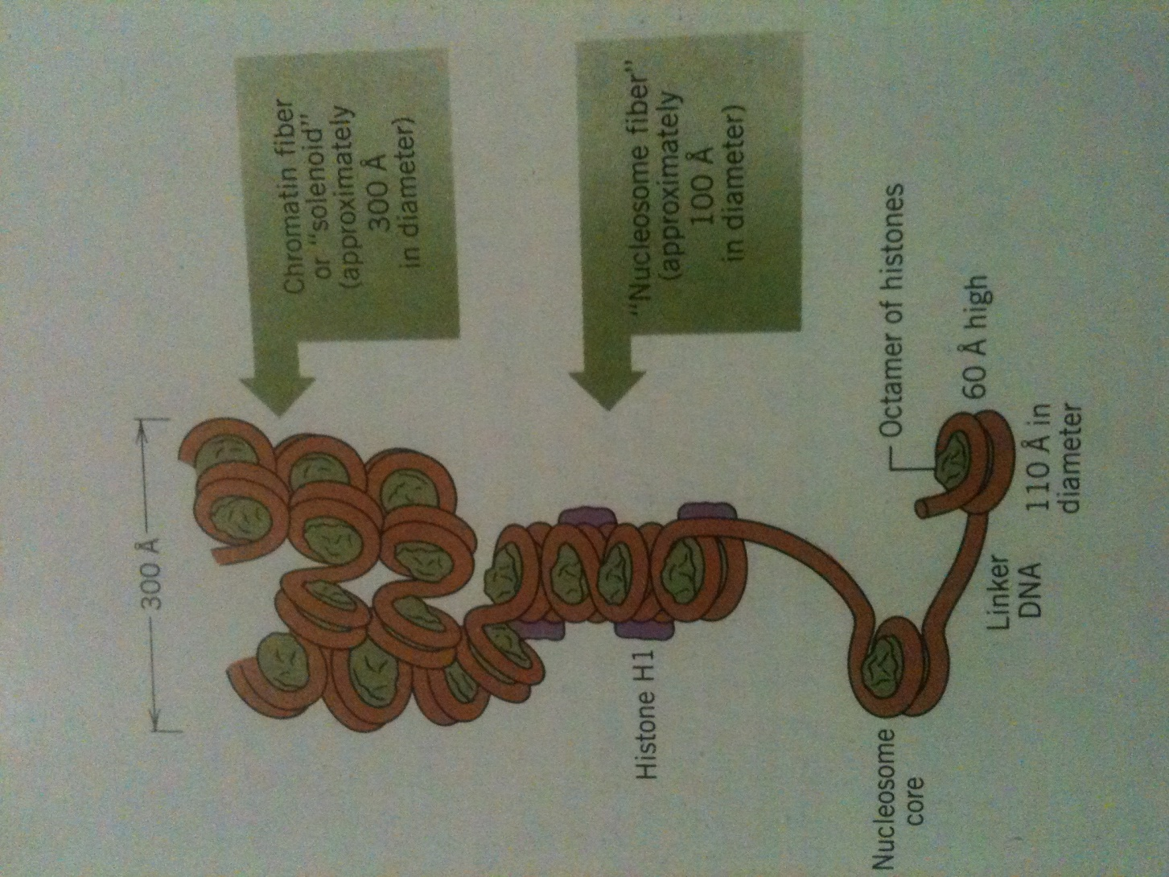

Slide 7
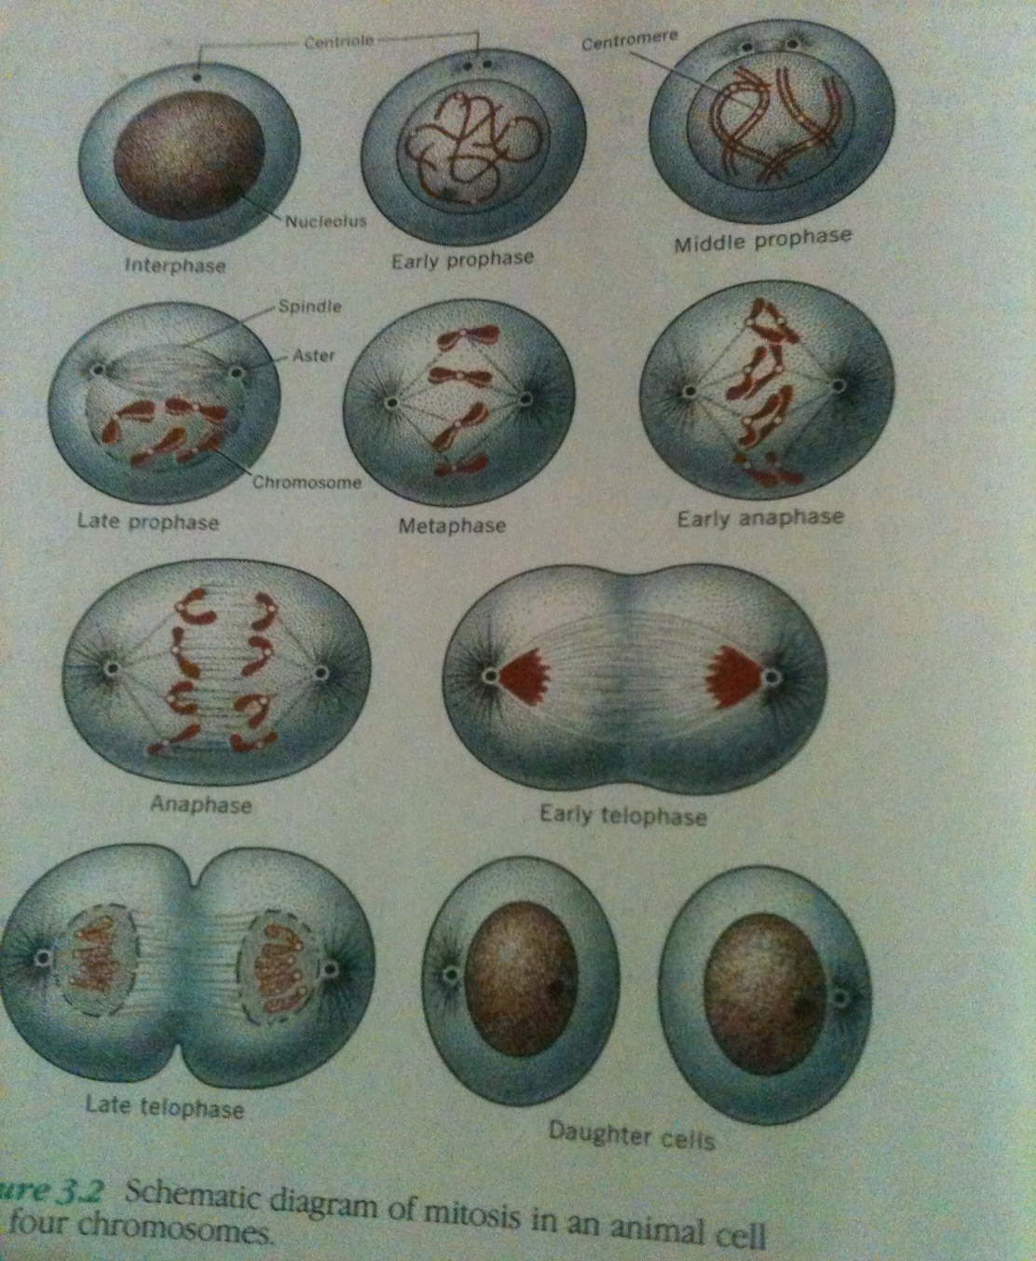
Cell division and DNA
condensation
Third level condensation
Finally non-histone chromosomes further condense chromatin fiber into a scaffold
Euchromatin and heterochromatin
When stained with feulgen reagent, the densely packed chromatin fiber stained intensely, this portion of chromosome is called heterochromatin

Slide 8
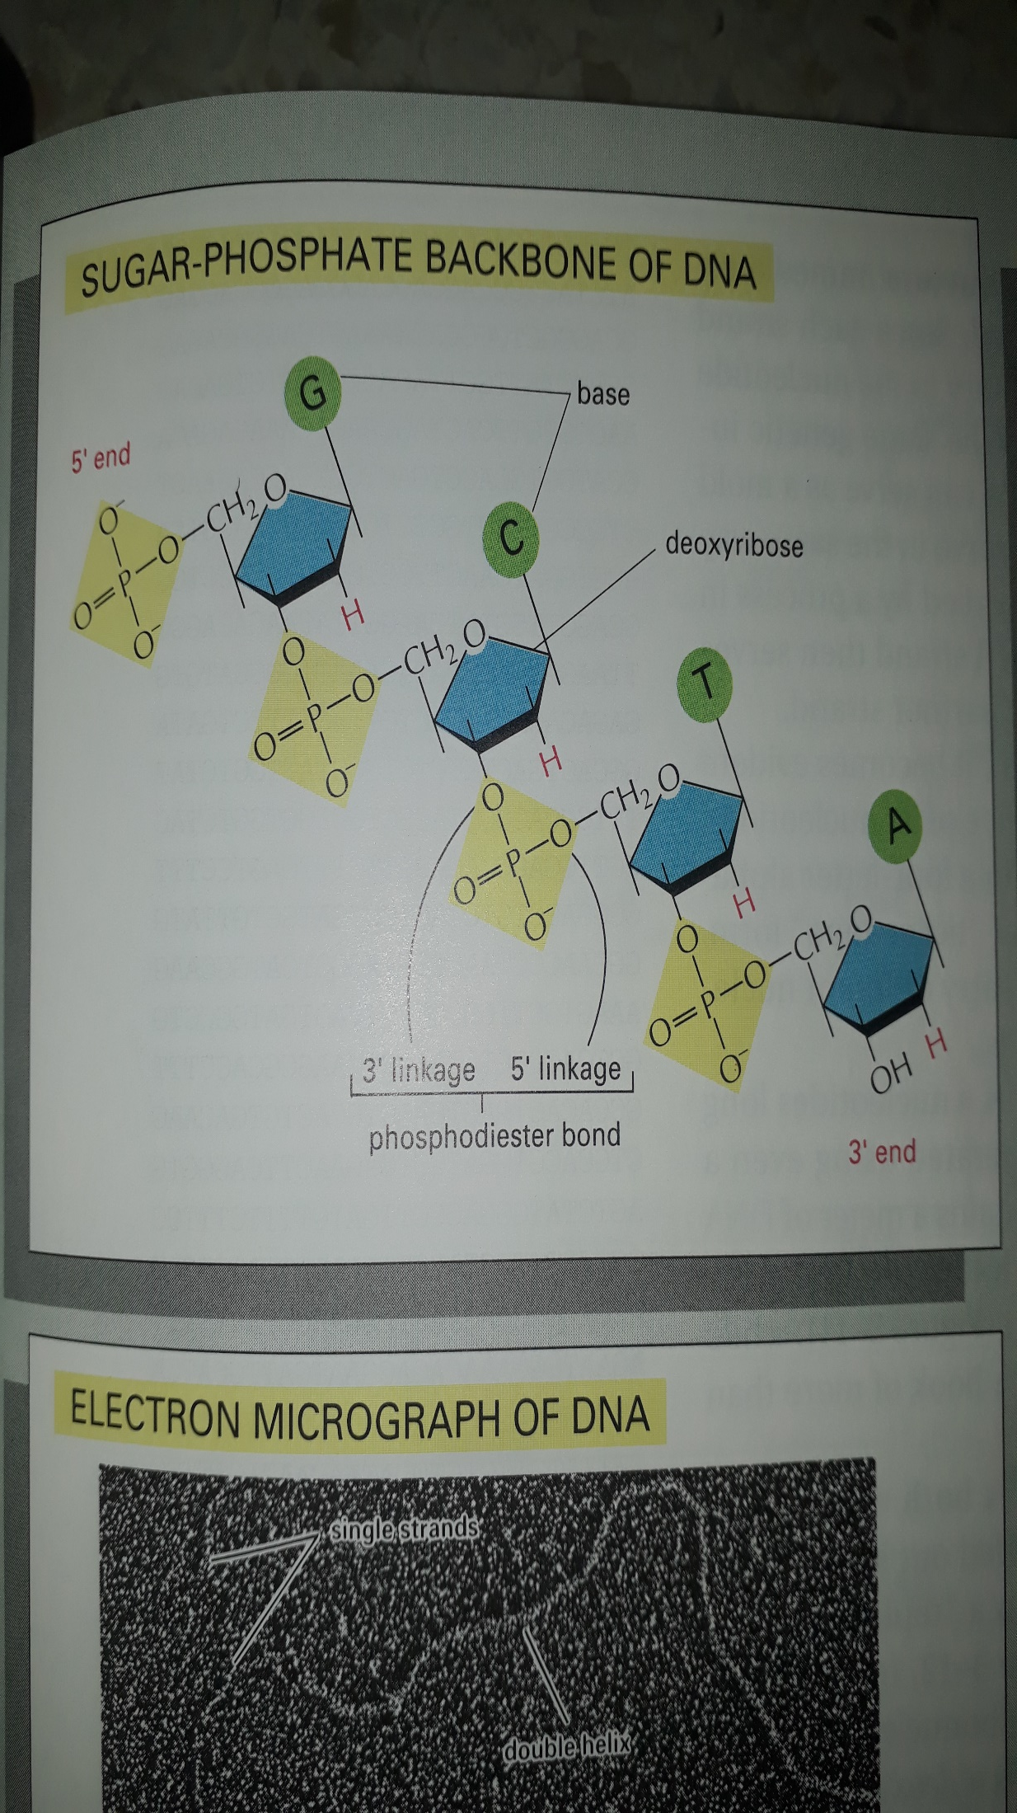
DNA molecular structure
DNA made up of four types of nucleotides; deoxyadenosine (dAMP), deoxyguanosine (dGMP), deoxythymidine (dTMP) and deoxycytidine (dCMP).
dAMP and dGMP are two ring structures and called purines
dCMP and dTMP are single ring structures and called pyrimidines
These nitrogenous bases are chemically bound to pentose sugar-phosphate backbone

Slide 9
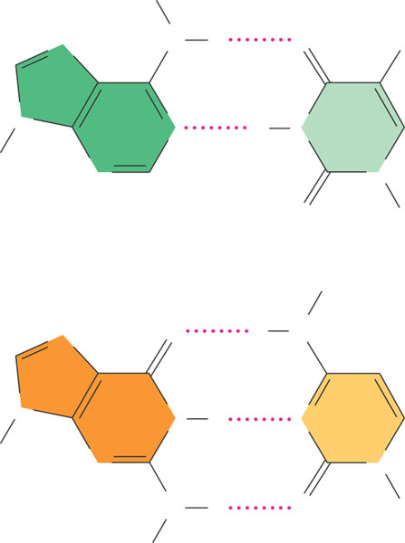
H
N
N
H
O
CH₃
N
N
H
N
Sugar
N
N
Purines
O
Sugar
Adenine (A)
Pyrimidines
Thymine (T)
H
N
O
H
N
N
N
H
N
Sugar
N
N
N
H
O
Sugar
H
Figure 16.8
Guanine (G)
Cytosine (C)

Slide 10
Watson and Crick DNA double helix (1953)
Based on two evidences;
1) concentration of adinine always equals to concentration of thymine, concentration of guanine equals to concentration of cytosine (E. Chargaph and colleagues)
2) X-ray diffraction photograph

Slide 11
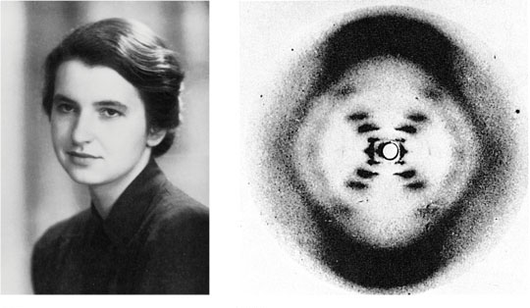
One of the X-ray diffraction photographs of DNA that led the double helix model of DNA structure. Central cross-shaped pattern indicative of double helix. Heavy dark patterns (top and bottom) indicates that bases are staked perpendicular to axis of molecule (Courtesy M.H.F. Wilkins and Franklins)
(a) Rosalind Franklin
(b)
Franklin’s X-ray diffraction
Photograph of DNA
Figure 16.6 a, b

Slide 12
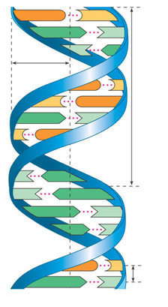
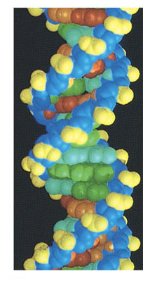
Conclusion from chemical analysis and X-ray diffraction photographs
1- DNA is a double helix molecule with two chains coiled in a spiral
2- phosphodiester bonds link the nucleotides in a polynucleotide chain
3- two polynucleotide strands bind together through hydrogen bonding
4- base pairs stacked between two chains perpendicular to the axis of molecule like steps of a stair
5- Base pairing is specific; Adenin with thymine, Guanine with cytosine
6- base pairs in DNA stacked 3.4oA apart with 10 base-pairs per turn (360oA) with double helix
G
C
A
T
T
A
1 nm
G
C
3.4 nm
C
G
A
T
C
G
T
A
T
A
A
T
A
T
G
C
0.34 nm
A
T
Figure 16.7a, c
(a) Key features of DNA structure
(c) Space-filling model

Slide 13
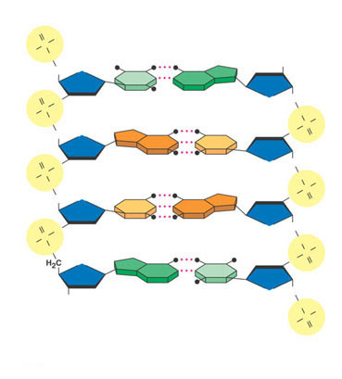
DNA strands are anti parallel : one strand goes from
3/ to 5/ direction the other the other strand in 5/ to 3/ direction
5 end
O
OH
P
Hydrogen bond
–O
O
3 end
OH
O
T
A
O
O
O
CH₂
–O
P
O
O
O–
O
P
H₂C
O
G
C
O
O
O
O
CH₂
–O
P
O
O
P
O–
H₂C
O
O
O
C
G
O
O
O
CH₂
–O
P
O
O–
O
P
H₂C
O
O
O
A
T
O
CH₂
OH
O
3 end
O–
O
P
(b) Partial chemical structure
O
Figure 16.7b
5 end

Slide 14
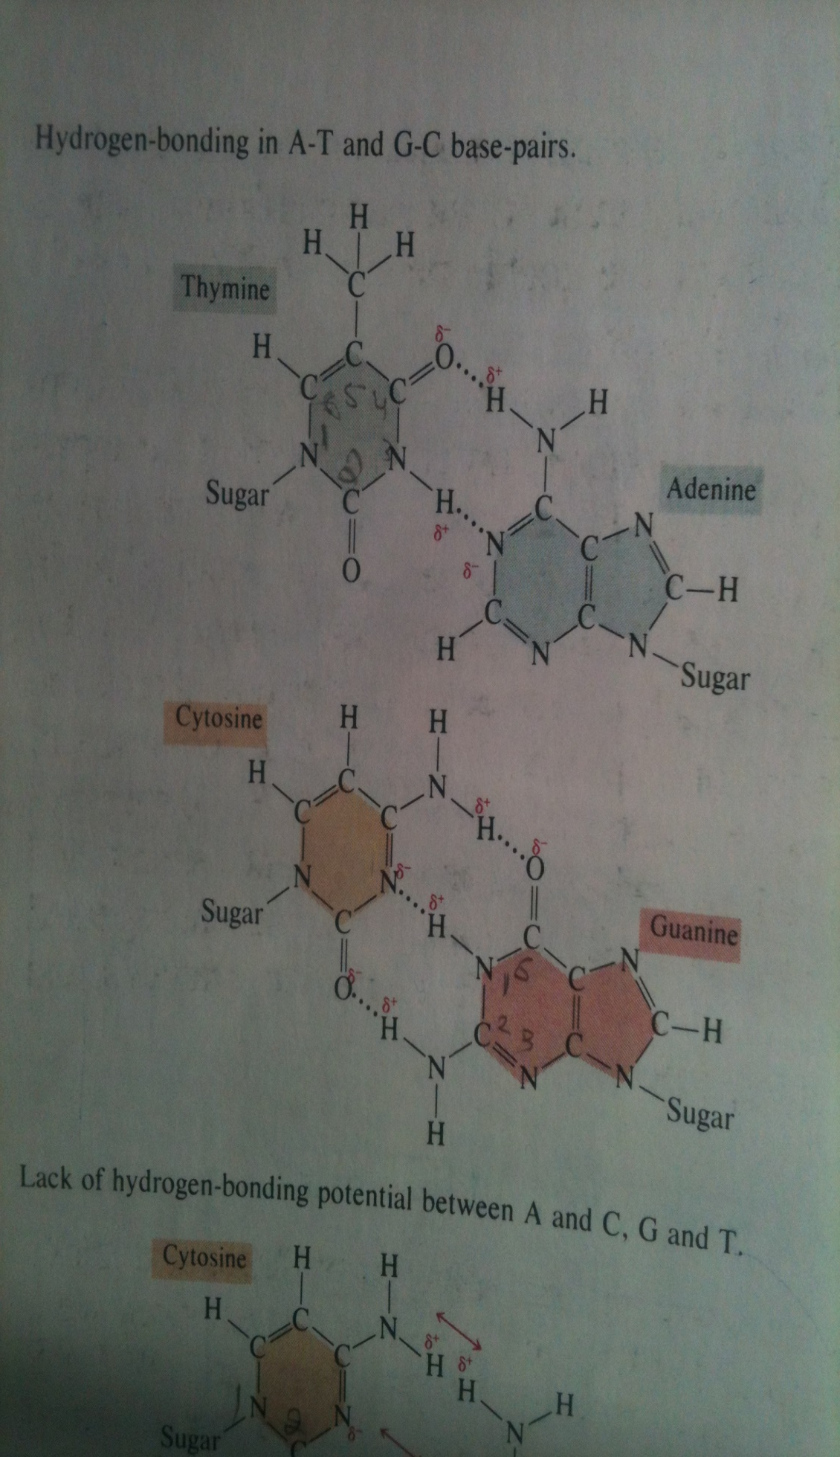
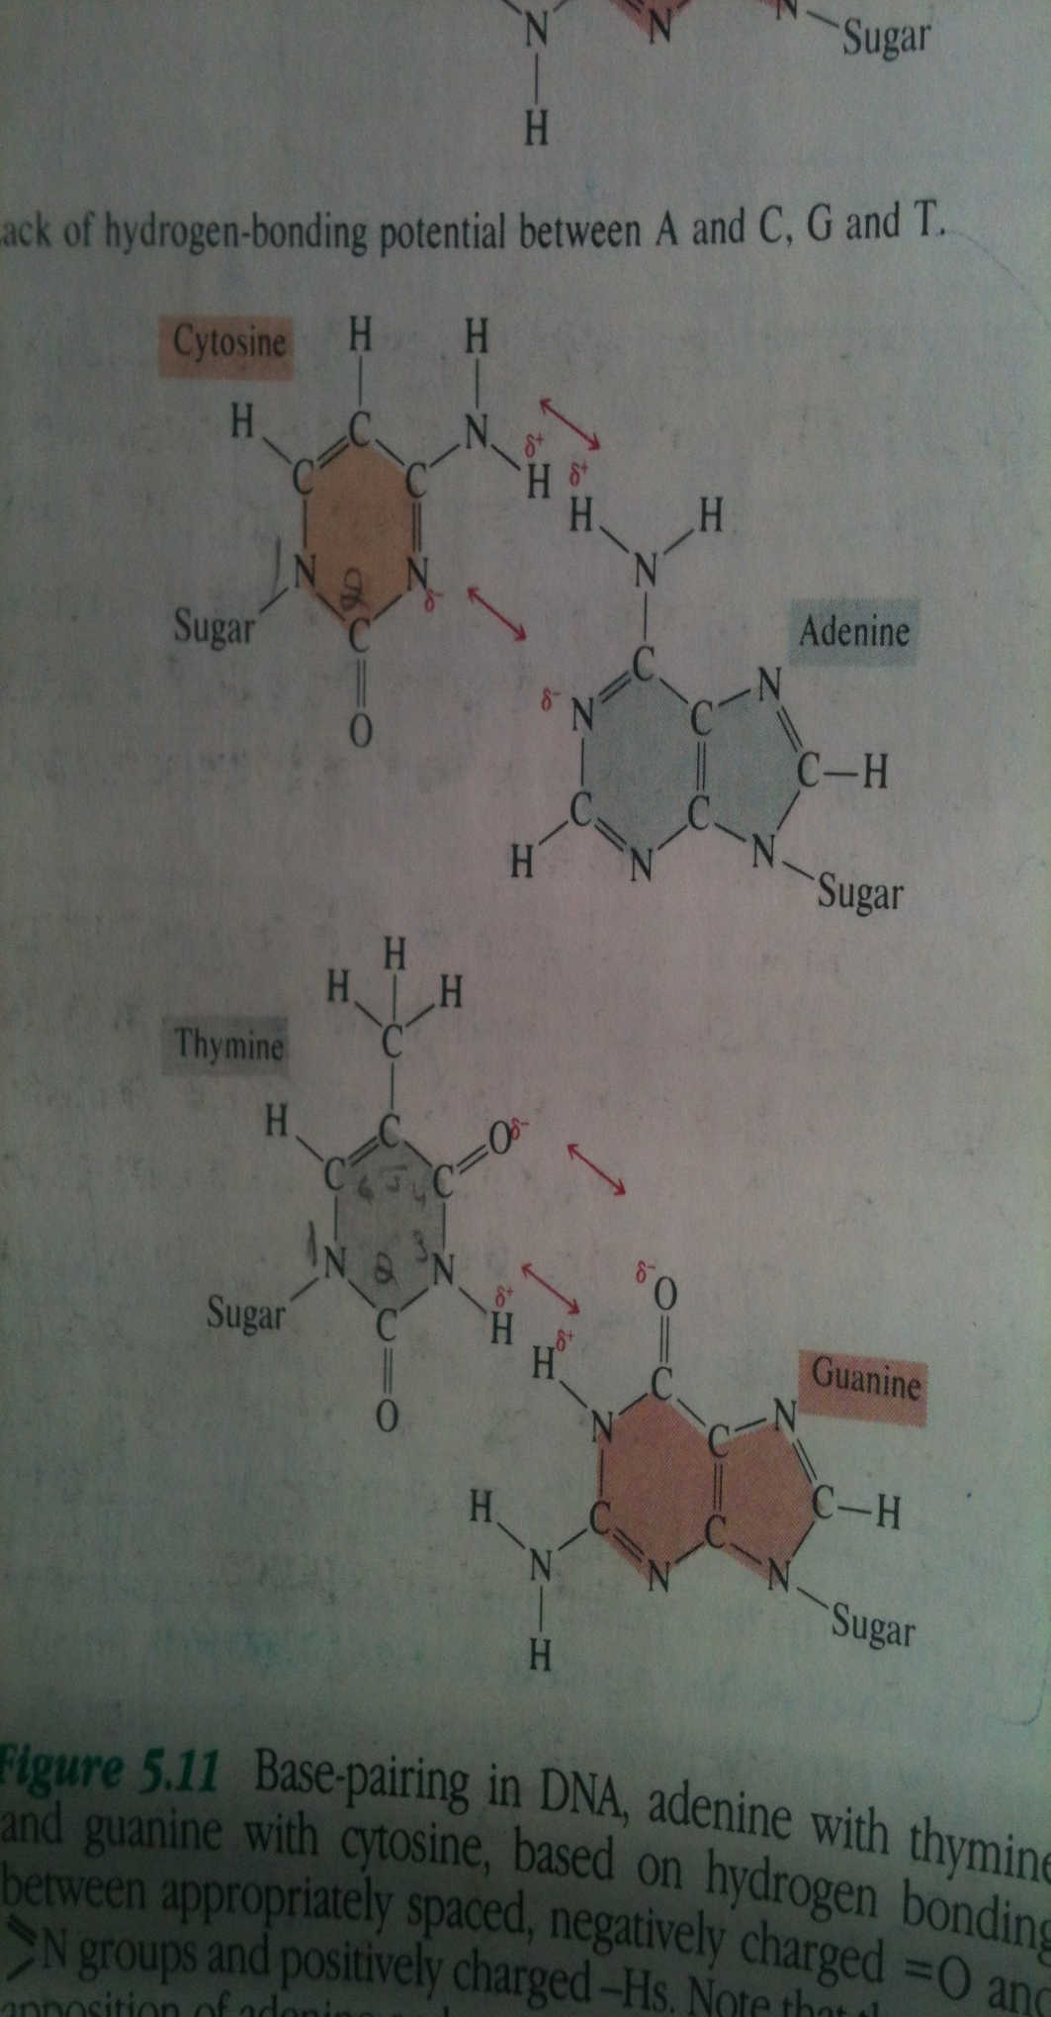

Slide 15
What you have learned in today’s lecture?

