Slide 1
DNA Replication

Slide 2
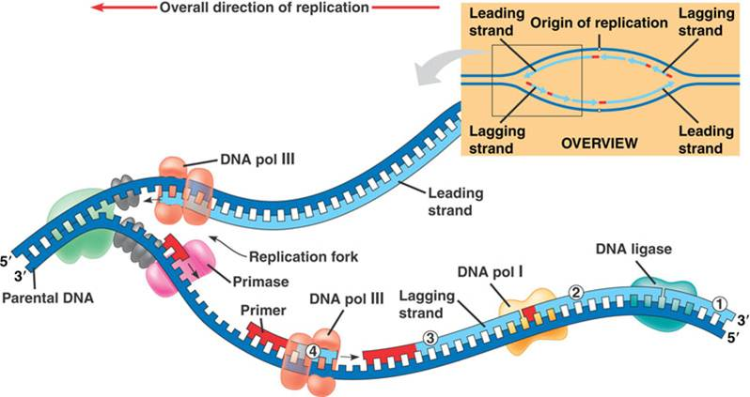
DNA REPLICATION

Slide 3
An overview of DNA replication

Slide 4
Replication of DNA and synthesis of histone and non-histone proteins occur at the same time
DNA packaging is supposedly the final stage of chromosome duplication
DNA replication occurs at 3/ → 5/ direction of DNA
DNA replication is thus continuous at one strand and discontinuous at the opposite strand (Okazaki fragments) – bidirectional replication
Replication occurs at specific sites of DNA called “Origins”

Slide 5
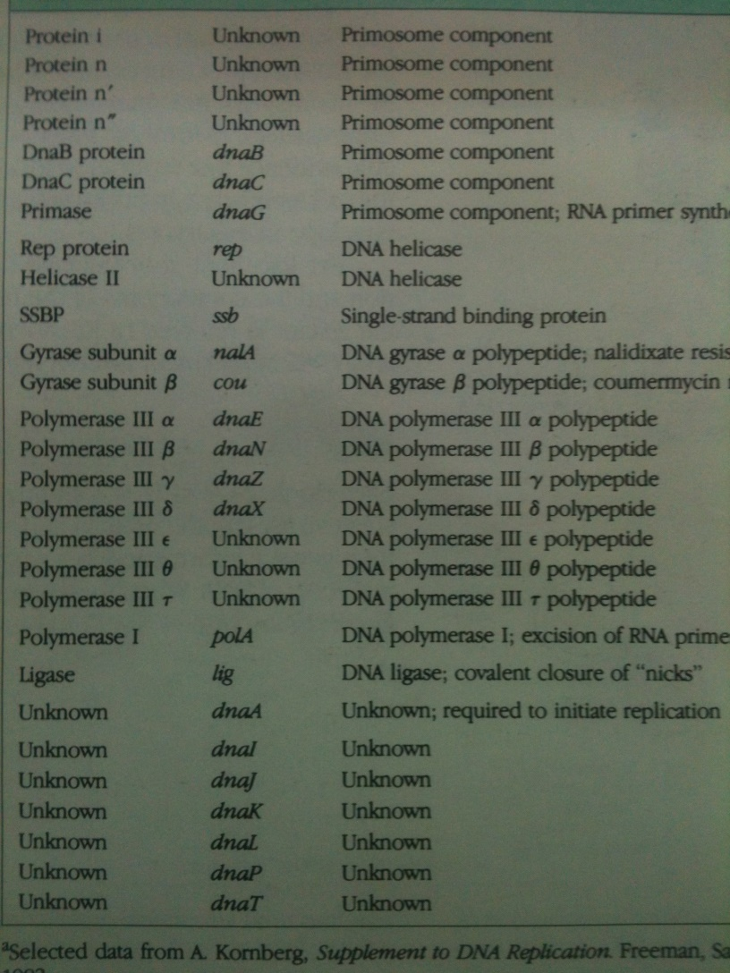
Proteins involved in DNA replication

Slide 6
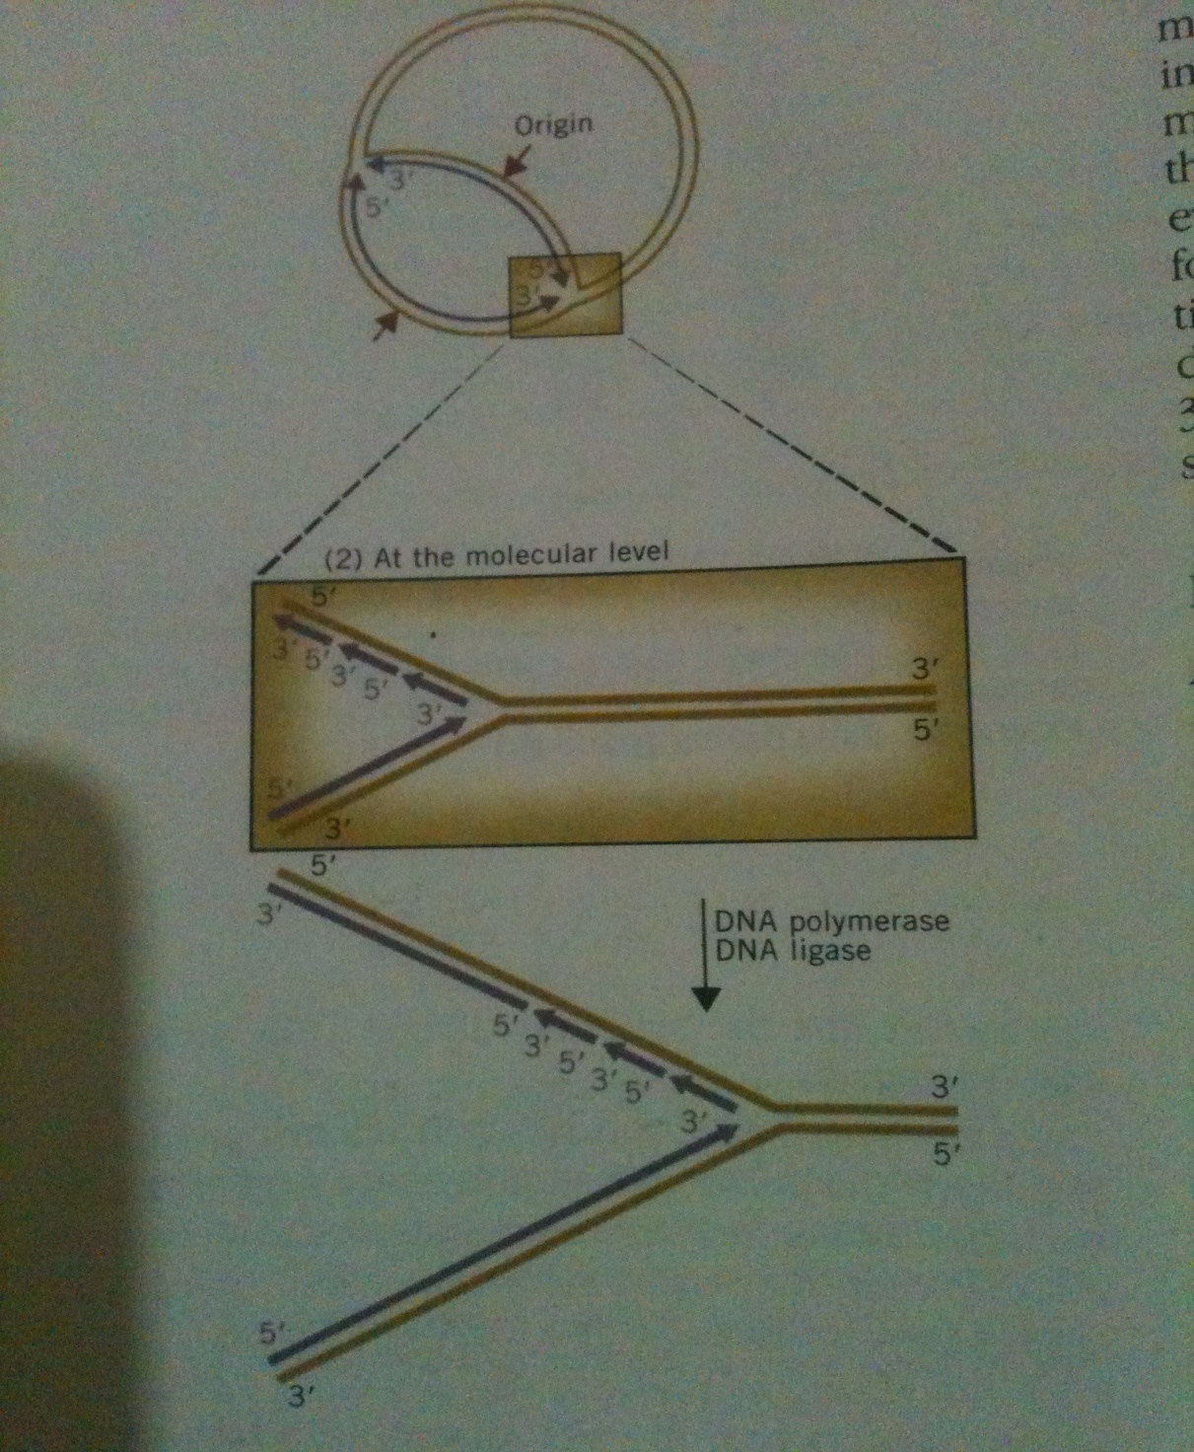
DNA synthesis occurs at specific sites along DNA molecule, those sites are known as “origins”
There is one origin in prokaryotes and many in eukaryotes

Slide 7
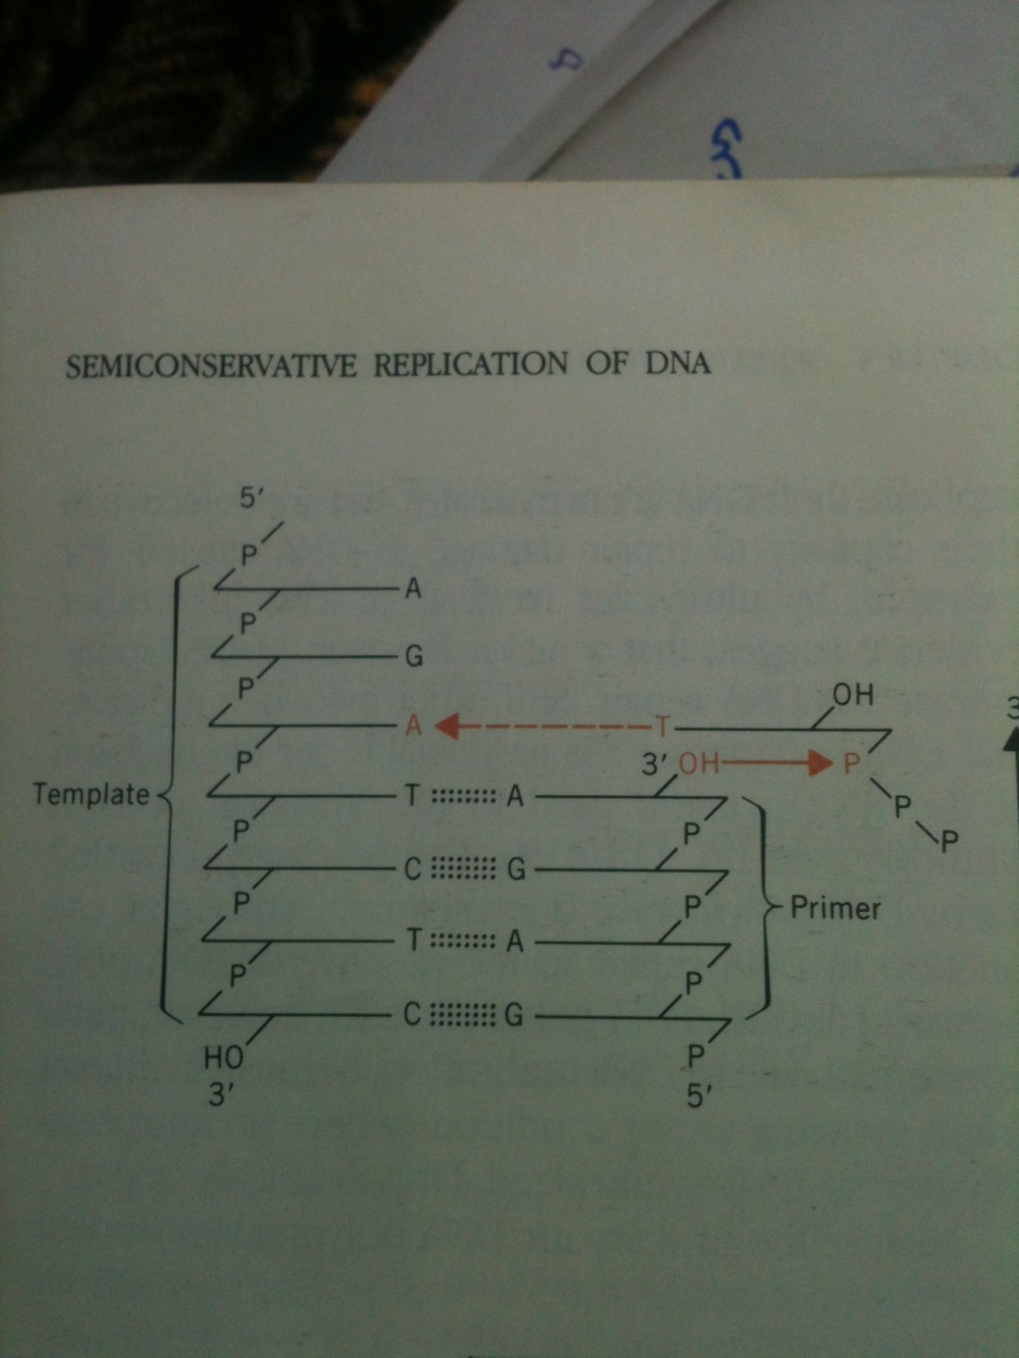
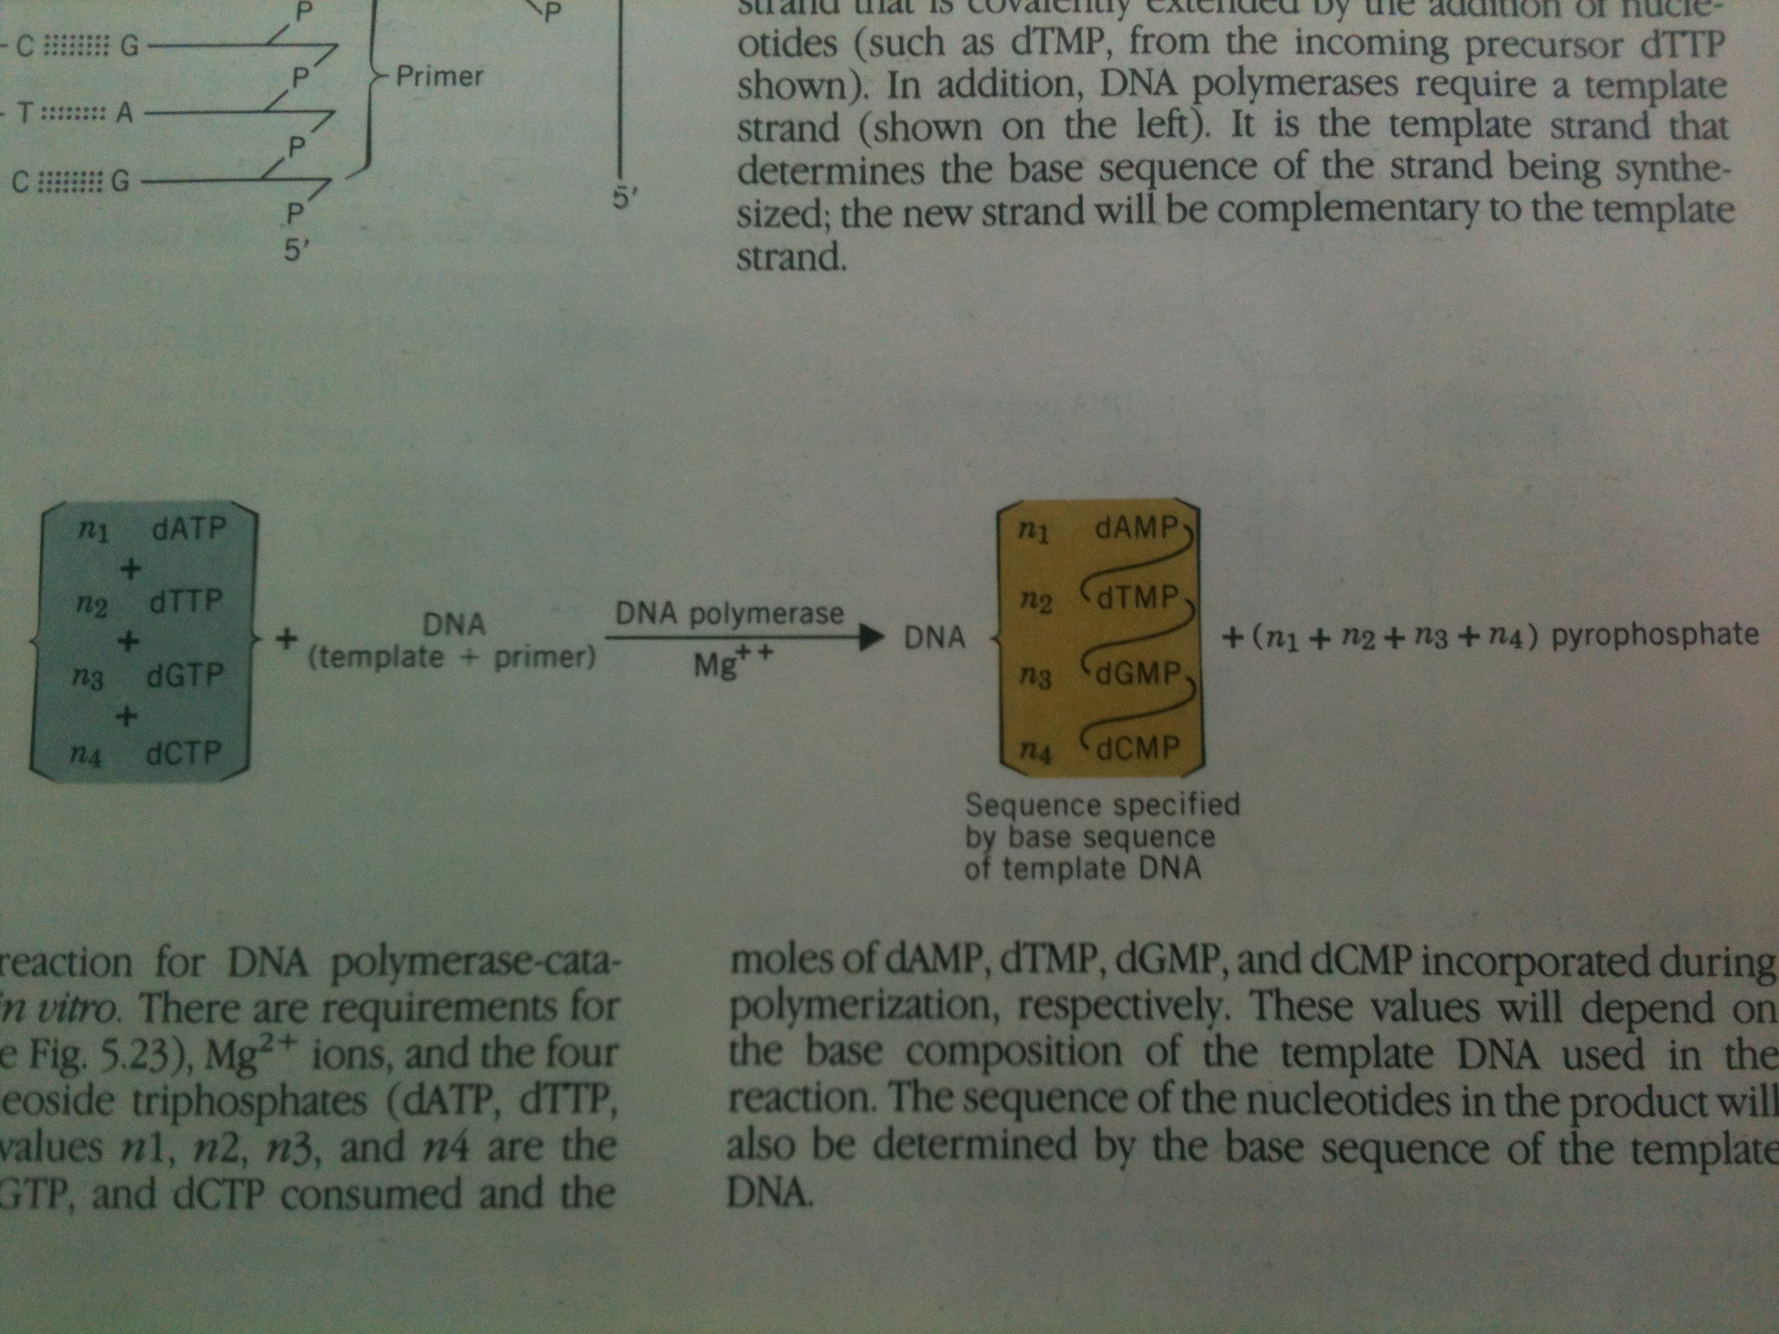
DNA polymerases are responsible for DNA strand synthesis and repair
DNA polymerase I requires 3/-hydroxyl on a preexisting DNA chain, thus it needs an RNA oligonucleotide to initiate DNA synthesis

Slide 8
There are many polymerase enzymes in eukaryotes and prokaryotes
DNA Polymerase III is responsible for DNA elongation, while DNA plymerase II and I act as repairing of growing DNA in case mismatch happens and plymerase I is also responsible for excision of primer
Eukaryotic DNA polymerases have exonuclease activity which is required for proofreading of synthesizing DNA

Slide 9
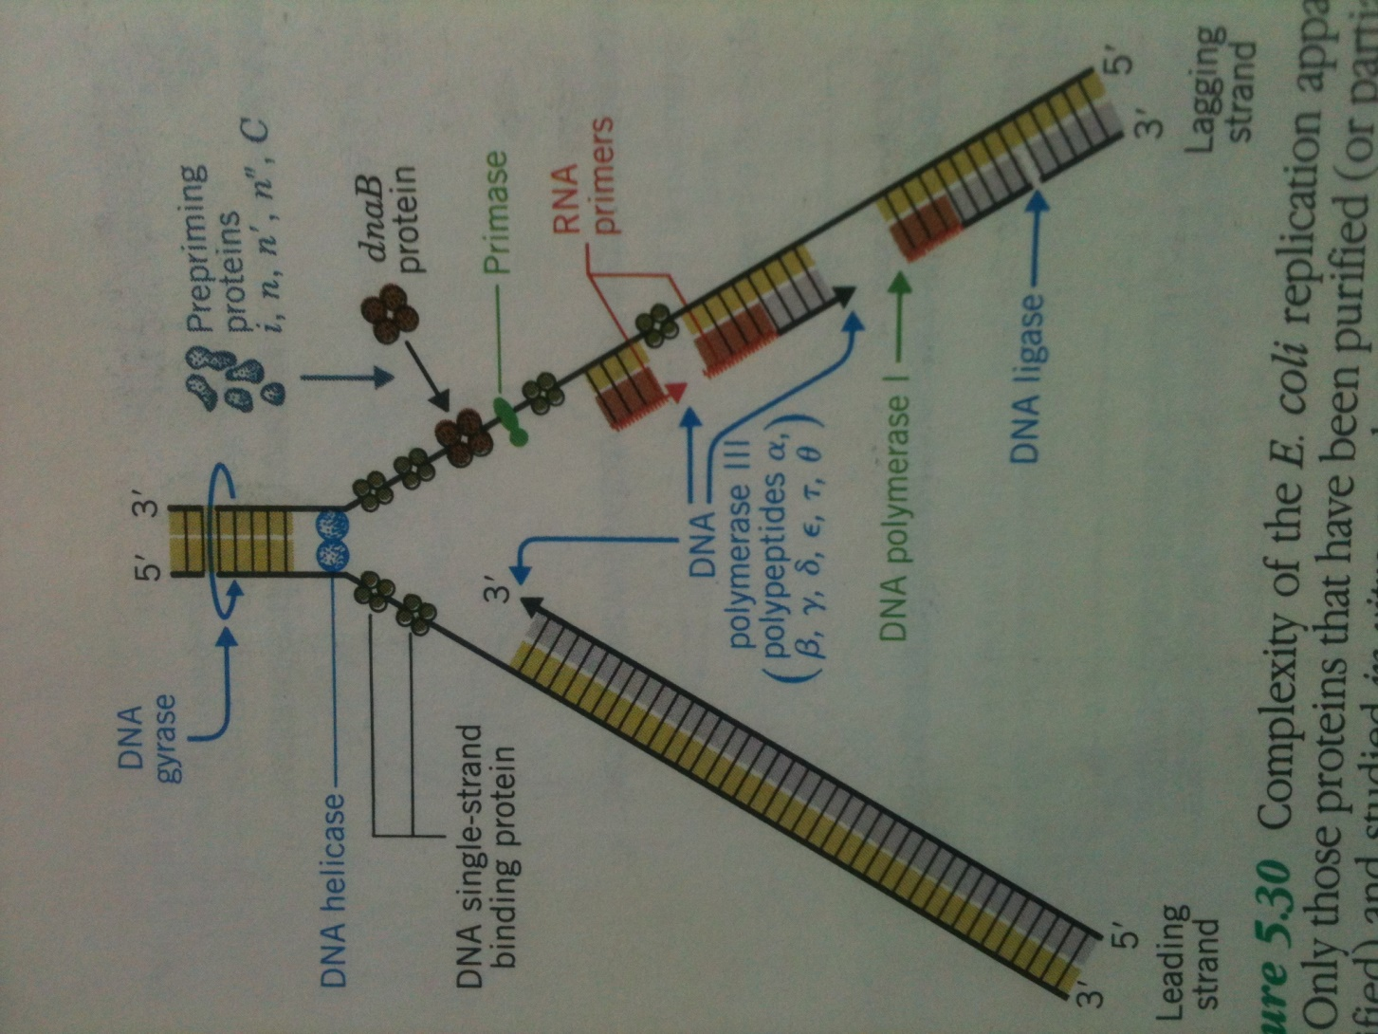

Slide 10
A closer look to DNA replication

Slide 11
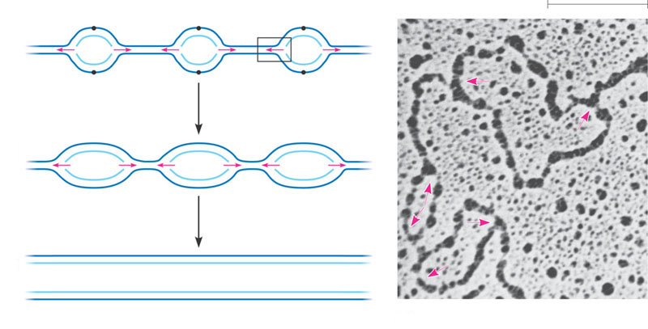
Getting started
Origin of replication and replication fork
Replication of DNA started at specific sites known as “Origins”
Those sites contain specific sequences of nucloetides, which are being recognized by specific proteins (probably polymerase 1 in prokaryotes)
Those proteins recognize those sites and open double helix of DNA at those points, making “replication bubble”
Single origin in prokaryotes and 100s to few1000s in eukaryotes
Origin of replication
Parental (template) strand
0.25 µm
Daughter (new) strand
1
Replication begins at specific sites
where the two parental strands
separate and form replication
bubbles.
Bubble
Replication fork
2
The bubbles expand laterally, as
DNA replication proceeds in both
directions.
3
Eventually, the replication
bubbles fuse, and synthesis of
the daughter strands is
complete.
Two daughter DNA molecules
(a)
In eukaryotes, DNA replication begins at many sites along the giant
DNA molecule of each chromosome.
(b)
In this micrograph, three replication
bubbles are visible along the DNA of
a cultured Chinese hamster cell (TEM).
Figure 16.12 a, b

Slide 12
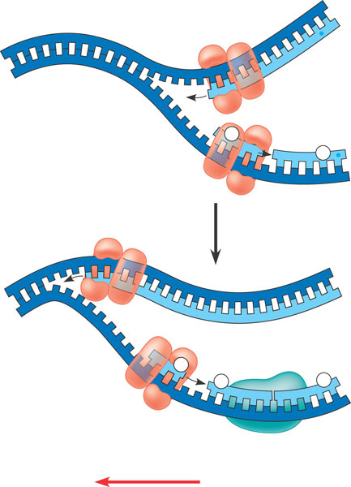
Synthesis of leading and lagging strands during DNA replication
Bidirectional replication in both bacteria and eukaryotes
At each end of replication bubble, there is replication fork
Replication fork is Y-shaped region where parental strands are being unwound
1
DNA pol Ill elongates
DNA strands only in the
5 3 direction.
3
2
5
One new strand, the leading strand,
can elongate continuously 5 3
as the replication fork progresses.
Parental DNA
5
3
Okazaki
fragments
The other new strand, the
lagging strand must grow in an overall
3 5 direction by addition of short
segments, Okazaki fragments, that grow
5 3 (numbered here in the order
they were made).
3
2
3
1
5
DNA pol III
Template
strand
DNA ligase joins Okazaki
fragments by forming a bond between
their free ends. This results in a
continuous strand.
4
Leading strand
3
Lagging strand
2
1
Template
strand
DNA ligase
Figure 16.14
Overall direction of replication

Slide 13
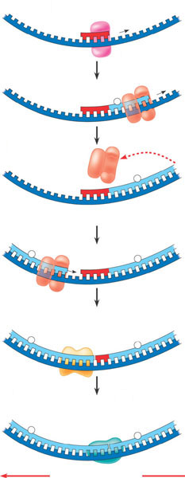
1
Primase joins RNA nucleotides
into a primer.
3
5
5
3
Template
strand
2
DNA pol III adds DNA nucleotides to the
primer, forming an Okazaki fragment.
3
RNA primer
3
5
5
1
3
After reaching the next
RNA primer (not shown),
DNA pol III falls off.
3
Okazaki
fragment
3
1
5
4
After the second fragment is
primed. DNA pol III adds DNA
nucleotides until it reaches the
first primer and falls off.
5
5
3
3
2
1
5
5
DNA pol 1 replaces the
RNA with DNA, adding to
the 3 end of fragment 2.
5
3
3
2
1
5
6
DNA ligase forms a bond
between the newest DNA
and the adjacent DNA of
fragment 1.
7
The lagging strand
in this region is now
complete.
5
3
3
2
1
5
Figure 16.15
Overall direction of replication

Slide 14
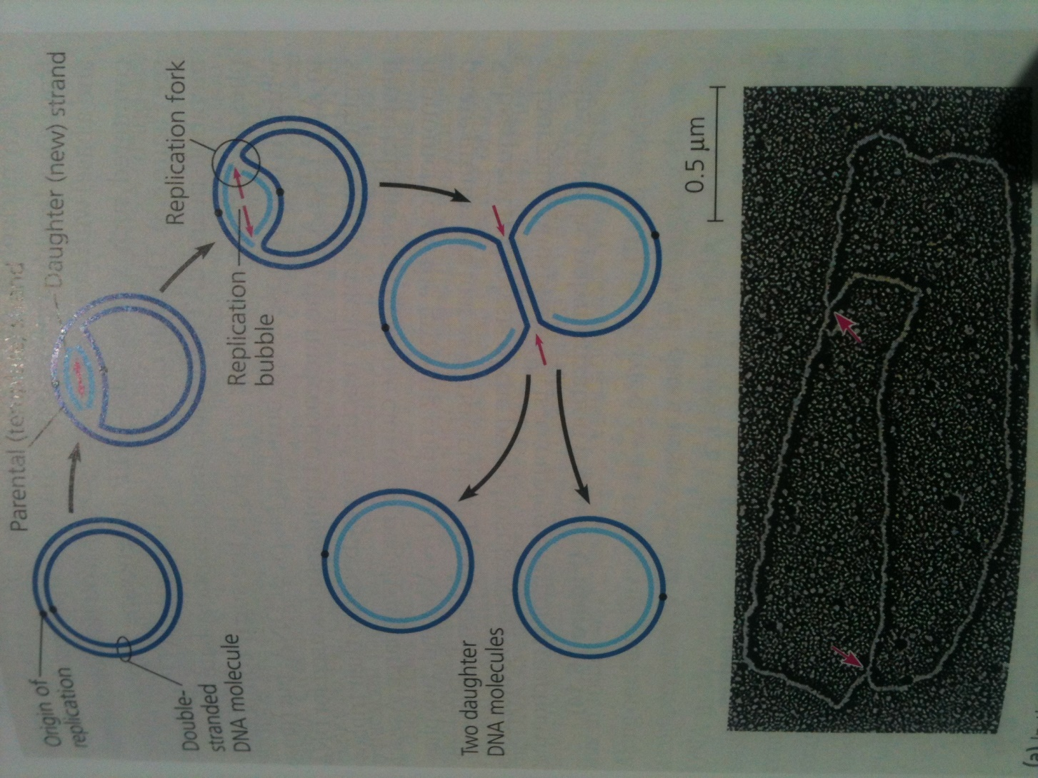

Slide 15
Enzymes involved in “getting started” of DNA replication

Slide 16
Helicases: untwist double helix at replication fork to separate the two parental stands
Single strand binding proteins (SSBP): bind to the unpaired DNA strands, stabilizing them
Topoisomerases: the untwisting of double helix causes tighter twisting and strain ahead of the replication fork, topoisomerase help relieve this train by breaking, swiveling and rejoining DNA strands
Primase: DNA synthesizing enzymes cannot “initiate” synthesis of polynucleotide, they need “already” existing chain of fee 3/OH end to add nucleotides. Therefore, primase enzyme make primer (RNA oligonucleotide) to provide free 3/OH to enzymes to initiate synthesis of polynucleotide.
Primer 5 to 10 nucleotides long

Slide 17
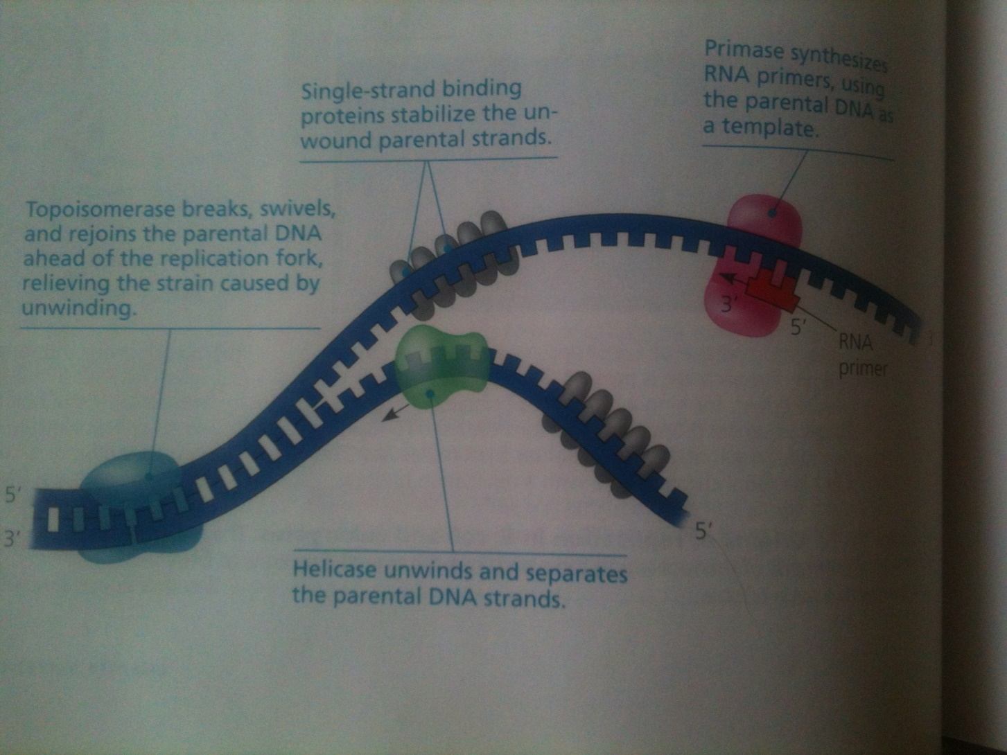

Slide 18
Synthesizing a new DNA strand

Slide 19
DNA polymerases catalyze the synthesis of new DNA by adding nucleotides to a preexisting chain
In prokaryotes e.g. E. coli, several DNA polymerases, of which polymerase I and polymerase III play major role in DNA synthesis
In eukaryotes, at least 11 different polymerases discovered
Primer is required for free 3/OH to add nucleotides to begin DNA synthesis
Polymerase III adds a DNA nucleotide to the growing chain of DNA
Nucleotide comes from nucleoside triphosphate
Two phosphates of nucleoside are lost as pyrophosphate when it is added to the growing DNA chain

Slide 21
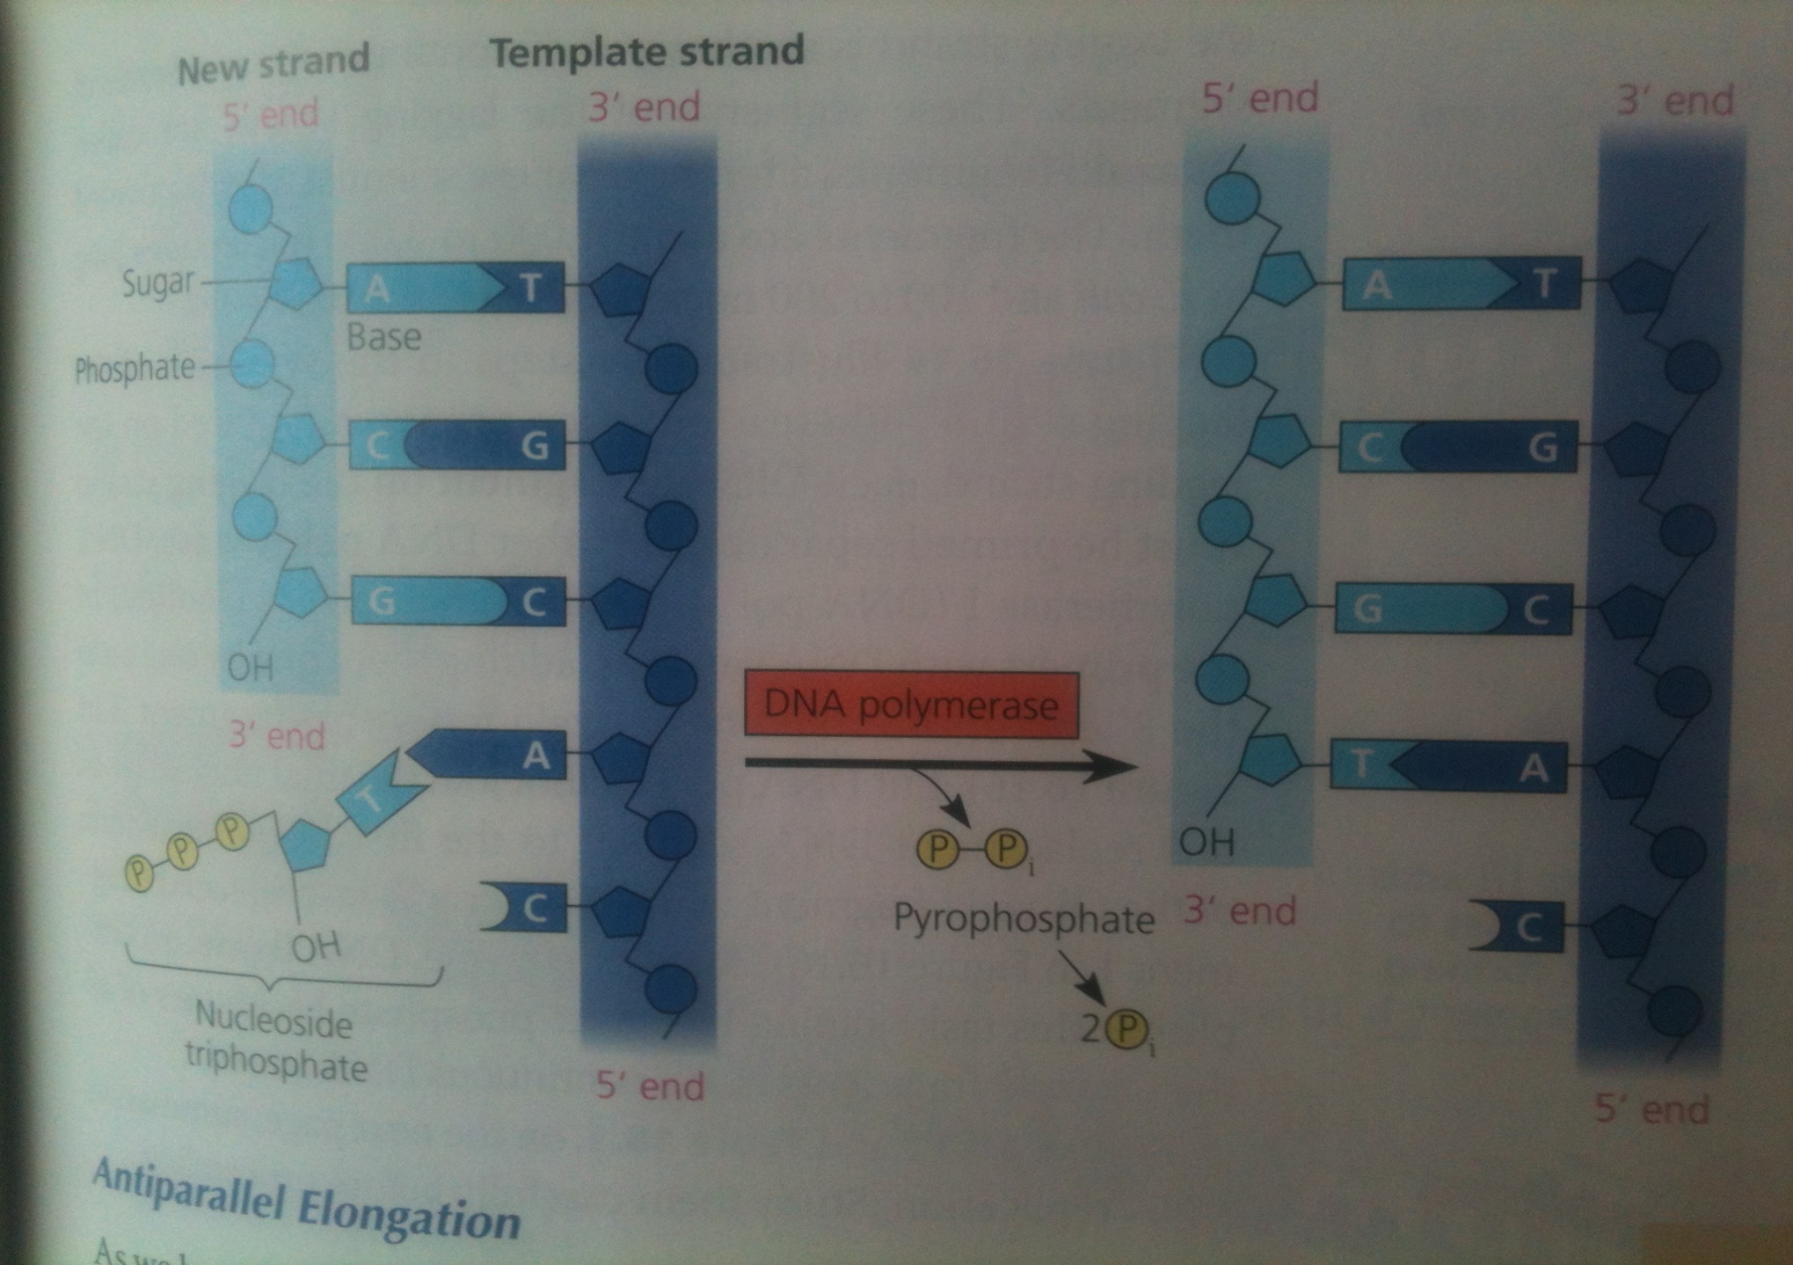

Slide 22
Antiparallel elongation of DNA

Slide 23
As the two strands of DNA molecule are antiparallel, the replication of these two strands is also anti parallel
The DNA strand is being replicated in 3/ to 5/ direction because of the requirement of polymerase III to have free 3/OH end to add nucleotide
The growing chain thus build in 5/ to 3/ direction
Leading strand: elongation of DNA is continuous in the direction of replication fork
Lagging strand: elongation of DNA is away from the direction of replication fork and is discontinuous in fragments known as Okazaki fragments

Slide 24
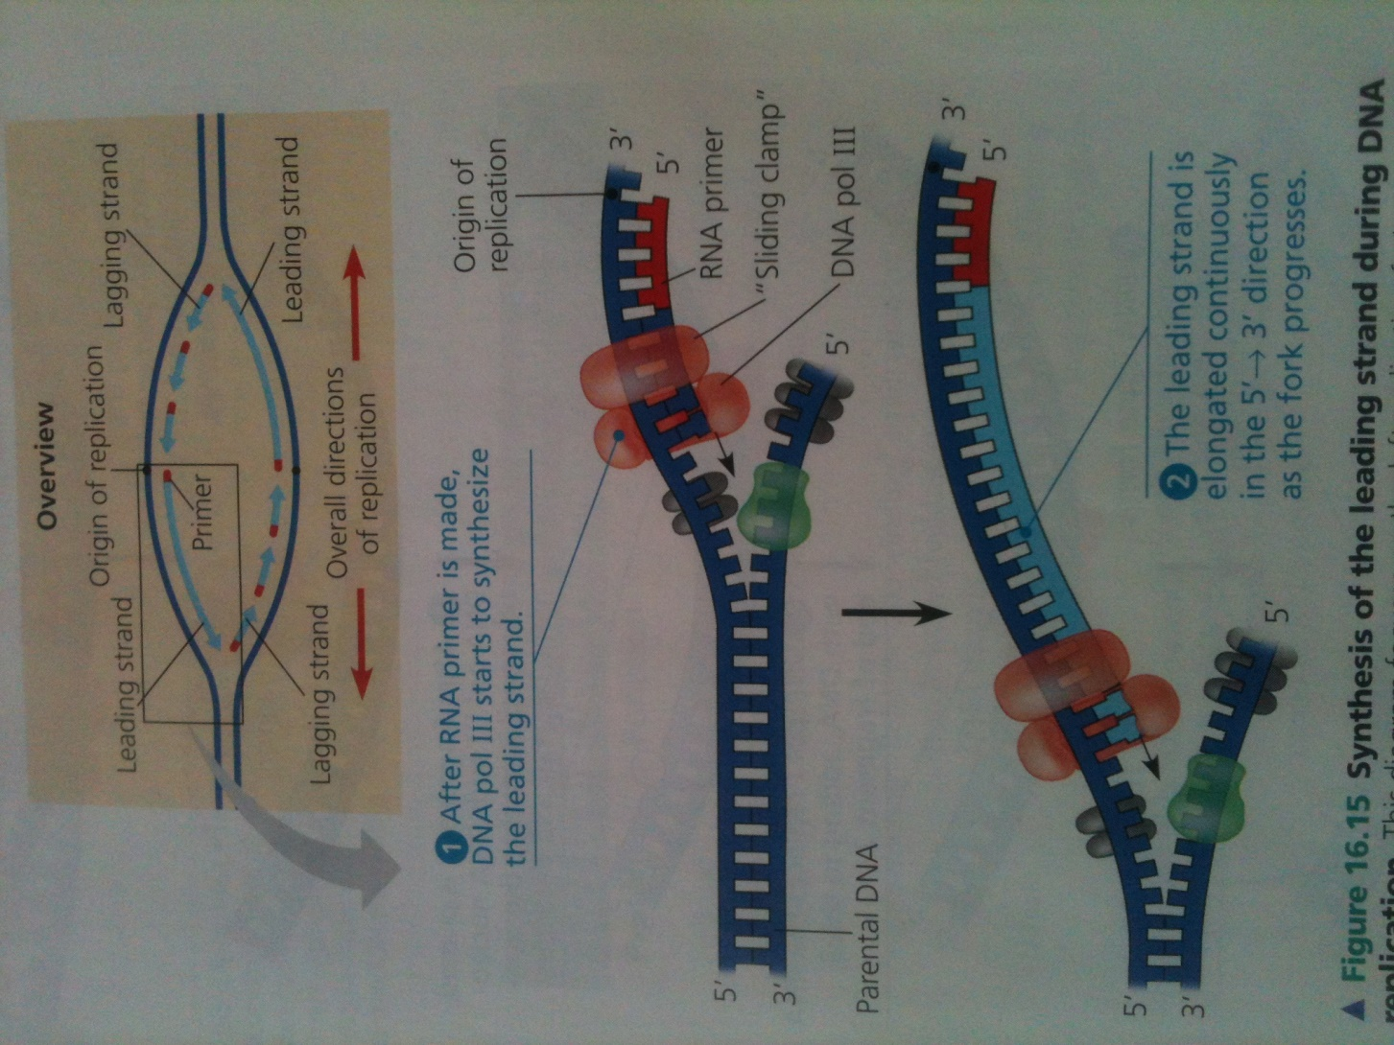

Slide 25
As the growing DNA fragment reaches to the end of other DNA fragment along parental DNA strand, polymerase I replace the primer nucleotides from the end of adjacent DNA fragment until it completely excise RNA primer.
DNA ligase then make covalent bond between the two nucleotides of two fragments together

Slide 26
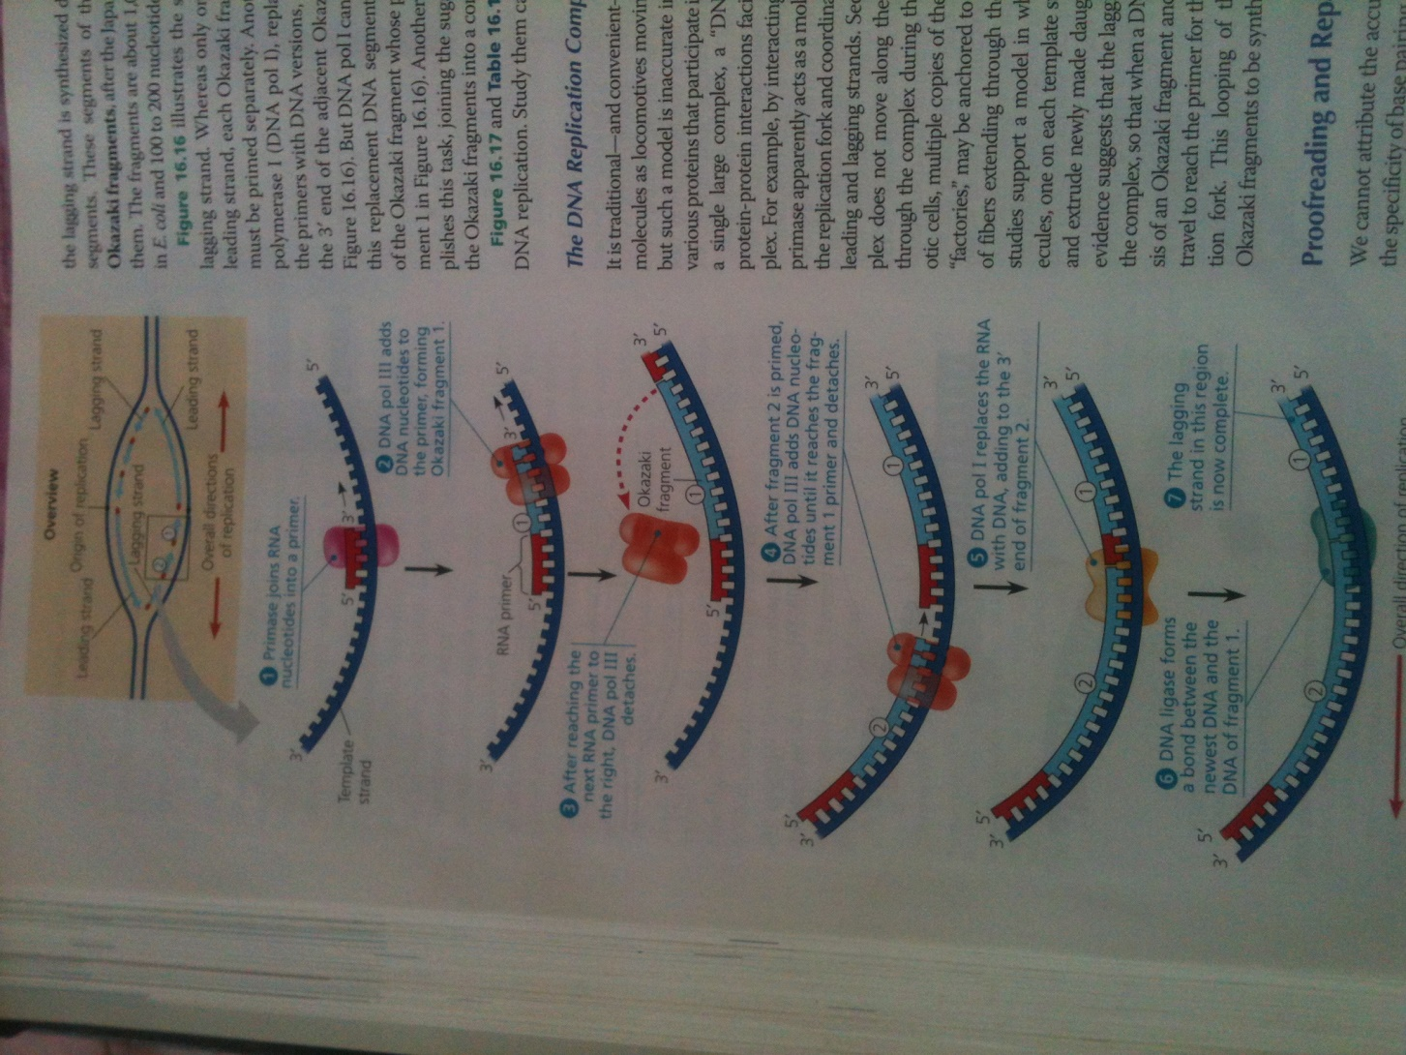

Slide 27
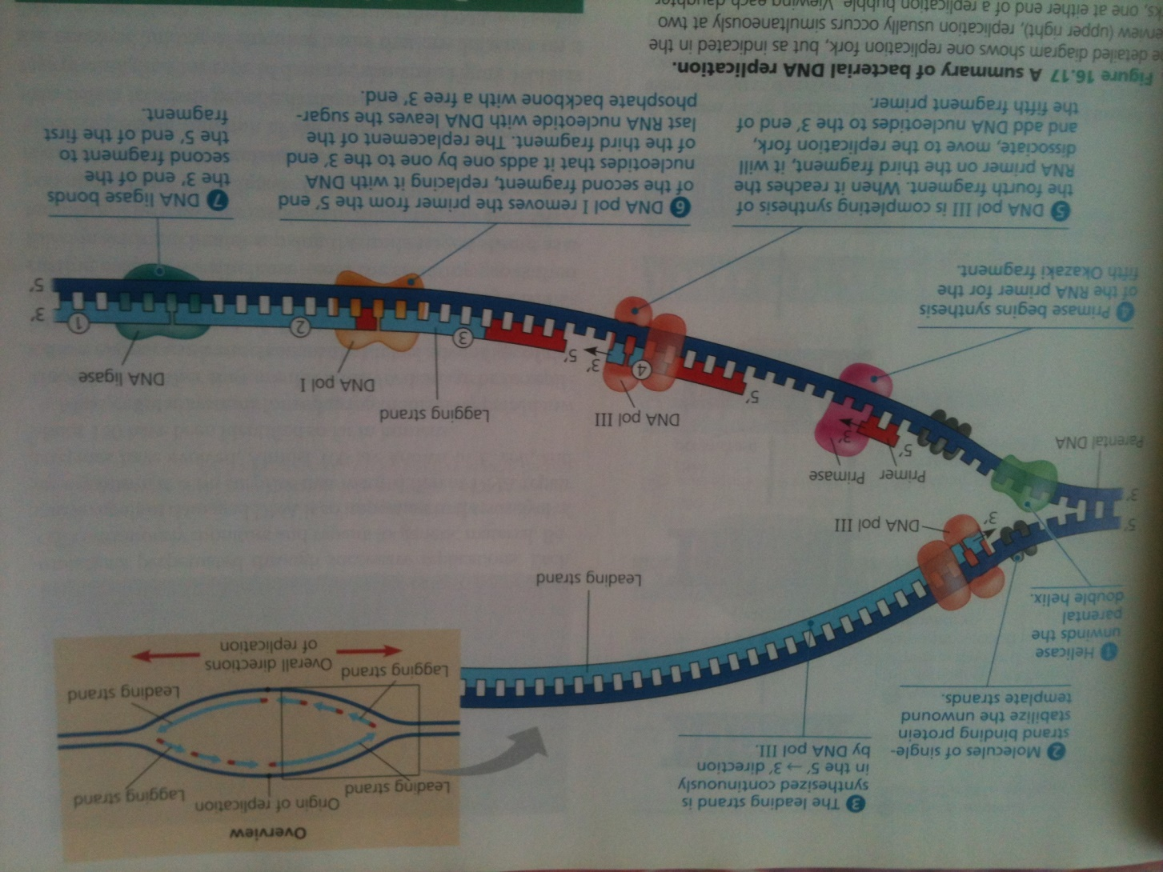

Slide 28
