Slide 2
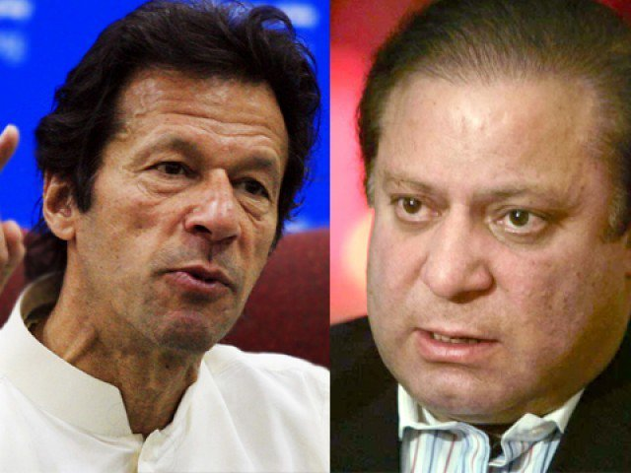
Who is the best leader and why?

Slide 5
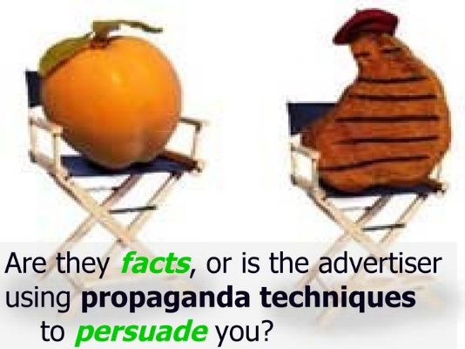

Slide 6
What is Propaganda ?
Information, especially of a biased or misleading nature, used to promote a political cause or point of view.
Information, ideas, or rumors deliberately spread to help or harm a person, group, movement, institution, nation, etc.
Official government communications to the public that are designed to influence opinion. The information may be true or false, but it is always carefully selected for its political effect.

Slide 7
Ideas or statements that are often false or exaggerated and that are spread in order to help a cause, a political leader, a government, etc.
Propaganda is a mode of communication used to manipulate or influence the opinion of groups to support a particular cause or belief. Over the centuries, propaganda has taken the form of artwork, films, speeches, and music.

Slide 8
Despite the fact that its use is not exclusively negative, propaganda very often involves a heavy emphasis on the benefits and virtues of one idea or group, while simultaneously distorting the truth or suppressing the counter-argument.
For example, the Nazi party rose to power by promoting the idea that it would lead Germany out of economic depression, which it claimed was the result of Jewish people stealing jobs from hard-working Germans.

Slide 13
Some Facts About Propaganda
Propaganda messages can be delivered as part of the mainstream news media, including through music, magazines, movies, and television shows.
Propaganda may also take the form of reports, publications, and leaflets targeted to a particular segment of the population.
Propaganda presents the facts selectively in order to encourage people to come to a particular conclusion.
It is common for propaganda to be aimed at children and young adults, because they lack the critical reasoning skills to help determine the objectivity of a particular message.
Techniques used in propaganda can include appeals to fear, statements of prejudice disinformation, demonizing the enemy and scapegoating.
The most effective propaganda campaigns are based upon the truth.

Slide 15
History of Propaganda
Originally this word was derived from an administrative body of the Catholic church (congregation) created in 1622, called the Congregatio de Propaganda Fide (Congregation for Propagating the Faith), or informally simply Propaganda. Its activity was aimed at "propagating" the Catholic faith in non-Catholic countries.

Slide 16
Pre-Modern Precedent
Primitive forms of propaganda have been a human activity as far back as reliable recorded evidence exists.The Arthashastra written by Chanakya (c. 350 – 283 BC), a professor of political science at Takshashila University and a prime minister of the Maurya Empire in ancient India, discussed propaganda in detail, such as how to spread propaganda and how to apply it in warfare. His student Chandragupta Maurya (c. 340 – 293 BC), founder of the Maurya Empire, employed these methods during his rise to power.
Another example of early propaganda is the 12th-century work, The War of the Irish with the Foreigners, written by the Dál gCais to portray themselves as legitimate rulers of Ireland.

Slide 17
19tn Century
Propaganda as generally understood, is a modern phenomenon that emerged from the creation of literate and politically active societies informed by a mass media, where governments increasingly saw the necessity for swaying public opinion in favor of its policies. During the French Revolutionary Propaganda was among the first of the Modern Period. A notable example was perhaps during the Indian Rebellion of 1857, where Indian sepoys rebelled against the British East India Company's rule in India. Incidents of rape committed by Indian rebels against English women or girls were exaggerated to great effect by the British media to justify continued British colonialism in the Indian subcontinent. At the time, British newspapers had printed various accounts about English women and girls being raped by the Indian rebels. It was later found that some of these accounts were false stories created to perpetuate the common stereotypes of the native people of India as savages who need to be civilized by British colonialists, a mission sometimes known as "The White Man's Burden". One such account published by The Times, regarding an incident where 48 English girls as young as 10–14 were supposedly raped by the Indian rebels in Delhi, was criticized as a false propaganda story by Karl Marx, who pointed out that the story was reported by a clergyman in Bangalore, far from the events of the rebellion.

Slide 18
First World War
The first large-scale and organized propagation of government propaganda was occasioned by the outbreak of war in 1914. In the war's initial stages, propaganda output was greatly increased by the British and German governments, to persuade their populace in the justness of their cause, to encourage voluntary recruitment, and above all to demonize the enemy. Heavy use was made of posters, as well as the new medium of film.
Germany
At the start of the war, Germany expanded its unofficial propaganda machinery, establishing the Central Office for Foreign Services, which among other duties was tasked with propaganda distribution to neutral nations, persuading them to either side with Germany or to maintain their stance of neutrality. After the declaration of war, Britain immediately cut the undersea cables that connected Germany to the outside world, thereby cutting off a major propaganda outlet.

Slide 19
The Germans relied instead on the powerful wireless Nauen Transmitter Station to broadcast pro-German news reports to the world. Among other techniques used to keep up the morale of the troops, mobile cinemas were regularly dispatched to the front line for the entertainment of the troops.
Germany published several newspapers and magazines for the occupied areas. The 'Gazette des Ardennes,' was designed for French readers in Belgium and France

Slide 20
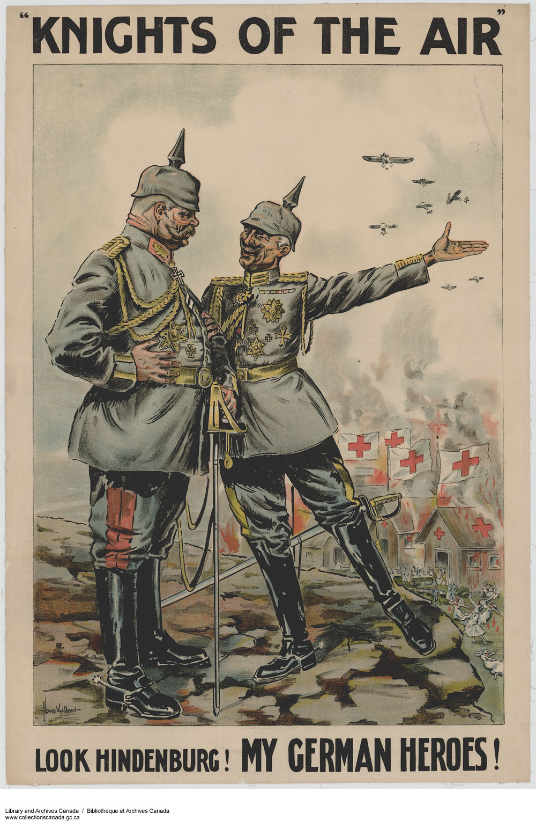
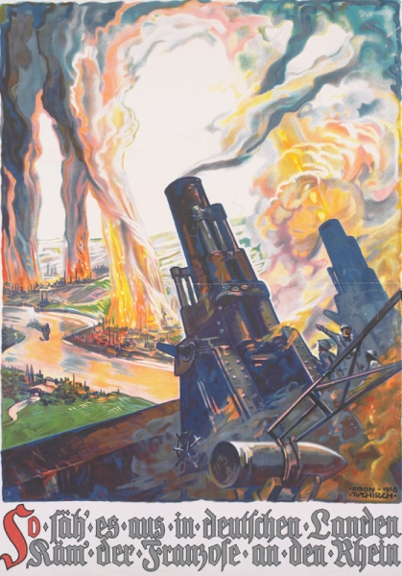
Translation reads: 'This is how it would look in German lands if the French reached the Rhine.' 1918.
Art.IWM PST 7194

Slide 21
Britain
British propaganda during World War I — called "an impressive exercise in improvisation" — was hastily expanded at the beginning of the war and was rapidly brought under government control as the War Propaganda Bureau (Wellington House), under the overall leadership of journalist Charles Masterman. The Bureau began its propaganda campaign on 2 September 1914 when Masterman invited 25 leading British authors to Wellington House to discuss ways of best promoting Britain's interests during the war. Those who attended included William Archer, Arthur Conan Doyle, Arnold Bennett, John Masefield, Ford Madox Ford, G. K. Chesterton, Henry Newbolt, John Galsworthy, Thomas Hardy, Rudyard Kipling, Gilbert Parker, G. M. Trevelyan and H. G. Wells. Several of the writers agreed to write pamphlets and books that would promote the government's point of view; these were printed and published by such well-known publishers as Hodder & Stoughton, Methuen, Oxford University Press, John Murray, Macmillan and Thomas Nelson.

Slide 22
After January 1916 the Bureau's activities were subsumed under the office of the Secretary of State for Foreign Affairs. In May 1916 Masterman began recruiting artists, including Muirhead Bone, Francis Dodd, Eric Kennington and others, to paint pictures of the war in France and the home front. In early 1918 it was decided that a senior government figure should take over responsibility for propaganda and on 4 March Lord Beaverbrook, owner of the Daily Express newspaper, was made Minister of Information. The British effort soon far surpassed the German in its quality and ability to sway the public mood both at home and abroad.
A variety of propaganda methods were used by the British during the war, with emphasis on the need for credibility. Written forms of distributed propaganda included books, pamphlets, official publications, ministerial speeches or royal messages. They were targeted at influential individuals, such as journalists and politicians, rather than a mass audience. Pamphlets were distributed to various foreign countries, primarily the United States: - these pamphlets were academic in tone and factual in nature, distributed through unofficial channels. By 1916, 7 million copies had been circulated by Wellington House in various languages.

Slide 23
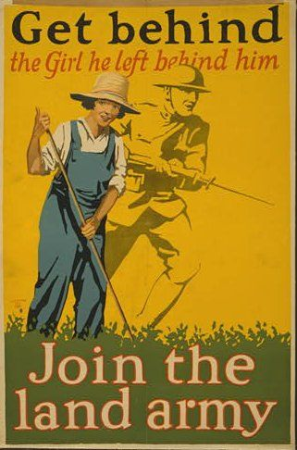
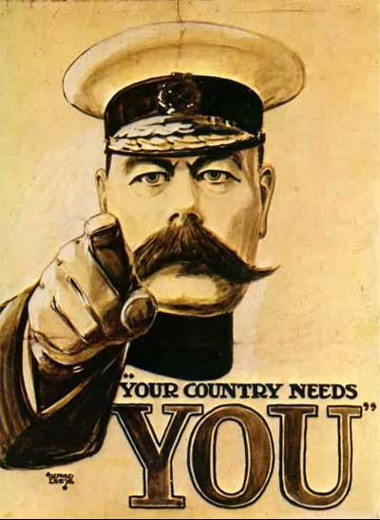
During World War One, British propaganda posters were used to:- ✓ Recruit men to join the army; ✓ Recruit women to work in the factories and in the Women's Land Army; ✓ Encourage people to save food and not to waste it; ✓ Keep morale high and encourage people to buy government bonds.

Slide 24
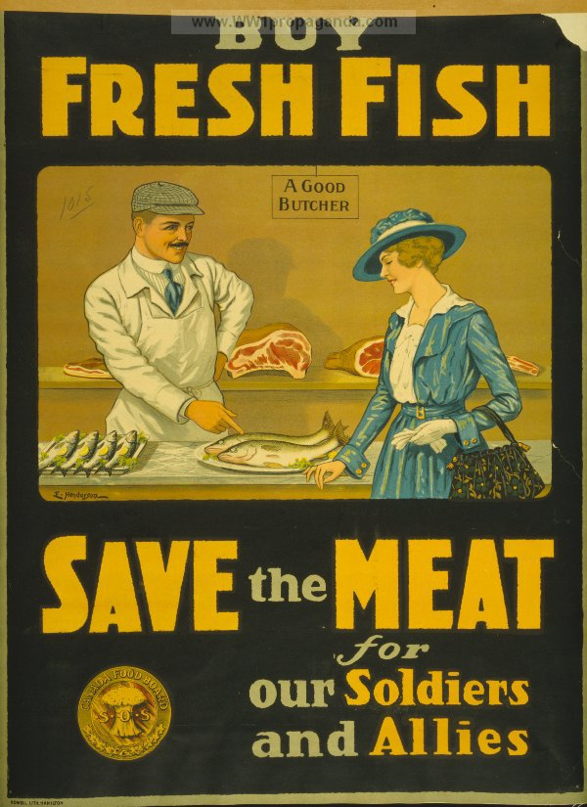
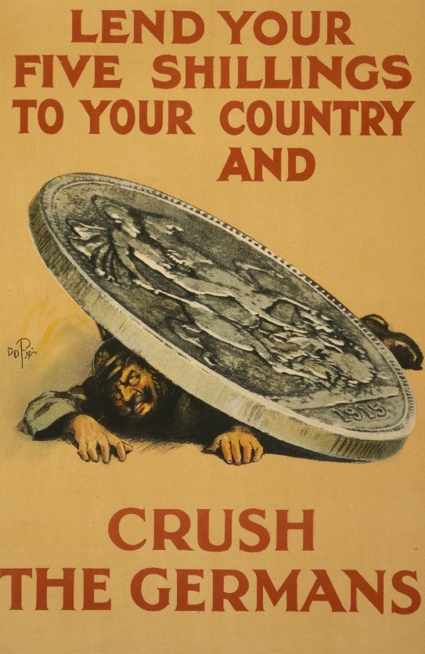

Slide 25
United States
Before the United States declared war in 1917, it established a propaganda department along similar lines. Propaganda experts Walter Lippmann and Edward Bernays participated in the Creel Commission, which was to sway popular opinion to support the government policies
World war II
World War II saw continued use of propaganda as a weapon of war, building on the experience of WW1, both by Hitler's propagandist Joseph Goebbels and the British Political Warfare Executive, as well as the United States Office of War Information.
Within the USA, the British Security Coordination activities worked to counter pro-German sentiment, and isolationist opinion.
The British broadcast black propaganda through fake German-language radio stations to Europe. It was disguised to sound like legitimate German radio broadcasts, but it had a negative twist designed to undermine German morale. The Germans undertook a similar program. The Reich Ministry of Public Enlightenment and Propaganda used English language broadcasts - such as Germany Calling - broadcast to the UK. Presenter William Joyce - a British fascist - gained the nickname "Lord Haw-Haw" from the popular press

Slide 26
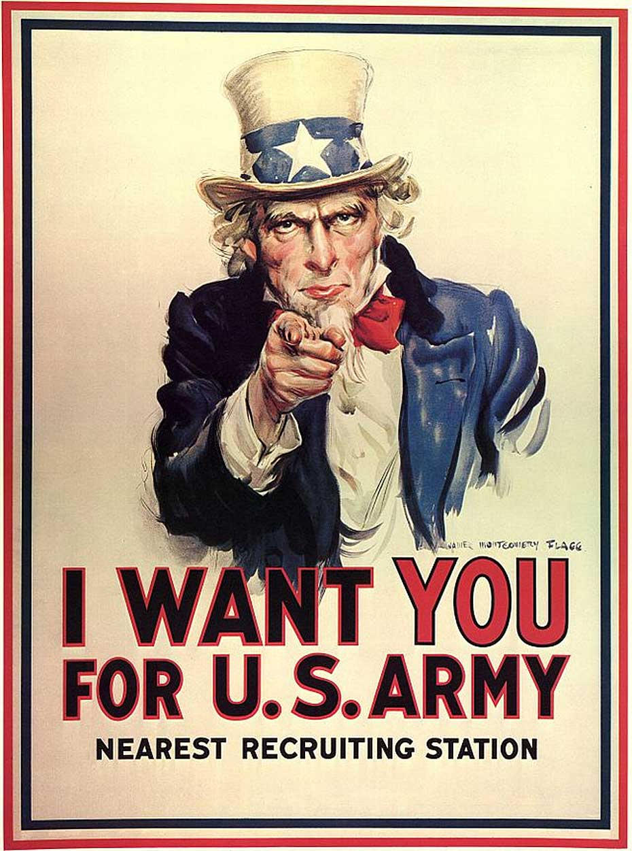
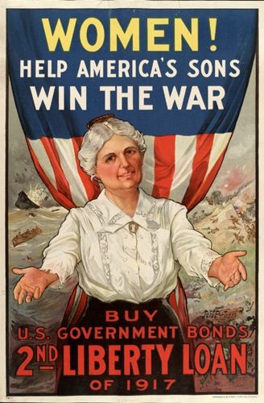

Slide 27
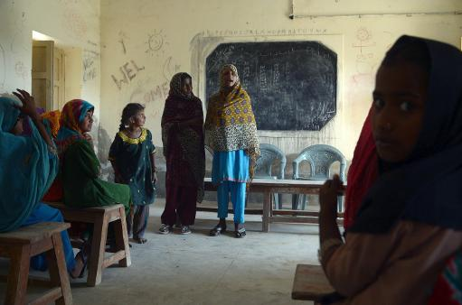
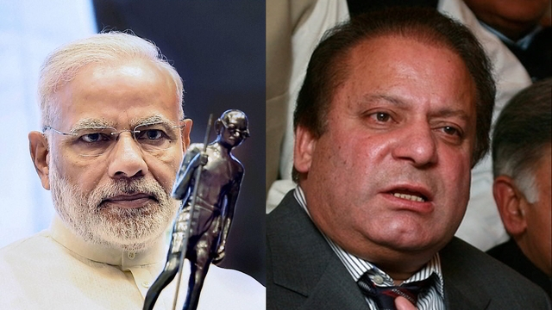
Propaganda in Modern Times.
Examples

Slide 29
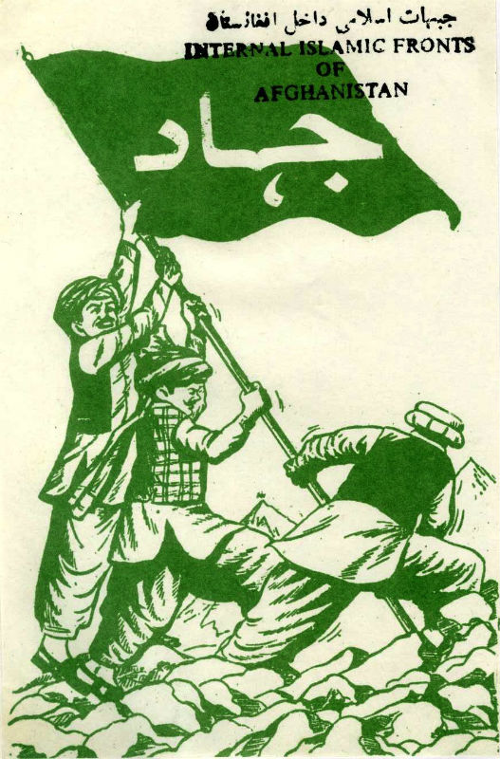
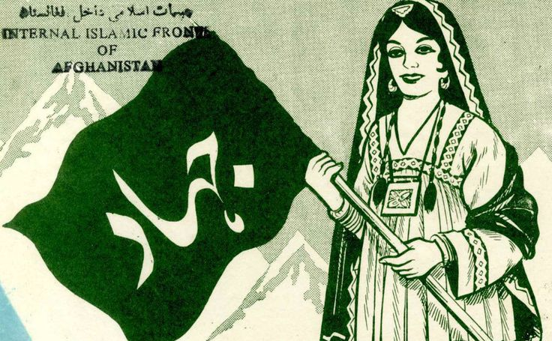

Slide 31
Types of Propaganda
White Propaganda is a type of Propaganda where the correct author of the information is clear and the purpose of the information is transparent. Because of the public accountability of the author, it is suggested that White Propaganda is often mainly based on the fact, and although the whole truth is often not told, it is not intentionally deceptive.
Persian Gulf War
White Broadcasting
During the 1991 Persian Gulf War, the United States Government commissioned the use of White Propaganda radio broadcasts which presented the United States in a positive light and reduced the enemy’s will to resist. White Propaganda radio stations, like the Voice of America, featured programs which gave testimonies from happy Iraqi prisoners of war, selected readings and prayers from the Qur’an, as well as the locations of United States bombing targets for the following day. Stations like the Voice of America attempted to build the credibility of the United States among Iraqi civilians and militants by trying to convince them of the good intentions of the broadcasters.

Slide 32
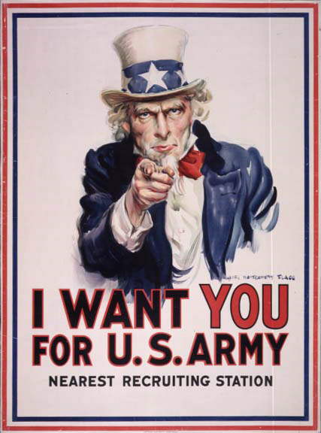
Image for White Propaganda

Slide 33
Black propaganda is false information and material that purports to be from a source on one side of a conflict, but is actually from the opposing side. It is typically used to vilify, embarrass, or misrepresent the enemy.
The major characteristic of black propaganda is that the people are not aware that someone is influencing them, and do not feel that they are being pushed in a certain direction. Black propaganda purports to emanate from a source other than the true source. This type of propaganda is associated with covert psychological operations. Black propaganda is the "big lie", including all types of creative deceit
Governments can be noted to conduct black propaganda
Black propaganda is necessary to obfuscate a government's involvement in activities that may be detrimental to its foreign policies.

Slide 34
Example:
The British broadcast black propaganda through fake German-language radio stations to Europe. It was disguised to sound like legitimate German radio broadcasts, but it had a negative twist designed to undermine German morale. The Germans undertook a similar program. The Reich Ministry of Public Enlightenment and Propaganda used English language broadcasts - such as Germany Calling - broadcast to the UK. Presenter William Joyce - a British fascist - gained the nickname "Lord Haw-Haw" from the popular press

Slide 35
Grey propaganda
Propaganda that does not specifically identify any source
Example;
In the wake of 11 September 2001 involving terrorist attacks against New York and Washington, D.C., the United States prepared the population of Afghanistan for a planned U.S. air and land war by dropping food containers and radios that could only pick up one signal. The U.S.-run radio station, which did not formally identify itself, simply referred to itself as Afghan FM. Sandwiched between some lively Afghan music an announcement was broadcast “for the attention of the noble people of Afghanistan.” The announcer then proceeded to explain that American forces would be passing through the area and that their aim was not to harm the people but rather to arrest Osama bin Laden and those who support him.

Slide 36
Propaganda Techniques
(i) Name-calling:
This technique consists in giving a bad name to a person, a group, an idea or an event. The name so given arouses an emotional attitude of hostility and rejection. The terms “capitalist,” “fascist,” war-monger” create an emotional attitude of hatred toward the person.
Examples.
Nawaz Sharif is called” god father” by PTI leaders.
The B.J.P. was called after the Ayodhya incident a fascist party and a communal organization.

Slide 37
Glittering Generally:
Under this technique the propagandist uses some attractive or impressive words or ideas which mislead the people. He may call his party “the protector of Islam” or the “savior of Women” or use the words like secularism, equality, justice, democracy to influence the public.
Testimonial
A propaganda technique in which a famous person or a celebrity endorse a certain view, and testifies to the idea or product. This is an effective technique of propaganda which often works wonders to influence an idea.
Example;
Shahid Afridi promotes Head & Shoulder and he wants his fans to buy it.

Slide 38
Plain-folk Device:
This device is used extensively by politicians. The politician professes that he is just like others, with their common virtues and vices. Thus a leader may embrace a child in a slum area or take his lunch sitting with the slum dwellers on a mat to impress upon them that he is one of them.
Band-wagon:
Under this technique the propagandist advertises that since everybody is doing a thing, therefore, you may as well do it. Thus, the advertisement, “Five crores of people in Pakistan are using Head & Shoulder so you also should have it today” is a band-wagon technique.

Slide 40
Q & A

