Slide 1
PERFORMANCE APPRAISAL
Performance Appraisal is the systematic evaluation of the individual with respect to his or her performance on the job and his or her potential for development.
PURPOSES
    Training and development
    Identification of potential
    Promotion decision
    Compensation administration
    Work force planning
    Validation/ Confirmation of selection procedure

Slide 2
METHODS OF APPRAISAL
A) Traditional Methods
B) Modern Methods
A. TRADITIONAL METHODS
1) Rating Scales
2) Checklists
3) Forced Distribution Method
4) Critical incident method
5) Annual confidential report
6) Essay method

Slide 3
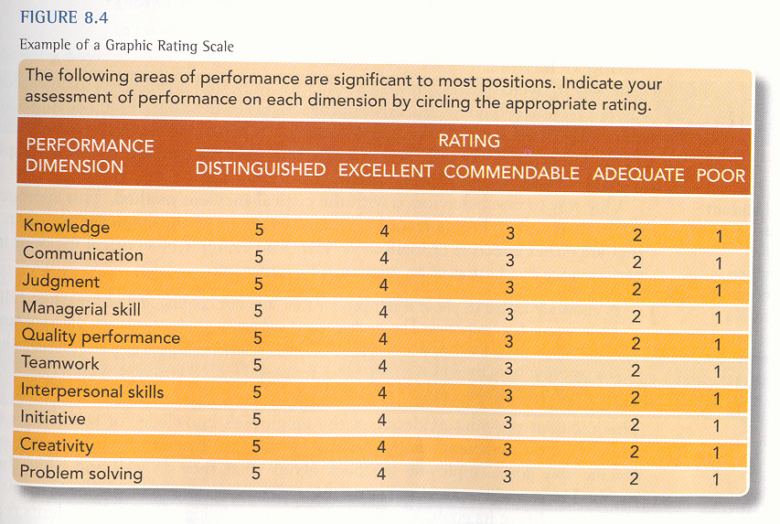
1. RATING SCALES
A simple and popular technique.
Consists of various job-related performance criterion which are to be rated on a scale of 1 to 5.

Slide 4
2. CHECKLIST METHOD
The checklist method requires the rater to select statements that describe employee’s performance and characteristics. The rater may be immediate boss. The items are assigned weights on the checklist depending on each item’s importance. The result is called weighted checklist.
The advantages are economy, ease of administration, The limited training required of trainers and standardization.
The disadvantages are rater bias (halo effect), use of personality criteria instead of performance, misinterpretation of checklist and use of improper weights.
Check each of the following items that apply to the named employee’s performance
Employee’s Name __________ Department ________
Rater’s Name ___________ Date ________
Weights Check Here
(6.5) 1. Employee works overtime when asked _____________
(4.0) 2. Employee keeps workstation or desk well organized _____________
(3.9) 3. Employee cooperatively assists others who need help _____________
(4.3) 4. Employee plans actions before beginning job ______________
. .
. .
(0.2) 10. Employee listens to others’ advice but seldom follows it _____________
100. Total of weights

Slide 5
3. COMPARATIVE EVALUATION APPROCHES
Straight Ranking method
Ranking employees from best to worst on a particular trait, choosing highest, then lowest, until all are ranked.
1 __ 2__ 3__ 4__ 5__ 6 __ 7__ 8__ 9__ 10__
HIGHEST LOWEST
Alternative ranking
Ranking employees from WORST to BEST on a particular trait, choosing LOWEST, then HIGHEST, until all are ranked.
10 __ 9__ 8__ 7__ 6__ 5 __ 4__ 3__ 2__ 1__
LOWEST HIGHEST

Slide 6
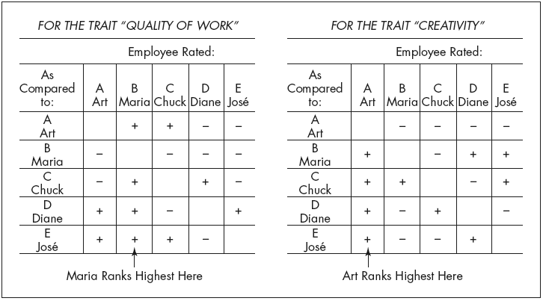
4. Paired comparison method
Ranking employees by making a chart of all possible pairs of the employees for each trait and indicating which is the better employee of the pair.
Note: + means “better than.” − means “worse than.” For each chart, add up the number of 1’s in each column to get the highest-ranked employee.

Slide 7
5. FORCED DISTRIBUTION METHOD
Based on the assumption that the employee performance levels conforms to a normal statistical distribution ( a bell-shaped curve).
The rater is compelled to distribute the employees on all points on the rating scale.
-----5-------4-------3-------2-------1------
Excellent →Poor
“No more than 5% of employees should receive a “5” rating.”
“At least 50% of employees should receive a rating of “3” or lower.

Slide 8
6. CRITICAL INCIDENTS METHOD
It was developed following the research conducted by the armed forces in the United States during World War II.
Employee’s performance is measured in terms of certain ‘events’ or ‘episodes’ that occur in the performance of employee’s job.
The critical incidents are discovered after a thorough study of the personnel working on the job. The collected incidents are then ranked in the order of frequency and importance.
7. ESSAY METHOD
Supervisor makes a free form, open-ended appraisal of an employee in his own words and puts down his impressions about the employee.
Usually the following factors are taken into consideration:
1) Relations with fellow workers.
2) General organization and planning ability.
3) Job knowledge and potential.
4) Employee characteristics and attitude.
5) Understanding and application of company policies and procedures.

Slide 9
8. CONFIDENTIAL REPORT
A traditional form of appraisal used mostly in govt. organization.
A report is prepared by the employee’s immediate superior. It covers the strengths-weaknesses, achievements-failures, personality and behavior of the employees.
This report is kept confidential and is considered while making promotion decisions.
B. MODERN METHODS
1. Management by Objectives (MBO)
2. BARS
3. Assessment Centers
4. 360 degree evaluation.

Slide 10
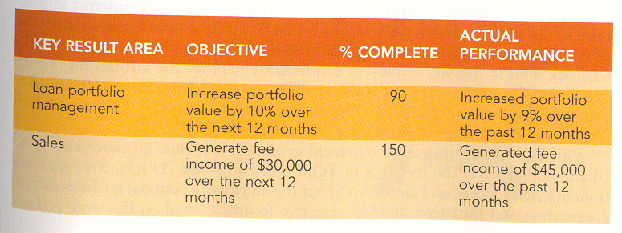
1. MANAGEMENT BY OBJECTIVES
The concept of MBO was developed by PETER F. DRUCKER in 1954.
Definition: MBO is a process whereby the superiors and subordinates of an organization jointly identify its common goals, define each individual’s major areas of responsibility in terms of results expected of him and use these measures as guides for operating the unit and assessing the contribution of each member.

Slide 11
2. BEHAVIORALLY ANCHORED RATING SCALE
A quite new technique developed in 1960 that identify and evaluate relevant job-related behaviors. 1 shows the lowest and 7 shows the highest performance.
BEHAVIORAL EXPECTATION RATING SCALE FOR HOTEL BAR TENDER
Performance Category
Extremely Outstanding Performance | 7 | You can expect this bar tender to help customers in need.
Good performance | 6 | You can expect this bar tender to calm down arguments before they erupt into fights.
Fairly Good Performance | 5 | You can expect this bar tender to use direction about whether to continue serving intoxicated customers who are with other patrons.
Acceptable Performance | 4 | You can expect this bar tender to stop serving drinks to those who intoxicated and alone.
Fairly Poor Performance | 3 | You can expect this bar tender to make idle conversation with customers who are alone.
Poor Performance | 2 | You can expect this bar tender to check identification of young customers on their first time in the bar
Extremely Poor Performance | 1 | You can expect this bar tender to pick up customers’ drinks, finished or not, with little or no warning at closing time.

Slide 12
3. ASSESSMENT CENTERS
are standardized employees appraisals by multiple raters and evaluations. Used for highly responsible jobs.
Interviews, psychological tests, peer rating, simulated work environments, leadership style, personal background histories, group discussion, in-depth interviews etc to evaluate their future potential.
Psychologist and manager evaluate the strengths, weaknesses and future potential of each attendee.
Assessment centers are both time-consuming and costly.

Slide 13
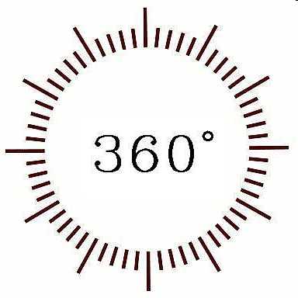
4. 360-Degree Evaluation
A multi-rater Evaluation that involves input from multiple levels within the firm and external source as well. The raters include;
Peers (Coworkers)
Subordinates
Super-ordinates
Customers

Slide 14
PROBLEMS IN APPRAISAL/ ERRORS IN JUDGMENT
HALO ERRORS
The appraiser allows the single characteristics of the employee to dominate his judgment of the employee.
E.g. good communication skills.
LENIENCY ERRORS
Gives harsher evaluation than deserved
Gives higher ratings than deserved
CENTRAL TENDENCY
Rater unwilling to give extreme ratings, use only the middle part of the scale. Rater neither applauds nor condemns. It happens because rater is unfamiliar to all employees.
DEPARTMENTAL PRESSURES: Bonus/Pay increase equal for all employees.
Training opportunity needs selection fairly. Not for all employees.

