Slide 2
Protein Synthesis – Translation

Slide 3
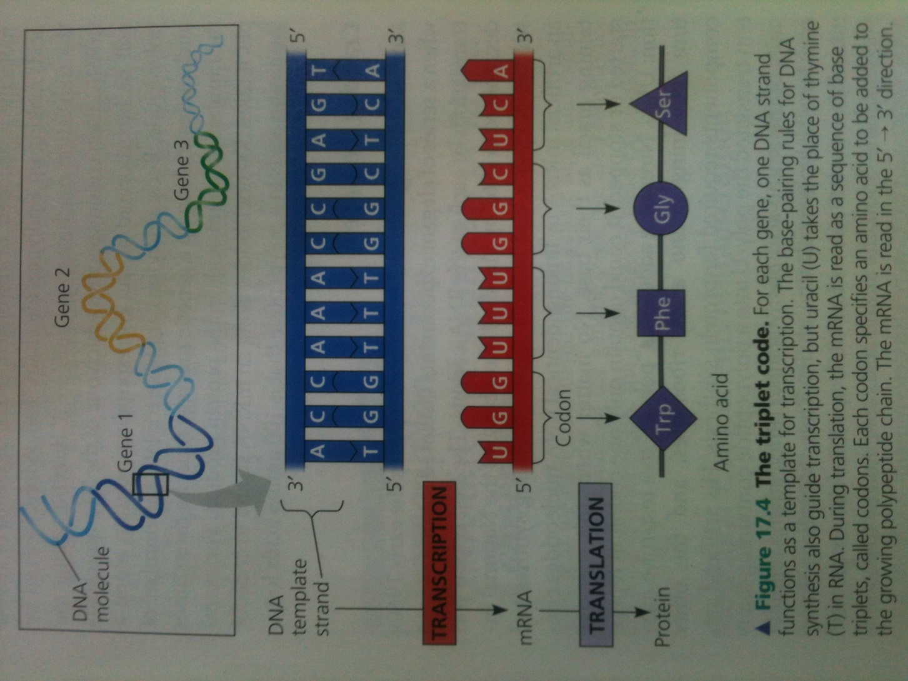

Slide 4
Genetic code

Slide 5
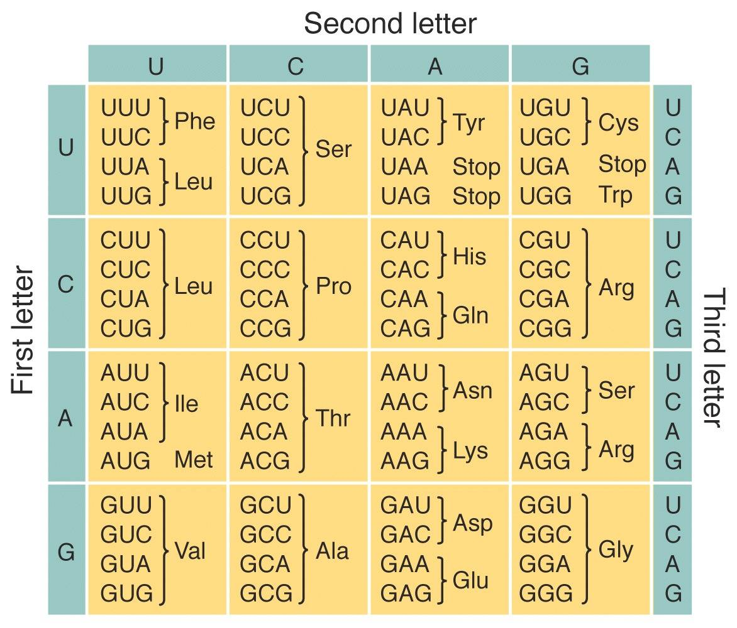

Slide 6
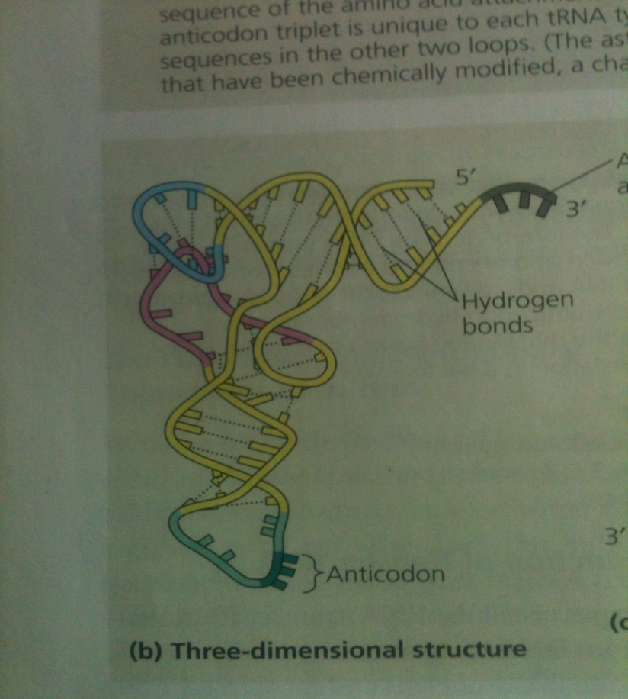
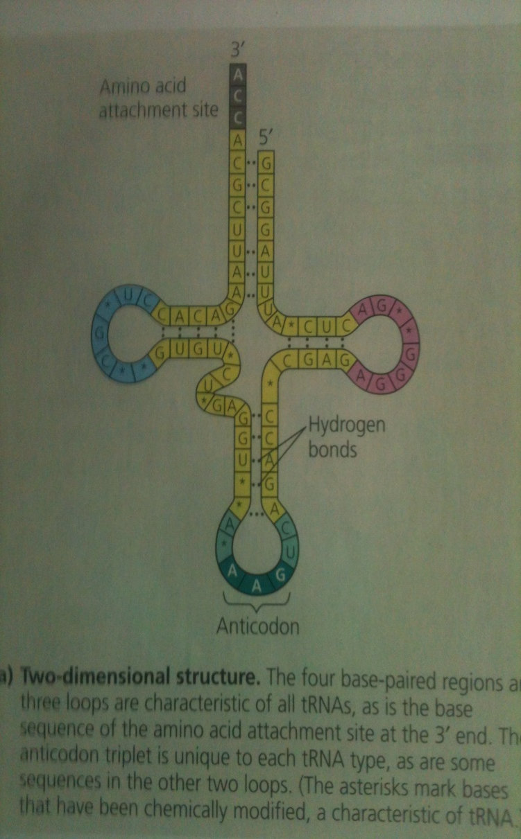
Molecular components of translation
mRNA, rRNA, tRNA and amino acids
tRNA: single RNA strand of about 80 nucleotides long
It functions for attaching a given amino acid to the growing polypeptide chain
It is a three dimensional structure molecule

Slide 7
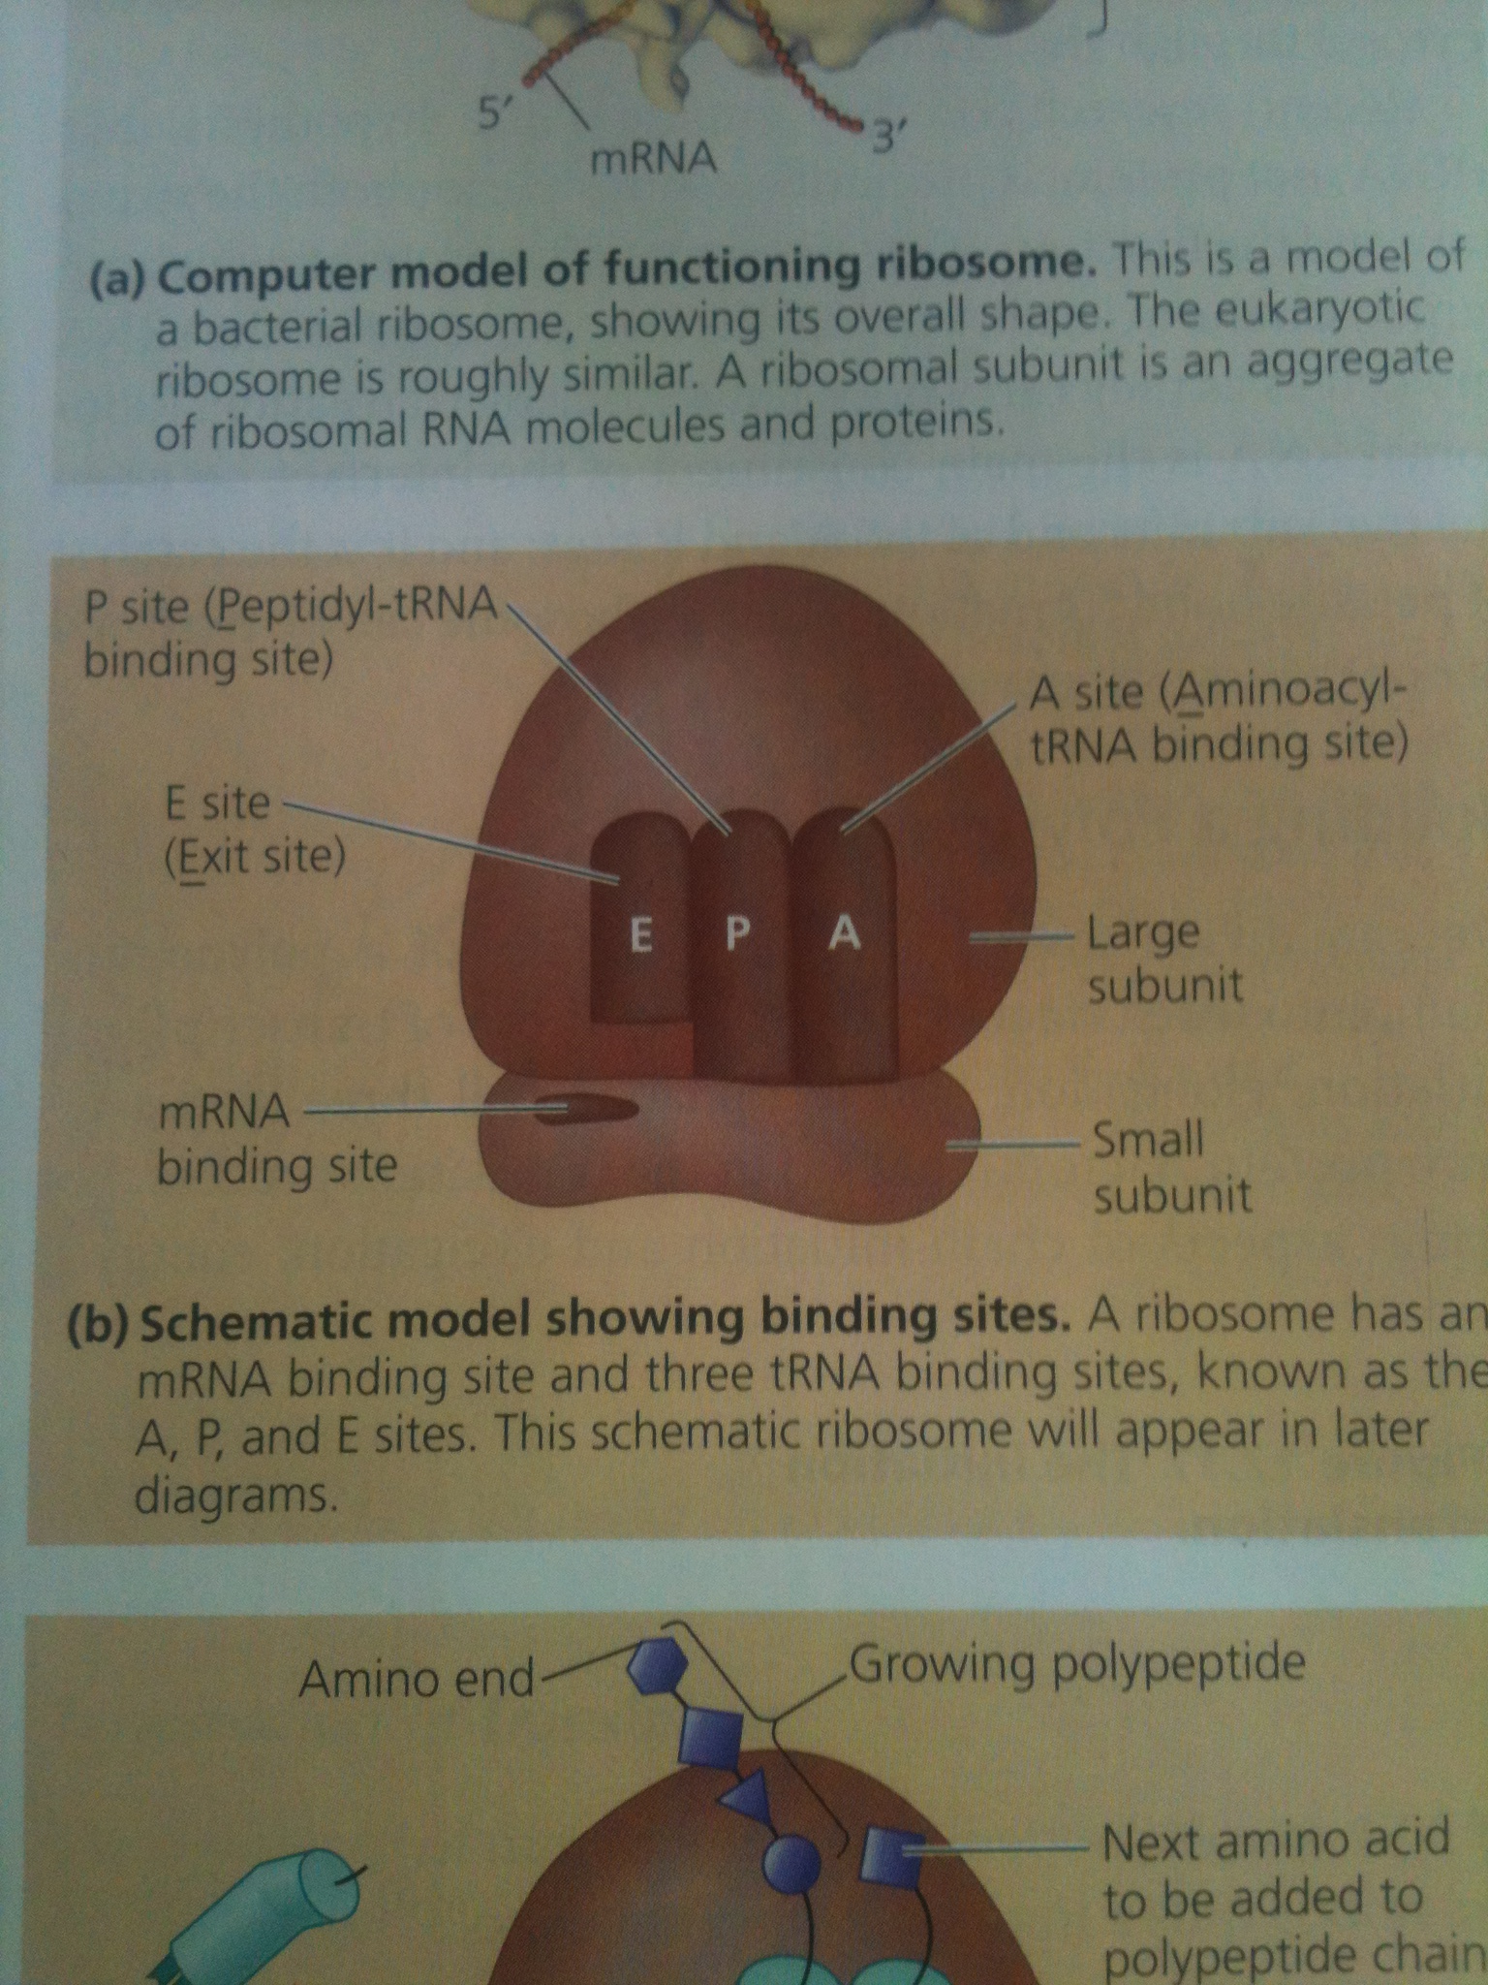
rRNA and ribosome
Ribosomes made of rRNA and proteins
Made in nucleus then transported to cytoplasm
Two subunits large and small
Three sites of large subunit of rRNA: A (Aminoacyle tRNA)site, P (peptidyl-tRNA binding) site and E (exit) site
Small subunit is for mRNA attachment
The two subunits join only when mRNA get attach to them

Slide 8
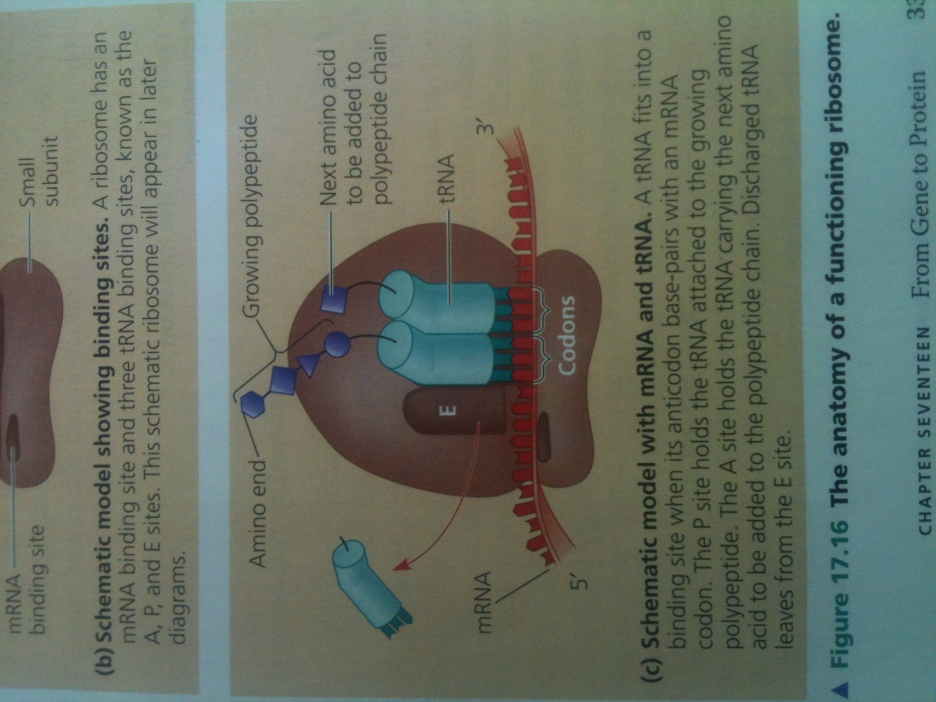

Slide 9
Building a polypeptide
Ribosome association and initiation of translation
bringing together tRNA with an amino acid, mRNA and the two subunits of ribosome
Small subunit of ribosome binds to mRNA and specific tRNA
The small subunit binds mRNA at specific RNA sequence upstream of start codon (AUG)
OR
The small subunit with initiator tRNA already bound, binds to the 5/ cap of mRNA until it reaches the start codon and here tRNA hydrogen bounds to it
In either case start codon act as a signal to initiate translation

Slide 10
The union of tRNA, mRNA and small subunit of ribosome is followed by attachment of large subunit of ribosome to complete/form translation initiation complex
Proteins called “initiation factors” bring components of initiation complex together and GTP provides energy for this process
The initiator tRNA sits in the P site of ribosome
The vacant A site is for the next aminoacyl tRNA
NOTE: polypeptide is synthesized in one direction: 5/ - 3/ along mRNA
NOTE: initial methionine at amino end “N-terminus” toward final aminoacid “carboxyl end OR C-terminus”

Slide 11
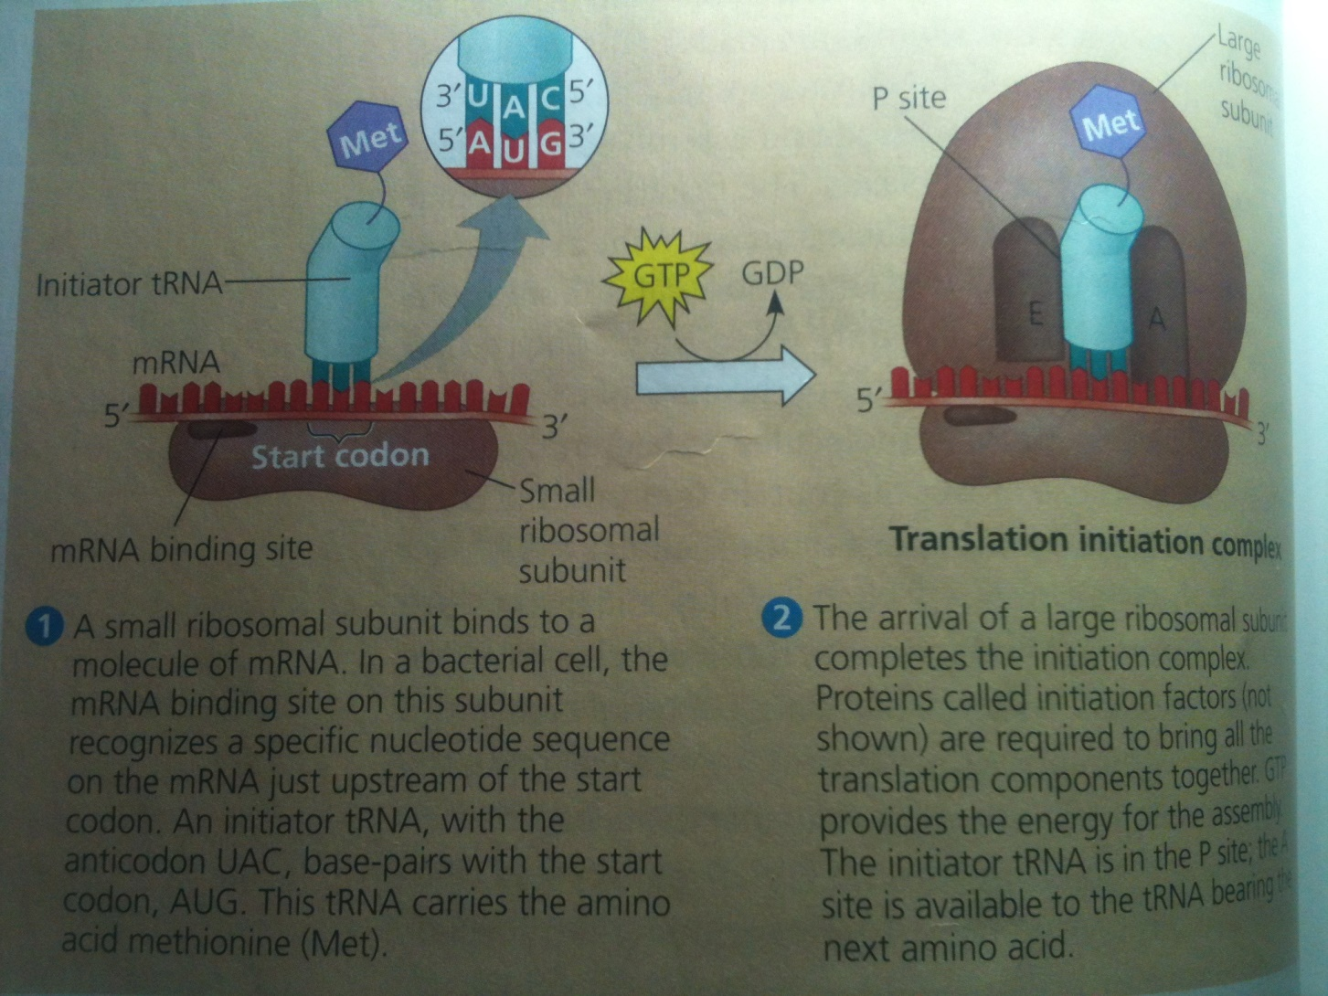

Slide 12
Elongation
Amino acids are added one by one to the growing chain of polypeptide translating the mRNA
Participation of several proteins called “elongation factors” is required
GTP provides energy for each step

Slide 13
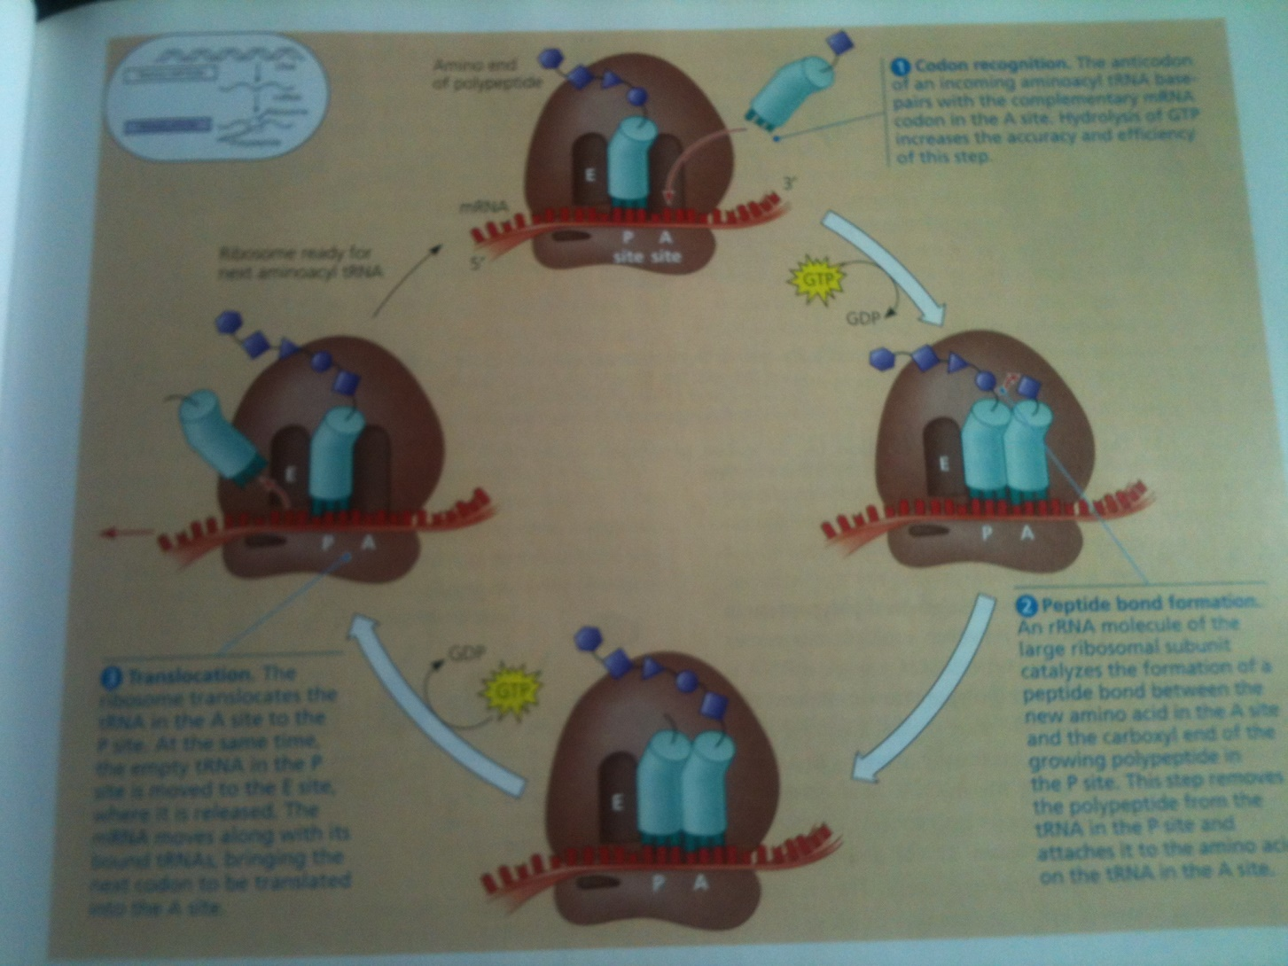

Slide 14
Termination
Elongation of polypeptide chain continues until stop codon reaches on mRNA at the A site on ribosome
The triplets UAG, UAA, and UGA do not code for any amino acid thus act as a signal to stop polypeptide synthesis
The protein release factor binds to stop codon at A site
This release factor add water to A site
This reaction hydrolyze (break) the bond between tRNA and polypeptide at P site of ribosome
Releasing the polypeptide through the exit tunnel of ribosom’s large subunit

Slide 15
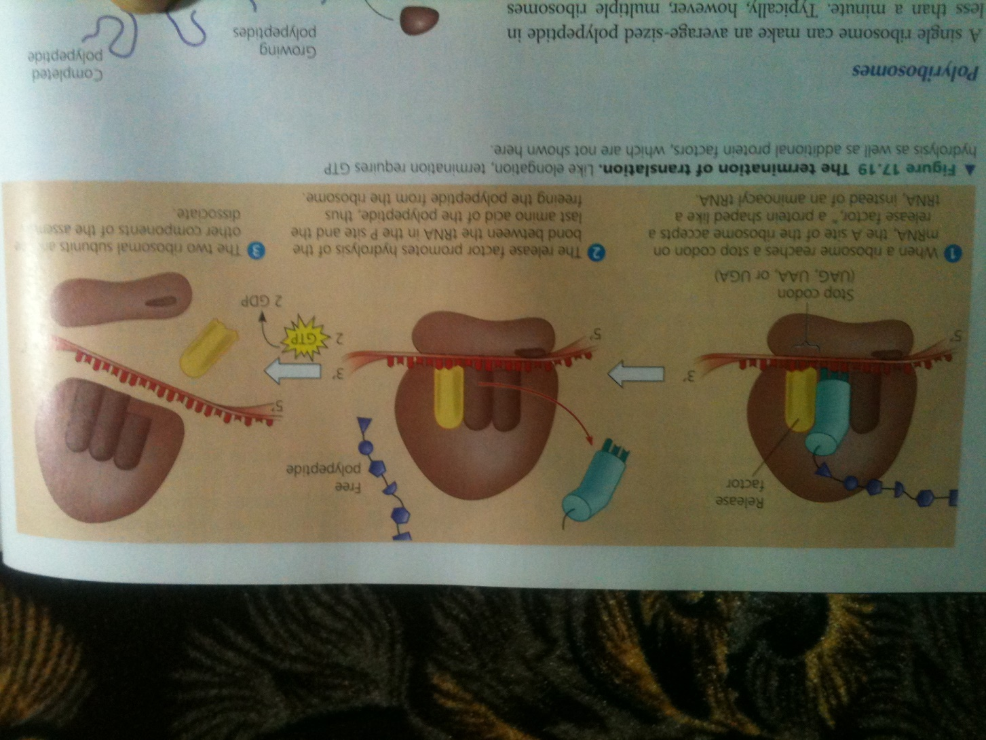

Slide 16
Something very interesting ☺
Polyribosomes
A single ribosome can make an average sized polypeptide in less than a minute
Many ribosomes translate an mRNA at a same time to make many copies of polypeptide chain from a given mRNA very quikly
Once a ribosome moves past the start codon, a second ribosome can attach to mRNA resulting in trailing along the mRNA
Such strings of ribosomes are called polyribosomes

Slide 17
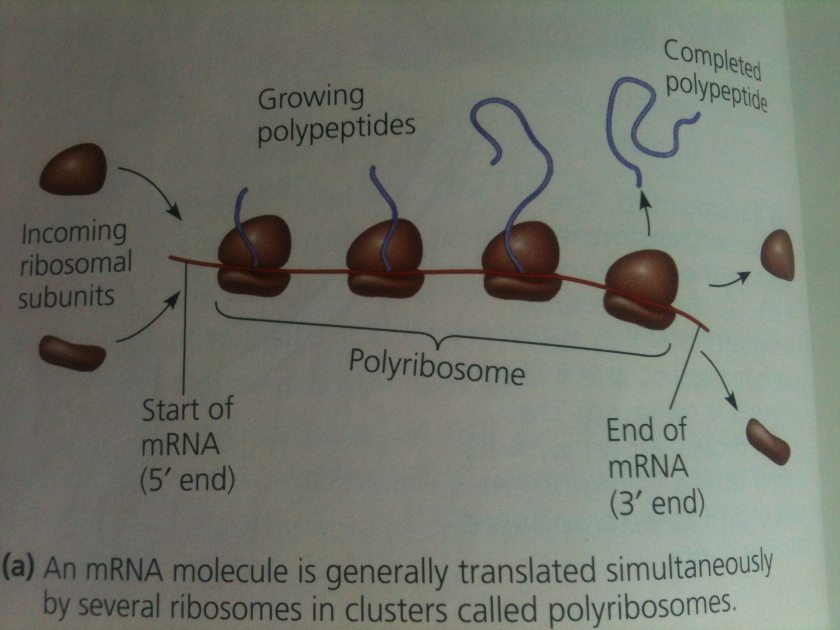

Slide 18
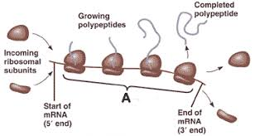

Slide 19
Peptide bond between amino acids

Slide 20
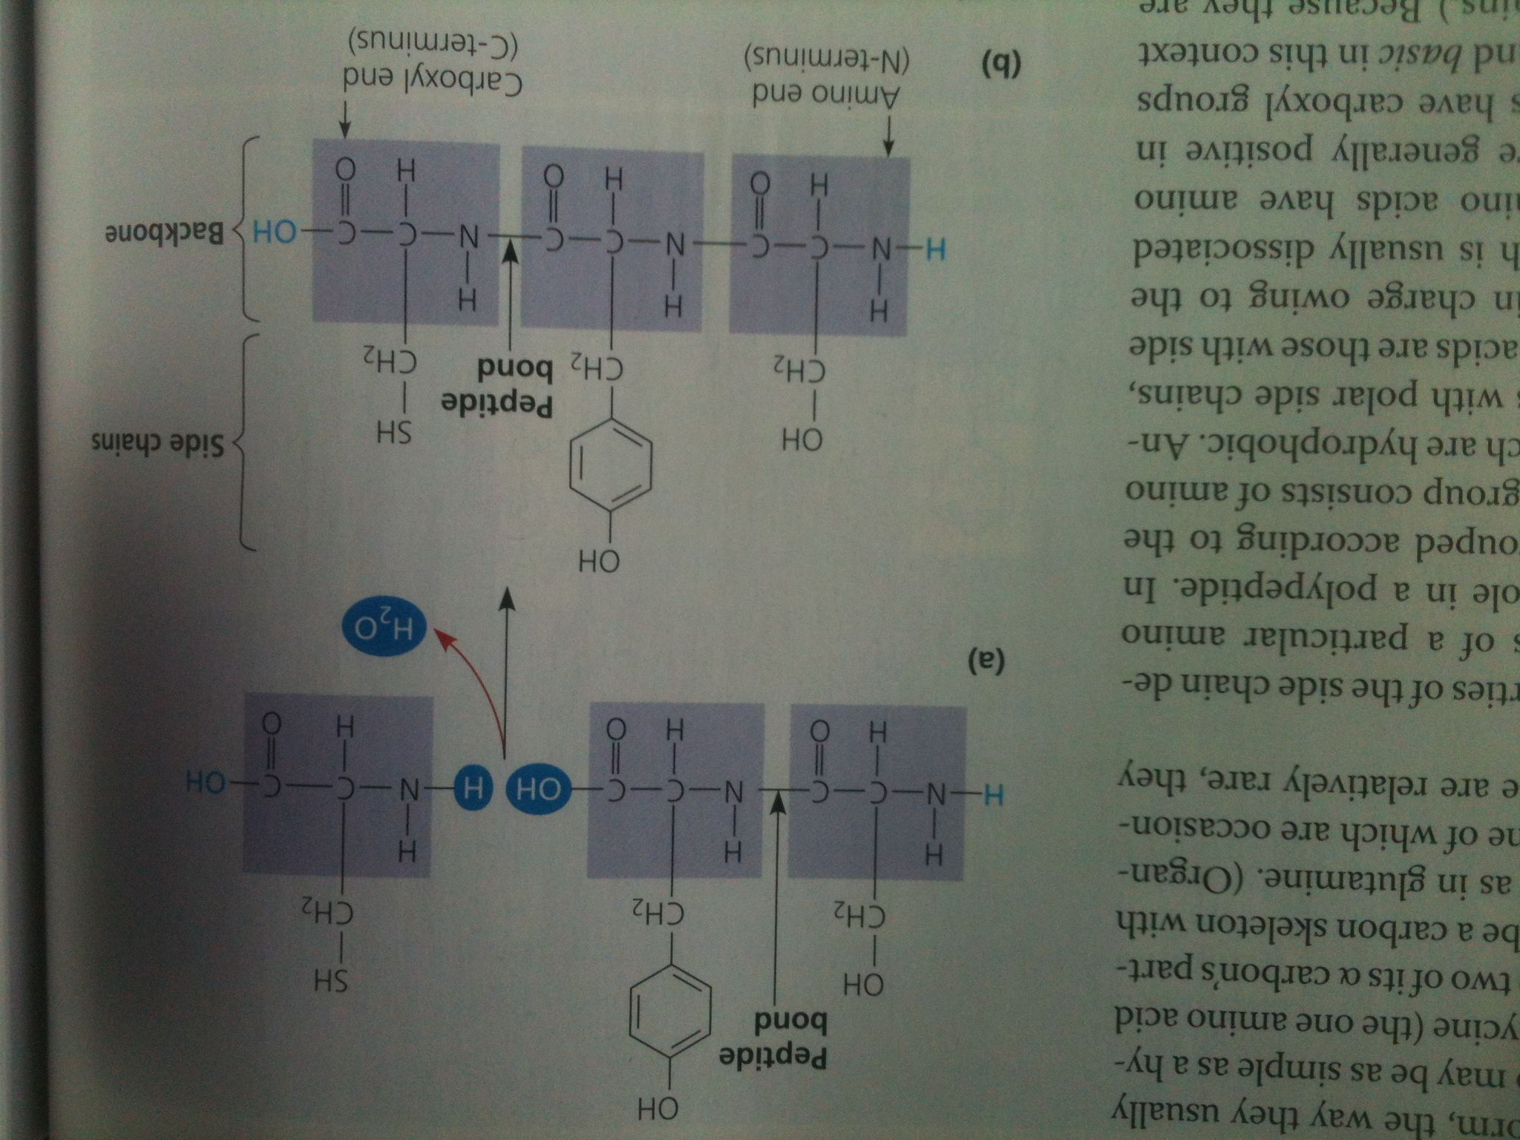

Slide 21
Modifications in Polypeptide Chain: Completing and Targeting the Functional Protein

Slide 22
Protein folding
Polypeptide chains undergo modifications after translation
Primary protein structure
Polypeptide chain being translated from mRNA before its coiling and supercoiling, having a unique sequence of amino acids.
e.g. Transthyretin, globular protein of blood, having FOUR identical polypeptide chains, each made up of 127 amino acids.
The UNIQUE sequence of amino acids in a polypeptide chain is by inherited genetic information in a gene

Slide 23
Secondary Protein Structure
Through hydrogen bonding between amino acids of polypeptide chain, the polypeptide chain gets coiled into two main patterns
1- α helix: a delicate coil held together by hydrogen bonding between every four amino acids. E.g. Some fibrous proteins such as α-keratin (hair protein) have α helix over most of the length of protein
2- β pleated sheets: two or more regions of polypeptide chain lying side by side are connected by hydrogen bonding. These sheets make up the core of many globular proteins. E.g. silk protein (transthyretin) of spider web

Slide 24
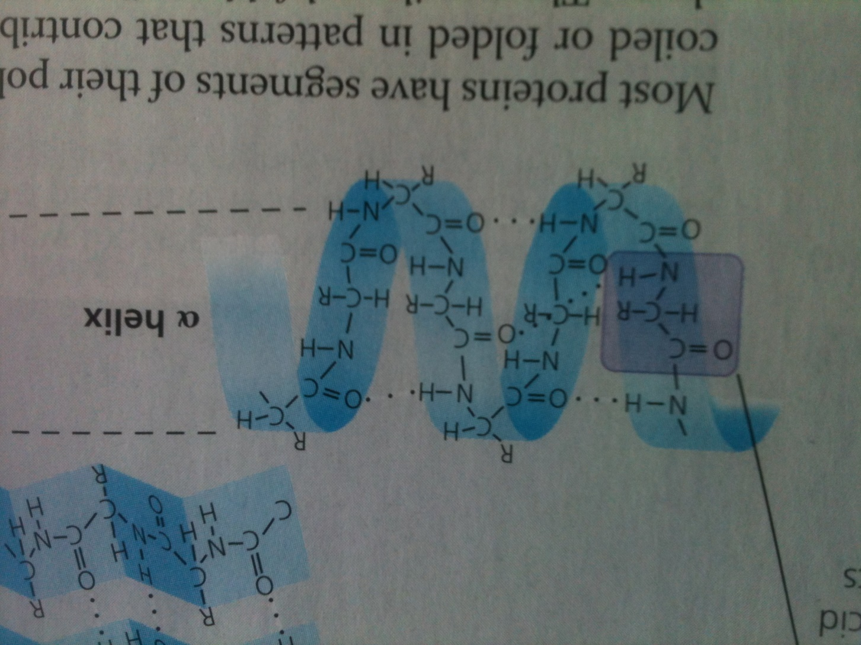

Slide 25
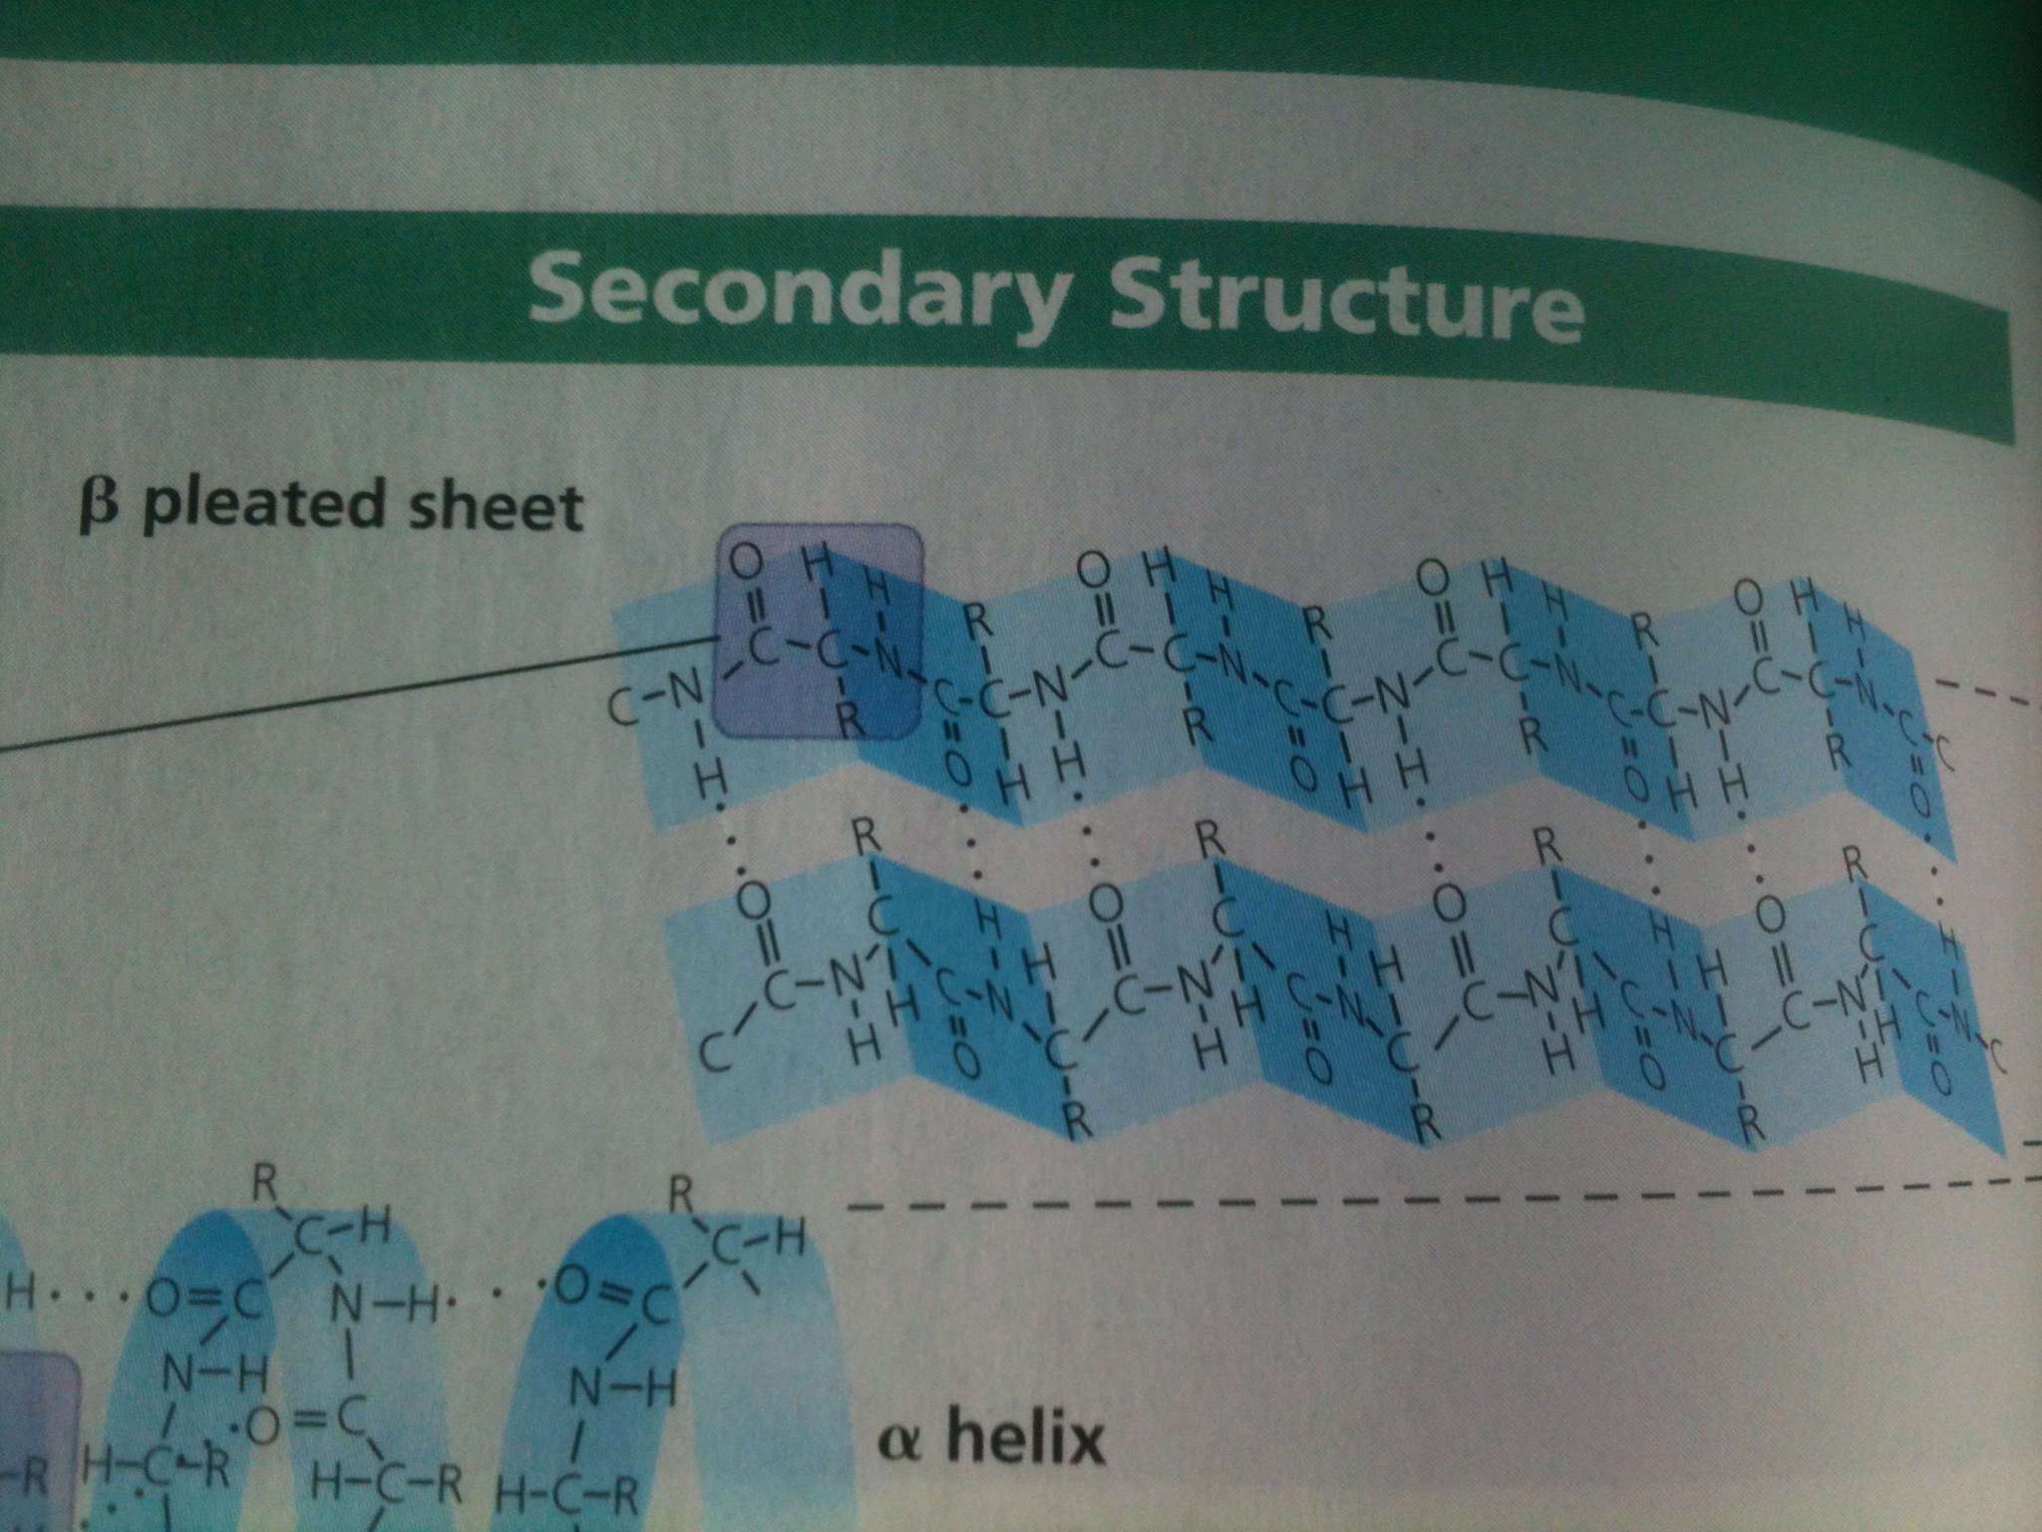

Slide 26
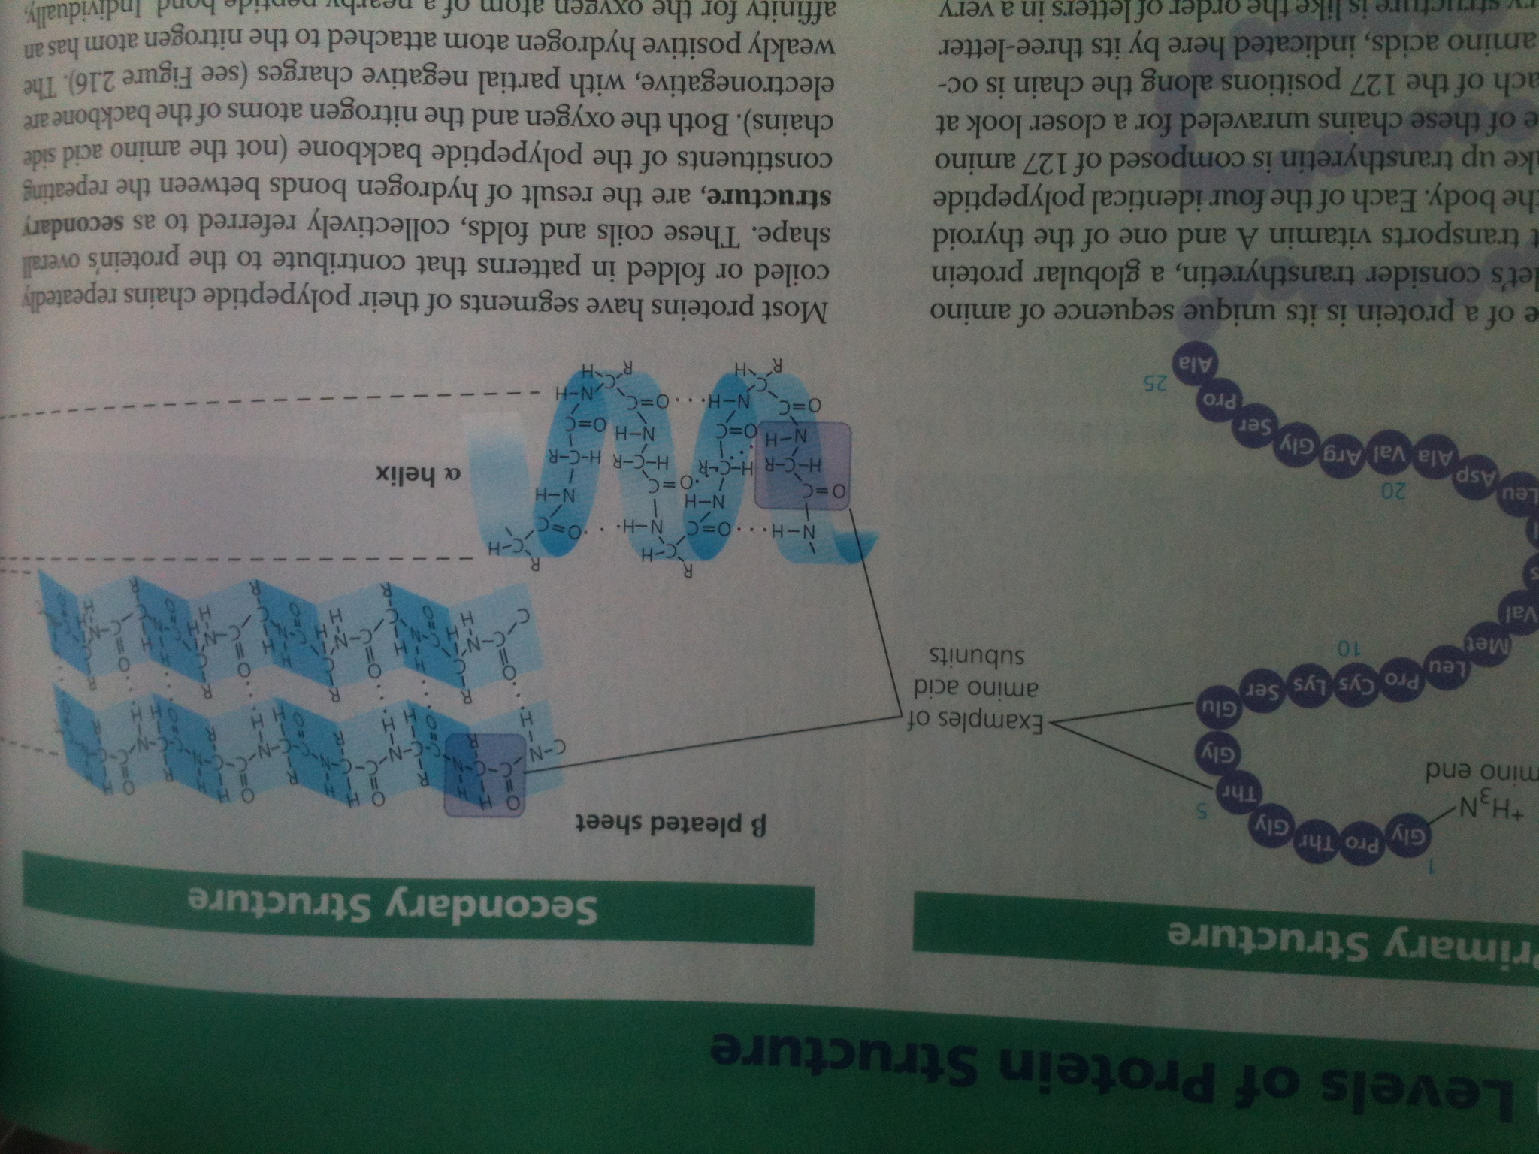

Slide 27
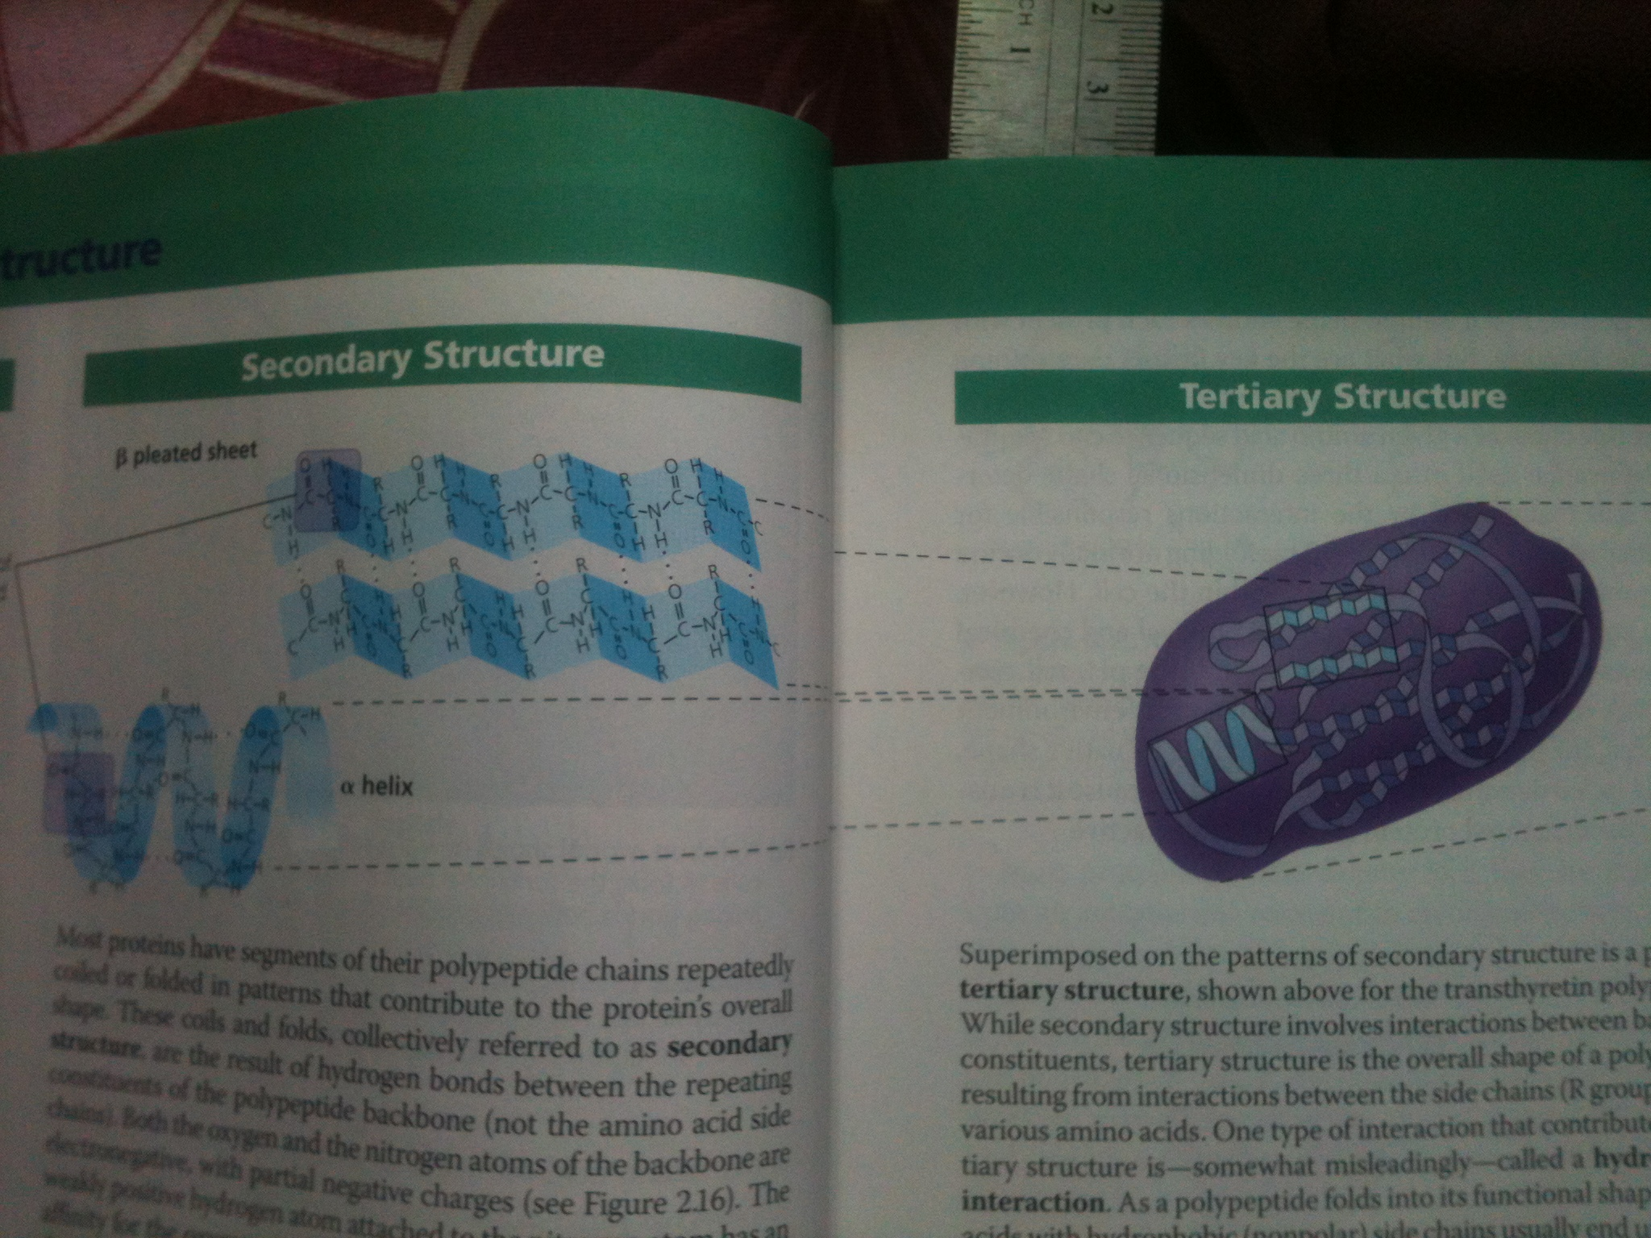

Slide 28
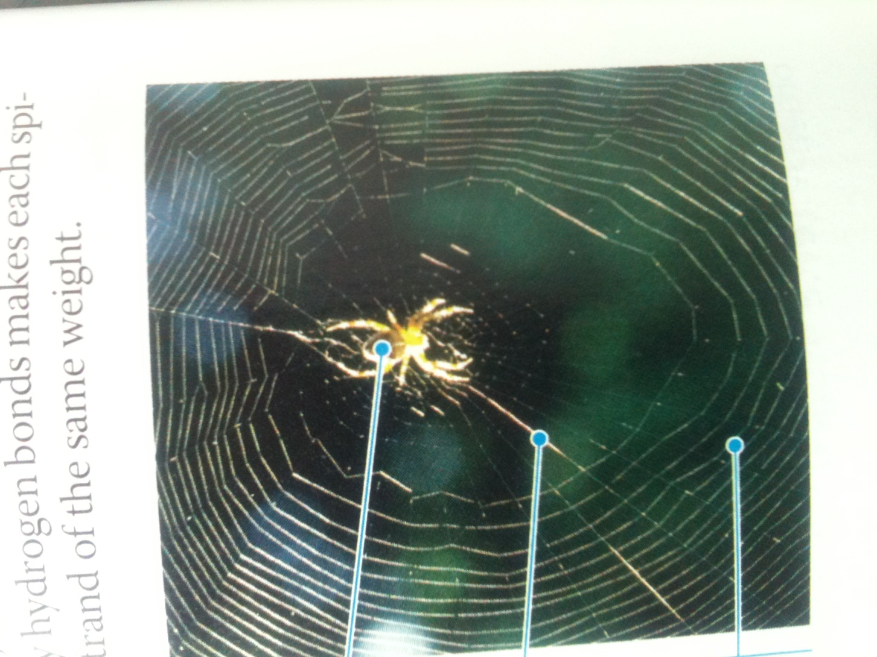

Slide 29
Tertiary structure of protein
Tertiary structure is the overall shape of a polypeptide resulting from interactions between the side chains of various amino acids
One type of interaction is hydrophobic interaction, the hydrophobic amino acids usually end up in clusters at the core of protein
Hydrophobic interaction is caused by the action of water
Once the nonpolar amino acid side chains are close together, van der Waals interactions help hold them together
Disulfide bridge: the shape of protein may be reinforced further by covalent bonds called disulfide bridge (e.g. cysteine and mythionine amino acid)
All of theses different kinds of bonds can occur in one protein

Slide 30
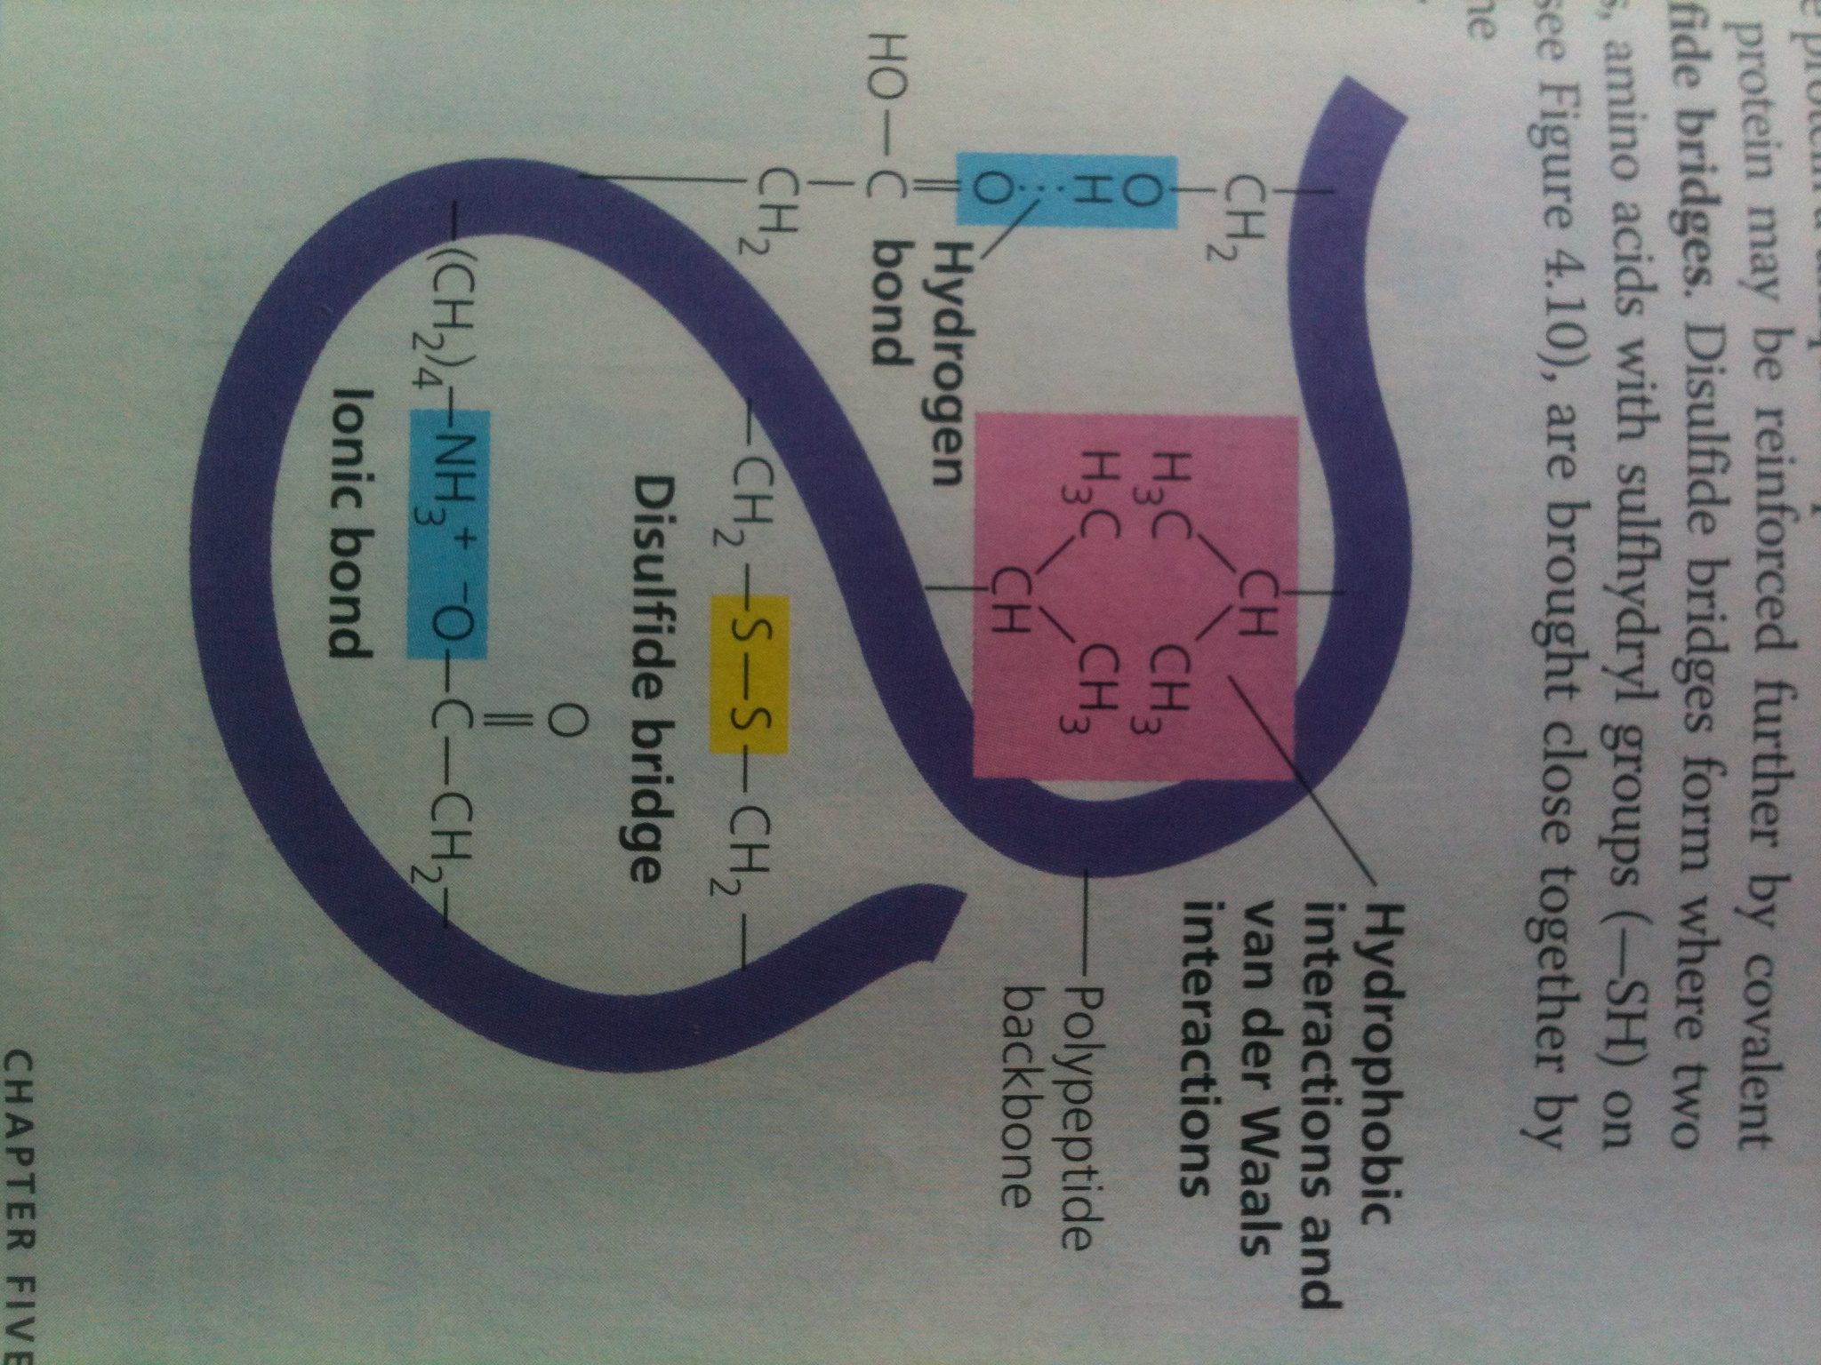

Slide 31
Quaternary structure of protein
Some proteins consist of two or more polypeptide chains aggregated together into a single unit
Quaternary structure is the over all protein structure that results from aggregation of two or more polypeptide chains.
E.g. RNA polymerase of prokaryotes, collagen a fibrous protein, which has helical subunits intertwined into a larger triple helix.
These fibrous proteins (collagens) function as a girders of connective tissue in skin, bone, tendons, ligaments etc. (collagen accounts for 40% of total proteins in human)
Hemoglobin

Slide 32
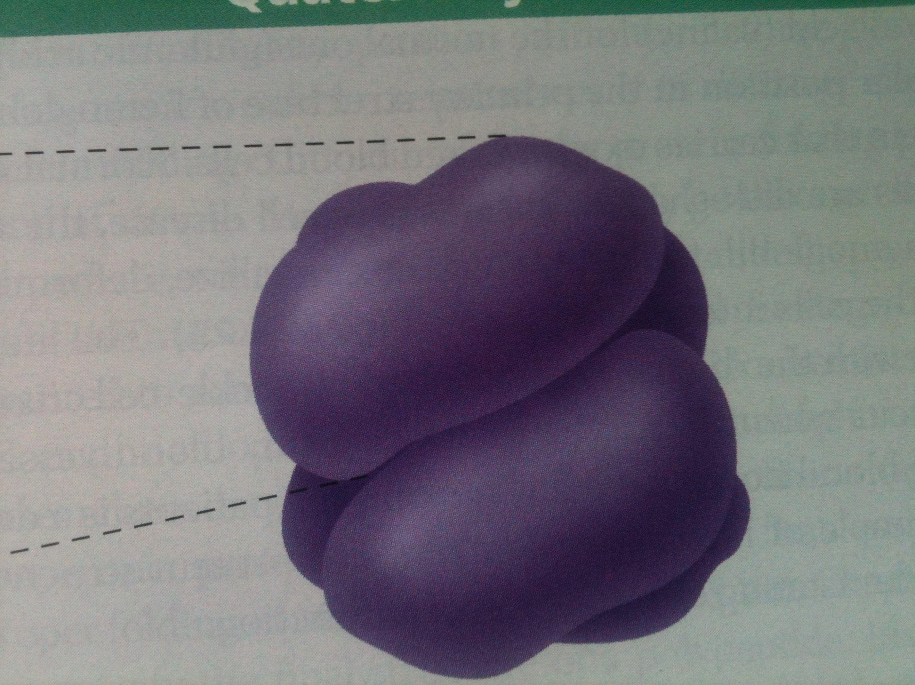

Slide 33
In some proteins, the polypeptide chain is cut into two parts held together by hydrogen bonding e.g. insulin. Enzymes cut the central portion of polypeptide chain of insulin, the two resulting polypeptide chains held together by disulfide bridge

Slide 34
Targeting polypeptides to specific location
Two populations of ribosomes: free ribosomes and membrane-bound ribosomes
Free ribosomes synthesize mostly the proteins of cytosol
Membrane bound ribosomes synthesis proteins of endomembrane system i.e. endoplasmic reticulum, golgi body, nuclear envelop, lysosomes ,vacuoles and plasma membrane.
Mechanism
Signal peptide, signal-recognition particle (SRP) and membrane SRP receptor protein

Slide 35
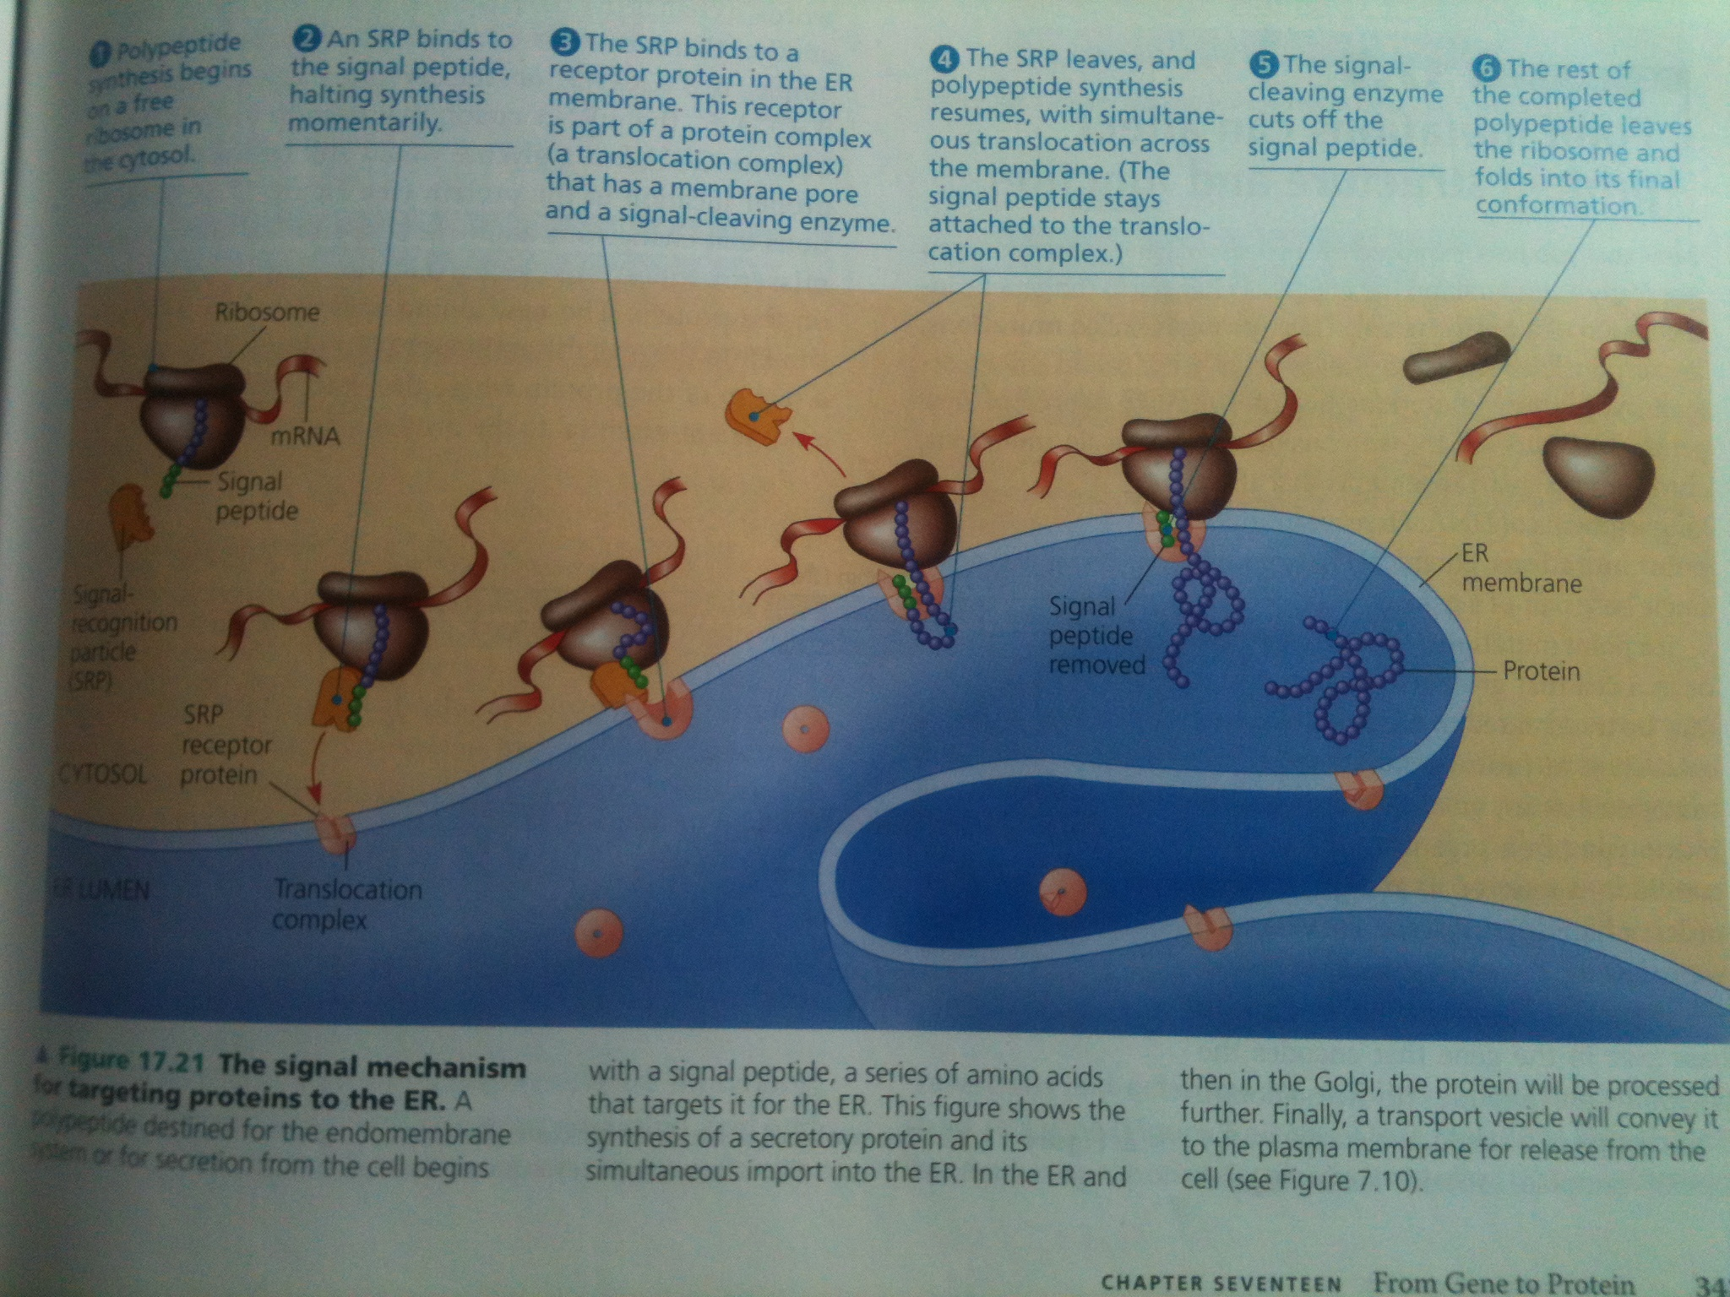

Slide 36
Other kinds of signals are used to target polypeptides to mitochondria, chloroplast, the interior of nucleus, and other organelles that are not part of endomembrane system
Mechanisms of translocation vary but the common of all is the signal polypeptides

