Slide 1
The Nervous system,
Sensation and perception
Lecture By M.Sulaman

Slide 2
The Nervous System
The nervous system is never at rest. There is always a job for it to do. Even when you are sleeping the nervous system is busy regulating your body functions. The nervous system controls your emotions, movements, thinking, and behavior.

Slide 3
Structure of the Nervous system
Structurally, the nervous system is divided into two parts.
1)The central nervous system [CNS] (the brain and the spinal cord)
2)Peripheral nervous system [PNS] (the smaller branches of nerves that reach the other parts of the body)

Slide 4
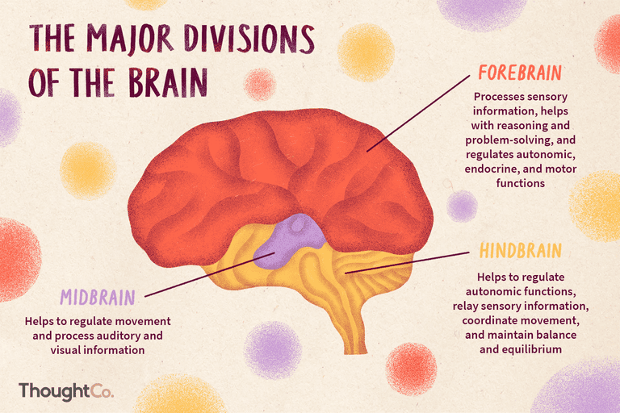
The Brain

Slide 5
THE BRAIN
The brain is composed of three parts
Forebrain
Midbrain
Hindbrain
The hindbrain, located at the rear base of the skull, is involved in the most basic processes of life.
It controls the following processes: posture, balance, voluntary movements, breathing, heart rate, and a variety of reflexes.
It works as a bridge between the spinal cord and the brain.

Slide 6
The Mid Brain
The midbrain is a small part of the brain above the pons that integrates sensory information and relays it upward.
The midbrain serves important functions in motor movement, particularly movements of the eye, and in auditory and visual processing.

Slide 7
The Forebrain
The forebrain, covering the brain’s central core and is the largest part of the brain
All sensory information with the exception of smell enters the forebrain.
The forebrain is responsible for a number of functions related to thinking, perceiving, and evaluating sensory information.
It controls functions such as hunger, thirst, and sexual behavior. It also controls the body’s reactions to changes in temperature, so when we are warm, we begin to sweat, and when we are cold, we shiver.

Slide 8
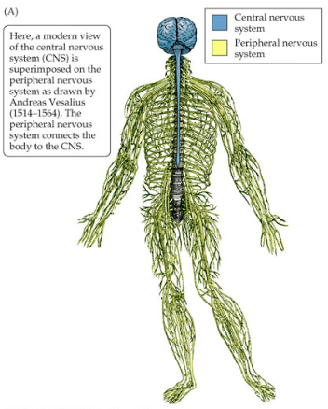
,

Slide 9
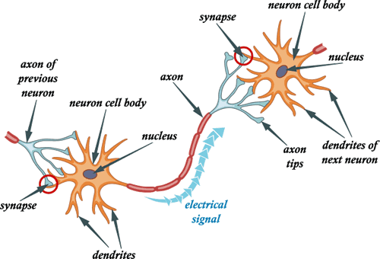
The human body contains billions of neurons. The neuron receives messages from other neurons on its dendrites. The messages are then transmitted down the axon and sent out through the axon terminals.
The myelin sheath is wrapped around the axon to protect it.

Slide 10
Neurons
The cells of the nervous system are called neurons
There are three types of neurons based on their functions
Sensory neurons:
These neurons receive sensory signals from the receptors and conveys these signals to the brain
Motor neurons:
These neurons conveys information or commands from brain to the specific organs
Inter neurons:
These neurons connects one neuron with another and conducts information inbetween

Slide 11
Neurons
Messages to and from the brain travel along the nerves, which are strings of long, thin cells called neurons
Transmission between neurons, or nerve cells, occurs whenever the cells are stimulated.
Neurons have three basic parts: the cell body, dendrites, and the axon
The cell body contains the nucleus and produces the energy needed to fuel neuron activity.
The dendrites are short, thin fibers that stick out from the cell body.
Dendrites receive impulses, or messages, from other neurons and send them to the cell body.

Slide 12
Neurons
The axon is a long fiber that carries the impulses away from the cell body toward the dendrites of the next neuron.
There is a space between the axon terminals of one neuron and the dendrites of another neuron. This space between neurons is called the synapse.
A neuron transmits its impulses or message to another neuron across the synapse by releasing chemicals called neurotransmitters.

Slide 13
How nervous system works
The nerves of the peripheral system conduct information from the bodily organs to the central nervous system and take information back to the organs.
The central nervous system interpret the messages received from sensory neurons.
After interpreting sensory messages then the brain sends motor information to the specific organs.
The peripheral nerves branch out from the spinal column and extends to all parts of the body.
All parts of the nervous system are well protected, brain by the skull, the spinal cord by the vertebrae, and the peripheral nerves by layers of sheathing.

Slide 14
.
Question and Answer session

