Slide 1
THE RISE AND
FALL OF NAPOLEON BONAPARTE by
Faiza Mir
Department of International Relations
University of Balochistan, Quetta

Slide 2
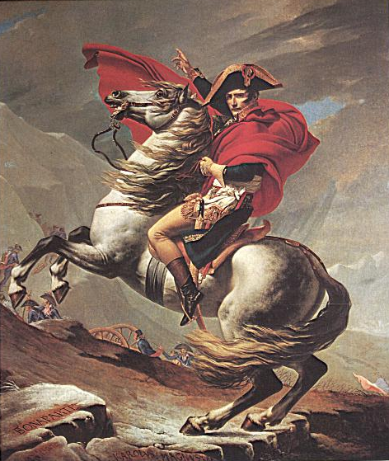
NAPOLEON
“He did not hate any more than he loved; for him
nothing existed but himself…Neither pity, nor
religion, nor attachment to any other idea
whatsoever, could [deflect] him from his principal
direction.”
Great military leader
Very ambitious & energetic
Age of Napoleon 1799-1814

Slide 3
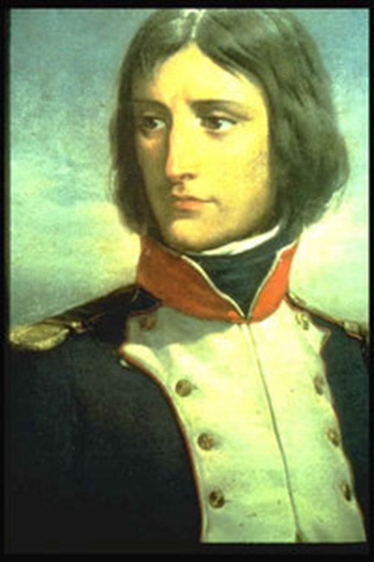
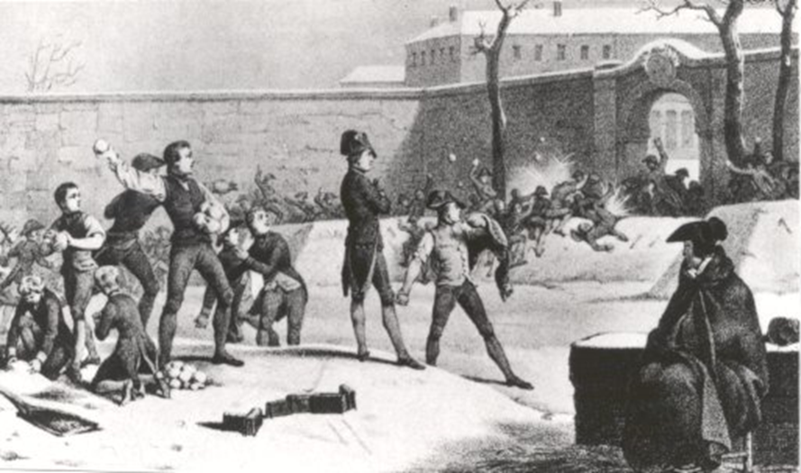
NAPOLEON’S RISE
Age 9 - Military school in France on Scholarship
Graduates in half the normal time
Officer at age 16
Lieutenant by age 20
General by age 24

Slide 4
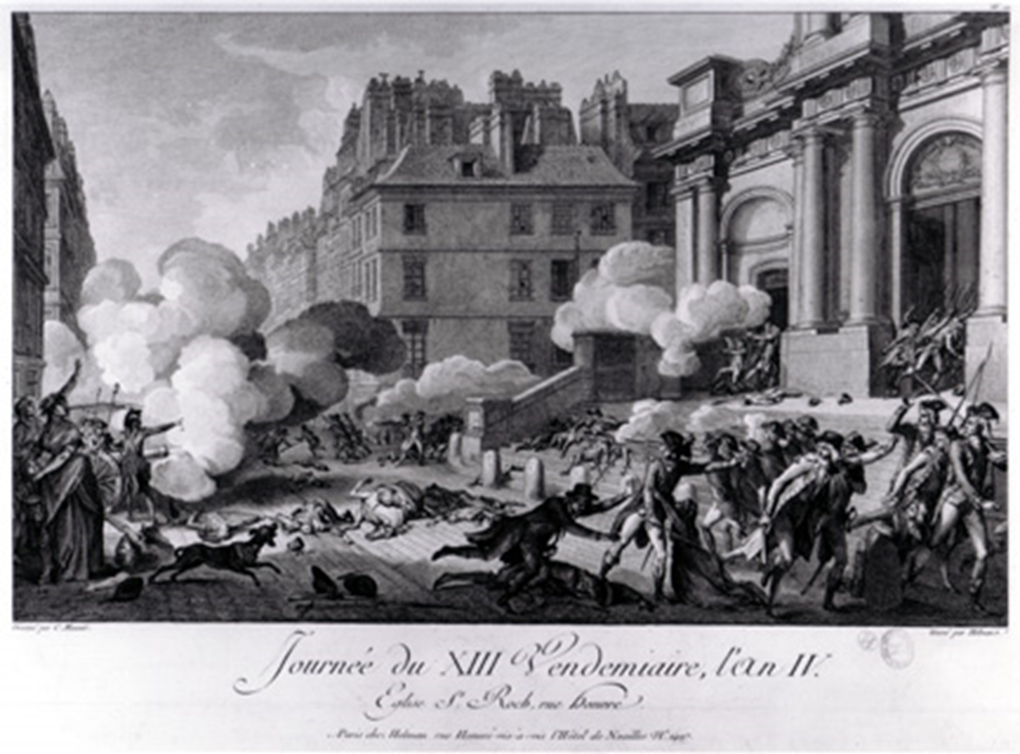
NAPOLEON’S RISE
A mob of Royalists in Paris declared a rebellion against the Directory, the new French government.
Napoleon saves the Directory, by using canon fire to scare the mob away.
Directory sent him into Italy- Success!

Slide 5
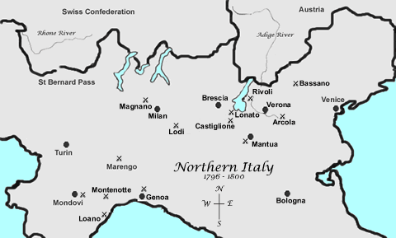
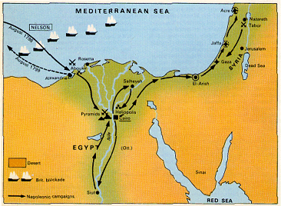
NAPOLEON’S RISE TO POWER
Early Campaigns:
  Italy
    Defeated Austrians
    Gained N. Italy
Egypt
  Initially won land battles
  But British destroyed French Navy
  Napoleon left army & returned to France a “hero”

Slide 6
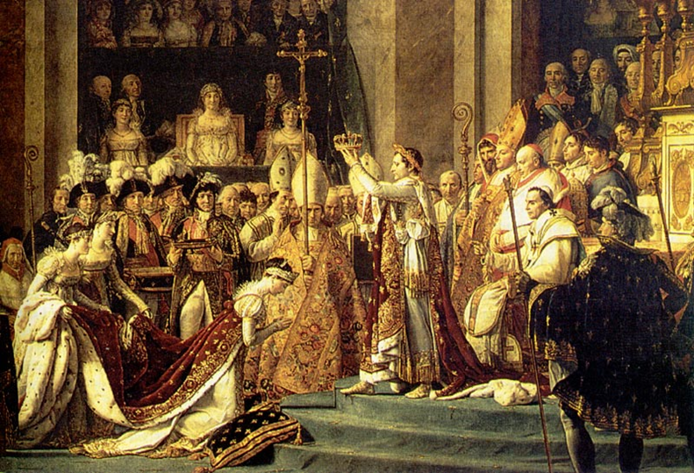
NAPOLEON SEIZES POWER
1799 Napoleon stages coup d'état; Becomes First Consul
1802 he made himself “Consul for Life”
1804 he crowned himself “Emperor”

Slide 7
NAPOLEON’S GOVERNMENT
As Emperor, Napoleon:
  Controlled army & navy
  Appoint or dismiss officials
  Made new laws
Legislative Branches
  Practiced the procedure called Plebiscite
    Vote yes or no; No debate
Napoleonic Code
  French law code
Bank of France
Public Education
Concordat
  Agreement w/ Pope
  France mostly Catholic, but religiously tolerant

Slide 8
NAPOLEON’S RISE
What did Napoleon promise France?
Stability, peace, and unity
What did Napoleon give France?
Stability, peace, and unity

Slide 9
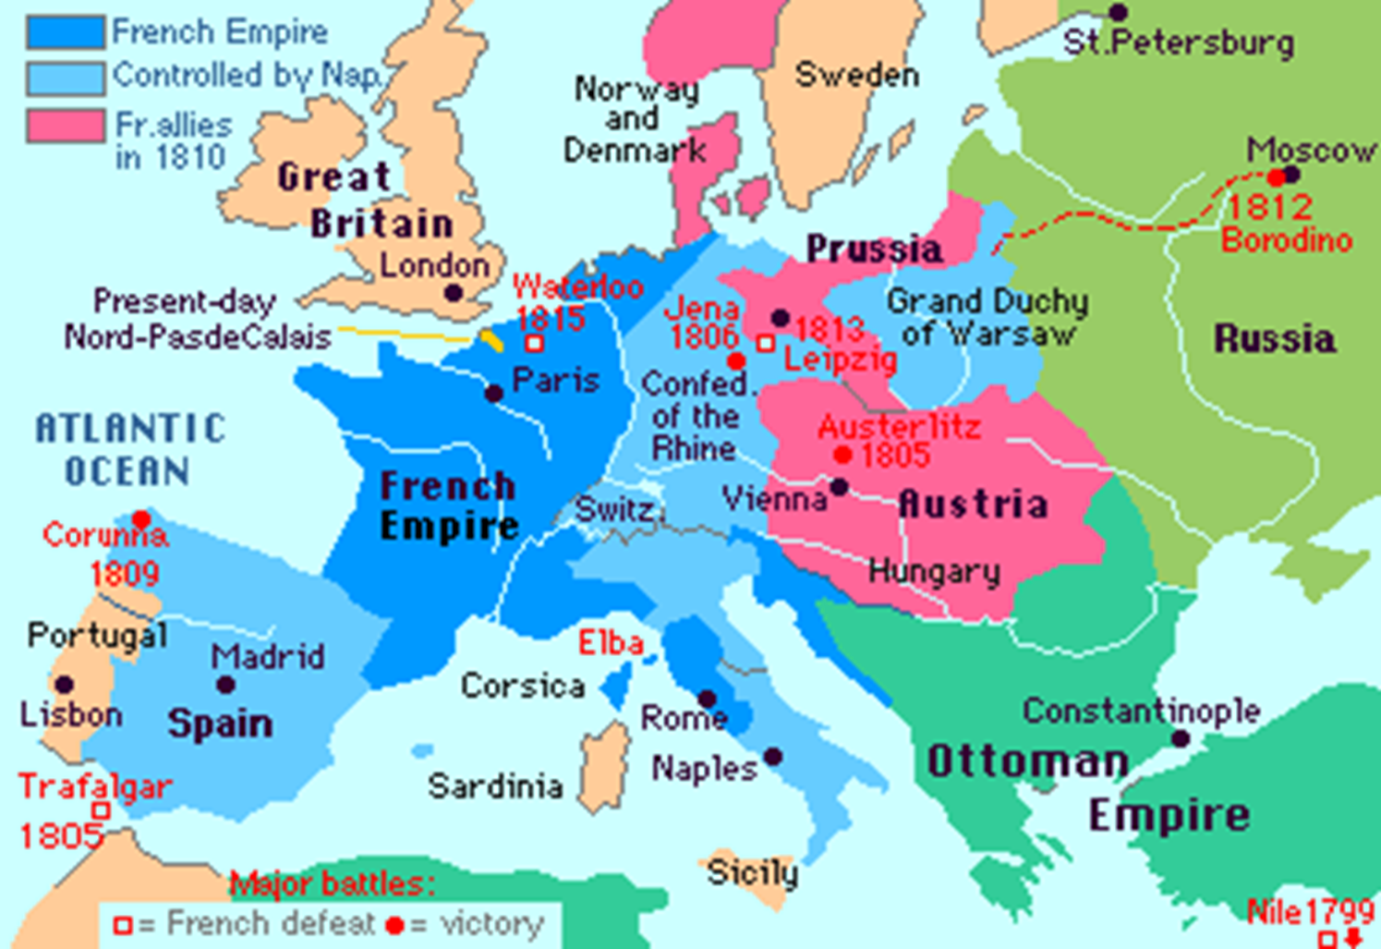
CONQUESTS

Slide 10
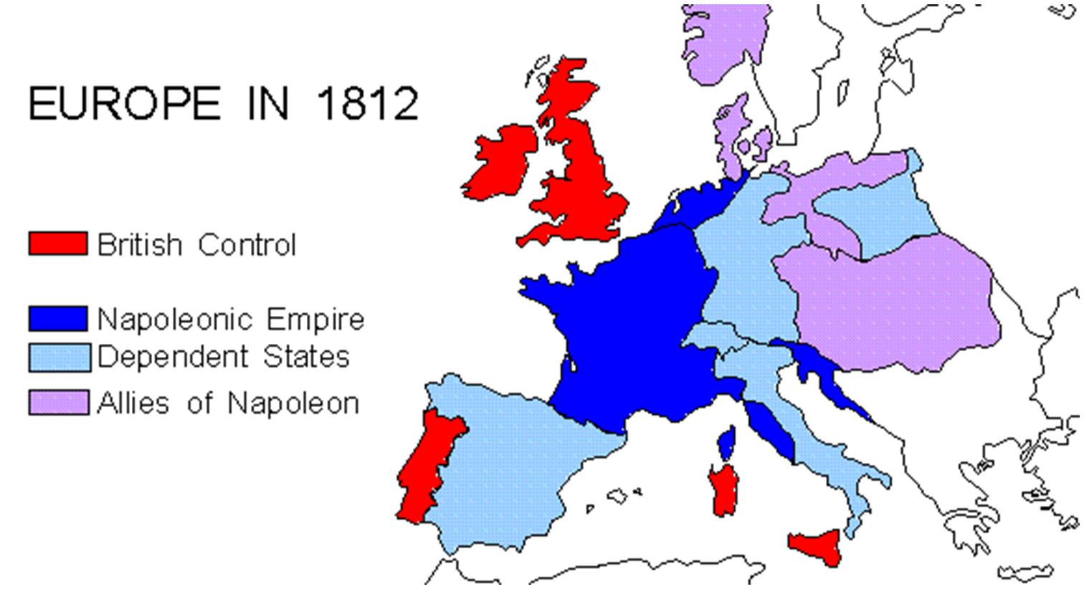
THE GREATEST EXTENT OF NAPOLEON’S EMPIRE!

Slide 11

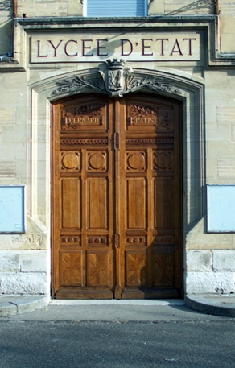
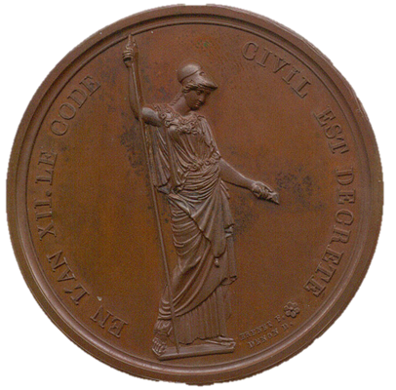
NAPOLEON’S REFORMS
Economy
  fixed tax collection
  established national postal system
  established a national bank
  fired the corrupt employees
Schools
  started government run public schools
  rewards based on merit
Religion – repairs the relationship with Church, freedom of religion
Napoleonic Code – A system of uniform laws

Slide 12

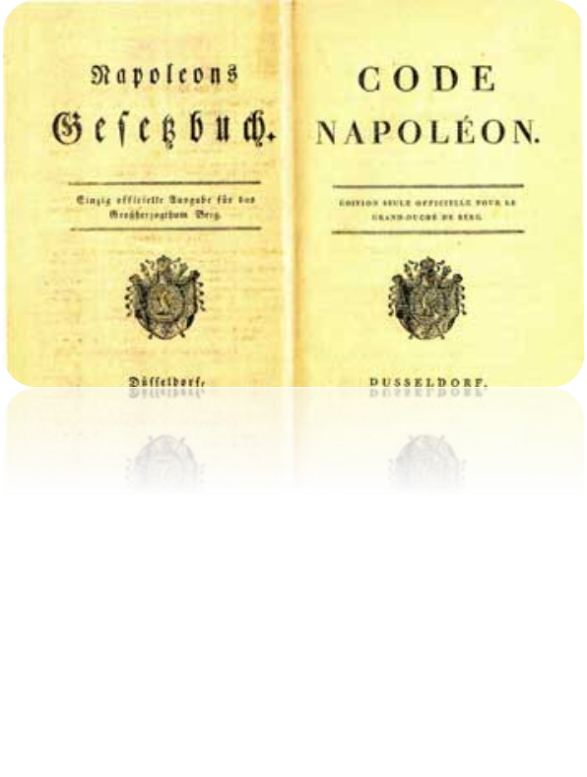
NAPOLEONIC CODE
Equality of all in the eyes of the law
No recognition of birthright (nobility)
Government positions based on merit
(qualifications instead of being noble)
Freedom of Religion
Freedom to find an occupation
of choice

Slide 13
Napoleon’s style of government has been called rule for the people, but not by the people.
Should freedom be limited to preserve national security?

Slide 14
HOLDING ON TO POWER…

Slide 15
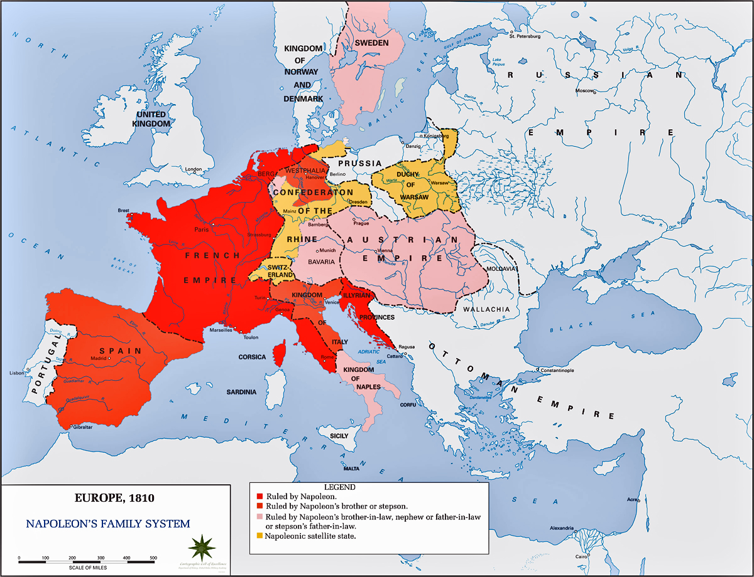
CONTINENTAL SYSTEM
Continental
System
Blockade of British Isles
No allies of France allowed to trade w/ Britain
Why created:
  Britain & allies start war w/ France
  France defeated allies; But couldn’t defeat British Navy

Slide 16
MAINTAINING CONTROL: REORGANIZATION OF EUROPE
Abolished HRE
Made family members monarchs of conquered countries
Abolished feudalism and serfdom
All new territories given Napoleonic Code

Slide 17
THE BEGINNING OF THE END…

Slide 18
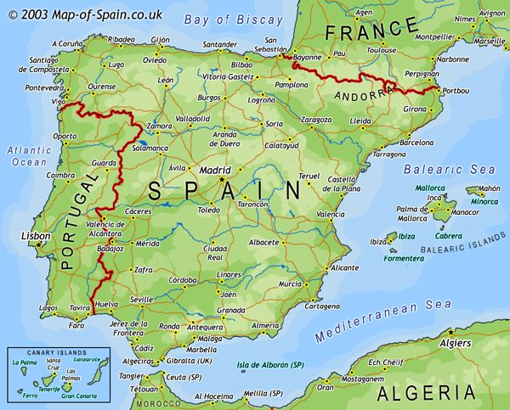
THE PENINSULAR WAR 1808-1814
War in Iberian Peninsula
France vs. Britain/Portugal/Spain
Why:
  Portugal ignored Cont. System
  Napoleon invaded Port., then Spain, & took both over
  Napoleon made bro. Joseph, King Port. & Spain
  Britain drove Joseph off throne

Slide 19
“I made a mistake attacking Russia. I thought the whole world would be behind me. Everybody turned against me… One shudders when one thinks of Russia… She overflows on you if you lose; she retires back into the ice banks if you win… and I tried [to attack her] stupidly…”
~Napoleon

Slide 20
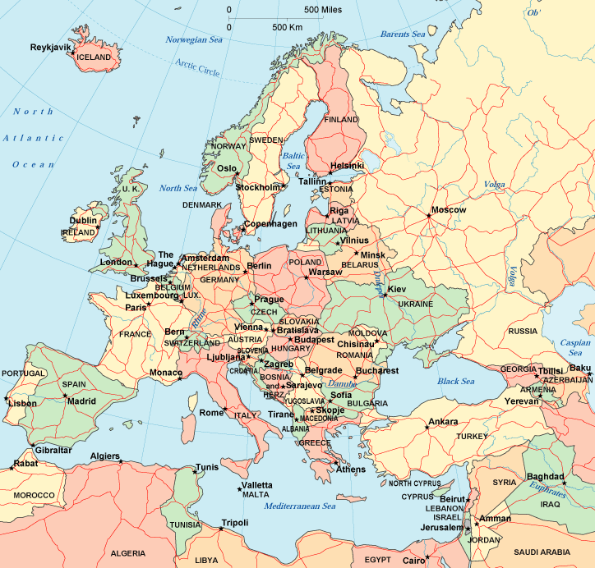
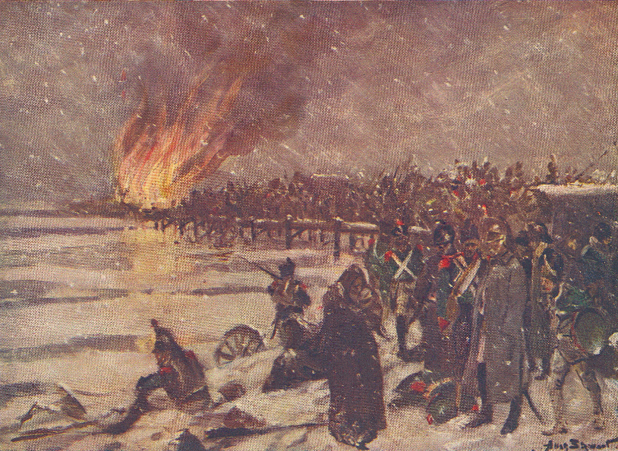
PROBLEMS IN RUSSIA
1812 Russia ignores Cont. System
Napoleon invaded Russia, but campaign ended in disaster
Russians defeated Napoleon using scorched-earth policy

Slide 21
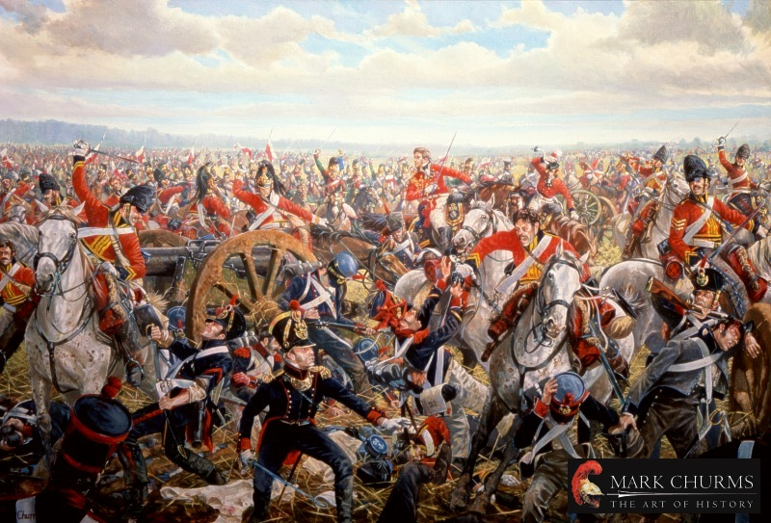
NAPOLEONS FINAL DEFEAT: THE BATTLE OF WATERLOO

Slide 22

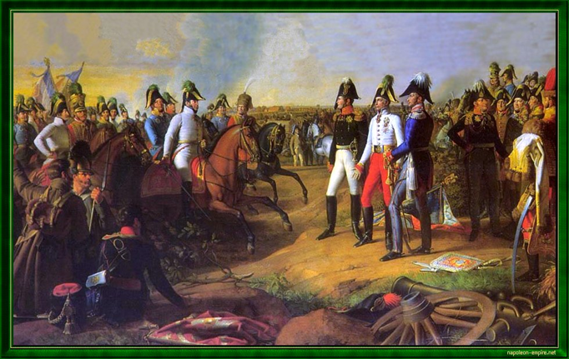
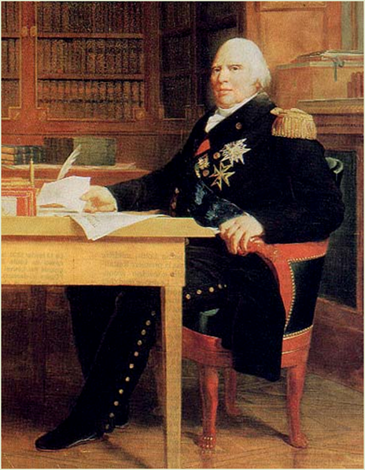
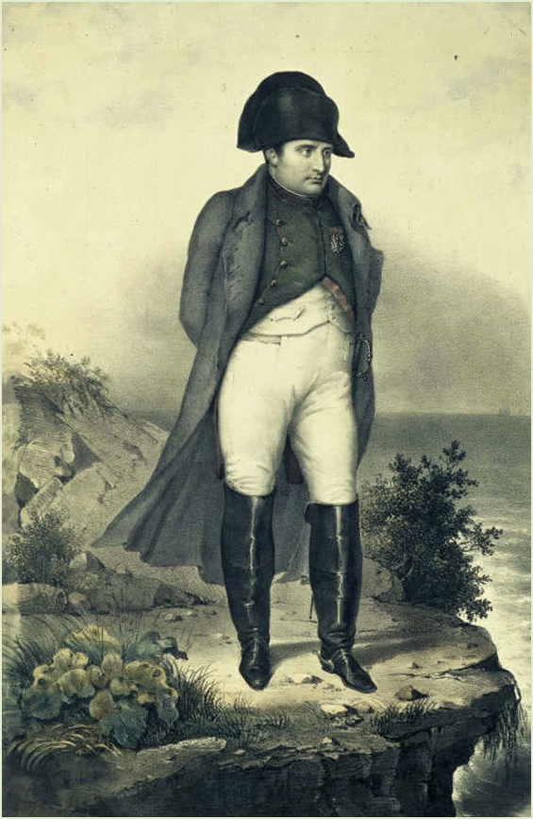
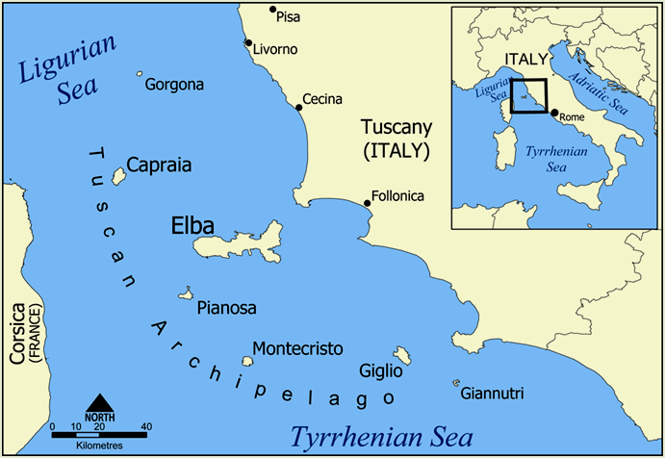

The Bourbon’s Return: Louis XVIII
Napoleon is Exiled to Elba

Slide 23
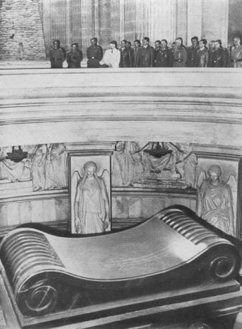
HITLER VISITS NAPOLEON’S TOMB (1940)
“That was the greatest and finest moment of my life.”
~Hitler

Slide 24
ENLIGHTENED DESPOT
The term 'Enlightened Despot" was given to rulers during the Enlightenment period that used their power and influence to better the lives of their people. Rulers, such as Catherine the Great and Joseph II did this through religious tolerance, abolition to serfdom and more.
Napoleon embodied this same (moral) quality in the sense that he used his status and power during the Revolution to bring out and surface Revolution ideals and help his people.

Slide 25
A RETURN TO PEACE
Having defeated Napoleon, the major European powers wanted to restore order, keep the peace, and suppress the ideas of Revolution.
Delegates throughout Europe came to Vienna, Austria to have a conference about the future of Europe.
Most decision-making authority rested with Great Britain, Austria, Prussia, and Russia.

Slide 26
FOOD FOR THOUGHT
Was Napoleon a Revolutionary or a Tyrant???

