Slide 1
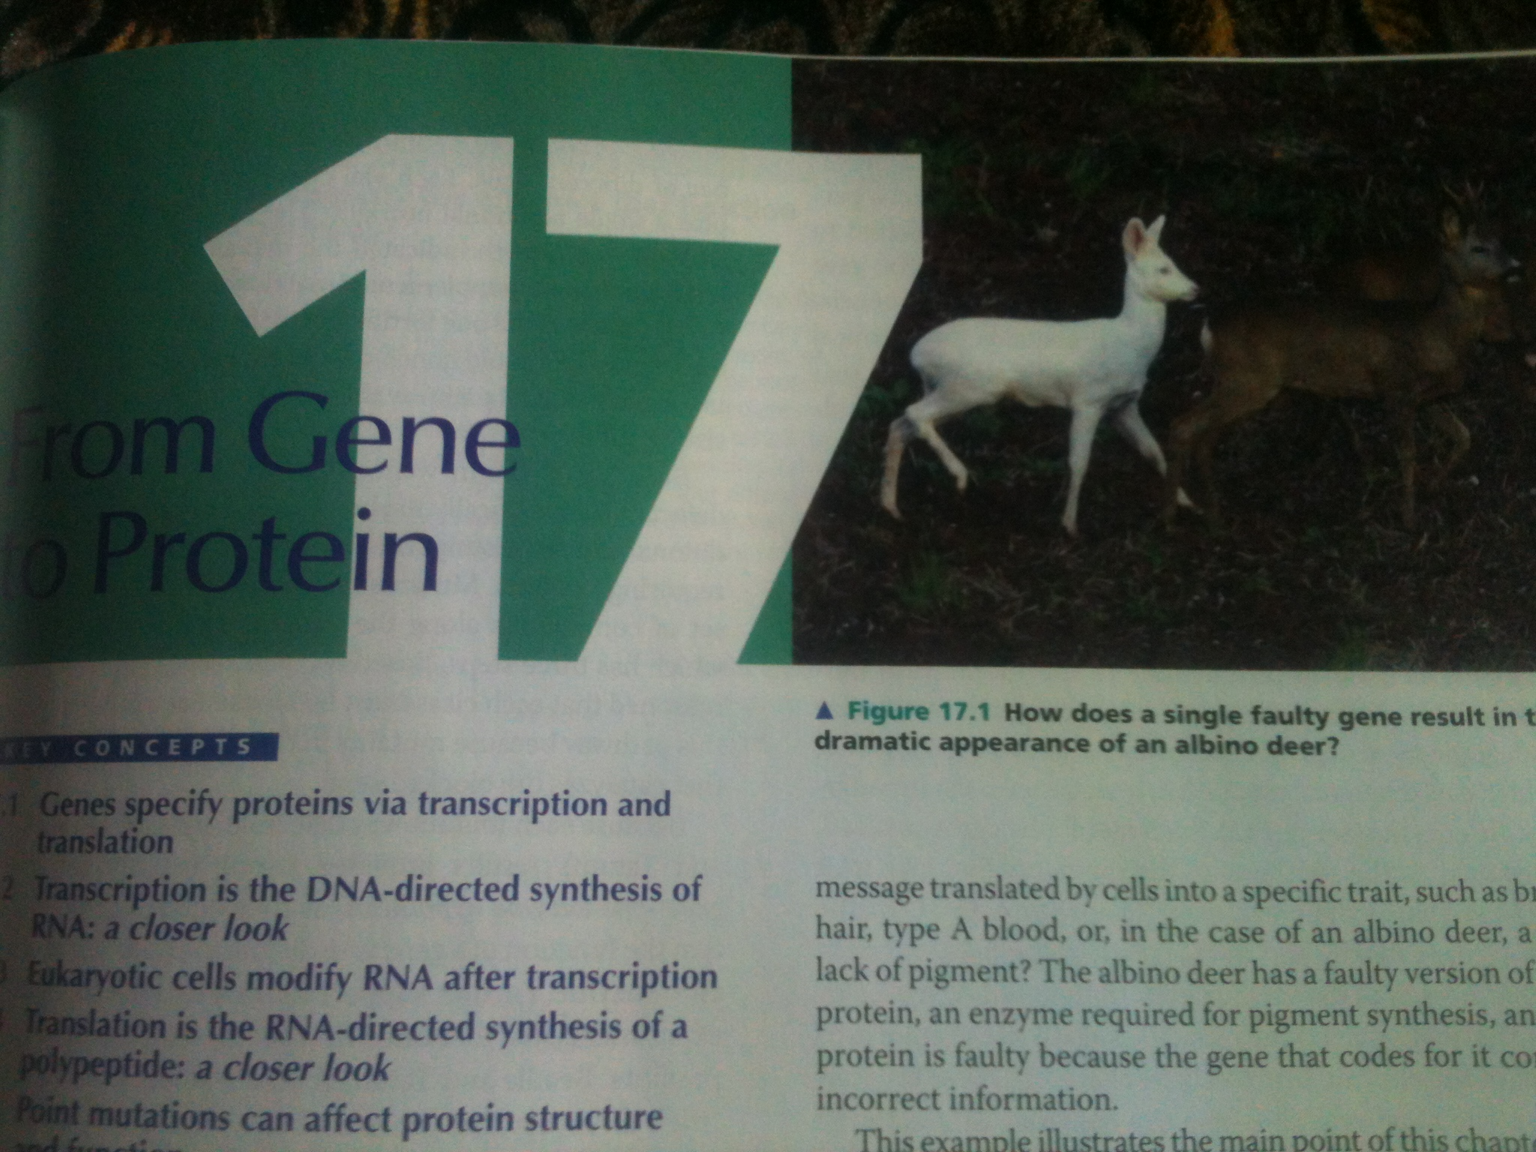
From Gene to Protein

Slide 2
What is gene?
Gene is the part/portion or segment of DNA which has a code for an RNA
Gene is thus divided into two main types
1- structural genes, which have code for mRNA
2- non-structural genes, which have code for rRNA and tRNA
RNAs further make polypeptide chain for protein
Thus genes code for proteins

Slide 3
Ultrastructure of prokaryotic gene
Upstream
Down stream
3/
+1
5/
10 sequences upstream pribnow box; TATAAT sequence
Termination sequences (e.g. TCCGGAGCACCATTAGCGTCCGGA)
35 sequences upstream recognition sequence; TTGACA sequence
Initiation site A or G sequence
Promoter region
Ultrastructure of eukaryotic gene
Upstream
Down stream
+1
3/
5/
75 sequences upstream CAT box; GGCCAATCT
25 sequences upstream TATA box; TATAAAA sequence
Initiation site A or G sequence
Promoter region

Slide 4
How Gene Works to Make a Protein? (Gene Expression)
RNAs get transcribed from genes
They further translated into polypeptide chains
Thus gene expression is divided into two main processes
1- Transcription: RNA synthesis
2- Translation: polypeptide chain synthesis

Slide 5
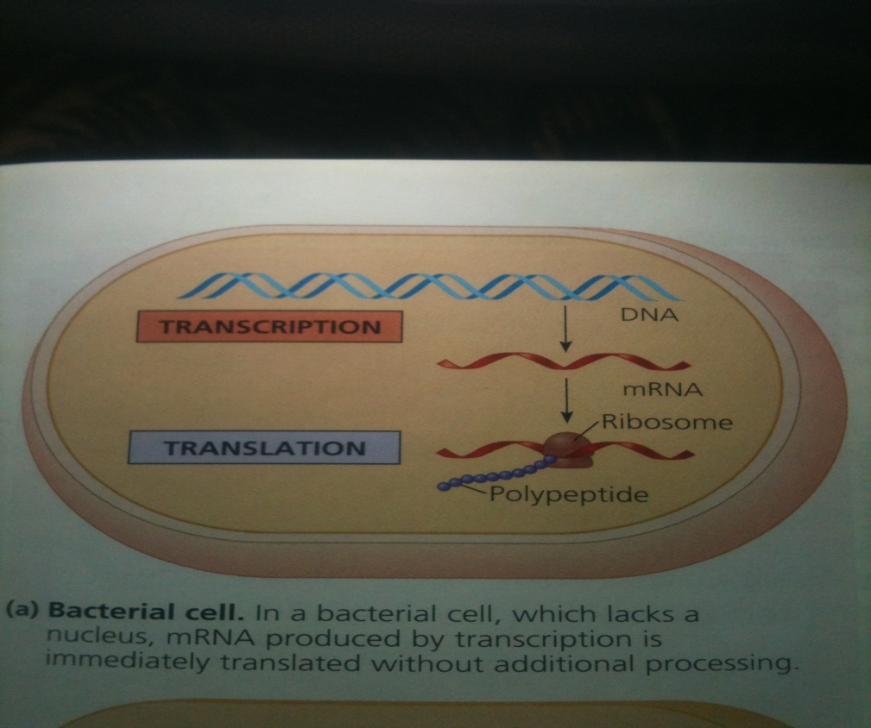
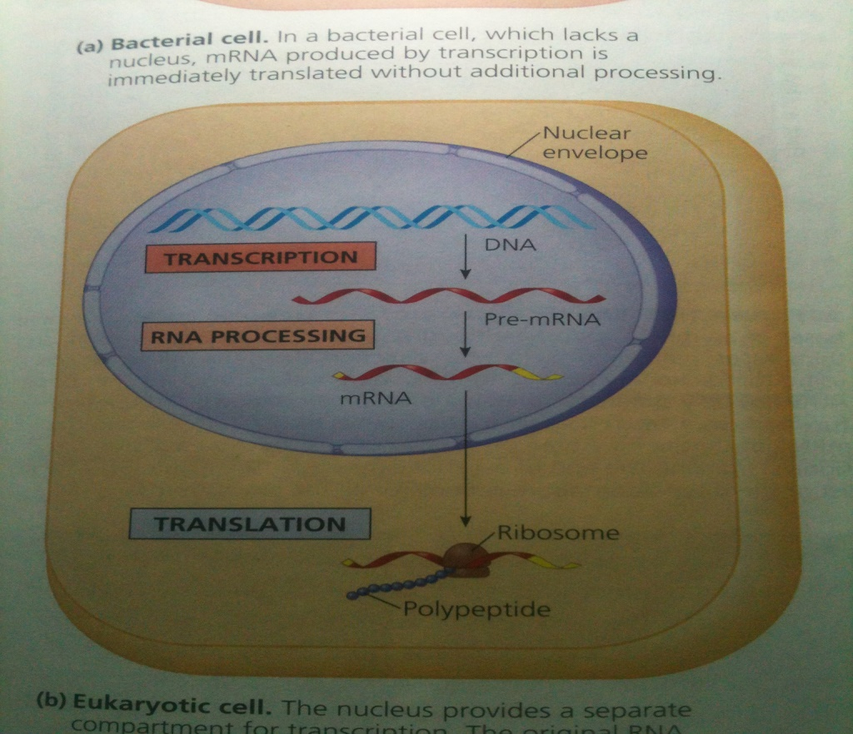
Transcription
Transcription is the process of RNA synthesis
Where it occurs?
In prokaryotes it occurs in cell lumen
In eukaryotes it occurs in nucleus
rRNA synthesis occurs in nucleolus

Slide 6
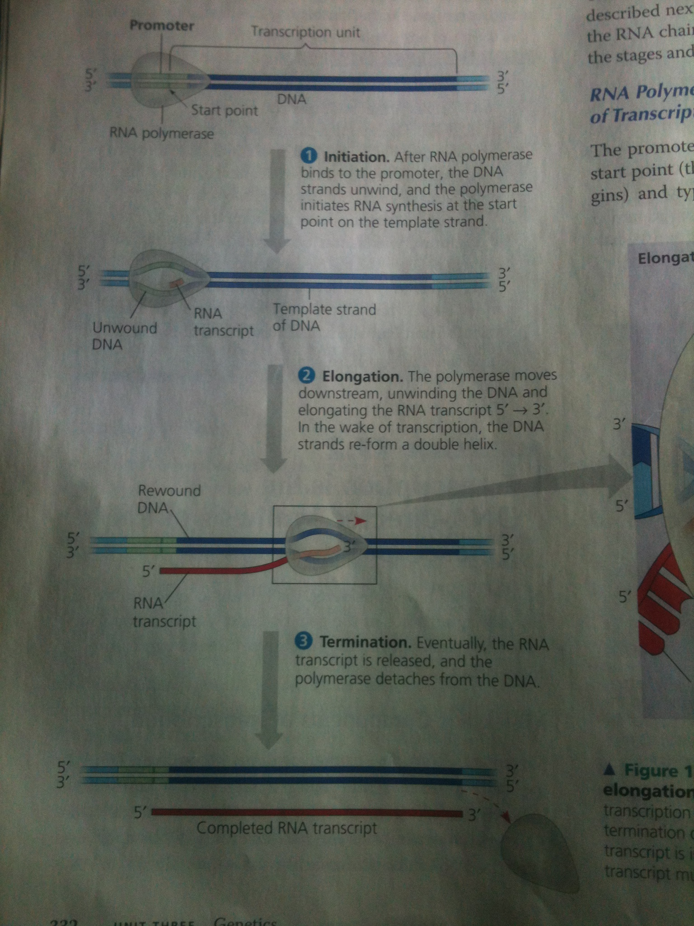
Only one strand (sense strand) of DNA for a given gene gets transcribed
Both strands are transcribed but for different genes
Initiation, elongation and termination of RNA have specific requirements

Slide 7
Initiation of RNA synthesis
Promoter region There are specific regions in DNA molecule from where transcription starts
Promoter region determines which of the two DNA strands will transcribe
In prokaryotes, two conserve sequences occur at 10 (pribnow box; TATAAT sequence) and 35 nucleotides (recognition sequence; TTGACA sequence) upstream of the initiation point in promoter region.
In eukaryotes, these sequences are 25 (TATA box; TATAAAA sequence) and 75 sequences (CAT box; GGCCAATCT) upstream of transcription initiation site in promoter region

Slide 8
Enzymes involved in transcription
Polymerase enzymes are involved in the synthesis of RNA from DNA strand (gene)
Prokaryotes polymerase enzyme consists of five polypeptides known as core enzyme. Another polypeptide “Sigma factor” joins with core enzyme to initiate transcription and thereafter it releases from core enzyme
Eukaryotes Polymerase 1 required for rRNA, polymerase 11 for mRNA and polymerase 111 for tRNA and small nuclear RNA
Transcription complex in eukaryotes
In eukaryotes a collection of proteins called transcription factors mediate binding of RNA polymerase to initiate transcription
Once the polymerase is firmly attached to promoter region, it piers the DNA strand apart and starts transcription of RNA from specific start point

Slide 9
Elongation of RNA Transcript
Contrary to DNA synthesis, RNA synthesis “does not require a primer” to initiate transcription.
Polymerase enzyme directly start adding nucleotide sequences complementary to DNA template stand.

Slide 10
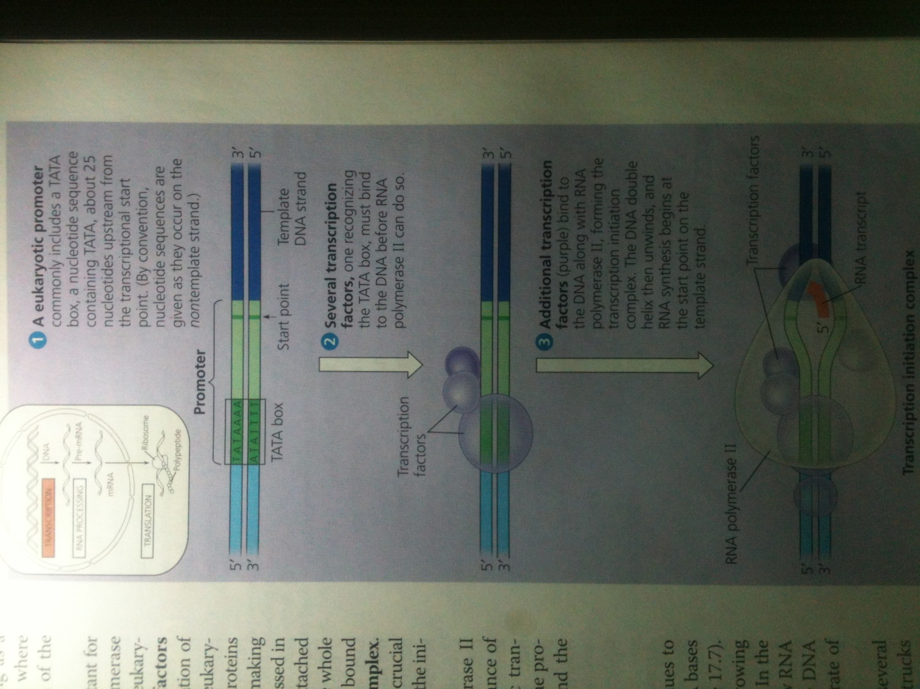

Slide 11
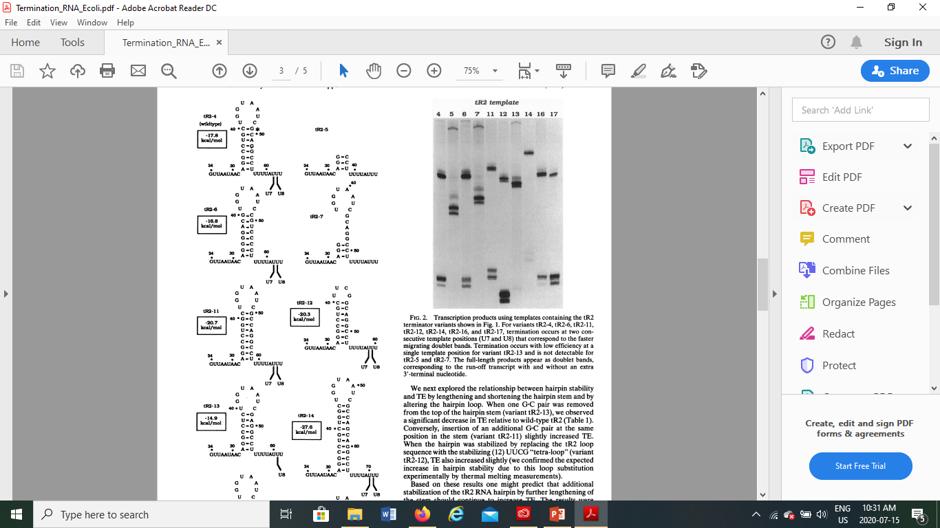
Termination of RNA in Prokaryotes
Prokaryotic genes have termination sequences e.g. TCCGGAGCACCATTAGCGTCCGGA. These sequences have repeats, which upon transcription of RNA, cause them to make hydrogen bond on RNA transcript.
The growing RNA form a “hair pin loop”, which probably hinder polymerase enzyme to further move up and synthesize RNA.

Slide 12
Termination RNA transcript (continued)
Hairpin loop termination is Rho independent
Rho is transcription termination factor and is a protein. Found first in Lambda Phage virus and E coli.
The Rho factor is a hexameric protein around which a 70- to 80-base segment of the growing RNA transcript wraps. This interaction activates an ATPase activity of Rho that is associated with its movement along the RNA in the 3′ direction until it eventually unwinds the RNA-DNA hybrid at the active site of RNA polymerase. Whether transcription is terminated or not seems to depend on whether Rho moves sufficiently fast to “catch up” with the polymerase. Consequently, pausing of polymerase during elongation is thought to be an important component of Rho-dependent termination, as it is in Rho-independent termination.

Slide 13
RNA Transcription termination in Eukaryotes
Mechanism is different than prokaryotes and viruses
Transcription ofpre-rRNA genes by RNA polymerase I is terminated by a mechanism that requires a polymerase-specific termination factor. This DNA-binding Protein binds downstream of the transcription unit
RNA polymerase III terminates after polymerizing a series of U residues; unlike Rho-independent termination in bacteria, however, termination by RNA polymerase III does not require an upstream stem-loop secondary structure in the RNA transcript.
protein complex that cleaves and polyadenylates the nascent mRNA transcript at specific sequences associates with the phosphorylated carboxyl-terminal domain (CTD) of RNA polymerase II following initiation. This cleavage/ polyadenylation complex may suppress termination until the sequence signaling cleavage and polyadenylation is transcribed by the polymerase.

Slide 14
Eukaryotic cells modify RNA after transcription
Alteration of mRNA ends
1- 5/ cap: modified form of guanine is added to the 5/ end of mRNA after transcription of 20 – 40 nucleotides
3- Polyadenylation signal AAUAAA
2- Poly A tail: addition of 50 – 250 more adenine nucleotides
Functions: 1) export of mRNA from nucleus to cytoplasm 2) Protect mRNA from enzymatic degradation 3) 5/ cap facilitate attachment of ribosomes to mRNA to start translation

Slide 15
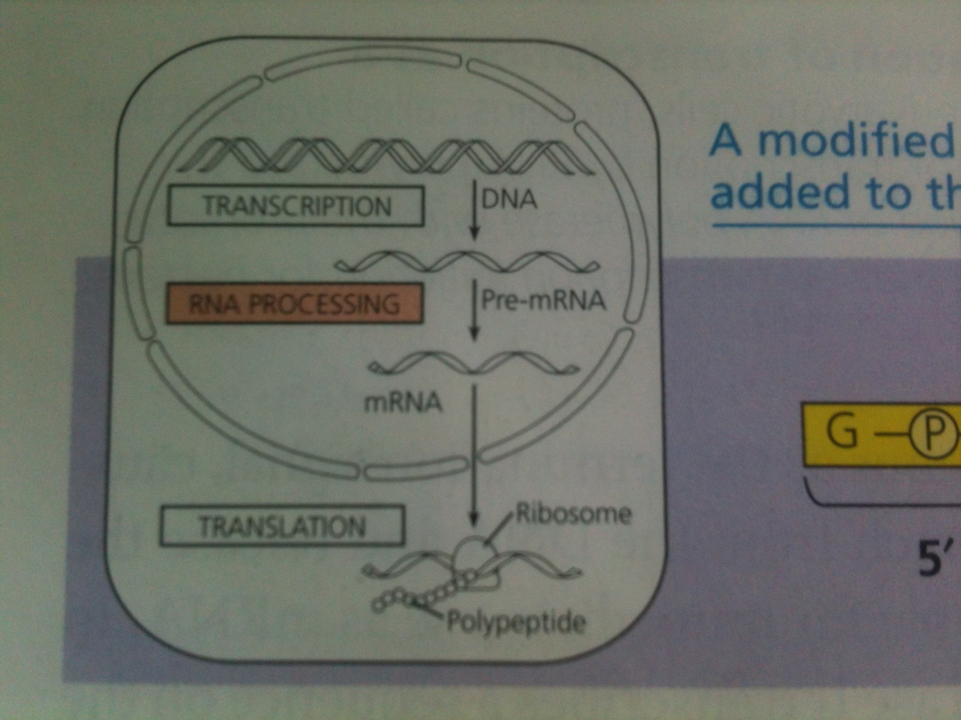
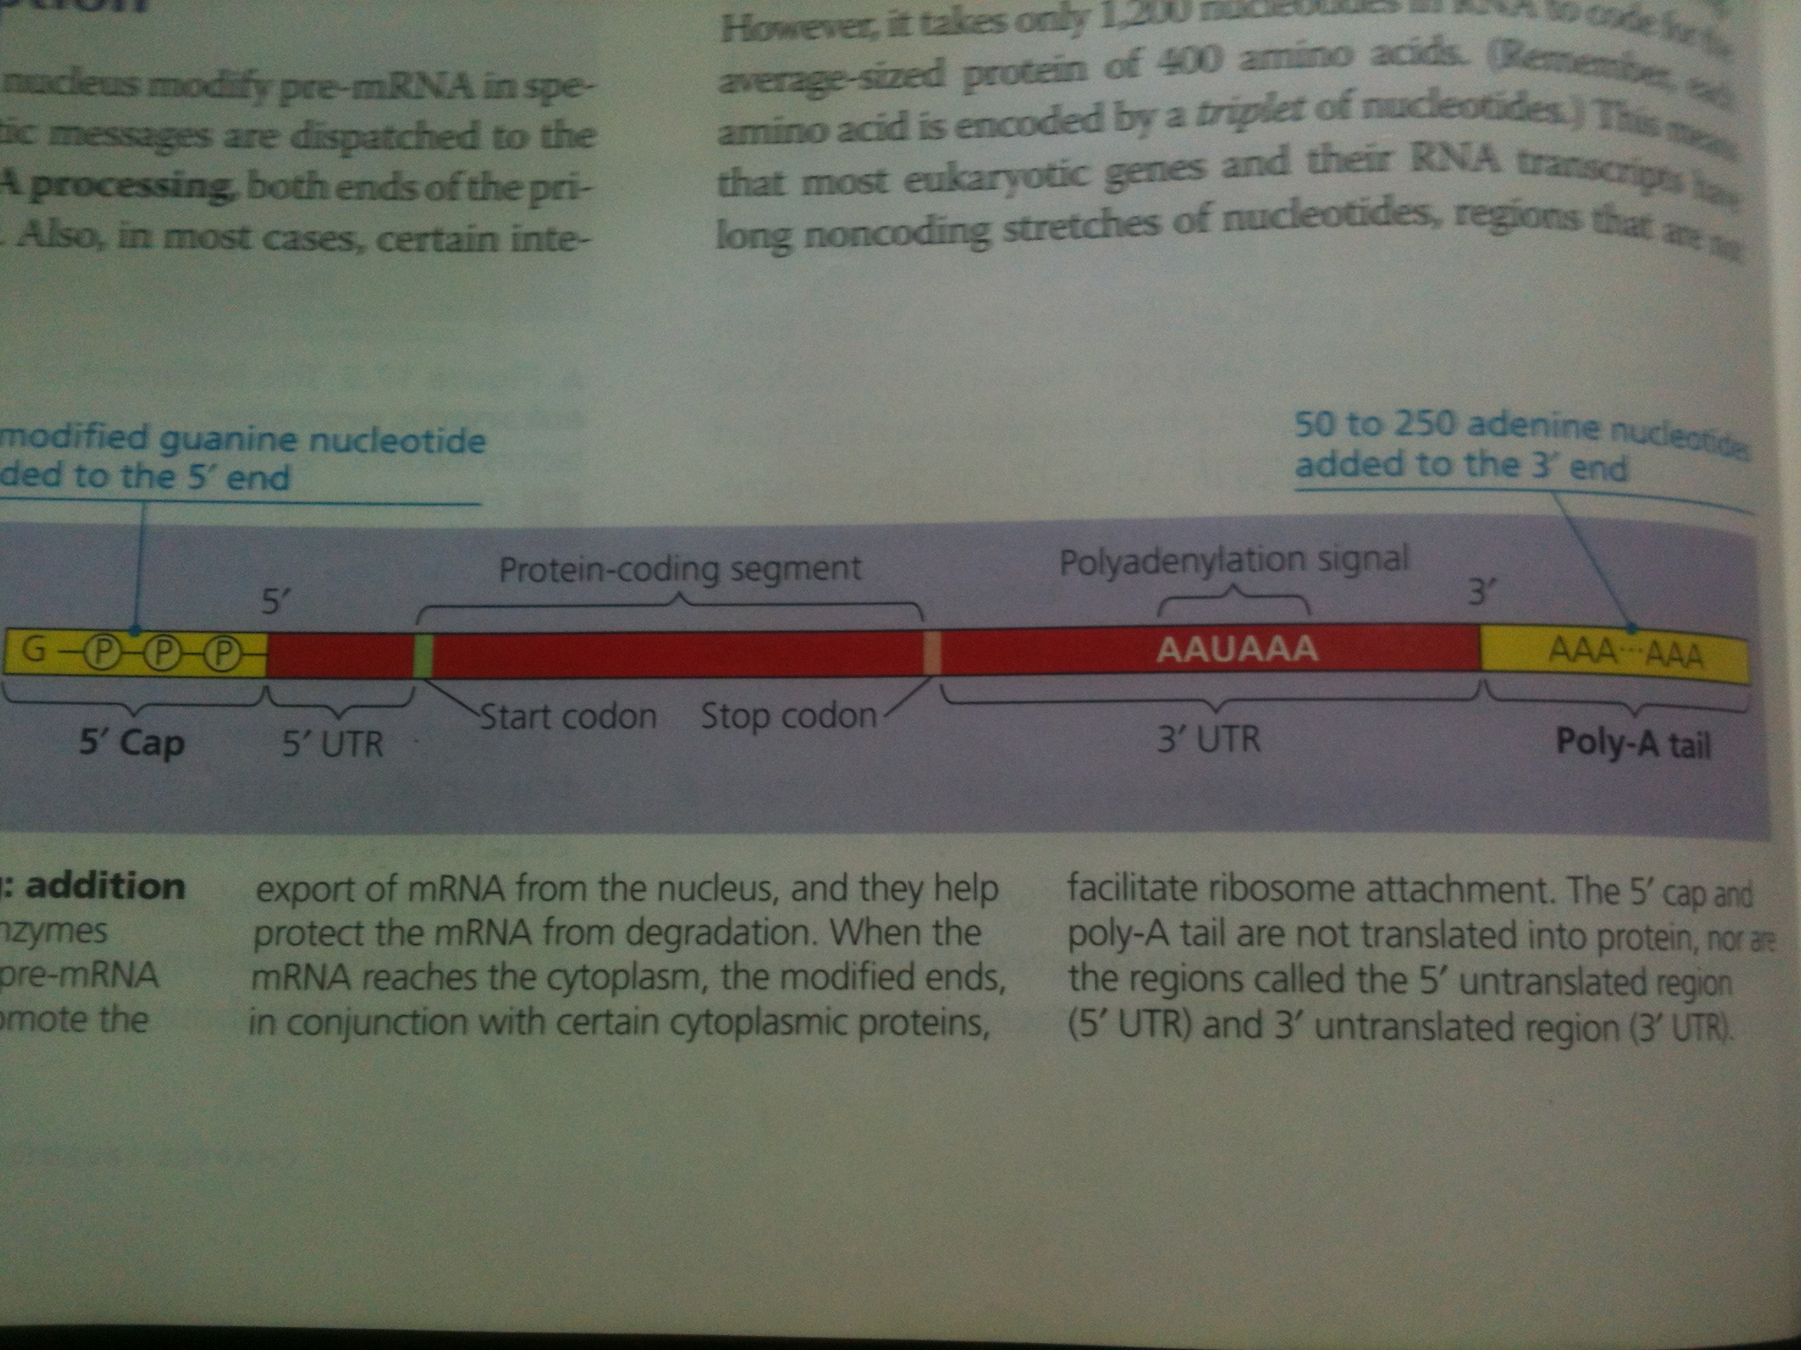

Slide 16
RNA splicing: Introns, exons
Average length of transcription unit along human DNA molecule is about 27,000 base pairs
However, it takes only 1200 nucleotides to code for 400 long polypeptide chain
Means a large portion of mRNA is removed
Noncoding versus coding sequences: the intervening non-coding sequences called “introns” in mRNA are removed and the coding sequences called “exons” are joined again before the exit of mRNA to cytoplasm for translation

Slide 17
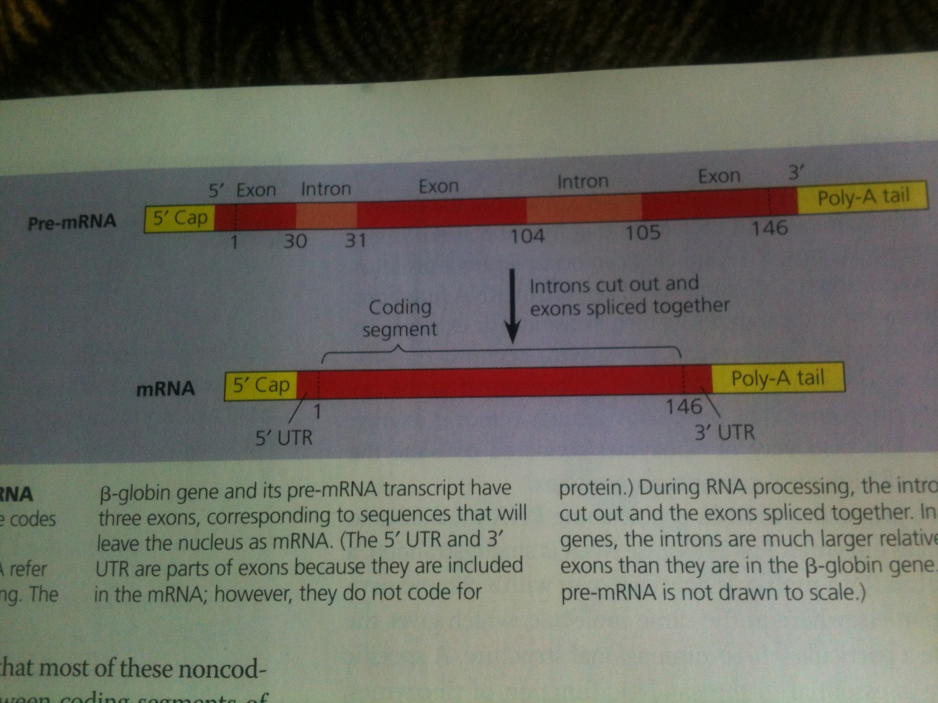

Slide 18
Mechanism of RNA splicing
Short nucleotide sequences called “splice sites” at each end of intron being recognized by “small nuclear ribonucleoproteins (snRNPs)” containing small nuclear RNA (snRNA) complementary to the nucleotide sequences at splice sites of mRNA.
Several different snRNPs join together with other proteins to form a large assembly called “spliceosome” as big as a ribosome
Spliceosome cut introns and join exons
Endonucleases

Slide 19
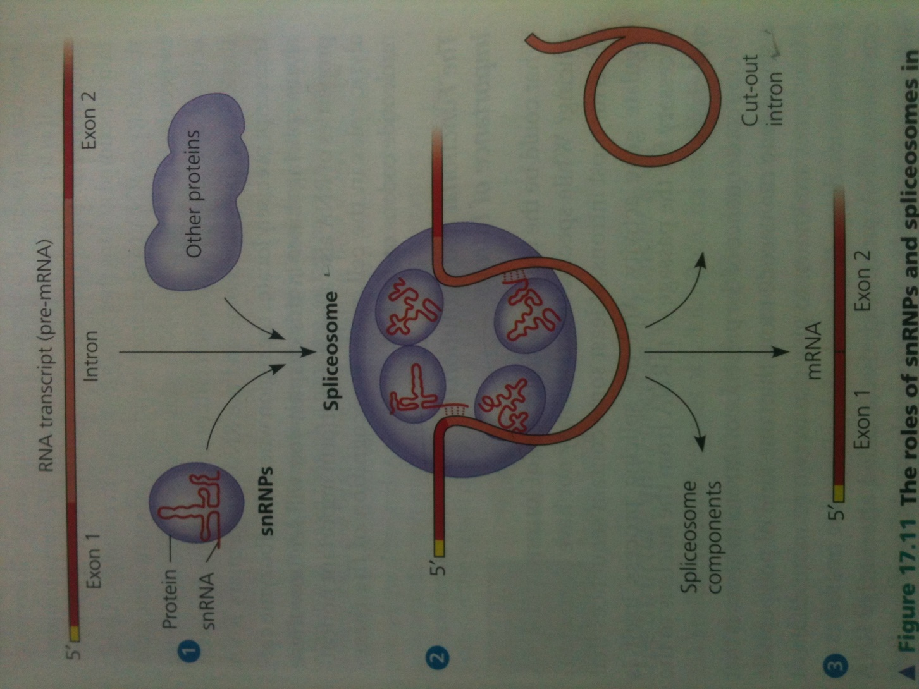

Slide 20
Functional and evolutionary importance of introns
Single gene encode more than one kind of protein “alternative splicing”
Because of alternative splicing, number of different protein products an organism produces is much greater than its number of genes

Slide 21
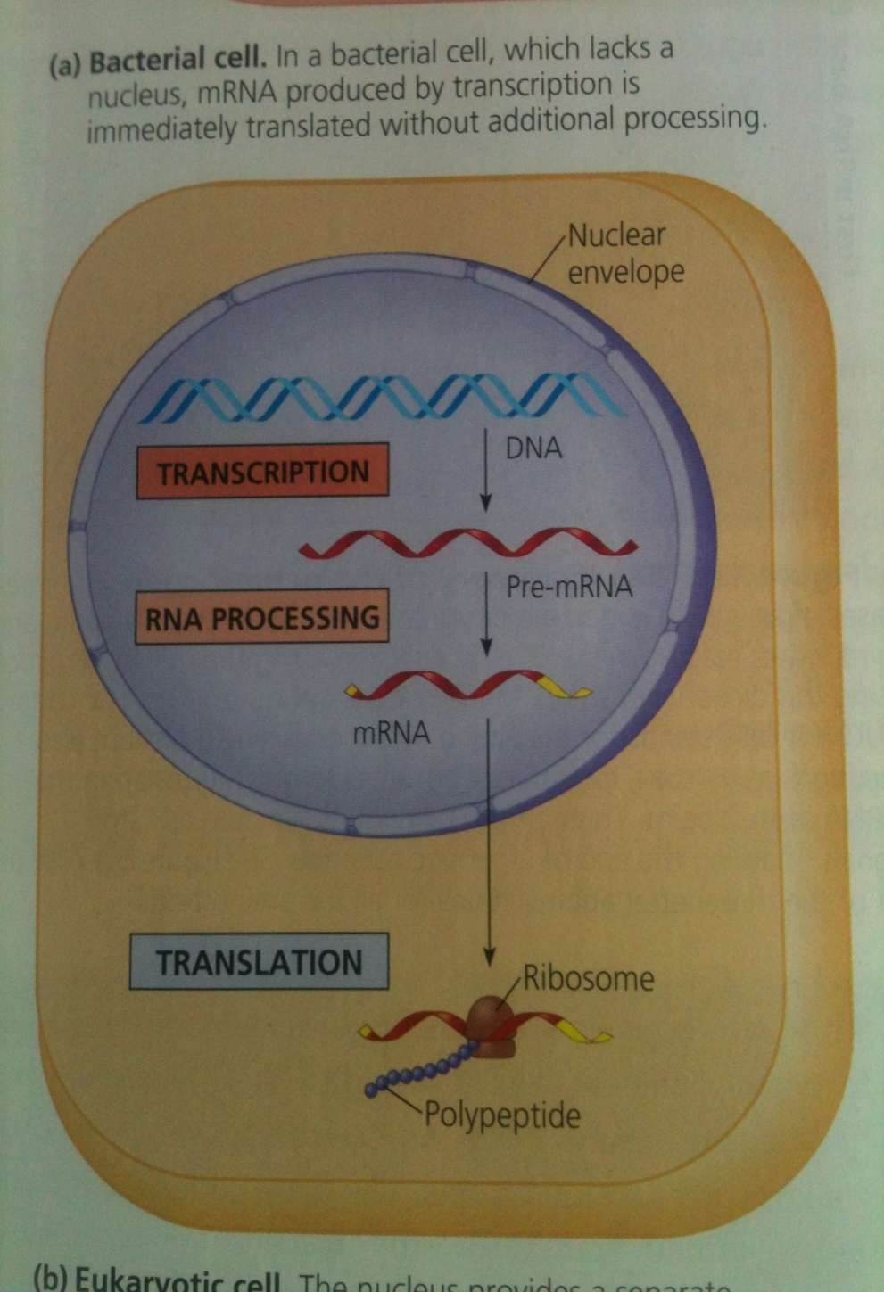
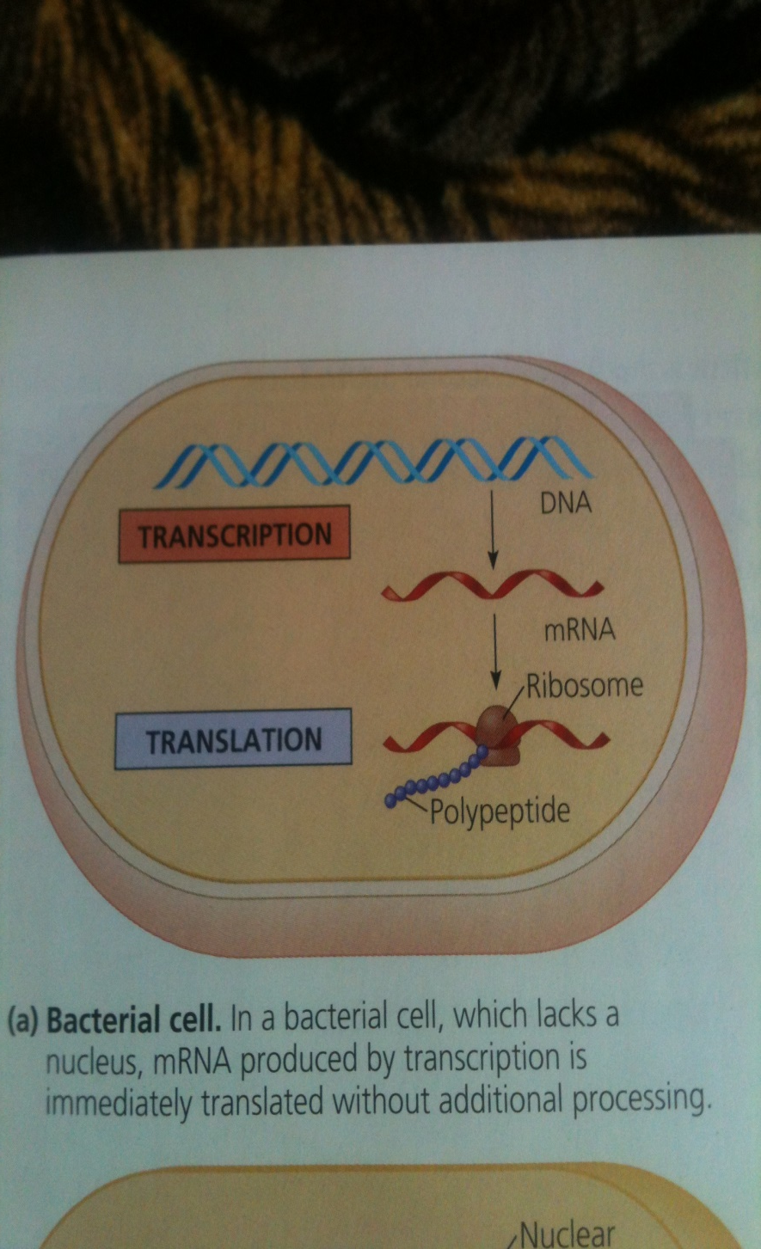
Translation: the process of polypeptide chain synthesis from mRNA

