Slide 1
4.Social Welfare in Pakistan
Social work
Social welfare
Social policy
Social welfare policy
Welfare state
Related concepts

Slide 2
Policy
The goals, means, and principles pursued by public or private institution sit is particularly associated with the idea of principles, which are guiding specific actions in chase of goals. Social policy: a term applied to various areas of policy, usually within a governmental or political setting as an interdisciplinary and applied subject concerned with the analysis of societies' responses to social need.

Slide 3
Social welfare policy:
A subset of social policies, in particular programs/regulations designed to satisfy individual and familial needs inadequately met through the market system. Publicly financed and administered programs designed to meet basic needs inadequately met through the social system.

Slide 4
Social Welfare Policy and Welfare State
Social welfare policy is the major factor in shaping the practice environment. Social welfare policies both reflect and help to define the type of society we live in.

Slide 5
Social workers in the area of social welfare policies
Social policy-makers, evaluator, and planner:
These social workers work for the government usually at senior level. They examine social trends of the society (e.g. falling birth rates, rapid aging population; increasing divorce rates, etc.)Working together with experts in other related fields (e.g. medicine, legal professions) to recommend appropriate policies to key ministry committee that will impact the society as a whole.

Slide 6
Social Welfare Policy form the framework
Social welfare policies are important because they form the framework that allows all citizens of a particular nation to live within their basic rights with access to some of the most basic social facilities.

Slide 7
Although the terms are often used interchangeably, social welfare policy is theoretically a subset of social policy. In other words, all social welfare policies are social policies but not all social policies are social welfare policies. The difference though is more theoretical than practical as it is rare to have social policies that are not believed to contribute to the well-being of society.

Slide 8
Difference of Social policy and social welfare policy
One set of social policies that one could argue are not necessarily social welfare policies are those regulating gender. For example, whether restrooms are unisex or single gender and whether biology or gender identification should determine use of single-gender bathrooms a matter of social policy, the legal age of marriage, whether women are compelled to take their husbands last names, whether married couples hold property in common or can still hold property as individuals, or whether polygamy is legal.

Slide 9
Various laws and policies vary across different regions and countries are intended to promote different ideals of social conduct, but while these are social policies, they are not necessarily social welfare policies but instead efforts to sustain local cultural norms. Racial separation would be an example of a social policy informed by racism that did not enhance social welfare but actually harmed many Pakistani citizens.
On the other hand, social policies that aim to reduce child hunger, provide prenatal care, reduce crime, or promote universal education all would be considered social welfare policies

Slide 10
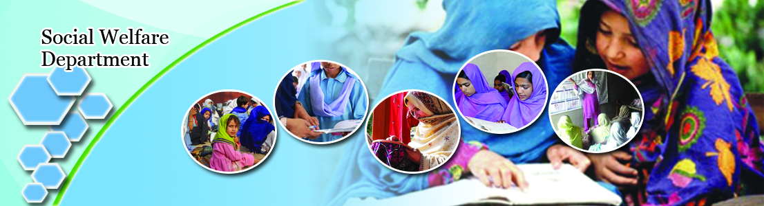
Women empowerment

Slide 11
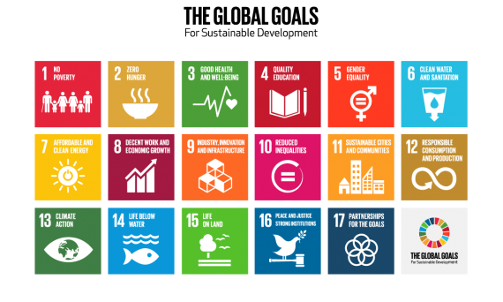
The global goals

Slide 12
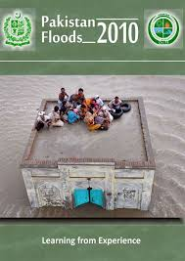
Emergencies

Slide 13
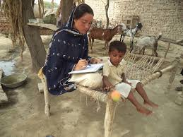
Early child marriages

Slide 14


Slide 15
Importance of social welfare policy
Social welfare policy is important for two main reasons.

Slide 16
1.people who could benefit from them
First, these policies are important to those people who could benefit from them and could help our country by helping them. Our country has a number of poor people who could benefit from social welfare programs that are wisely conceived and administered. This could help them out of poverty which would be a great benefit to them. At the same time this could be beneficial to our whole society. Fewer poor people would lead to less crime. More people in the middle class would boost our economy.

Slide 17
2.Government is strapped for money
Second, social welfare policies are important because our government is strapped for money. We face serious economic problems with the government running large deficits every year. What this means is that we have to be smarter about our social welfare policies. We have to do more to ensure that they really work so that they are not just wasting our money. We have to do this or the political reaction against such programs will be so great that these programs will probably disappear.
For these reasons, it is important and critical to have good social welfare policies.

Slide 18
Welfare State
Welfare state is a buzz word today.
Every country call herself a welfare state but the level of welfare services vary from society to society.
The term refers to “those societies where the government has the responsibility for the wellbeing of the citizens and that this cannot be entrusted to the individual, private corporations, or local community

Slide 19
A welfare state typically protects people against poverty by means of
  Unemployment benefits
  Family allowances
  Income supplements for the poorly paid and
  Old age pension
the state provide comprehensive medical care, free education, public housing.
These programmes are financed by state insurance schemes and taxation.

Slide 20
Welfare state also refers to organizing, financing, and provision of welfare benefits and services by government.
The term “ welfare state” is used to describe the combination of benefits and services intended to increase the well-being of citizens and provided either directly or indirectly.

Slide 21
The welfare state also seeks to relieve poverty and reduce inequality by guaranteeing a minimum level of financial assistance through social security or unemployment benefits.

