Slide 1
Training & Development

Slide 2

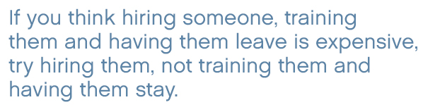

CFO asks CEO, “What happens if we invest in developing our people and then they leave us?”
CEO: “What happens if we don’t, and they stay?”
~Peter Baeklund

Slide 3
Training and Development
Training and Development (T&D) - Efforts designed to improve employee’s competency and organizational performance.
Training - Designed to provide employees with the knowledge and skills needed for their present jobs.
Development – Activities that prepare employees for future responsibilities. Future-Oriented activities that focuses on employee personal growth.

Slide 4
Training and Development
Training and Development
  Represents an ongoing investment in employees and realizes that employees are assets with value.
Importance of Training and Development
  Rapid technological changes cause skill obsolescence.
  Redesign of work brings about the need for new skills.
  Mergers and acquisitions have increased the need for integrating employees into different corporate cultures.
  Employees are moving between employers more often, necessitating the training of more new hires.
  Globalization of business requires new knowledge and skills.

Slide 5
Benefits of Training and Development
Individual employee
  Increased employee marketability
  Increased employee employability security
Organization
  Improved bottom line, efficiency, and profitability
  Increased flexible in having employees who can assume different and varied responsibilities
  Reduced layers of management
  Helps make employees more accountable for results.

Slide 6
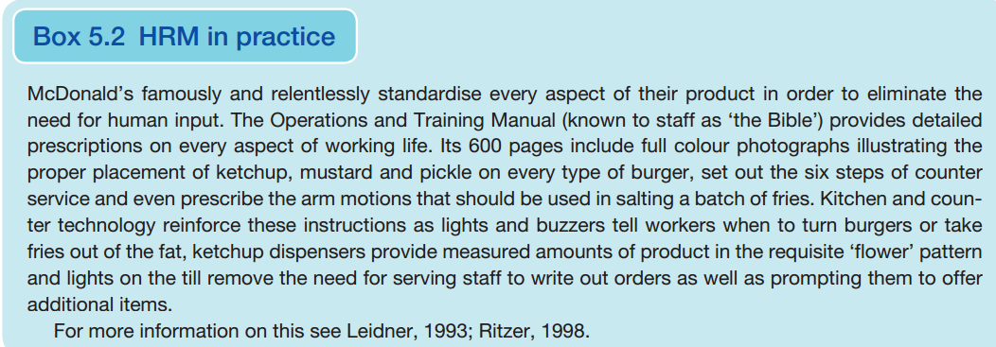

Slide 7
The Training and Development Process
Need Assessment
Establish specific objectives
Selecting T&D Contents & methods
Implement T&D programs
Evaluate T&D programs

Slide 8
1. Need Assessment
Need assessment diagnoses current problems and future challenges to be met through T&D.
Organizational Analysis
Task Analysis
Person Analysis
Number of employees experiencing skill deficiency
Severity of skill deficiency
Importance of skill
Extent to which skill can be improved with training
Cost and Benefit Analysis

Slide 9
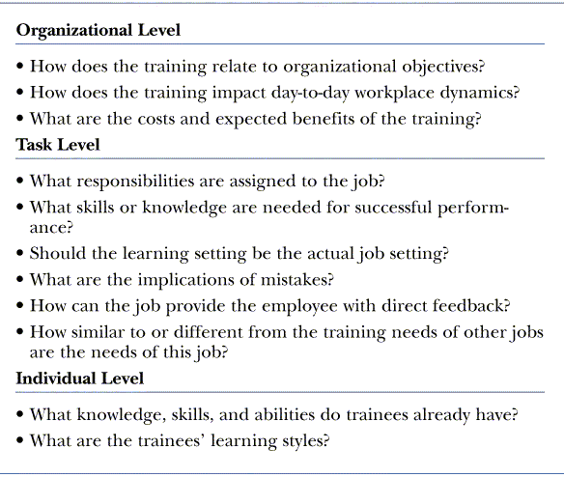
Levels of Need Assessment

Slide 10
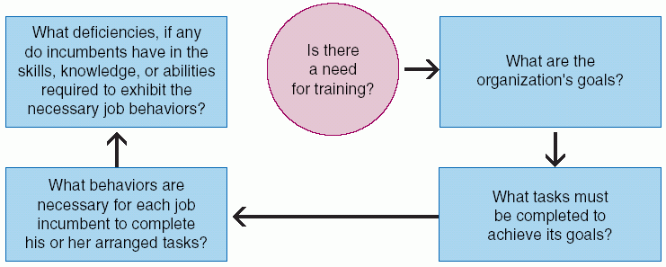
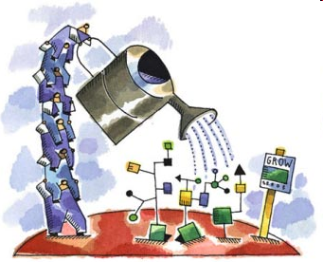
Need assessment is directed to find out gap between actual and desired Results.

Slide 11

2. Establishing T & D Objectives
Desired end results
Clear and concise objectives must be formulated
Benchmarks
SMART

Slide 12
3. T & D Methods
Two Broader categories
On Job Training (OJT)
takes place in a normal working situation, using the actual tools, equipment, documents or materials that trainees will use when fully trained.
Off-the-job training takes place away from normal work situations — implying that the employee does not count as a directly productive worker while such training takes place. Off-the-job training has the advantage that it allows people to get away from work and concentrate more thoroughly on the training itself

Slide 13

T & D Methods
Apprenticeships- An apprenticeship is a system of training a new generation of practitioners of a trade or profession with on-the-job training and often some accompanying study (classroom work and reading).
HRD Directed and Formal
Notes:
On-the-job training takes place in a normal working situation, using the actual tools, equipment, documents or materials that trainees will use when fully trained. On-the-job training has a general reputation as most effective for vocational work.
Off-the-job training takes place away from normal work situations — implying that the employee does not count as a directly productive worker while such training takes place. Off-the-job training has the advantage that it allows people to get away from work and concentrate more thoroughly on the training itself. This type of training has proven more effective in inculcating concepts and ideas.

Slide 14
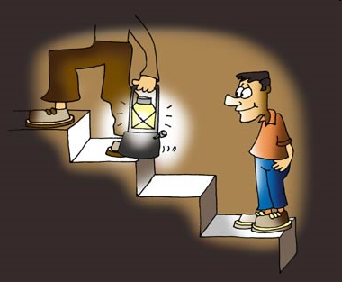
Coaching- Similar to apprenticeships but less formal.
Provided when needed without planned programs
Handled by Supervisor/manager not by HR Deptt.
Coach provide a model for trainee to copy.
Mentor: a trusted friend, counselor or teacher, usually a more experienced person. Mentorship refers to a developmental relationship in which a more experienced person helps a less experienced person, referred to as a protégé, apprentice, mentee, or (person) being mentored, develop in a specified capacity. Mentor can be anywhere in organization or even in another firm

Slide 15
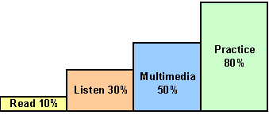
Informal Learning-
A research finding shows that as much as 80% of what employee learn through informal training means by performing their job on routine bases.
Job Redesign
Job enlargement “adds more things to do”
Job enrichment “adds more responsibility”
Job rotation “ employee is moved from one department to another”
Internship

Slide 16

Lectures- learning through communication rather then modeling.
Depends upon lecturer ability
Television, Films, Multimedia, Audiovisuals etc.
Work shop- A period of discussions and practical work on a particular subject in which people share their knowledge and experience.
Workshops are practical approach to discuss, discover or handle a given situation.
Practical approach dominates rather then theoretical work.

Slide 17
Seminars
Meeting to discuss or study a particular topic with a presenter
Seminar are learning from others/shared experience.
Seminars are means of exploring specific topic by different aspects through, discussions, speeches & reports.
Increasingly, the term "seminar" is used to describe a commercial event (though sometimes free to attend) where delegates are given information and instruction in a subject such as property investing, other types of investing, Internet marketing, self-improvement or a wide range of topics, by experts in that field
A seminar may be a large lecture course, especially when conducted by a renowned thinker (regardless of the size of the audience or the scope of student participation in discussion).
Notes:
Seminar is, generally, a form of academic instruction, either at a university or offered by a commercial or professional organization. It has the function of bringing together small groups for recurring meetings, focusing each time on some particular subject, in which everyone present is requested to actively participate. This is often accomplished through an ongoing Socratic dialogue with a seminar leader or instructor, or through a more formal presentation of research. Normally, participants must not be beginners in the field under discussion (at US universities, seminar classes are generally reserved for upper-class students, although at UK and Australian universities seminars are often used for all years). The idea behind the seminar system is to familiarize students more extensively with the methodology of their chosen subject and also to allow them to interact with examples of the practical problems that always crop up during research work. It is essentially a place where assigned readings are discussed, questions can be raised and debates conducted. It is relatively informal, at least compared to the lecture system of academic instruction.
In some European universities, a seminar may be a large lecture course, especially when conducted by a renowned thinker (regardless of the size of the audience or the scope of student participation in discussion). Some non-English speaking countries in Europe use the word seminar (e.g., German Seminar, Slovenian seminar, etc.) to refer to a university class that includes a term paper or project, as opposed to a lecture class (i.e., German Vorlesung, Slovenian predavanje, etc.). This does not correspond to English use of the term.
Increasingly, the term "seminar" is used to describe a commercial event (though sometimes free to attend) where delegates are given information and instruction in a subject such as property investing, other types of investing, Internet marketing, self-improvement or a wide range of topics, by experts in that field

Slide 18
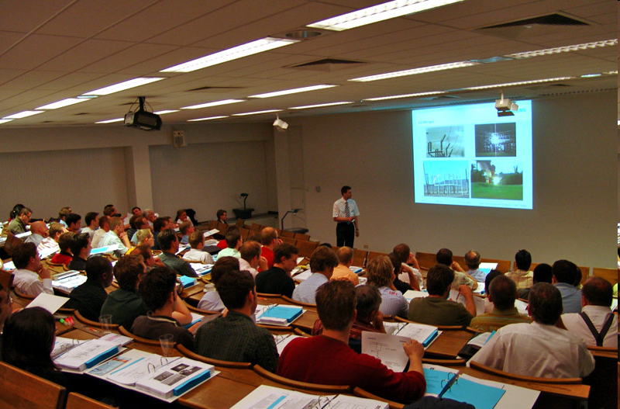

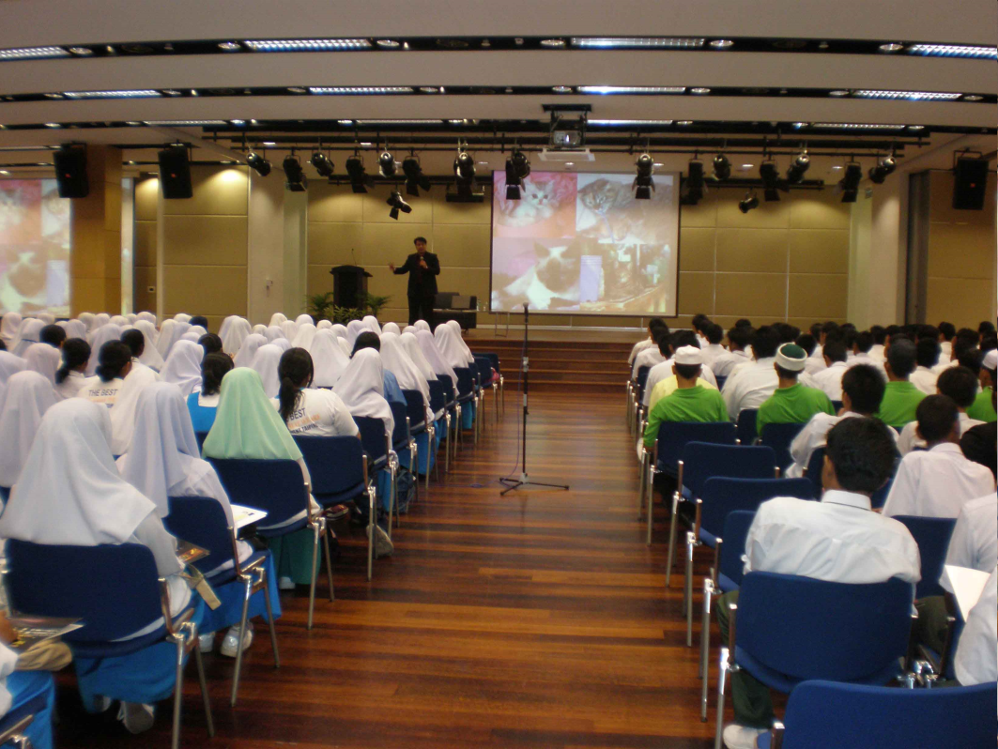
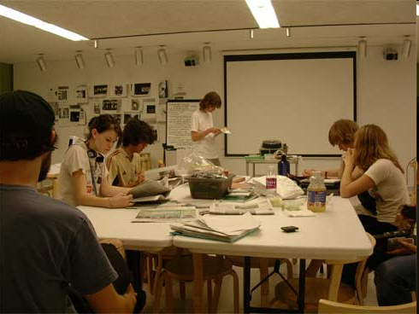
Seminar vs. Workshop

Slide 19
Role Playing- Methods that forces trainees to assume different identities.
Trainees are given some information related to description of the role, concerns, objectives, responsibilities, emotions, etc..
It refers to the changing of one's behavior to assume a role.
Multiple/Single/Rotation/Extempore

Slide 20



Behavior Modeling- Learning takes place mainly through observation of others experience.
Watching some one perform a behavior, learning through copying, matching it & rehearsing

Slide 21
Case Study
Trainees solve business problems
Individuals study information in case and make decisions
Used in classroom with instructor who serves as facilitator
Simulators
Training devices that model the real world
Range from simple paper mock-ups of mechanical devices to computerized simulations of total environments
May simulate automobiles and airplanes

Slide 22
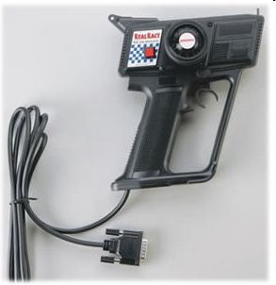
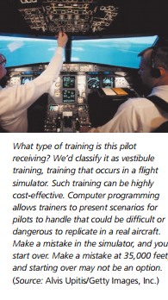
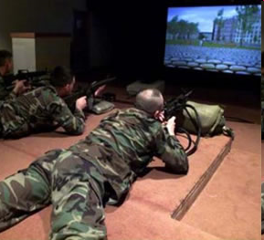
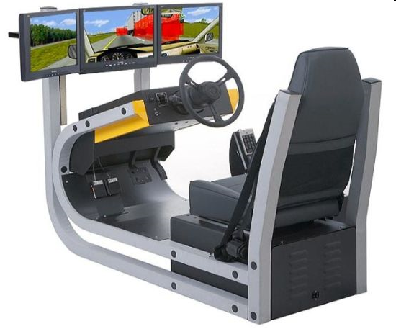



Slide 23
Business Games-
Computer or non computer (board) games that attempt to duplicate selected factors in a particular business situations. The players receive different roles like salesman, CEO, customer etc.
Action Learning
A training whereby the participants study their own actions and experience in order to improve performance. This concept is close to learning-by-doing. .
Vestibule Training
A training in which the training location is separate from the main productive areas of the plant; includes student carrels, lecture rooms, and in many instances the same type of equipment that the trainee will use in the work station.

Slide 24
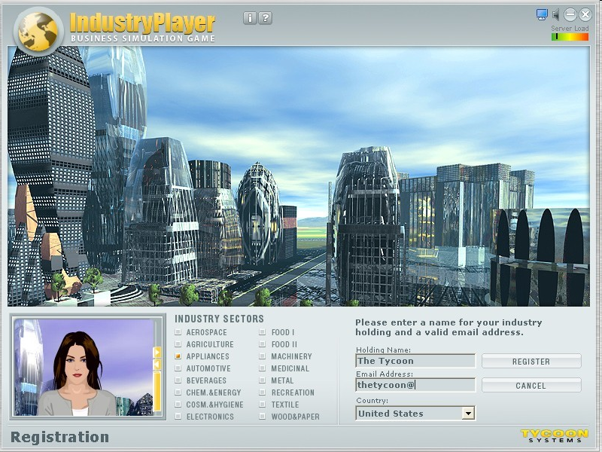
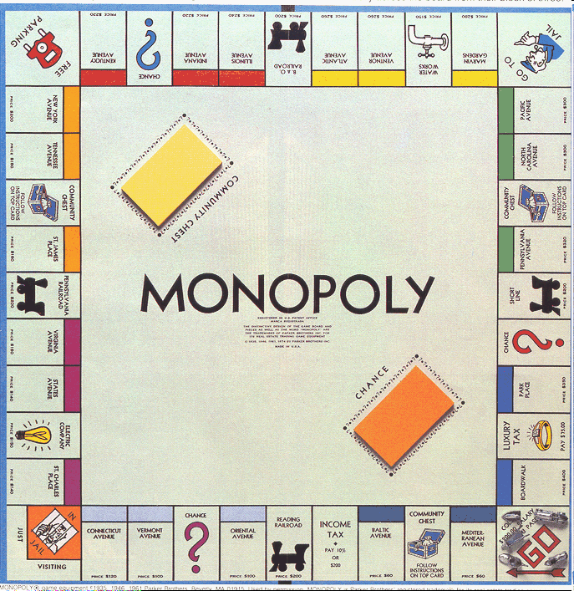




Slide 25

In-basket training
-Method of acquainting new or promoted employees with the complexities of their jobs by presenting them with a range of problems they might find in their 'in basket' when they take up the job. Trainees have a limited period of time to set priorities, organize their working schedule accordingly and respond to mails and phone calls.

Slide 26
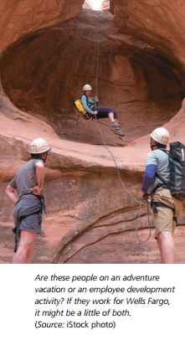
Adventure Training- A trend in employee development has been the use of adventure (sometimes referred to as outdoor, wilderness, or survival) training. The primary focus of such training is to teach trainees the importance of working together, or coming together as a team. Adventure training typically involves some major emotional and
physical challenge. This could be mountain climbing, paintball games, or surviving a week on a sailing adventure.

Slide 27
4. Implement T & D Program
Climate for
transfer
Opportunity to use
learned capability
Technological
Support
Implementation
of
Training
Self-management
skills
Manager support
Peer Support

Slide 28
5. Evaluating T & D Program
Participant’s opinions
Extent of learning
Behavioral change
Tests
Accomplishment of T&D objectives
Benchmarking

Slide 29
Performance Based Evaluation Methods
Post Training Performance Method:
Evaluating training programs based on how well employees can perform their jobs after training.
Pre-post Training Performance Method:
Evaluating training programs based on the difference in performance before & after training.
Pre-post Training Performance With Control Group Method:
Evaluating training by comparing pre-post training results with individuals.

Slide 30
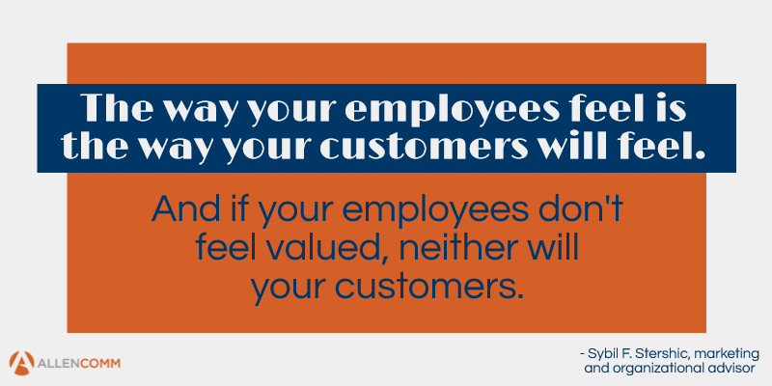
I hated every minute of training, but I said, 'Don't quit. Suffer now and live the rest of your life as a champion. (Muhammad Ali)

