Slide 1
UNIFICATION OF GERMANY
by
Faiza Mir
Department of International Relations
University of Balochistan, Quetta

Slide 2
MAIN IDEA
In the late 1800s, Otto von Bismarck transformed
Germany from a loose confederation of separate
states into a powerful empire.
THINK ABOUT:
How was Germany unified?
What tactics did Bismarck use?
How did the unification of Germany change Europe?

Slide 3
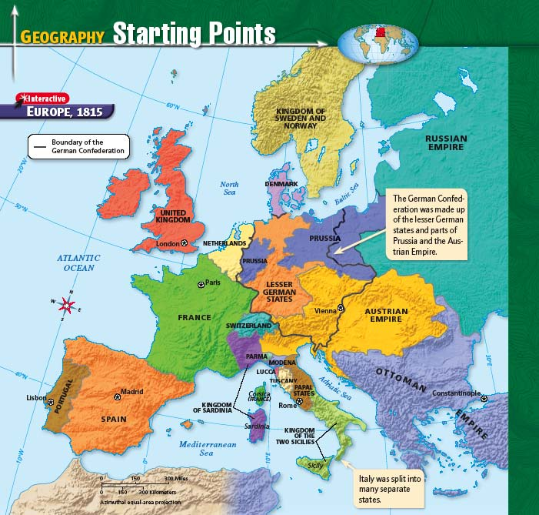

Slide 4
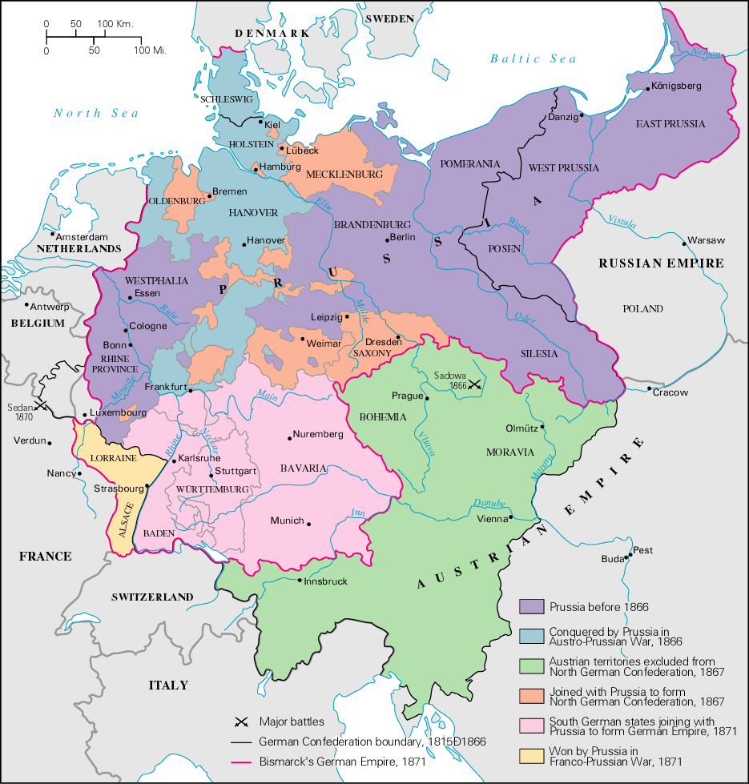

Slide 5
GERMAN CONFEDERATION
Formed in 1815 at the Congress of Vienna, the German Confederation replaced the Holy Roman Empire
Loose confederation/political association of 39 states
  Two largest states
    Prussia (Hohenzollerans)
    Austria (Hapsburgs)

Slide 6
AUSTRIA / PRUSSIA RIVALRY
Austrian Empire
Prussia
Older state
Multinational Empire
Major power in Europe
Newer State
Primarily German population
Powerful army
Authoritarian government – strong king
Industrialized quickly

Slide 7
BASIS FOR GERMAN NATIONALISM
Nationalism: Feeling of belonging
Nationalists: People who believe that a single “nationality” should unite under a single government
Goal of Nationalists – create a NATION-STATE
Bonds that create a nation-state:
  Shared:
    Language
    Culture
    Religion
    History
    Land (Territory)

Slide 8
If there was to be one Germany, which major power should lead the fight for unification?
Austria
Prussia

Slide 9
SETTING THE STAGE FOR GERMAN UNIFICATION: THE PREQUEL
Revolution of 1848
  Liberal revolution
  Desire for German unification grew
Promise of Reforms in Prussia
  Hint of liberal reforms
Creation of the Zollverein
  Economic alliance between the German states

Slide 10
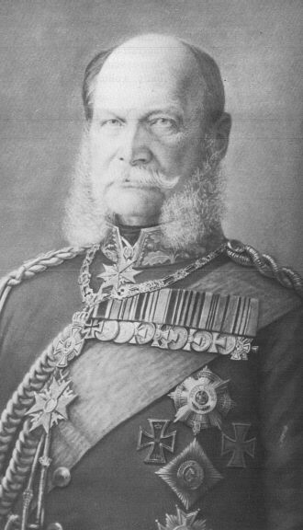
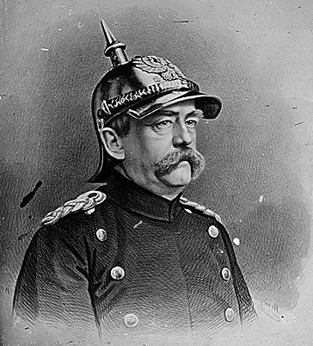
PRUSSIAN GOVERNMENT
King Wilhelm I
Prime Minister Otto von Bismarck

Slide 11
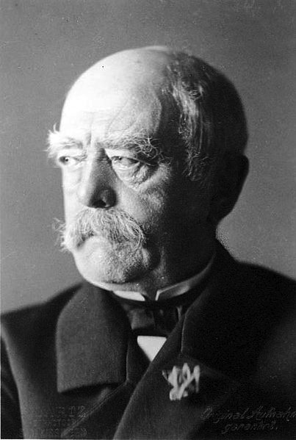
OTTO VON BISMARCK (1815-1898)
Prime minister of Prussia 1862-1890
Became chancellor of Northern German Confederation in 1867
“The Iron Chancellor”
“ The less people know about how laws and sausages are made, the better they’ll sleep at night”

Slide 12
BISMARCK’S PHILOSOPHY
Believed Prussia destined to lead German people to unification
Practiced Realpolitik
  “Politics of reality”
  Tough power politics, no room for idealism
Used “blood and iron” to create Germany

Slide 13
QUOTES BY BISMARCK
“The great questions of the day will not be settled by speeches and majority decisions but by blood and iron.”
“The less people know about how sausages and laws are made, the better they’ll sleep at night.”
“Some damned foolish thing in the Balkans will provoke the next war.”

Slide 14
STEPS TO GERMAN UNIFICATION
Bismarck became Prime Minister
A series of short wars:
  Danish War (1864)
  Austro-Prussian War (1866)
  Franco-Prussian War (1870-1871)
    Treaty of Frankfurt
    Coronation of Kaiser Wilhelm I

Slide 15
“Germany does not look to Prussia’s liberalism but to her power…Not by speeches and majorities will the great questions of the day be decided – that was the mistake of 1848-1849 – but by iron and blood”
~Otto von Bismarck

Slide 16
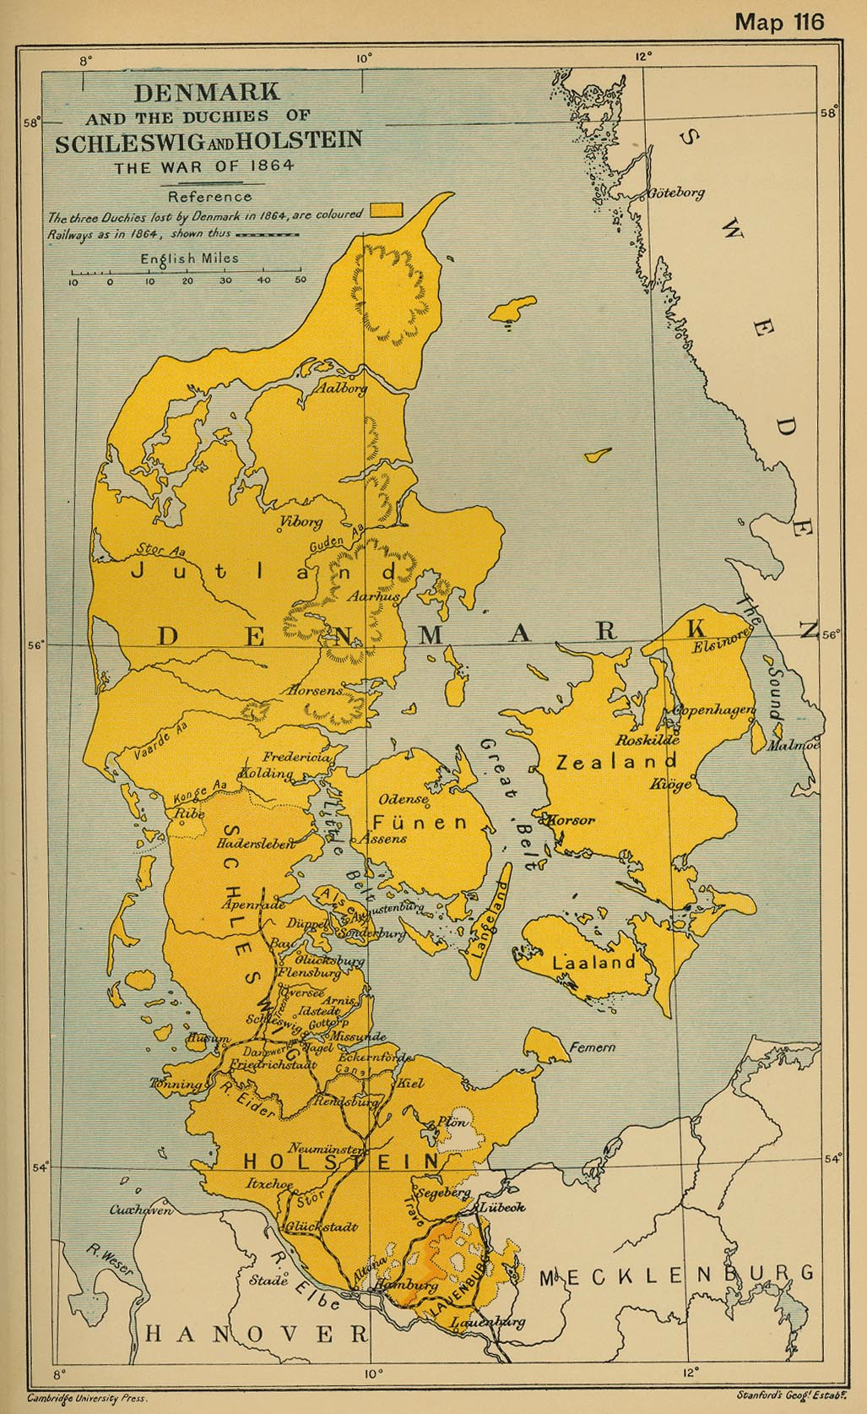
DANISH WAR (1864)
Denmark annexed areas:
  Holstein population was German
  Schleswig mixture of Germans and Danes
Prussia and Austria protest the annexation of German-speaking people; demand it be revoked
War starts:
Prussia and Austria (allies) vs. Denmark

Slide 17
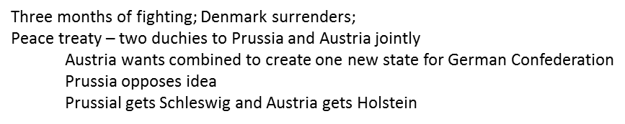
RESULTS OF DANISH WAR
Brief fight – Three months
Denmark gave up Holstein & Schleswig
Prussia and Austria disagreed over how to divide the territories

Slide 18
IMMEDIATE RESULTS
Increased national pride among Prussians
Support for Prussia as head of new Germany increased
Set the stage for conflict between Prussia and Austria

Slide 19
BISMARCK’S BACKROOM DEALINGS
Bismarck prepared for conflict with Austria
  Persuaded Napoleon III (France) to remain neutral
  Formed alliance with Italy
Provoked Austria into declaring war on Prussia in 1866
  Focused on the division of Holstein and Schleswig

Slide 20
AUSTRO-PRUSSIAN WAR, 1866
Also known as the Seven Weeks War
Prussian advantages
  Railroads (better transportation )
  Telegraphs (better communication)
  Modern weaponry (better army)

Slide 21
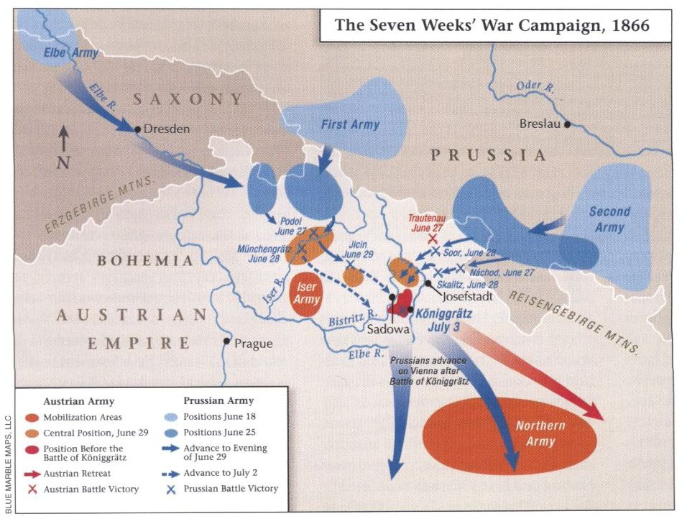

Slide 22
RESULTS OF THE AUSTRO-PRUSSIAN WAR
Prussians won !!!
Balance of European power shifted dramatically

Slide 23
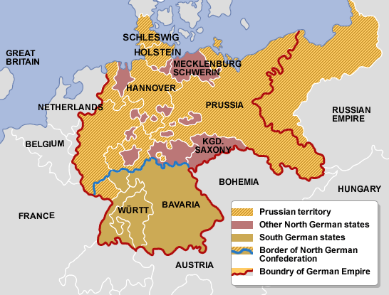
CREATION OF NORTHERN GERMAN CONFEDERATION (1867)
After Austro-Prussian War:
  Northern German states united with Prussia to form the North German Confederation
    Each state governed itself
    King of Prussia was head of Confederation
  Austria not a part of this new union

Slide 24
BISMARCK’S BACKROOM DEALINGS
Bismarck now needed to convince liberal German states that they wanted to be ruled by autocratic, conservative Prussia.
Strategy:
Fight a successful war against a common enemy

Slide 25
EMS TELEGRAM
King Wilhelm responded to telegram from the French
Bismarck altered Wilhelm’s response to make it sound like an insult
Telegram was published → angered the French!
June 1870 – France declared war on Prussia

Slide 26
FRANCO-PRUSSIAN WAR (1870-1871)
All German states joined in war against France
No outside nation came to help France
Short, but decisive war – German victory
Results of war:
  French Empire collapsed
  France lost Alsace-Lorraine (border territories)
  France paid Germany 5,000,000,000 francs (reparations)
  German army occupied much of France

Slide 27
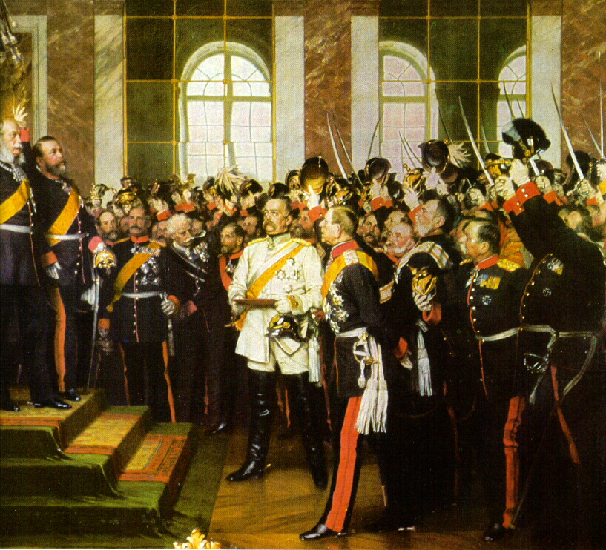
GERMAN EMPIRE
Wilhelm I proclaimed Emperor of Germany at Versailles on January 18, 1871
Berlin became Germany’s capital
Constitution united 25 German states into a federal form of government
  Local government in each state
  Emperor (or Kaiser) headed national government
  Kaiser was very powerful

Slide 28
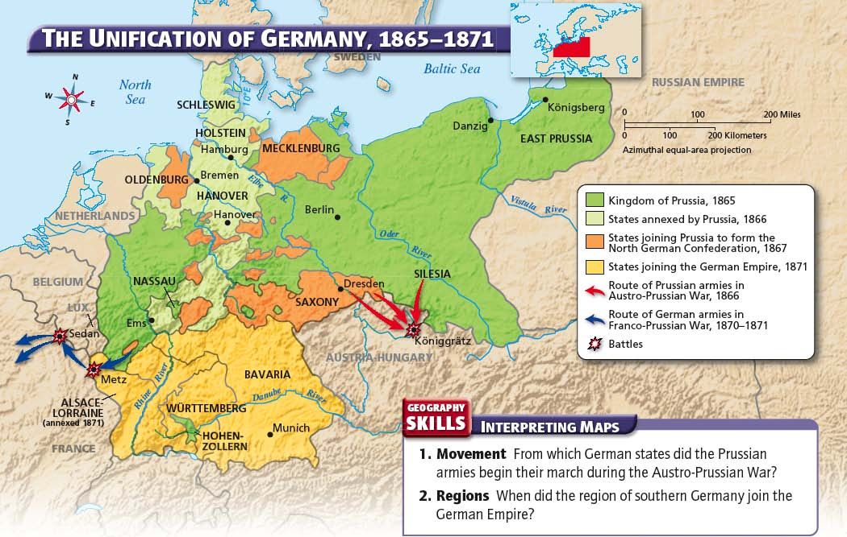

Slide 29
BALANCE OF POWER SHIFTS
1815 (Treaty of Vienna) – created a balance of power within Europe:
  Established Five Great Powers (Britain, France, Prussia, Austria, and Russia)
  Purpose was to maintain the peace
Changed by 1871
  Britain and Germany became stronger (super-powers)
  Austria, Russia, and Italy became weaker
  France lost power but remained important as a center of science and culture

Slide 30
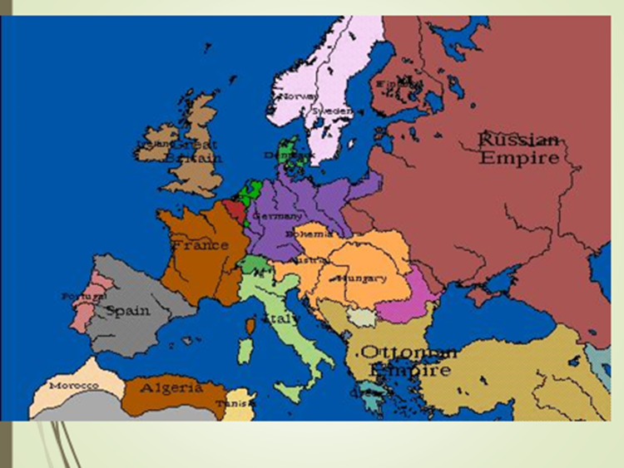

Slide 31
NUTSHELL !!
Germany is unified in 1871
Bismarck becomes Chancellor of Germany
Now, major powers in Europe are Britain, France, Austria, Russia, and Germany.
Assignment: How was Germany unified?
What tactics did Bismarck use?
How did the unification of Germany change Europe?

