Slide 1
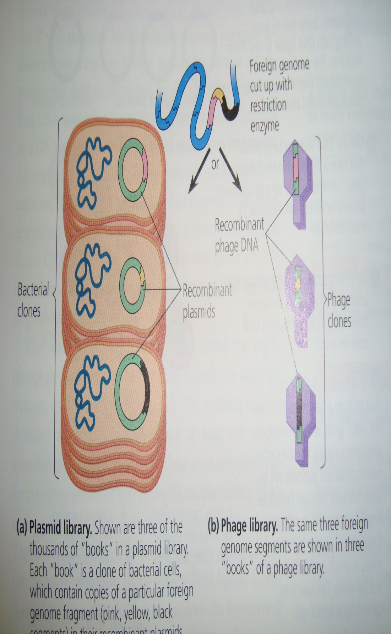
Storing cloned genes in DNA libraries
The cloning procedure described in the last slide is called as “shotgun approach” as whole genome was used to make its multiple copies
Each white colony of bacteria carry recombinant plasmids, which have a same foreign DNA segment
The complete set of plasmid-carrying copies of a particular segment from the initial genome from hummingbird, is referred to as “genomic library”
They can be stored for long period of time at low temperatures (e.g. -10 ºC to -20ºC)
Certain bacteriophages can also be used as cloning vectors
Bacterial plasmids do not carry a foreign DNA larger than 12 kb (kilo bases) while phage virus can carry 25 kb long foreign DNA fragment

Slide 2
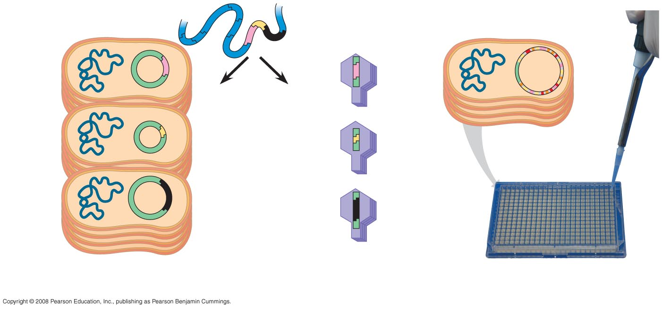
Fig. 20-5
Foreign genome cut up with restriction enzyme
Large insert with many genes
Large plasmid
or
BAC clone
Recombinant phage DNA
Bacterial clones
Recombinant plasmids
Phage clones
(a) Plasmid library
(b) Phage library
(c) A library of bacterial artificial chromosome (BAC) clones
Notes:
Figure 20.5 Genomic libraries

Slide 3
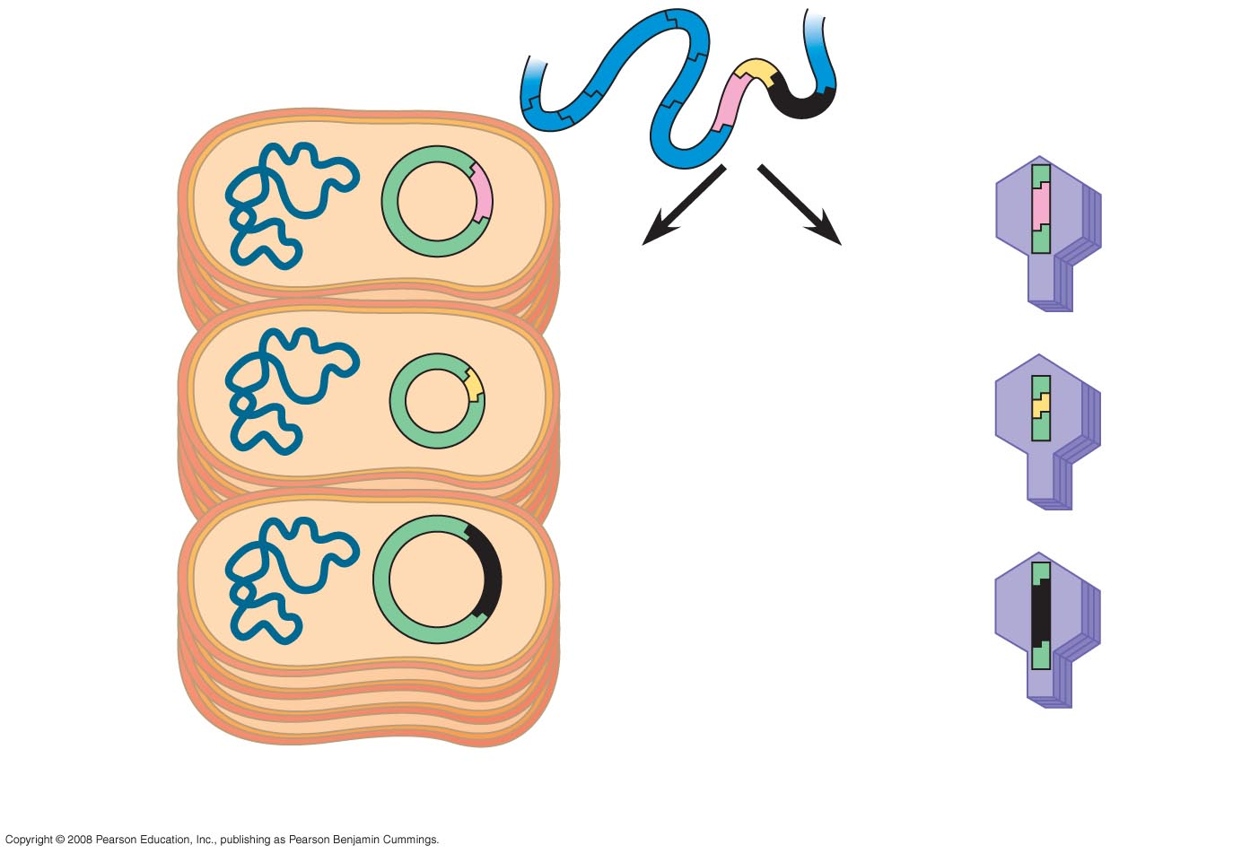
Fig. 20-5a
Foreign genome cut up with restriction enzyme
or
Recombinant phage DNA
Bacterial clones
Recombinant plasmids
Phage clones
(a) Plasmid library
(b) Phage library
Notes:
Figure 20.5a, b Genomic libraries

Slide 4
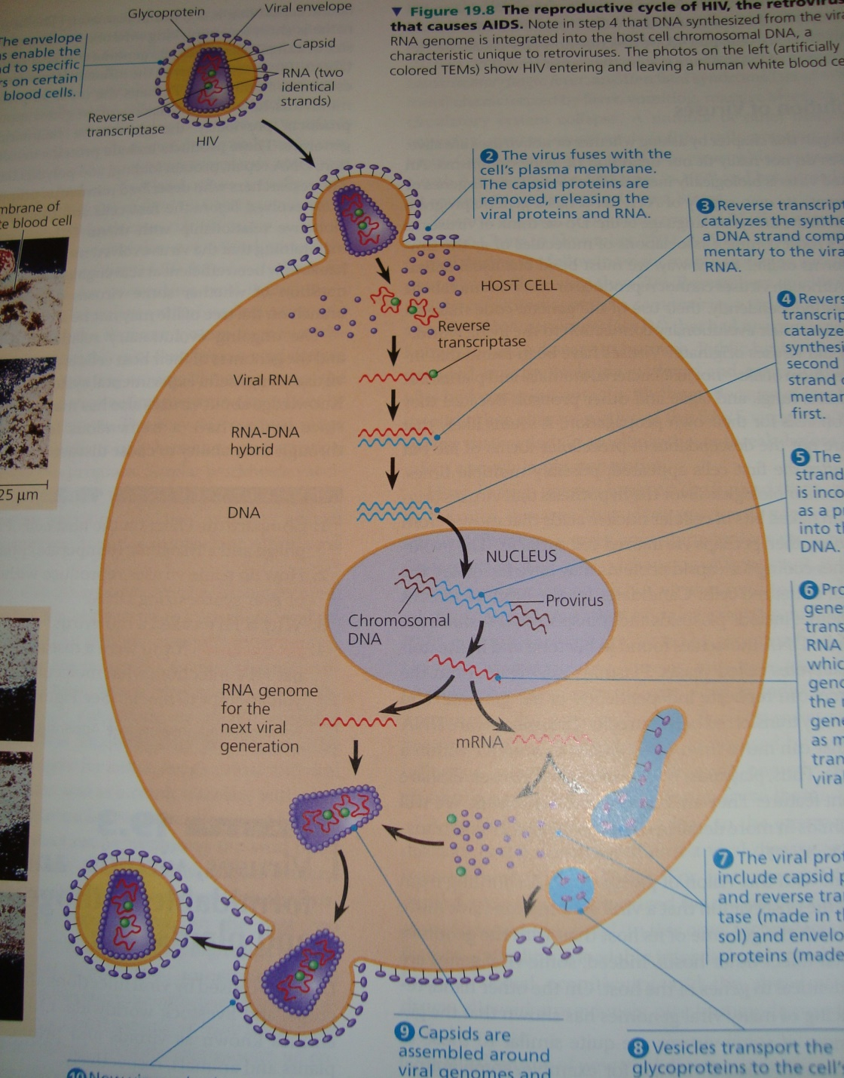
cDNA library
Researchers can make another kind of DNA library my starting with mRNA extracted fom cells
The enzyme “reverse transcriptase” obtained from retroviruses in used in vitro to make single-stranded DNA transcripts of the mRNA molecules

Slide 5
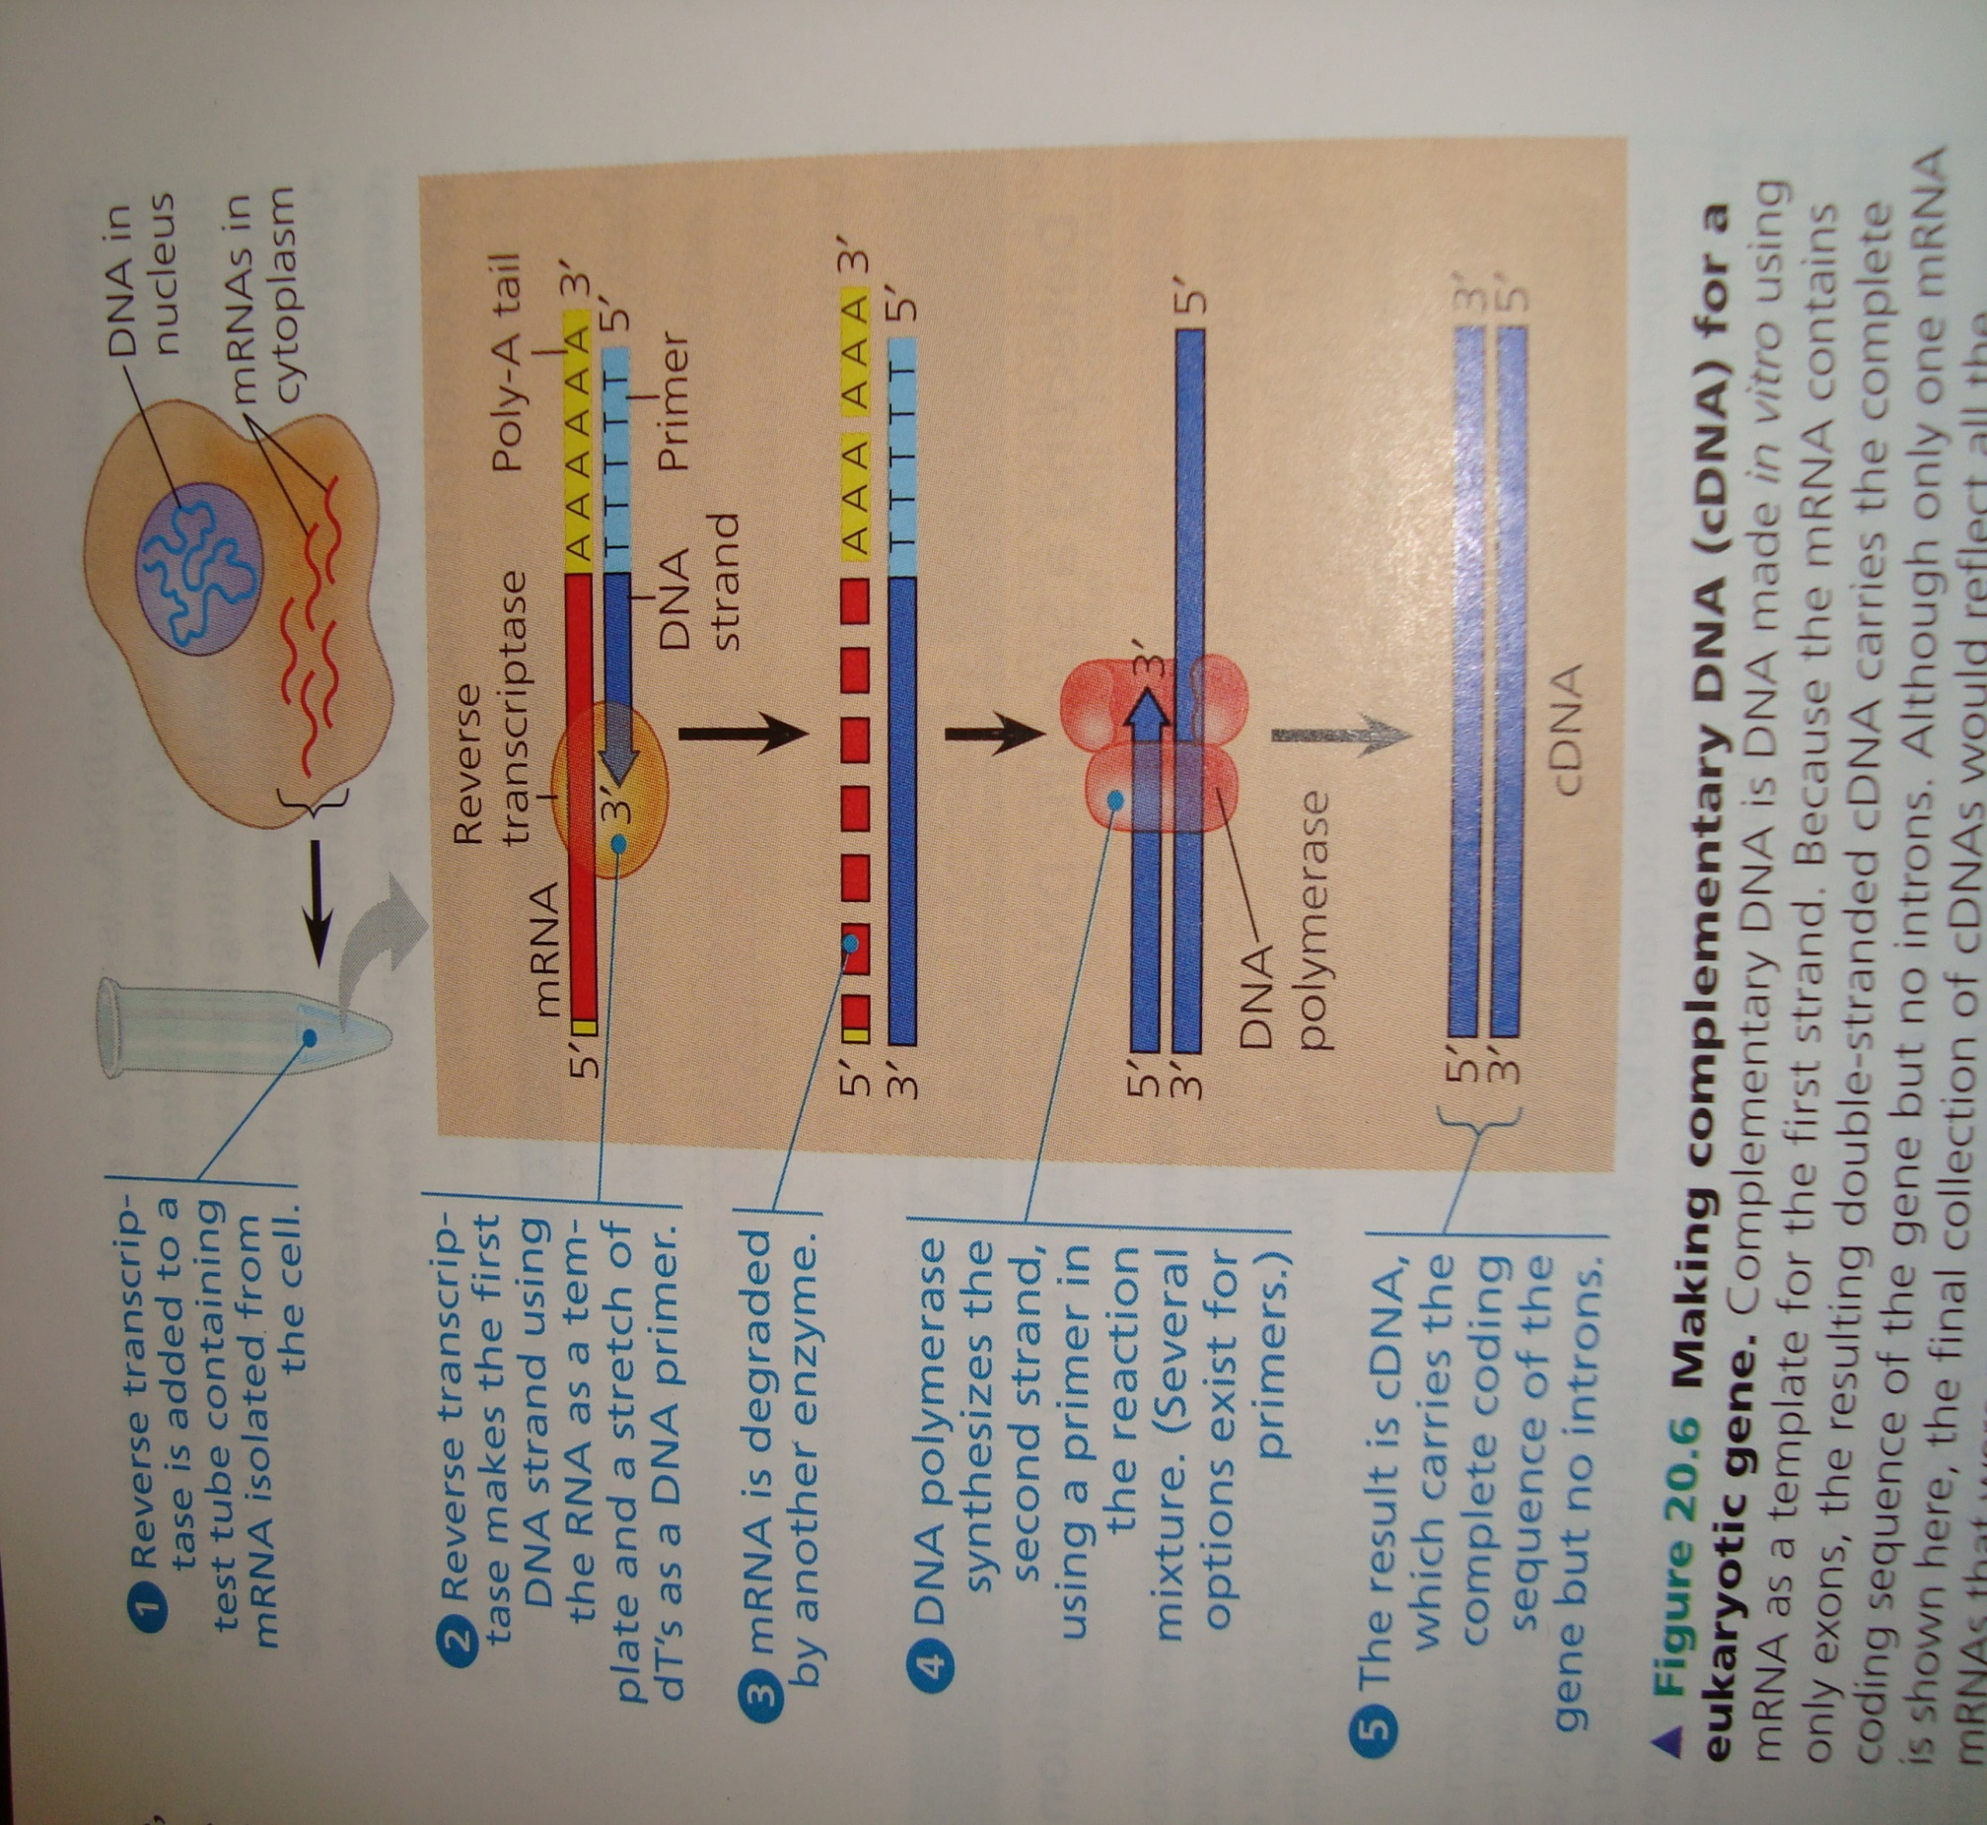
cDNA library
Recall that the 3/ end of mRNA has a stretch of adenine (A) ribonucleotides called poly A-tail.
This feature allows use of a short strand of thymine (dT) deoxyribonucleotides as a primer for reverse transcriptase.
Following enzymatic degradation of the mRNA, a second DNA strand, complementary to the first, is synthesized by DNA polymerase.
For creating a library, the cDNA is modified by the addition of restriction enzyme recognition sequences at each end
Then the cDNA is inserted into vector DNA in a manner similar to insertion of genomic DNA fragments

Slide 6
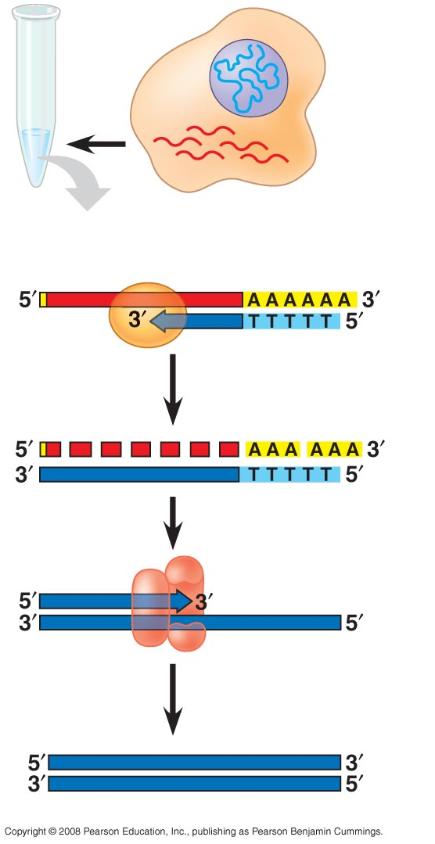
Fig. 20-6-5
DNA in nucleus
mRNAs in cytoplasm
Reverse transcriptase
Poly-A tail
mRNA
DNA strand
Primer
Degraded mRNA
DNA polymerase
cDNA
Notes:
Figure 20.6 Making complementary DNA (cDNA) for a eukaryotic gene

Slide 7
Replica plating and DNA hybradization: an efficient technique commonly used to detect a bacterial colony carrying a particular DNA clone
A replica of the culture is made by pressing a piece of absorbent paper (nylon or nitrocellulose paper) against the surface. This replica is then hybradized to a highly radioactive DNA probe. Those bacterial colonies that have bound the probe are identified by autoradiography

